Slide 1
AI Powered Presentation Generation
Transforming Document Analysis
AI-Generated Presentation

Slide 2
Introduction to AI
AI transforms industries
Automates repetitive tasks
Enables data-driven decisions
Notes:
Welcome and introduce the topic of AI transformation

Slide 3

Machine Learning Capabilities
Process vast amounts of data
Real-time data processing
Enable data-driven decision-making
Notes:
Explain machine learning capabilities and their impact

Slide 4
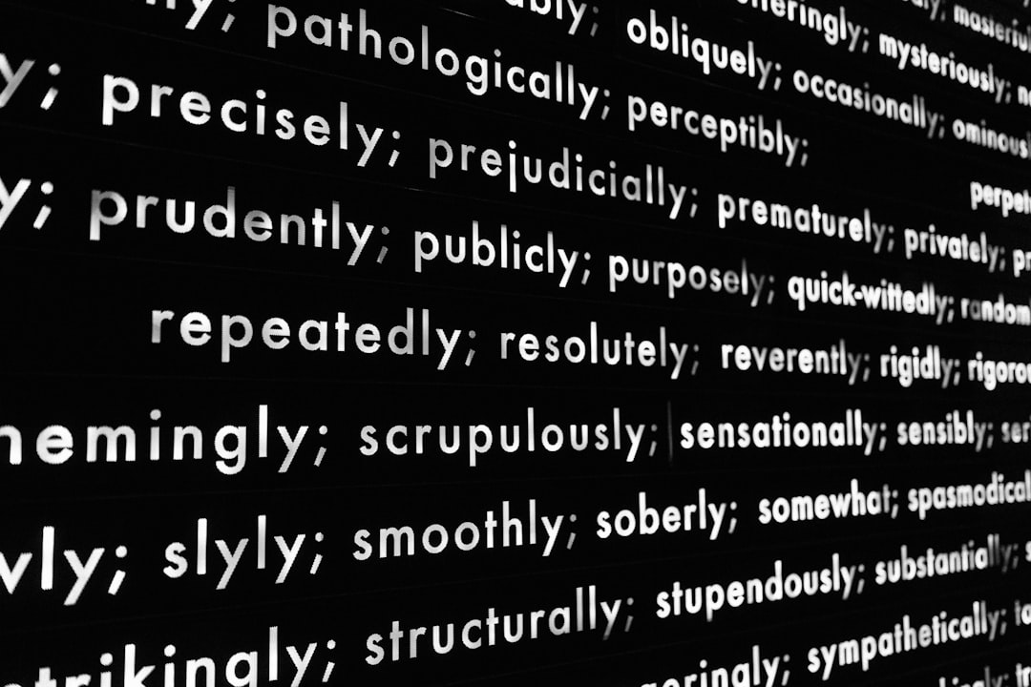
Natural Language Processing
Computers understand human language
Generate human-like text
Enhance document analysis
Notes:
Discuss Natural Language Processing and its applications

Slide 5

Computer Vision
Machines interpret visual information
Enable image and video analysis
Enhance data understanding
Notes:
Explain computer vision and its role in data analysis

Slide 6

AI Pipeline and Tools
Groq LLaMA for text summarization
LlamaIndex for retrieval
Automate slide creation
Notes:
Describe the AI pipeline and tools used for presentation generation

Slide 7

Benefits of AI Powered Generation
Save hours of manual creation
Ensure consistent formatting
Enhance presentation quality
Notes:
Highlight the benefits of using AI for presentation generation

Slide 8
Conclusion and Takeaways
AI transforms presentation generation
Saves time and ensures consistency
Enhances overall quality
Thank you
Notes:
Summarize key points and conclude the presentation

