Slide 1
CHRONIC KIDNEY DISEASE
SUBMITTED BY: JIGYASA SACHDEVA

Slide 2
Selection of variables and initial screening
Removed the following variables: 1. ID 2. Weight, Height, Obese. (Captured by BMI) 3. SBP, DBP (Significance covered by Hypertension) 4. Waist 5. HDL, LDL, Total Chol (Significance covered by Dyslipidemia) #Left with 24 variables.
Removed observations with null values in target column: CKD #Left with 6000 observations

Slide 3
Structure analysis
Converting AgeCat as categories of Age: 18-44, 44-65, 65+
Converting BMICat as categories of BMI: <18.5, 18.5-25, 25-30, 30+
Clubbing Hypertension and Fam Hypertension as one variable ‘hyper’ defined as- None, Only in individual, Only in Fam, Both #Similarly converting for CVD (cv) and diabetes (db)
Converting all the new variables into categories.
Releveled the bases of categorical variables with multiple bases: Activity: Base= Mostly sit, Race: Base= White, Age Category: Base= 18-44, BMIcat: Base= 18.5-25 hyper: Base= None, db: Base= None, cv: Base=None

Slide 4
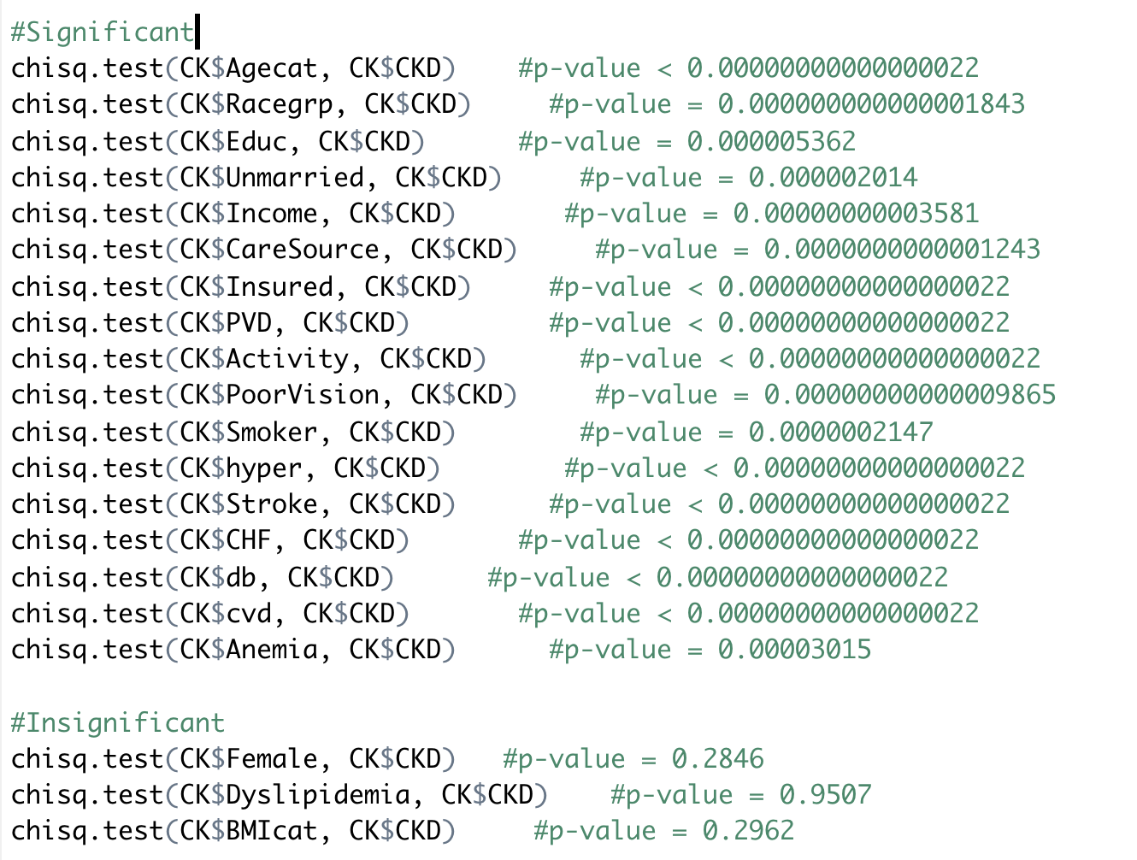
HYPOTHESIS testing
Computing Chi-square test for all the variables with the target variables.
Removed the variables: Female, Dyslipidemia and BMIcat as they are insignificant.
Omitting null values from all the variables in the new table.

Slide 5
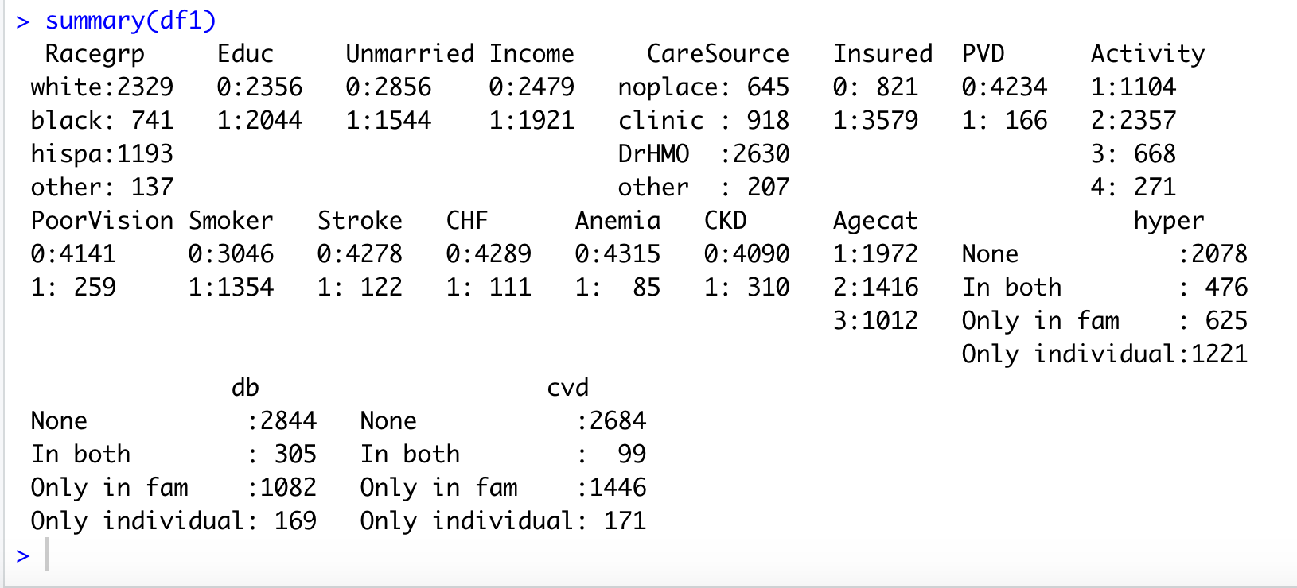
UNIVARIATE ANALYSIS
The target variable is very unevenly distributed. Only 7.2% of the population has CKD.
Similar proportion exists with PVD, Stroke, Anemia, CHF, Poor Vision.

Slide 6
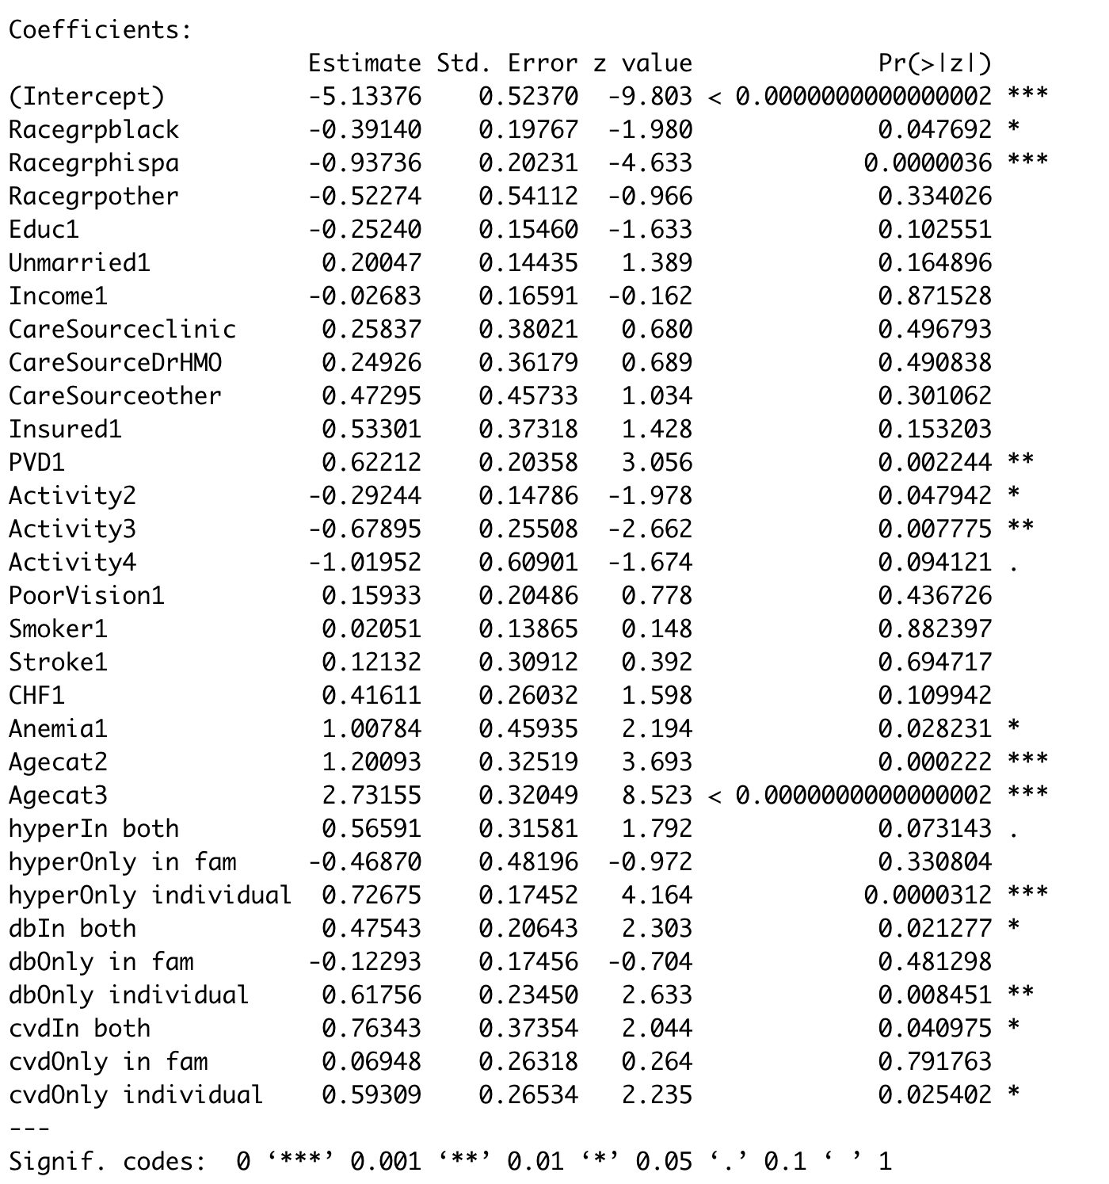
Logistic regression model
Variables with significant p-values:
Positive coefficients:
PVD, Anemia, Age category, hyperInBoth, hyperOnlyIndividual, dbInBoth, dbIndividual,
cvdInBoth, cvdIndividual
Negative coefficients:
Race group, Activity, Anemia

Slide 7
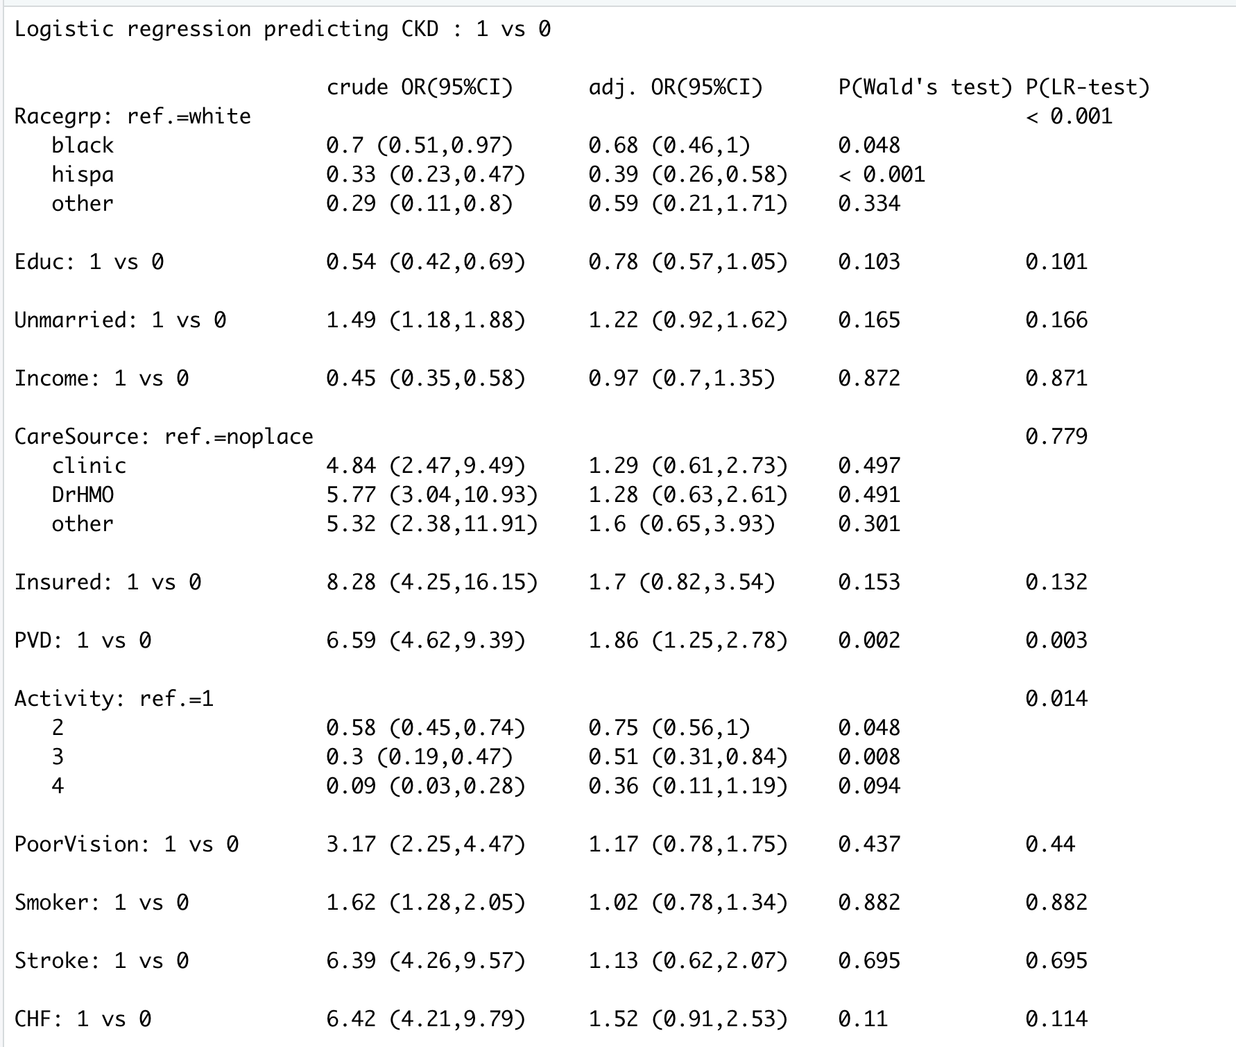
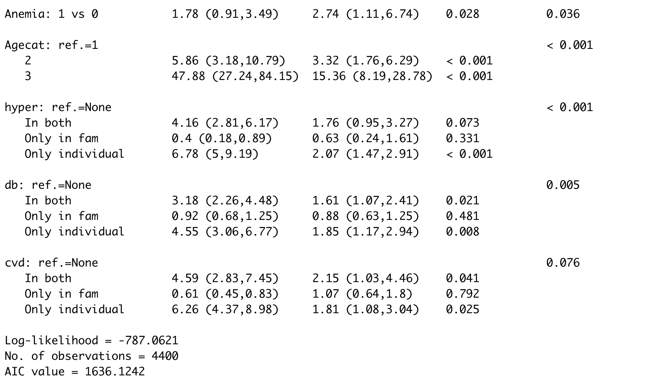
ODDS Ratio

Slide 8
INFERENCES
People with PVD are 6.59 times more likely to have CKD than people not having PVD
People who stand or walk are 0.58 times less likely; people lifting loads and climbing stairs are 0.3 times less likely and people doing heavy workout are 0. 09 times less likely to have CKD than people who mostly sit.
Blacks are 0.7 times less likely to have CKD and Hispanic are 0.33 times less likely to have CKD than Whites.
Anemic patients (in past 3 months) are 1.78 times more likely to have CKD than who aren’t.
People with age 44-65 are 5.86 times more likely and people with age 65+ are 47.88 times more likely to have CKD.
People having hypertension (with no family history) are 6.78 times more likely to have CKD than people who do not have hypertension nor have a family history. People having hypertension (with family history) are 4.16 times more likely to have CKD than people who do not have hypertension nor have a family history.
People having diabetes (with no family history) are 4.55 times more likely to have CKD than people who do not have diabetes nor have a family history. People having diabetes (with family history) are 3.18 times more likely to have CKD than people who do not have diabetes nor have a family history.
People having CVD (with family history) are 6.26 times more likely to have CKD than people who do not have CVD nor have a family history. People having CVD (with no family history) are 4.59 times more likely to have CKD than people who do not have CVD nor have a family history.

