Slide 1
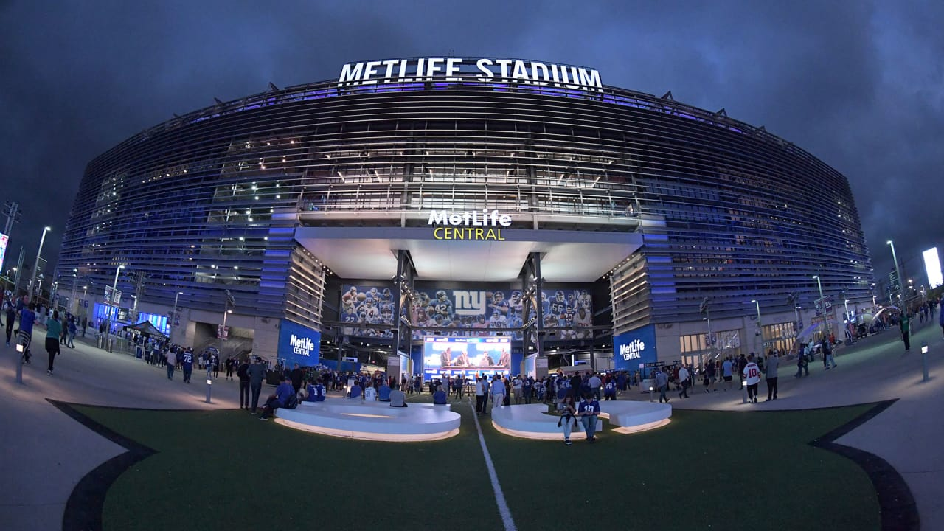
MetLife Stadium
Presented By: Jigyasa Sachdeva

Slide 2
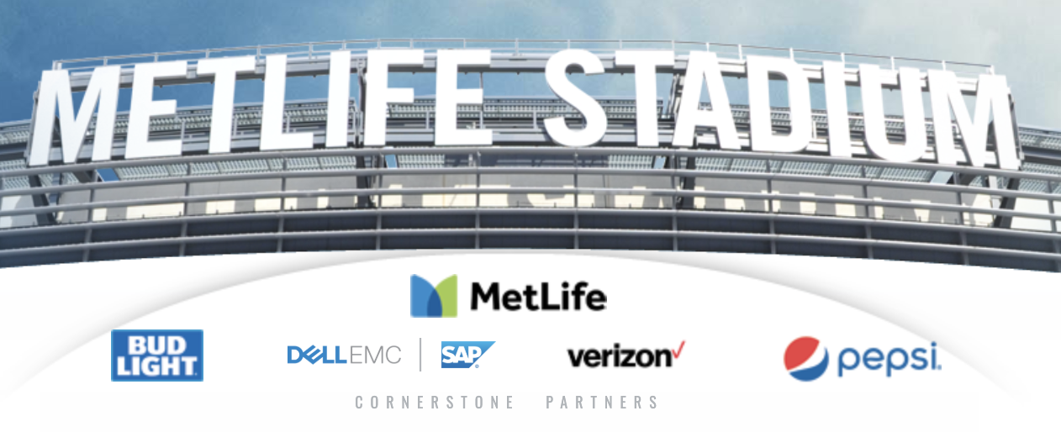

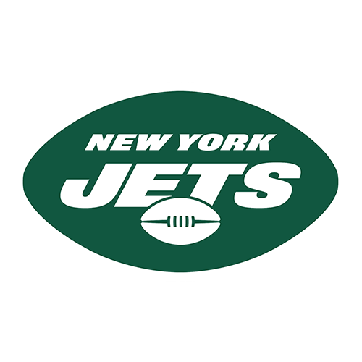
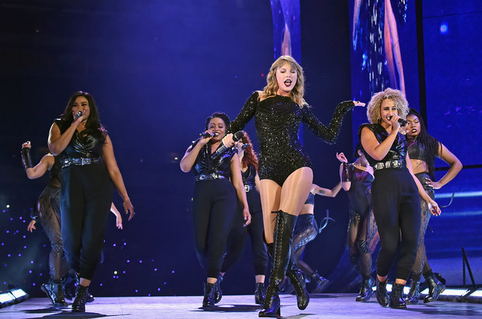
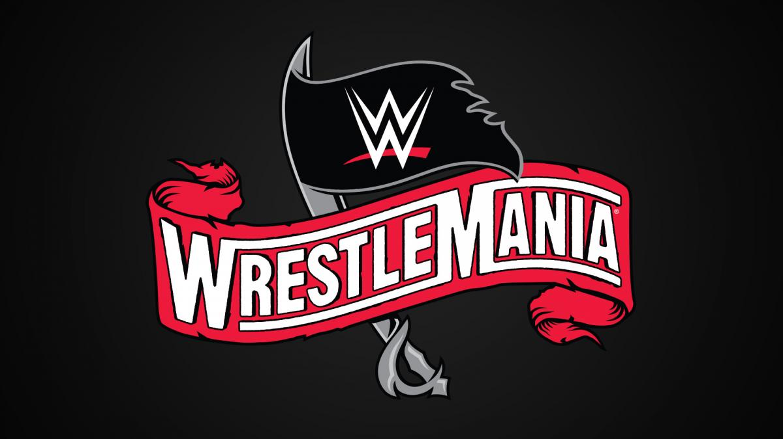
The MetLife Stadium was built in 2010 at the Meadowlands Sports Complex in New Jersey, with the goal of having one of the finest stadiums for consumers who enjoy watching American Football. Major events hosted at the stadium include Super Bowl XLVIII, WrestleMania, Bon Jovi, and taylor Swift. MetLife Stadium tops the industry charts annually since opening In July 2017, it was named "Venue of the Year" by the Stadium Business Summit

Slide 3
DISTRIBUTION CHANNELS
FACTS
PRICING
PRODUCT
•Cost: $1.6 billion
•Venue Size: 2.1 million square feet
•Capacity: 82,500 capability for football and soccer; 50,000 for most concerts
•Suites: 200+ on four separate levels; 16-24 seats per suite
•Parking: Approximately 28,000 spaces
•Ticket prices may vary according to popularity of the teams and dates.
•Ticket prices wherein the opponents are a popular team, may range between 50-750 dollars.
•Hosts 20 NFL games per season.
•Hosts 4-5 concerts on an average per year.
•New York Giants currently rank 4th amongst the NFCs
•New York Jets currently rank 3rd amongst the AFCs.
•MetLife Stadium currently rank 4th in the "7 best outdoor music venues" list.
•Primary distribution channels are websites like ticketmaster.com.
•Official websites of NY Giants, NY Jets and MetLife Stadium.
•Official Apps available on both android and IOS
•Ticket Offices situated at the stadium
NFC: National Football Conference Teams AFC: American Football Conference Teams

Slide 4
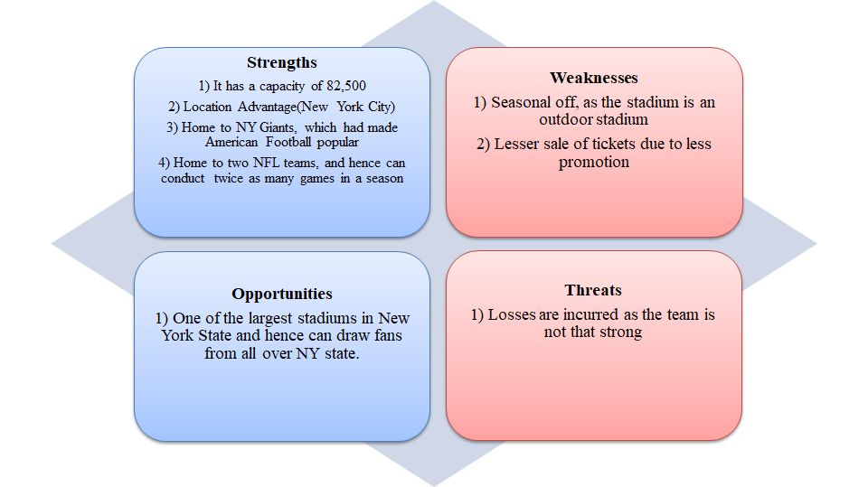
SWOT ANALYSIS
Objectives: 1) Try improving standings to attract more fans 2) Target audience for concerts and organise more such events. 3) Implement better promotional strategies.

Slide 5
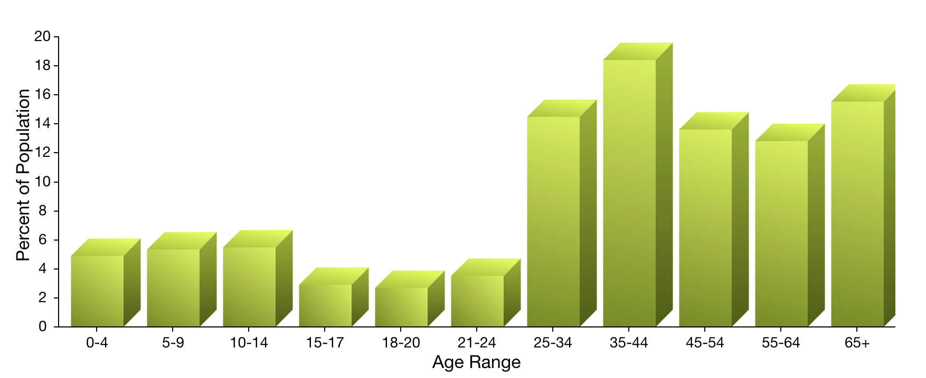
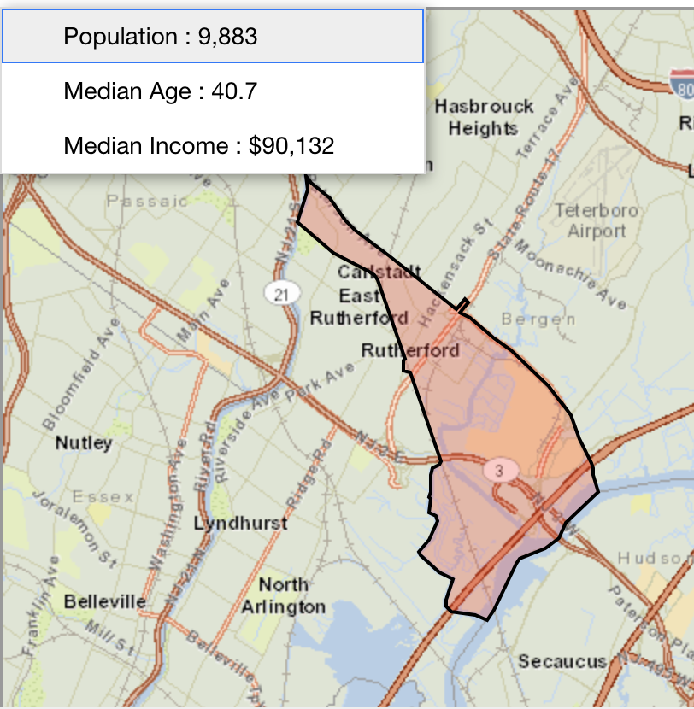
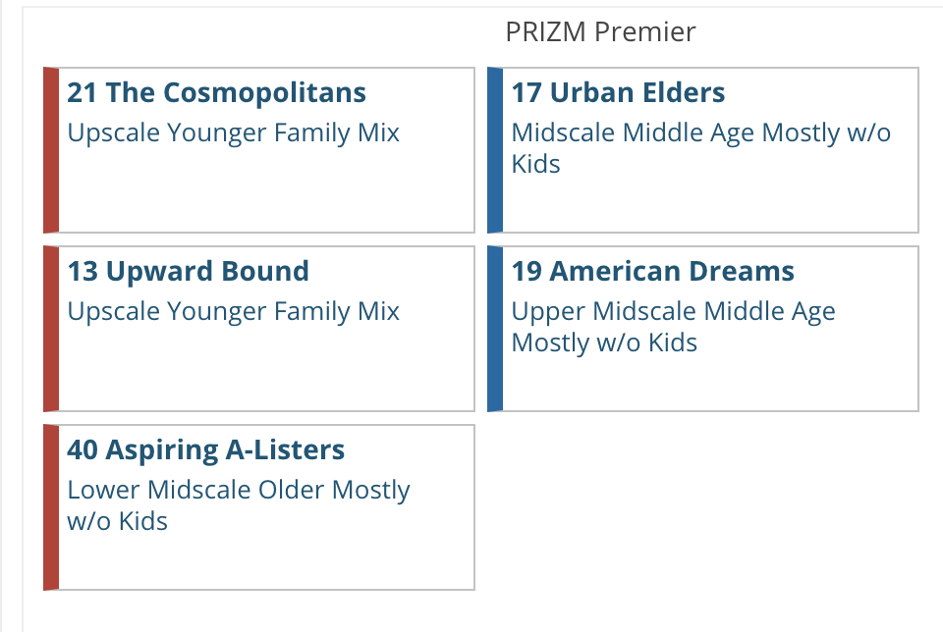
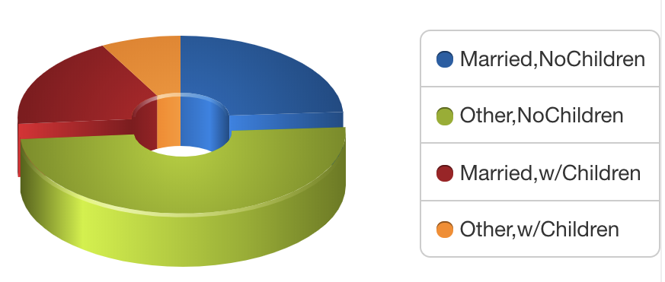
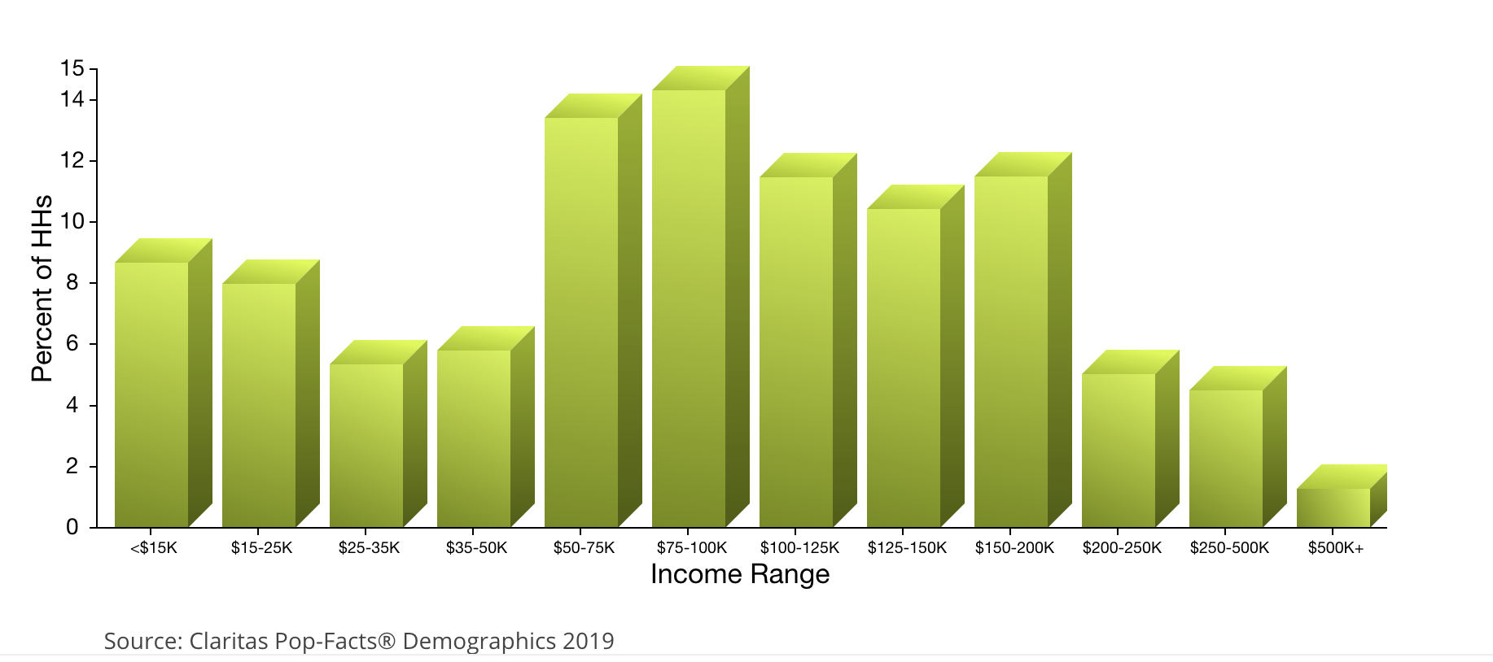
Market Research
Zip Code of MetLife Stadium: 07073
Zip Code Lookup: https://claritas360.claritas.com/mybestsegments/#zipLookup

Slide 6
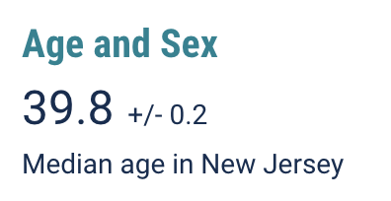
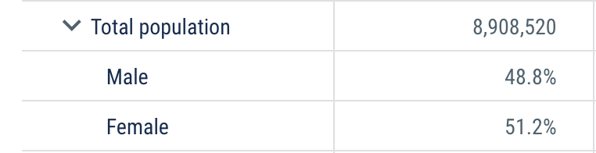
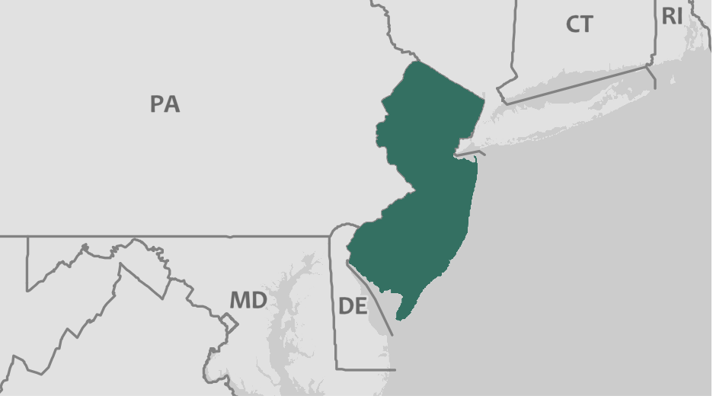
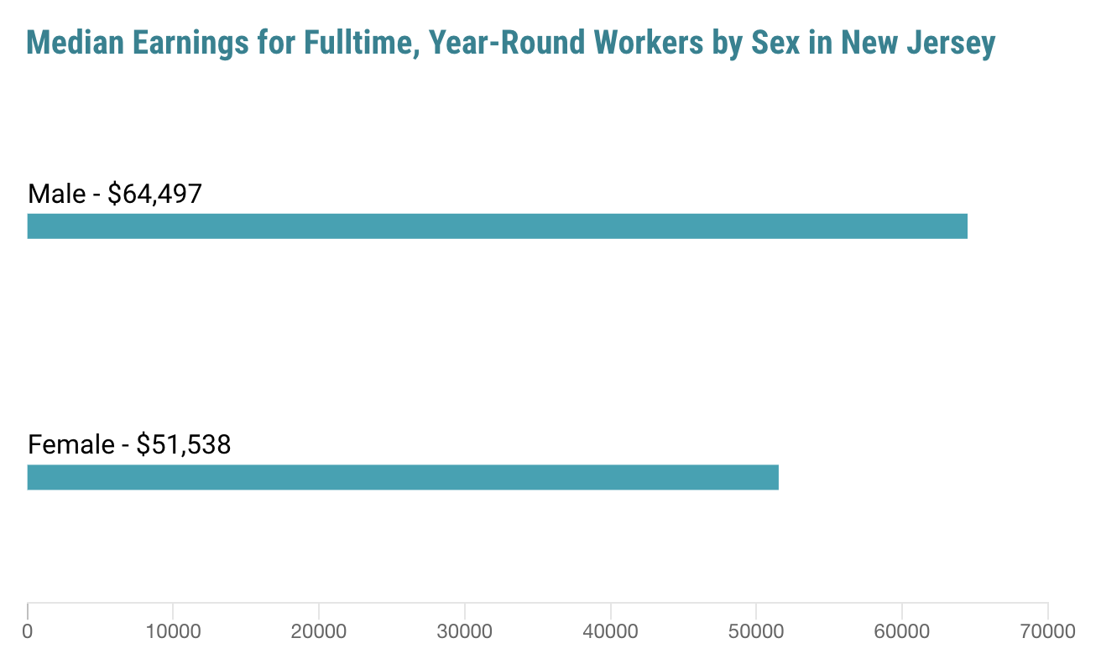
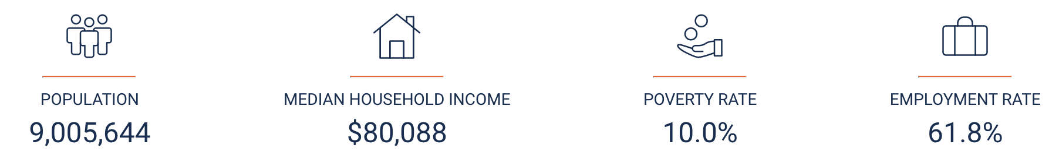
New Jersey
Census Government Data: https://data.census.gov/cedsci/profile?q=New%20Jersey&g=0400000US34&table=DP05&tid=ACSDP1Y2018.DP05

Slide 7
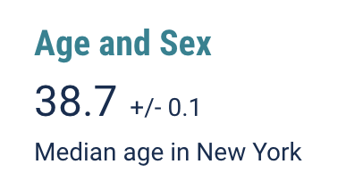
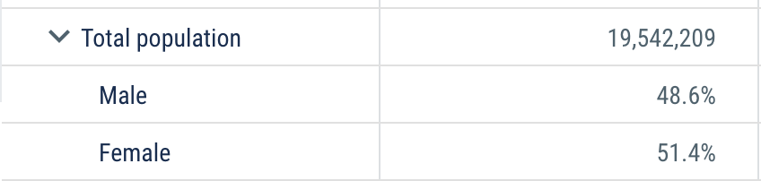
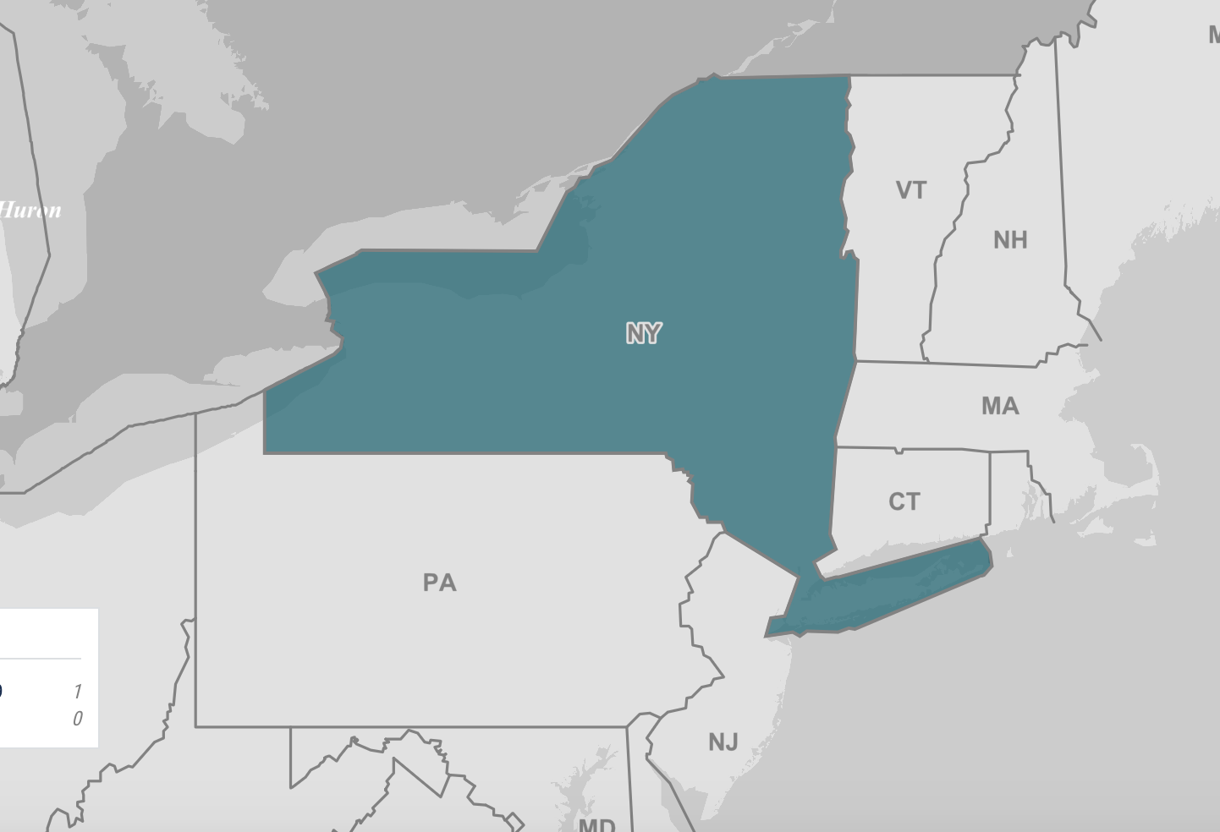
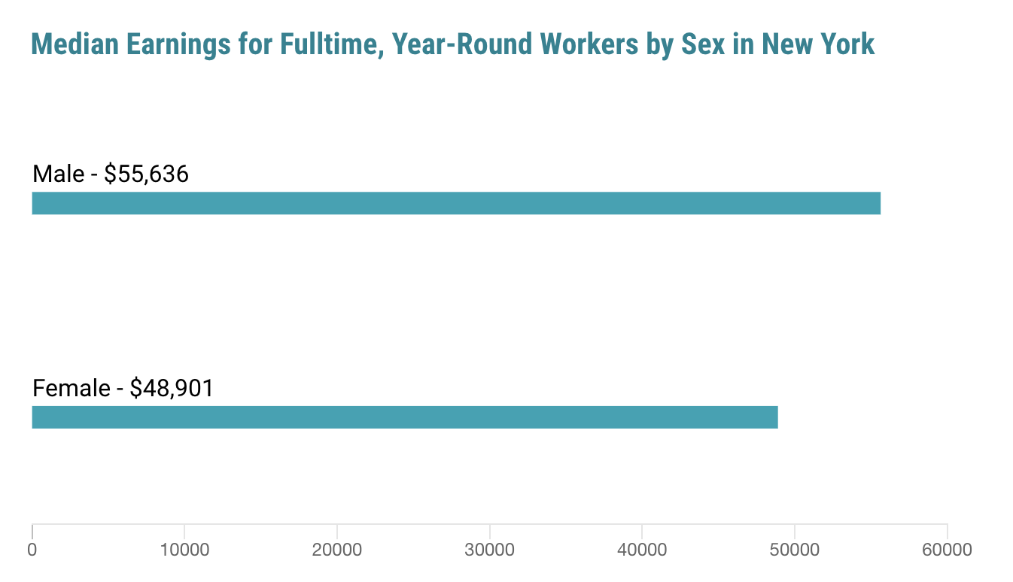
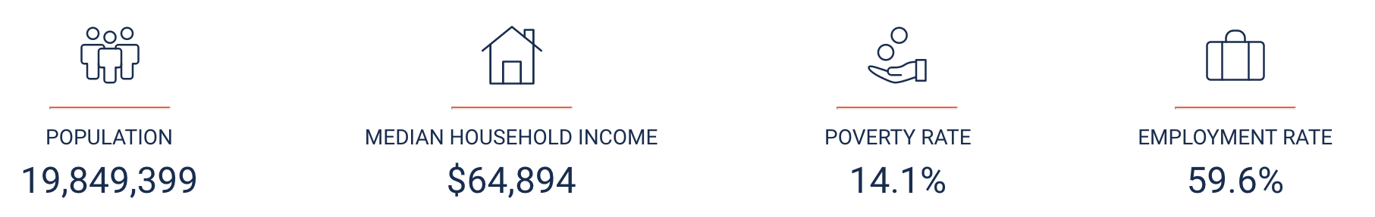
New York
Census Government Data: https://data.census.gov/cedsci/profile?q=New%20York&g=0400000US36

Slide 8
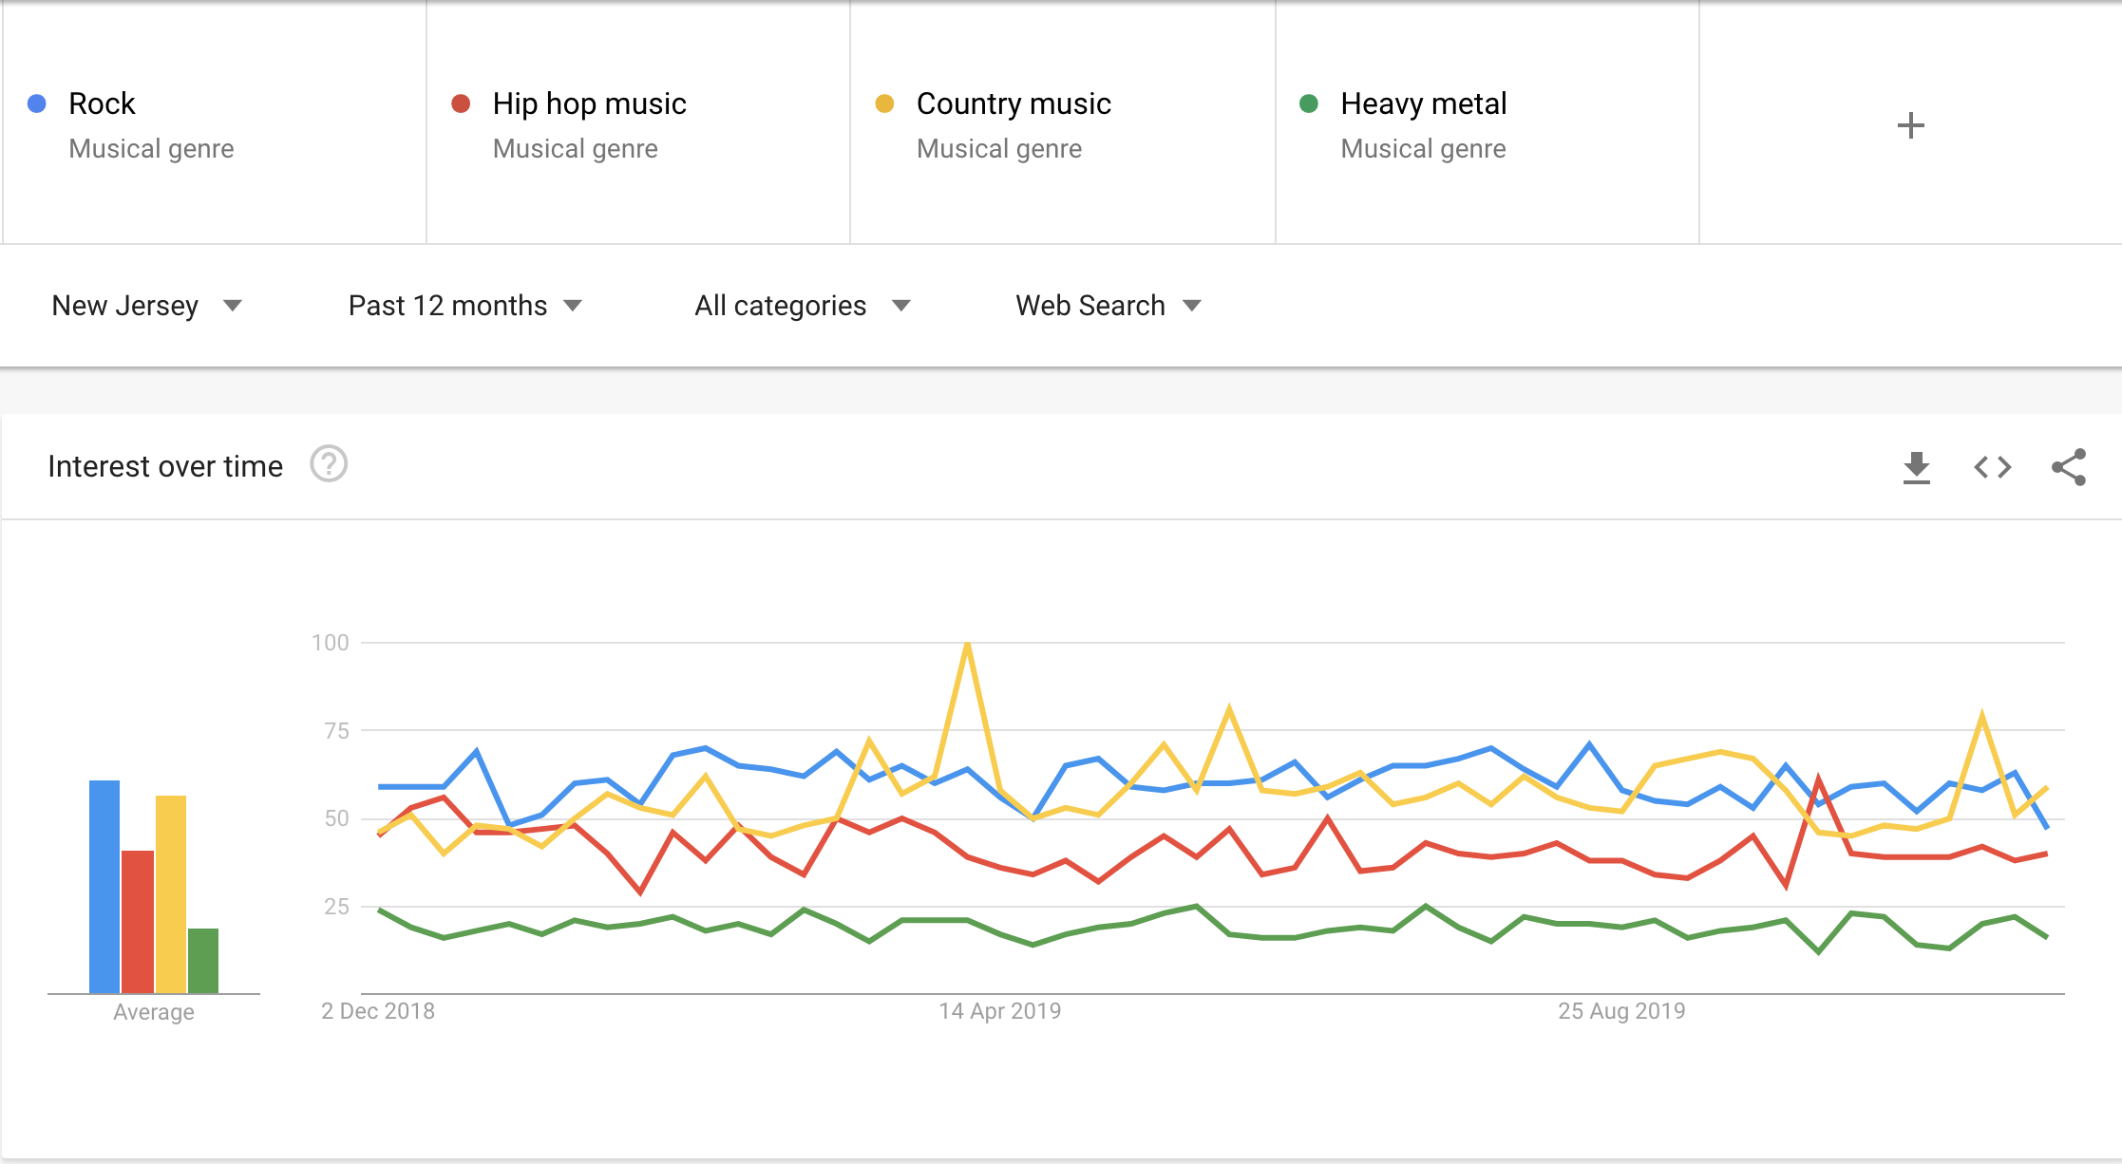
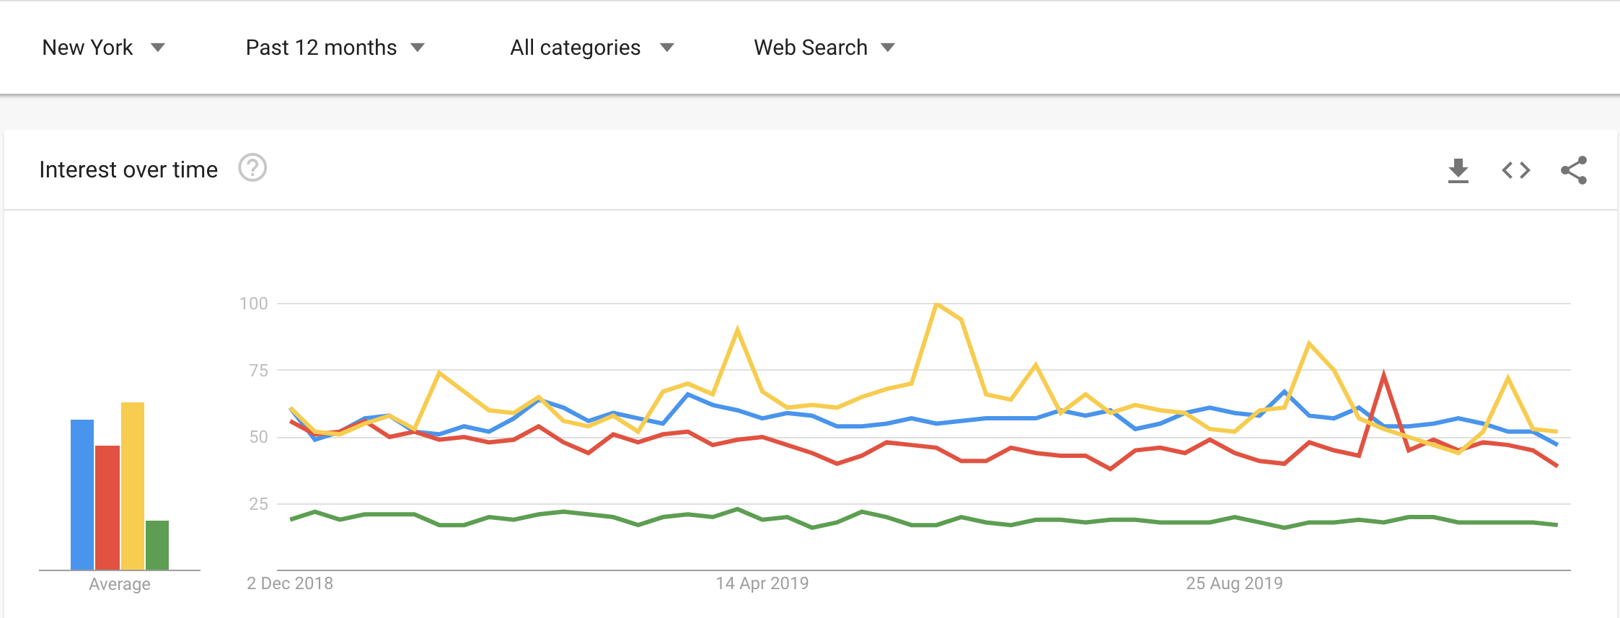
Music genre preferences
Order of preferences: 1. Rock 2. Country Music
3. Hip Hop music
4. Heavy Metal
Google Trends: New Jersey: https://trends.google.com/trends/explore?geo=US-NJ&q=%2Fm%2F06by7,%2Fm%2F0glt670,%2Fm%2F01lyv,%2Fm%2F03lty
New York: https://trends.google.com/trends/explore?geo=US-NY&q=%2Fm%2F06by7,%2Fm%2F0glt670,%2Fm%2F01lyv,%2Fm%2F03lty

Slide 9
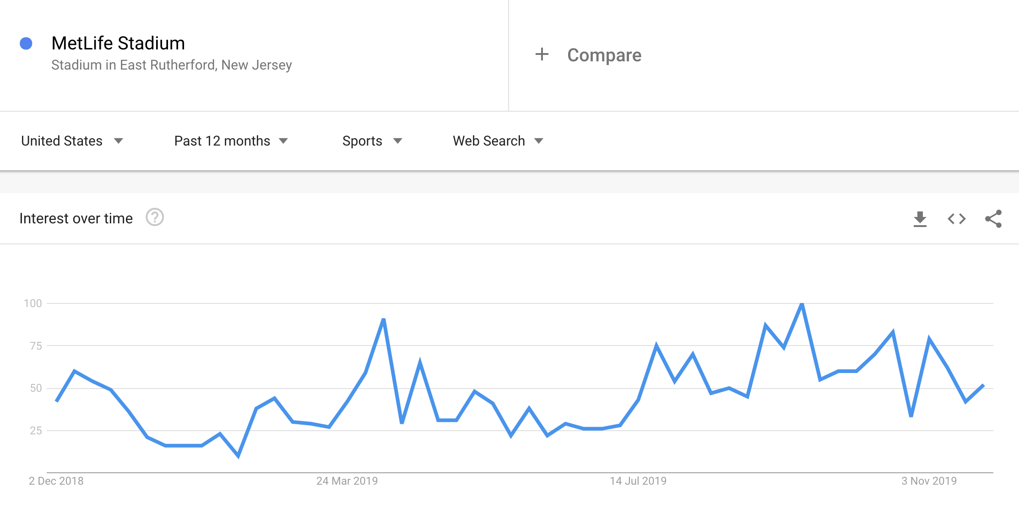
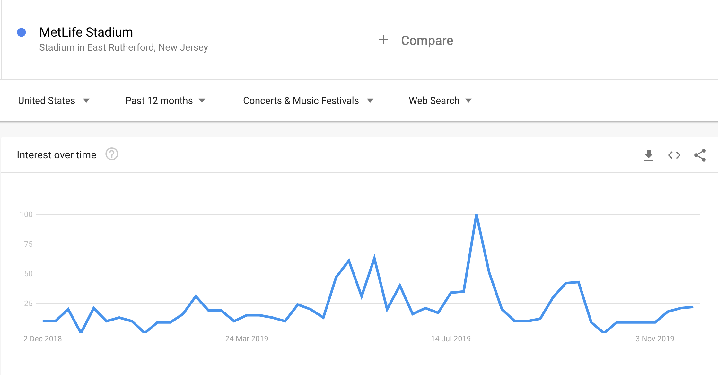
Web Searches
Off Season: Winters
Google Trends: Sports- https://trends.google.com/trends/explore?cat=20&geo=US&q=%2Fm%2F0dnkph Concerts & Music Festivals- https://trends.google.com/trends/explore?cat=891&geo=US&q=%2Fm%2F0dnkph

Slide 10
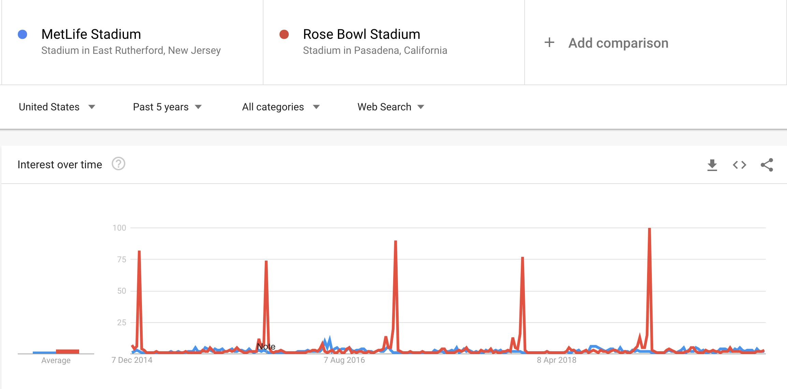
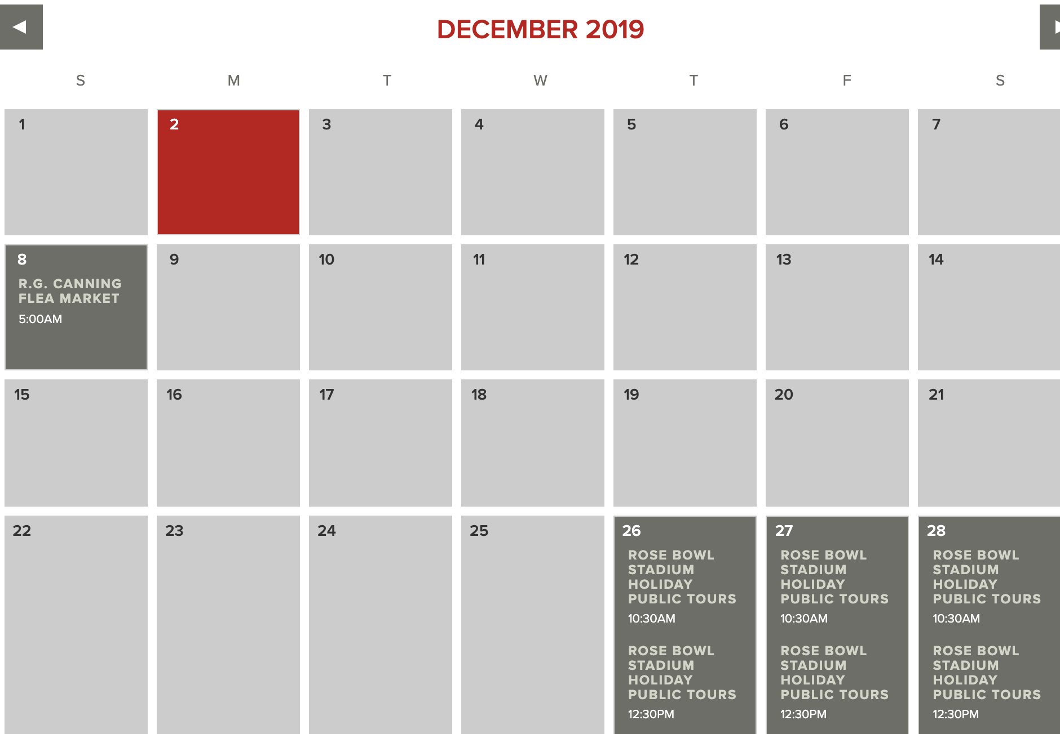
Competitor Analysis
Web Search and Google Shopping better than:
Mercedes-benz stadium
Heinz stadium
Michigan Stadium
Recommendation: Similar annual events should be conducted during off-season
Google Trends:
https://trends.google.com/trends/explore?date=today%205-y&geo=US&q=%2Fm%2F0dnkph,%2Fm%2F04j5_p

Slide 11
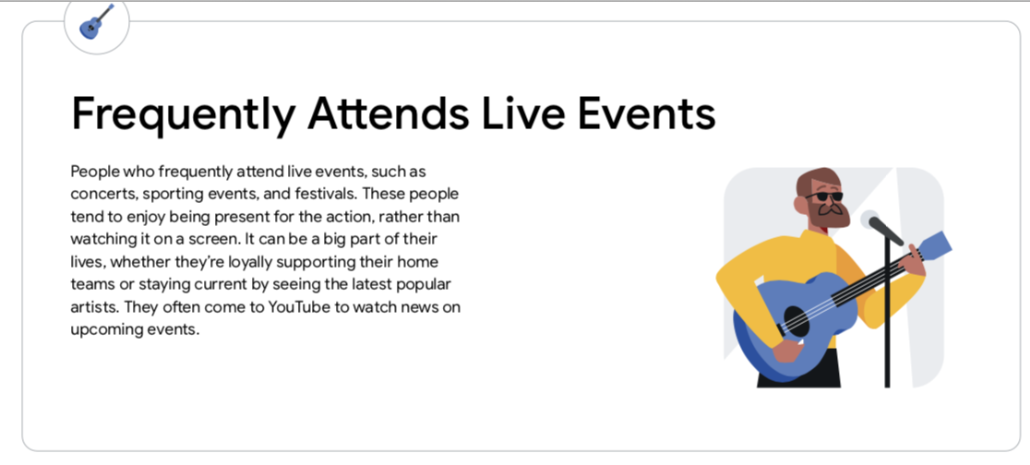
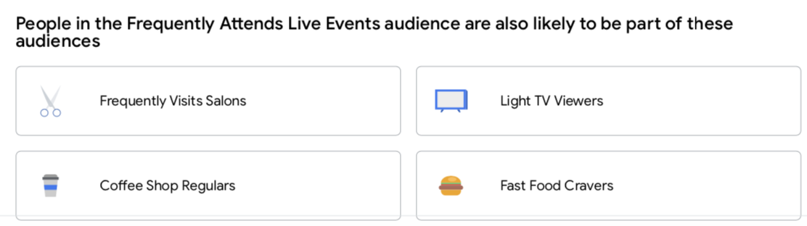
Product
1. Games: Jets haven’t made the playoffs since 2010. - Improve Player Management by signing better players. According to a survey, people in New Jersey prefered watching games on television due to comfort. - Improve comfort in the stadium. 2. Concerts: - Target the 30-50 age group (high market share and profitable) - Hold concerts of music genre: Rock, Country - MetLife hosted 11 concerts (highest) in 2016 and won awards and attained a high profit. Increase the number of concerts every year 3. Concessions: - Start serving variety of coffee during concerts.
Think with Google: https://storage.googleapis.com/yt-ads-audience.appspot.com/reports/youtube_audience_profile_3aadbc14a.pdf

Slide 12
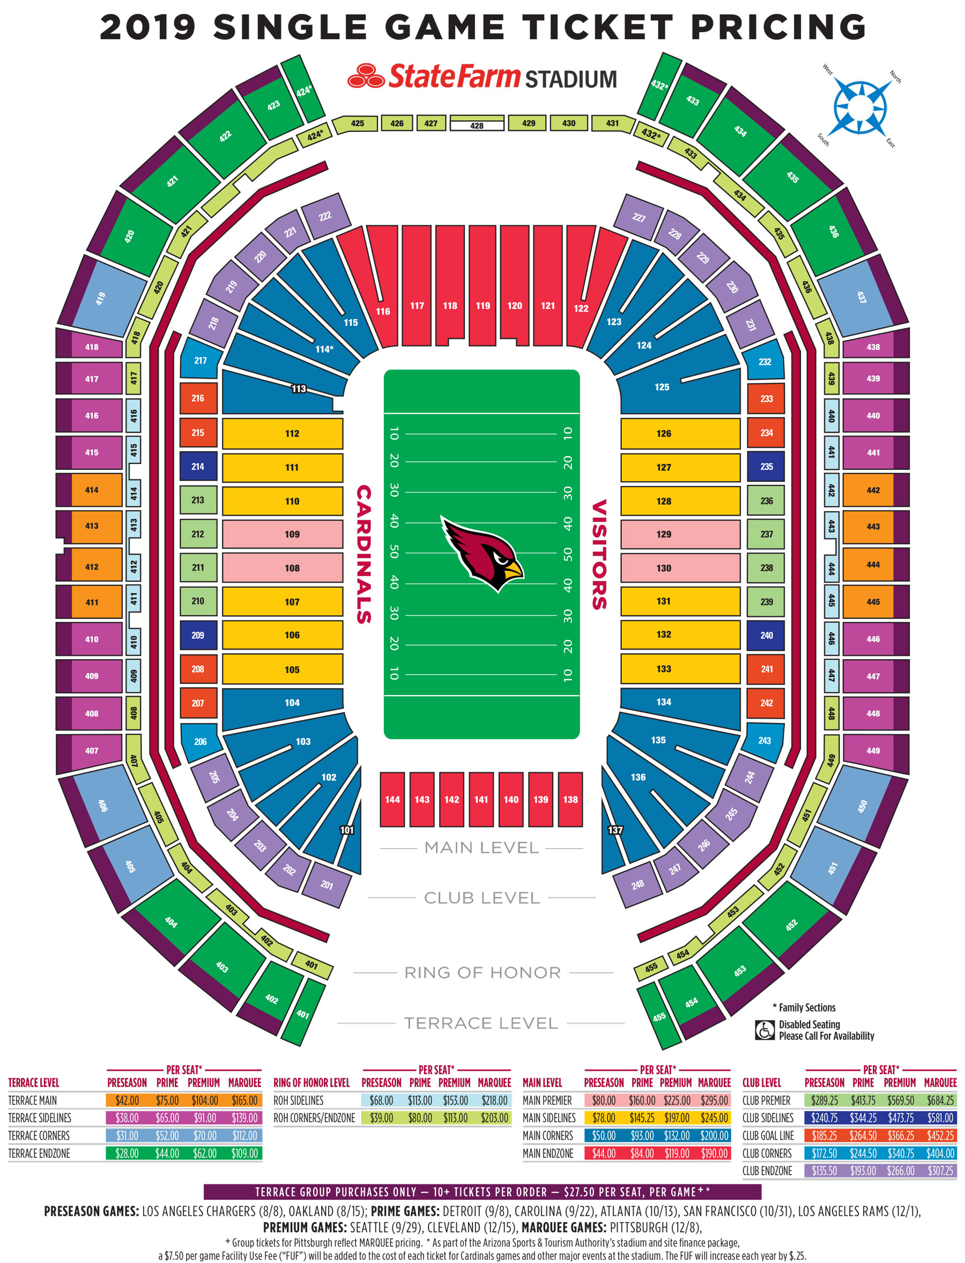
Price
1. Games: Range between the ticket price for MetLife is high (50-750$) - Decrease the range according to the targeted segment 65% tickets sold with higher ticket price helps achieving higher profit than 100% tickets sold with lesser ticket price - Increase ticket price when reaching to finals 2. Concerts - Increase average ticket price when targeting bands for elder age group -Have ticket prices with lesser spread before the median price and higher spread after. 3. Concessions: People are willing to pay during longer events and games. Even when they report problems, the quantity gets sold out. - Increase prices of all the food and beverages in concessions

Slide 13
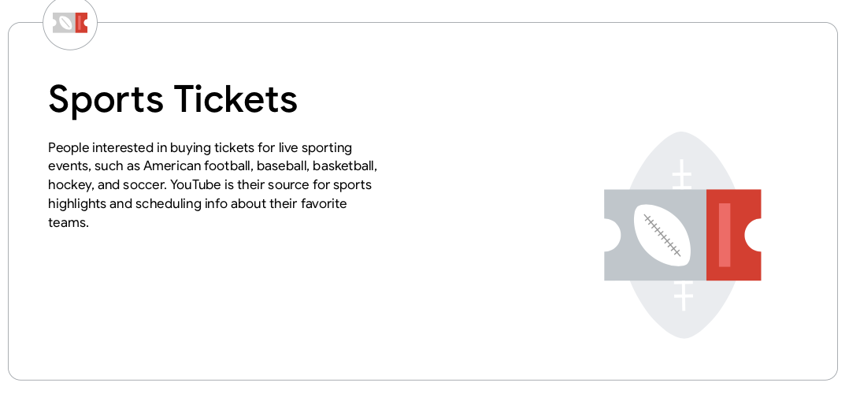
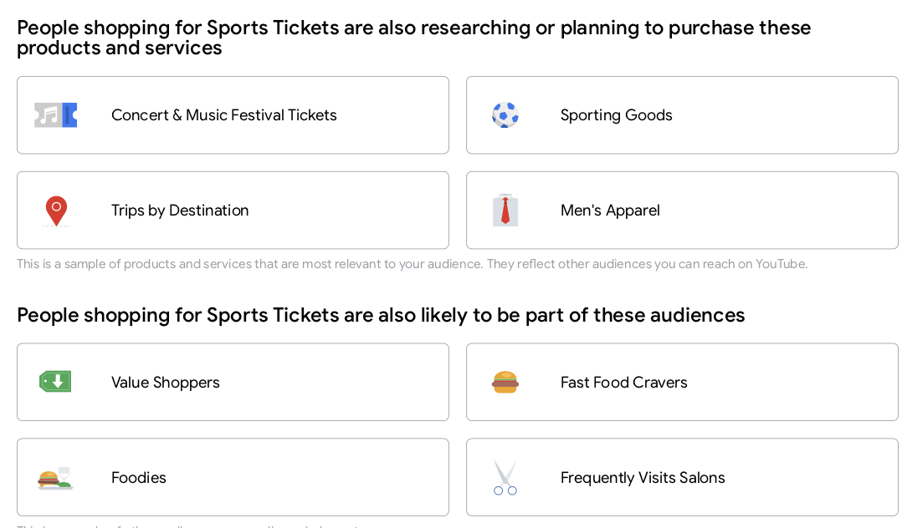
Promotion
1. Games: - Sample audience in New Jersey and New York to find the traditional media preference - Target the best 2 medias and gradually reduce investments in traditional promotions when a team is winning 2. Concerts - Favor social media advertising which can be targeted 3. Concessions: Since applications are a good source for promotion - Make the audience install application by giving discounts to audience if concessions are bought through apps at stalls Other strategies: - Add salons in the hotel as the audience is salon-goer - Auction sporting goods signed by players for wealthy audience - Sell men’s apparel in shops in the hotels

Slide 14
Implementation
Organise Games - 2 for New York Jets and 2 for New York Giants - Evaluate their functioning - Adjust player management - Analyse event report and adjust prices for tickets, concessions - Evaluate quantity of concessions Organise one more concert - Aligned with feedback from previous concert
Organise an annual event -Have signed sports goods to auction -Sell related merchandize Event reports and analysis by the end of the year. Band research - Book a band for February end aligned with majority population’s choice
Repeat this for the second half of the year - Have at least 6 concerts - Have annual event - Try improving standings of Jets and Giants
February
June
December
April
Off Season Tactics - Work on increasing the comfort of seats in the stadium.
- Player management by signing better players First concert by Feb end - Promotion for targeted audience - Add coffee as beverages in stalls -Increase average ticket price - Evaluate event report
Have multiple games -Ensure wins Have another concert

