Slide 1

PROPERTY PRICE VALUATION
IDS 400 | FALL’20
GROUP 7:
JIGYASA SACHDEVA (664791188)
VARUN MAHESHWARI (671624467)

Slide 2
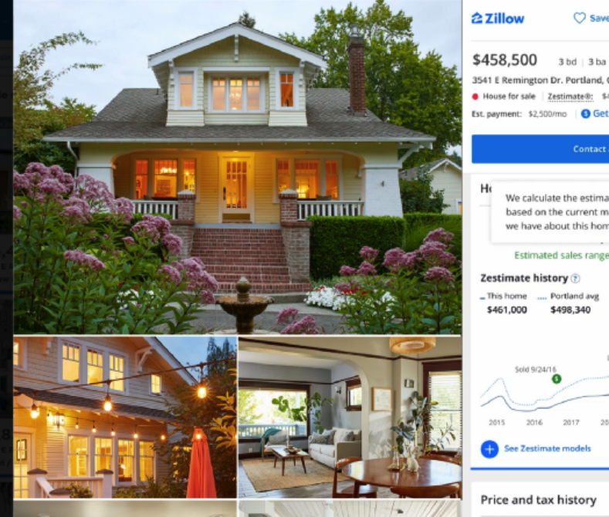
TASKS
Understand the business implication
Deep dive into data characteristics
Univariate and bivariate analysis
Machine Leaning Models
Inferences
Libraries used: pandas, numpy, plotly, seabon, sklearn, statsmodels, matplotlib

Slide 3
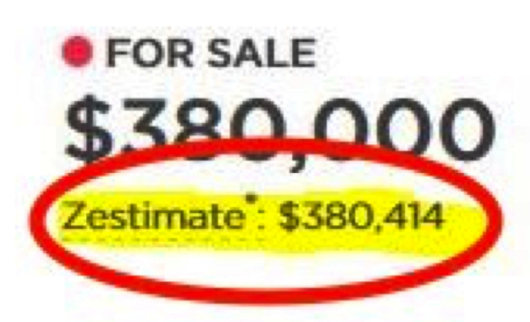
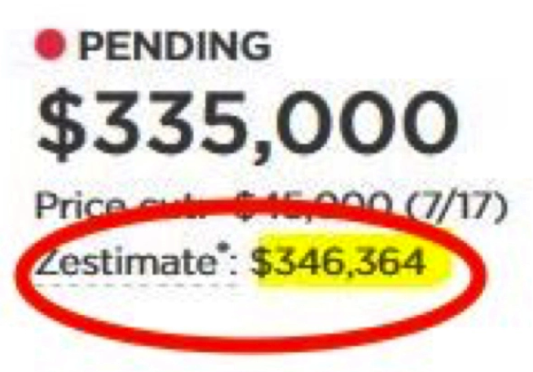
Business Implication
Zillow’s Zestimate home valuation has shaken up the U.S. real estate industry since first released 11 years ago.
Zillow uses statistical and machine learning algorithm to predict the true valuation of the property through combining and understanding multiple data points and key features of the house.
The goal of any automated valuation model is to harness data to produce an estimate of a property’s market value — where it would transact between a willing buyer and seller, at arm’s length, without compulsion.

Slide 4
Data Description
We are using a real estate sample dataset to evaluate a property price and provide a correct valuation for the market based the characteristics of the property
The data has 500 rows and 12 columns and includes key features of the property as shown
Lot size
Number of bedrooms
Number of bathrooms
Driveway
Recreational area
Full basement
Gas and Heat
Air Condition
Garage Place
Preferred area
Stories
Price

Slide 5
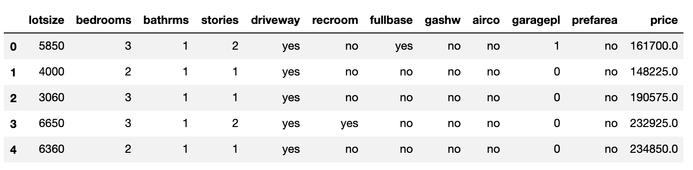
Data frame
Observations:
lotsize, bedrooms, bathrms, stories, garagepl, price are numerical variables
driveway, recroom, fullbase, gashw, airco, prefarea are categorical variables
No null values in the dataset

Slide 6
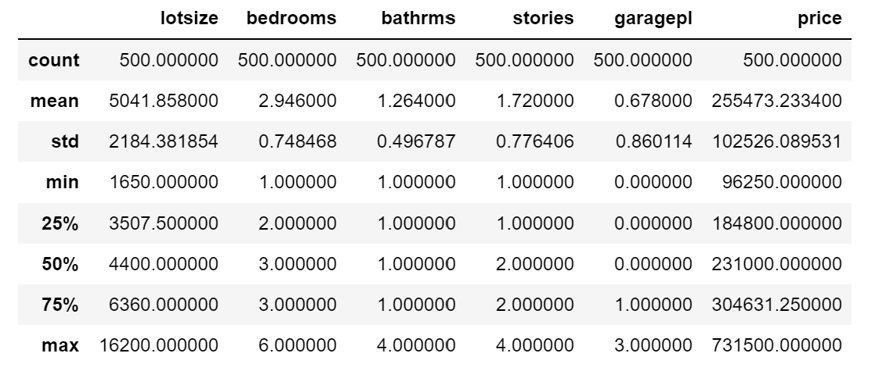
Univariate Analysis
The following table shows the preliminary descriptive statistics for numeric variables in the dataset:

Slide 7
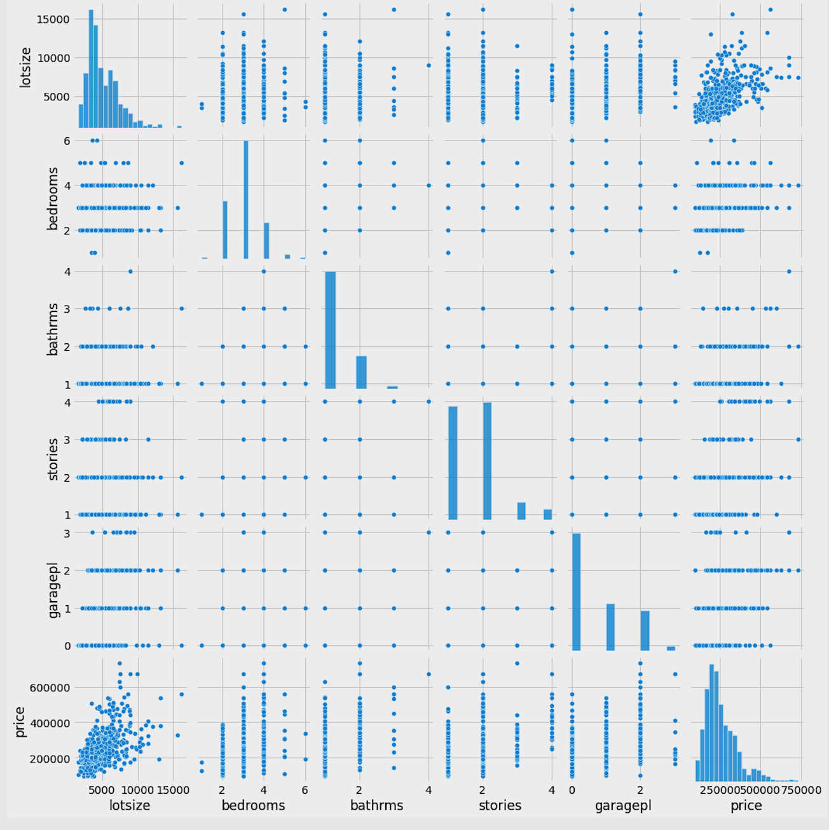
Bivariate Analysis

Slide 8
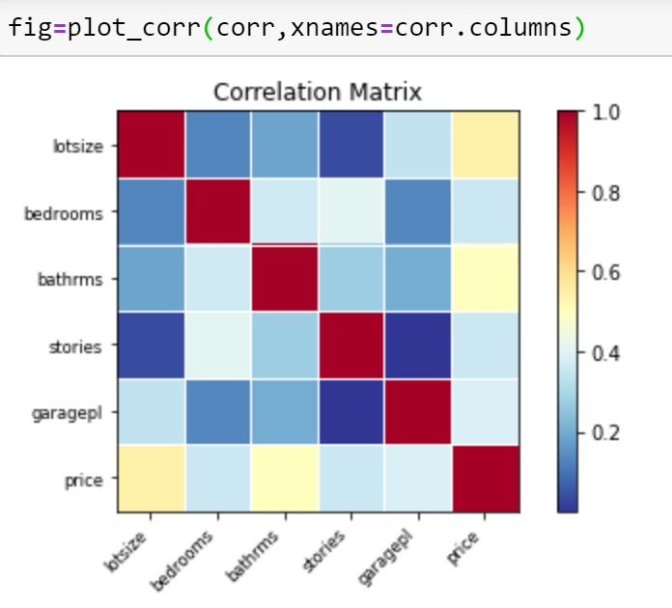
Correlation Matrix
A high correlation between dependent and independent variables is desired whereas the high correlation between 2 independent variables is undesired.
Here we see that price which is our dependent variable has a higher correlation with lot size and bathroom

Slide 9
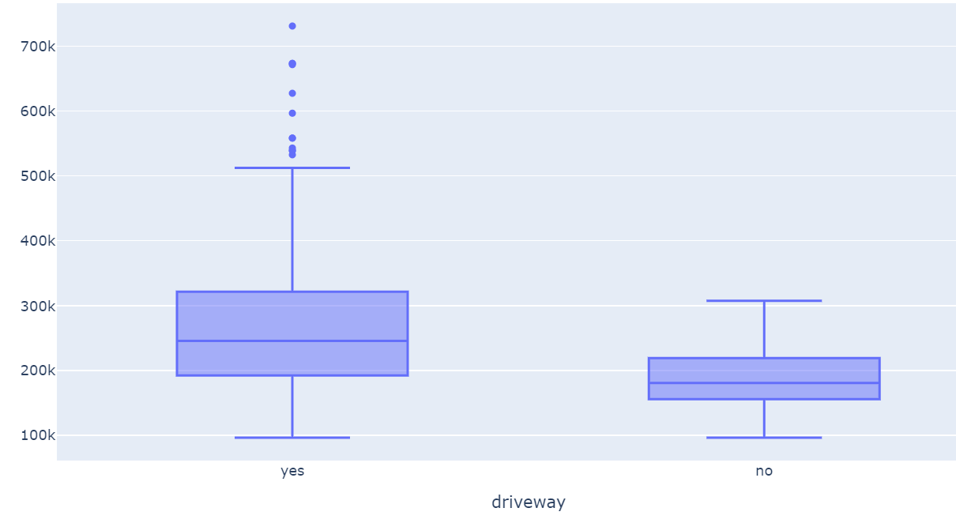
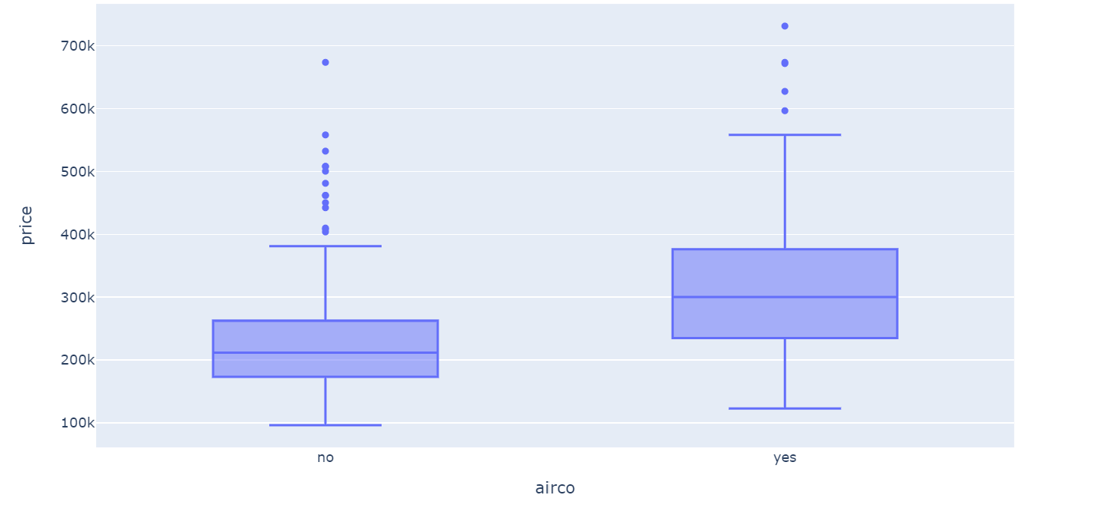
Bivariate Relationship (1/3)
Here we have plotted boxplots to understand relationship between price and factor variables like air condition and driveway.
We see the price differs as the value of factor variable changes

Slide 10
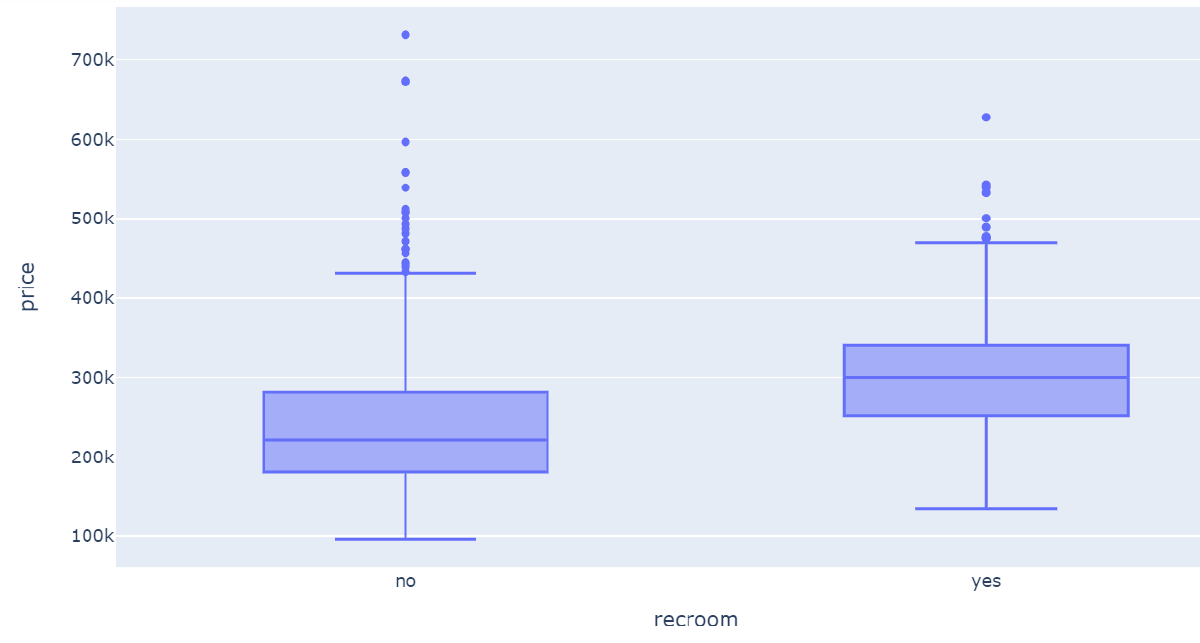
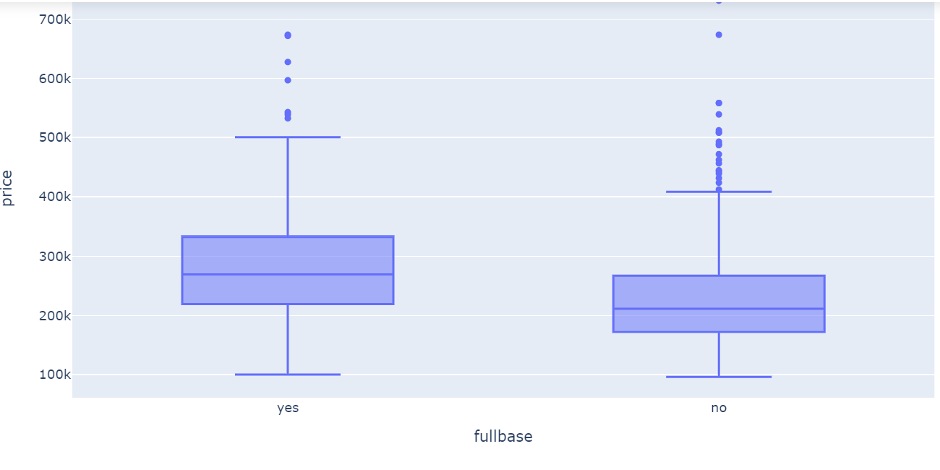
Bivariate Relationship (2/3)
Here we have plotted boxplots to understand relationship between price and factor variables like fullbase and recroom
We see the price differs as the value of factor variable changes

Slide 11
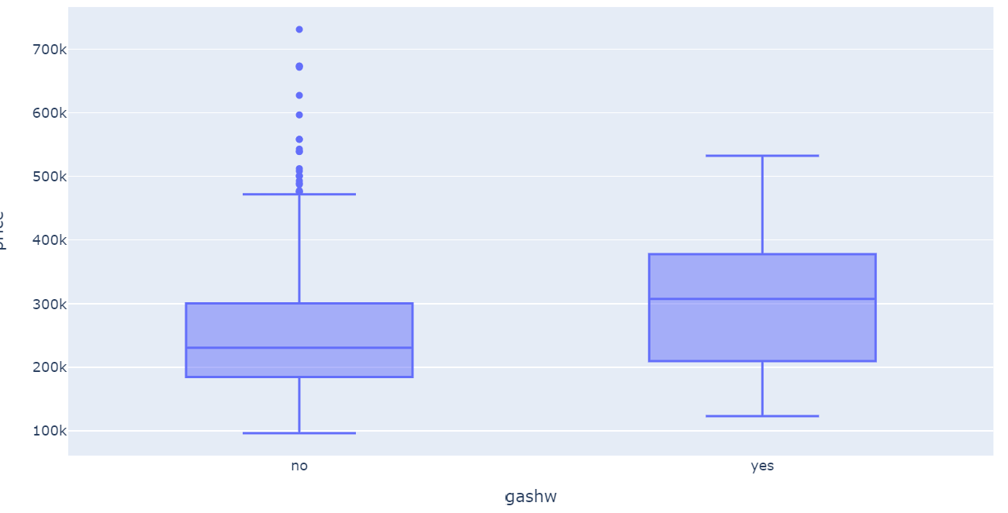
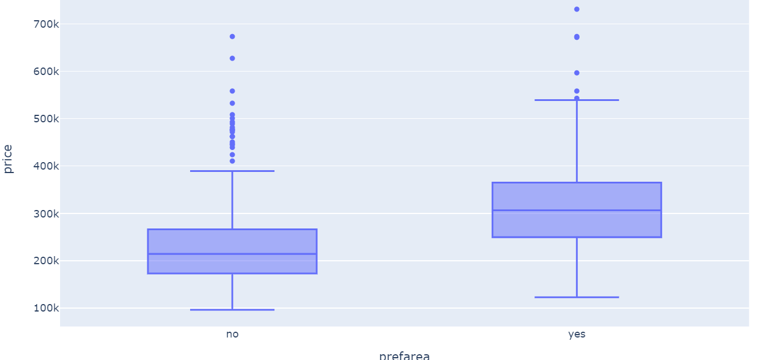
Bivariate Relationship (3/3)
Here we have plotted boxplots to understand relationship between price and factor variables like gashw and prefarea
We see the price differs as the value of factor variable changes

Slide 12
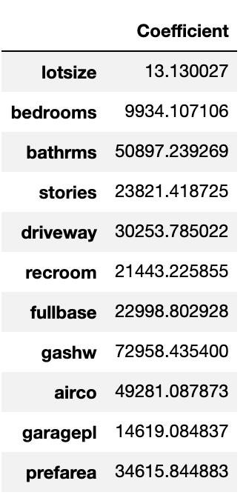
Model 1- Linear Regression
Steps:
One hot encoding of the entire data
Splitting the data into 70-30% for training and testing
Fitting linear regression model on the train data
Coefficient interpretation Example: 1 unit increase in lot size increases the property valuation by 13.130027$

Slide 13
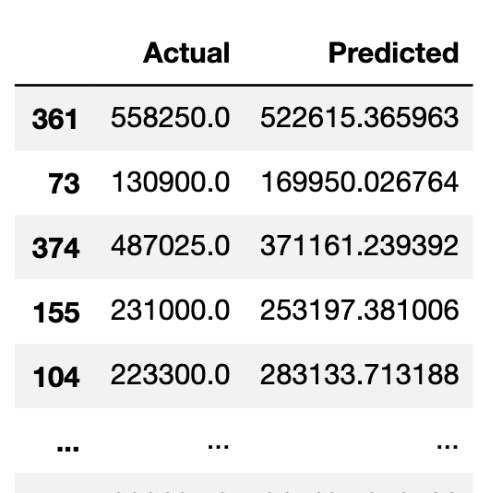
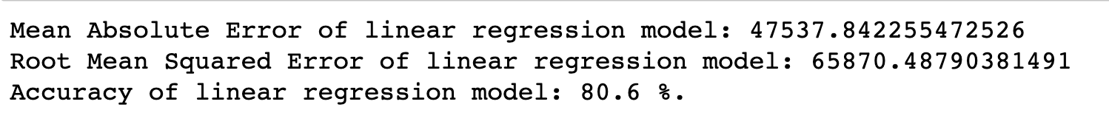
Steps continued
5. Prediction on test data and actual value comparison
6. Evaluating Mean Absolute Error, Root Mean Squared Error, Accuracy

Slide 14
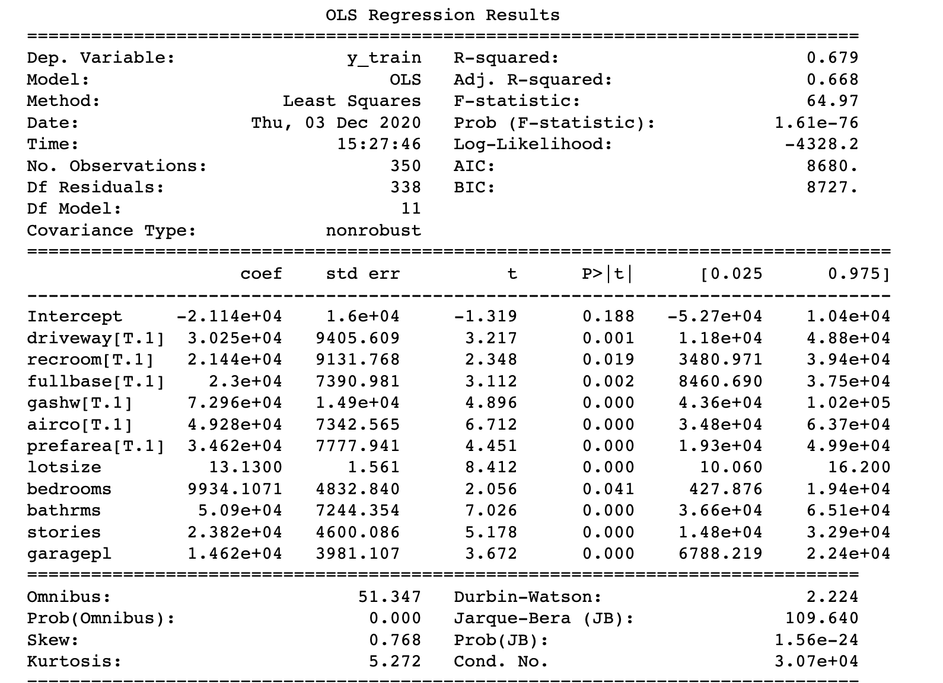
7. P-values, Adjusted R squared, Standard error

Slide 15
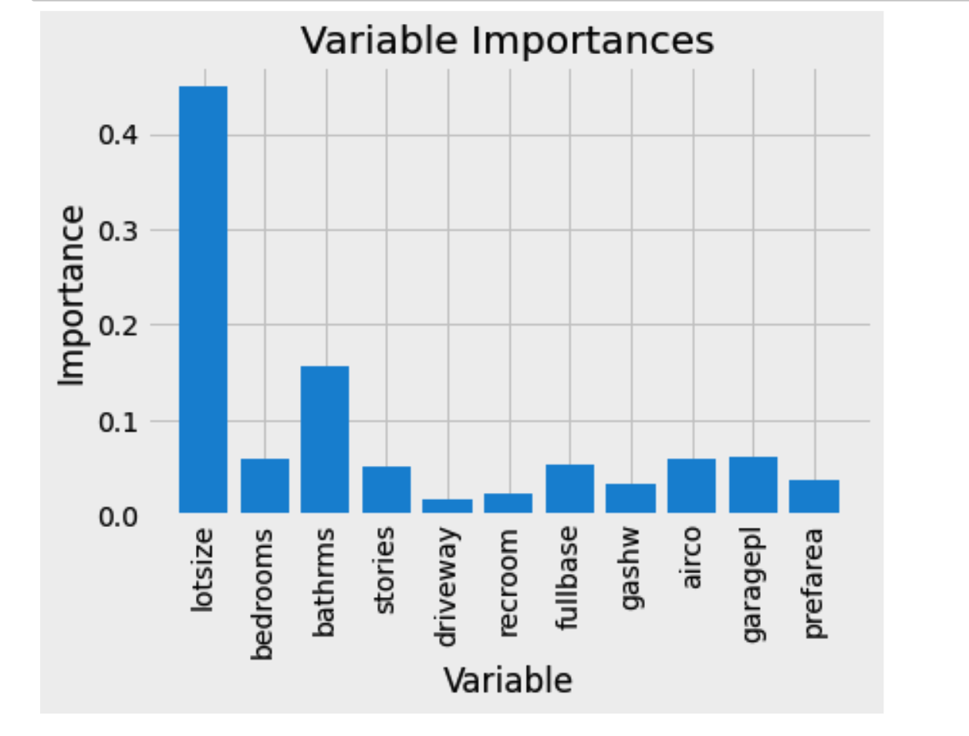
Model 2- Random Forest
Steps:
On the same train-test split, fit a random forest regressor
Visualize variable importance
Calculate Mean absolute error, Accuracy

Slide 16
Inferences
The independent variables have multicollinearity amongst them as number of bedrooms is usually directly proportional to number of bathrooms
Lot size and number of bedrooms are the most significant while calculating property valuation
The price of the property increases with increase in bedrooms, bathrooms, air conditioners, garage areas etc.
The accuracy of both the models- linear regression = 80.6% and random forest = 80.8% are comparable
The mean absolute error is around 40k, i.e. the error while estimating property valuation is +/- 40k of the actual price
Tuning the hyper parameters and applying advanced algorithms might be helpful for the Zestimate

