Slide 1
Modeling and Discovering Vulnerabilities with Code Property Graphs
Slidesgo 2022
Jigyas Sharma

Slide 2
Table of contents
01.Prerequisites
02.Objective
03.Methodology
04.Analysis
05.Evaluation
06.Conclusion
Static Code Analysis, Graph Theory(AST, CFG, PDG)
Graph based analysis to detect vulnerabilites
Construction of CPG and identifying vulnerabilities
Methods for traversing CPG and identifying vulnerabilities
Models created and vulnerabilities discovered
Summary, Significance and Q&A

Slide 3
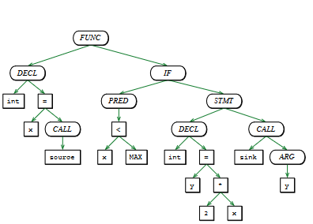
Abstract Syntax Trees
Abstract Syntax Trees are the first representations of code from parsers.
AST are the basis for other code representations.
Ordered Trees: inner nodes are operators, leaf nodes are operands.
ASTs are not suitable for advances code analysis.

Slide 4
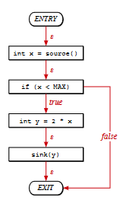
Control Flow Graphs
Control Flow Graphs describe the order of execution and conditions for execution.
Nodes represent statements and predicates; edges indicate control transfer.
Constructed from ASTs in two steps: structured and unstructured control statements.
Exposes Control Flow but lacks information about data flow.

Slide 5
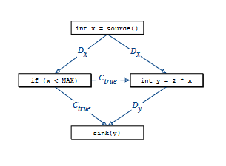
Program Dependence Graphs
Program Dependence Graphs identify statements and predicates affecting variables at specific statements.
Represents dependencies in statements.
Edges are either a data dependency or a control dependency.
Order of execution is unclear but dependencies are visible.

Slide 6
Objective
Creating a representation of source code combining the properties of Control Flow Graphs, Abstract Syntax Trees and Program Dependence Graphs.

Slide 7
Methodology
Property graphs list primary entities like objects/relations as nodes and edges. CPG uses this to represent ASTs, CFGs and PDGs.
Property Graphs
The nodes in the CPG take up an attribute labelled as either “code” or “order”.
Abstract Syntax Trees
Code Property Graphs
The edges in CPG inherit attributes from CFG with control flow direction. They are labelled either “true”, “false” or “ε”.
Control Flow Graphs
The edges in the CPG also take up either “data” or “control” values, depending up on the dependency as listed in the PDG.
Program Dependence Graphs

Slide 8
Traversing Well-known Vulnerabilities
Phase 01(Baseline)
Phase 02(AST)
We look at a vulnerability in SSH implementation that affected iOS devices. The buffer overflow was due to memory allocation of a user-controlled variable.
The vulnerability was identified using regular expressions. However, it did not provide information over attacker’s control over the variable.
This gives a baseline for how much CPG improves vulnerability detection over the regular techniques.
In this phase, we implement the usage of information available to us via ASTs. A technique called “MATCH” traversal is employed which filters nodes based on some criteria.
This leverages structural information, allowing for a more nuanced understanding of code.
To enhance identification, multiple “MATCH” traversals can be combined using logical operators.

Slide 9
Traversing Well-Known Vulnerabilites
Phase 03(AST+CFG)
Phase 04(CPG)
Enabling the use of control flow edges allows for modeling execution order of statements, enabling detection of a broader range of vulnerabilities.
Vulnerabilities are linked to specific path in CFGs. The relevance of the path is contingent on additional conditions such as if allocation returns pointer to allocated memory.
CFG vulnerabilities are identified by traversing using DFS to find all paths that meet a specified criteria.
The final approach combines structural insights, control flow and variable influence from data flow analysis. This allows tracing manipulation of data through a program.
The data flow edges are accounted for and follow the movement of variables with the code.
Using the combination of all these processes allows for identification of complex vulnerability patterns.

Slide 10
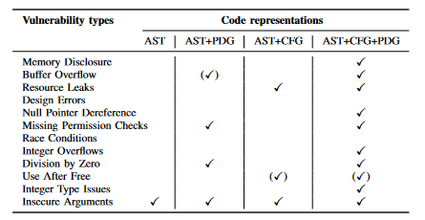
Evaluation
A static code analysis system was implemented based on the concept of CPG. The static code analysis would report and categorize 88 vulnerabilities into 12 types from the 2012 Linux kernel.
The model modeled 10 out of 12 vulnerabilities.
The majority of vulnerabilities discovered were prevelant in the previous year.
The traversals also lead to discovery of 18 previously undiscovered vulnerabilities.

Slide 11
Conclusions
Summary
Limitations
Future Work
CPG provides a method for an efficient evaluation of code in finding vulnerabilities.
Static analysis limitations, Potential Vulnerabilities and inter-procedure analysis.
Dynamic Analysis, ML techniques for pattern identification and inter-procedure analysis.

