Slide 1
Project Proposal
Jigyas Sharma
MSc. Computer Science

Slide 2
F1TENTHS AUTONOMOUS PERFORMANCE DRIVING SOFTWARE

Slide 3
Overview of the idea
Build a software that can optimize the performance of the car, in terms of time, while minimizing crashes.

Slide 4
Tech Stack(Tentative)
R: Data Preprocessing, Cleaning and Data Visualization
Python3: Machine Learning Framework and Algorithm Development
PyTorch: Computation Graphs and Deep Learning Framework
C: Embedded System Development

Slide 5
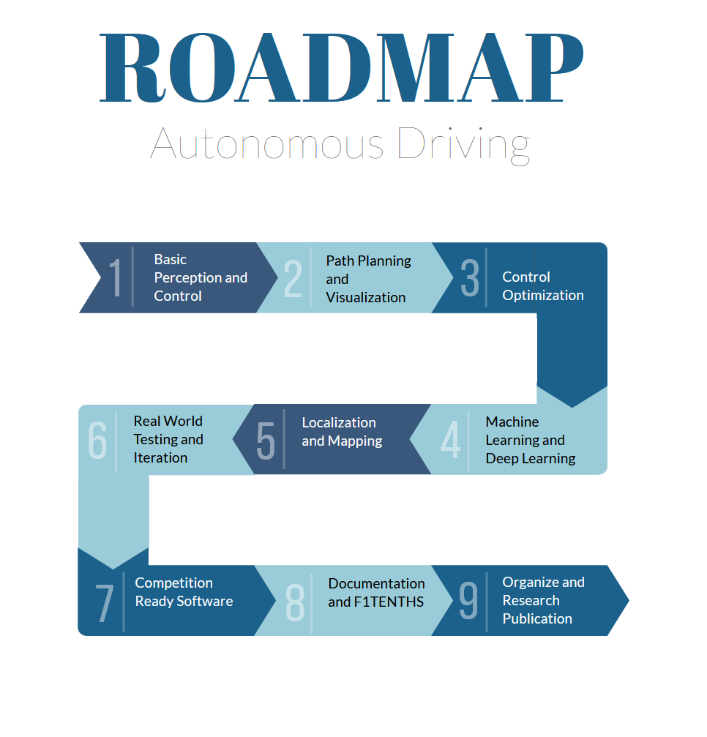
Notes:
Pro tip: Covert PDFs to a format like PNG, if possible.

Slide 6
Basic Perception and Control
Development of basic perception algorithms
Process sensor data correctly(LiDAR)
Identify obstacles, lanes and other cars
Implement basic control algorithm
Follow predefined path along with basic control

Slide 7
Path planning and Visualization
Develop path planning algorithms
Visualization of obstacles
Introduction of dynamic variables in the environment
Generate safe and efficient trajectory
Generate race specific trajectory

Slide 8
Control Optimization
Optimization of algorithms for better hardware control
Introduce high intensity parameters like high-speed turns and traction-based acceleration.
Identifying control constraints
Reduce distortion between optimized trajectory vs. actual trajectory

Slide 9
ML and Deep Learning
Introduction of machine learning and deep learning techniques in the stable control environment.
Perception, control and decision-making algorithms based on ML and Deep Learning
Model training for object detection, trajectory prediction and race strategy.

Slide 10
Localization and Mapping
Enhancement of Localization Techniques
Deployment of Simultaneous Localization and Mapping(SLAM)
Use of Extended Kalman Filter Localization
Utilization of Monte Carlo Localization(MCL)

Slide 11
Post Development Steps
Get competition ready software
Documentation for the code and theories used
F1TENTHS March or July 2024
Publication Research and Refinement

Slide 12
Thank you

