Slide 1
Ladle
learning audio Degradation for lossless enhancement

Slide 2
outline
Introduction
Background and Motivation
Methodology
Experimental Results
Summary of Research
Reflections and Evaluation

Slide 3
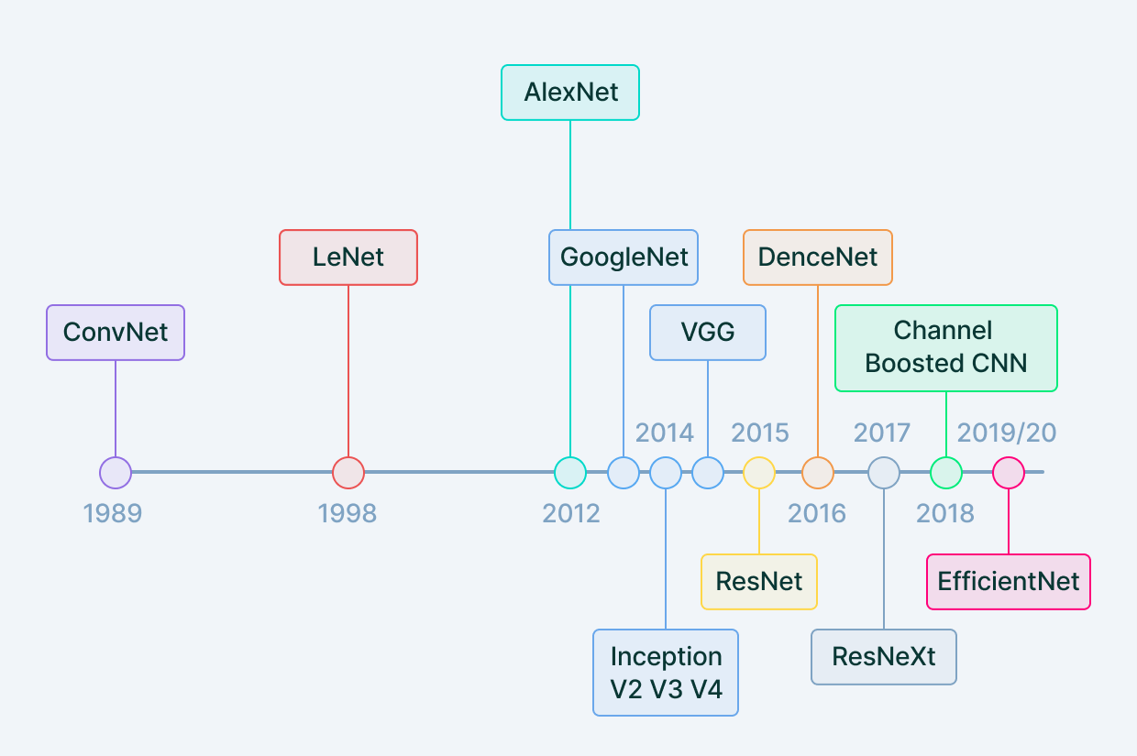
Introduction–evolution of cnn
Multiple CNN Architectures introduced over the years

Slide 4
why audio data is lossy
Compression Algorithms reduce file size by removing imperceptible features
Retained data is acceptable but discards critical information for fidelity
Recreating lossless quality from lossy is challenging due to removal of high-frequency

Slide 5
Can CNN help recover lost data
Audio data is sequential, high-dimensional and hierarchical
CNNs can capture local patterns and extract meaningful features
With careful design, CNN might handle the temporal and spectral characteristics of audio data
Combined with attention mechanisms, CNNs can form globalized relationships

Slide 6
Methodology–Dataset Creation
Lossless audio extracted from CDs and compressed
115 songs with a uniform sampling rate of 44kHz(Lossless) and 32kHz(Lossy)
Segmentation Size | Lossy Sample Rate | Lossy Neurons | Lossless Sample Rate | Lossless Neuron
1 second | 32 kHz | 64000 | 44 kHz | 88000
0.01 second | 32 kHz | 640 | 44 kHz | 880
0.1 second | 32 kHz | 6400 | 44 kHz | 8800
0.1 second | 44 kHz | 8800 | 44 kHz | 8800

Slide 7
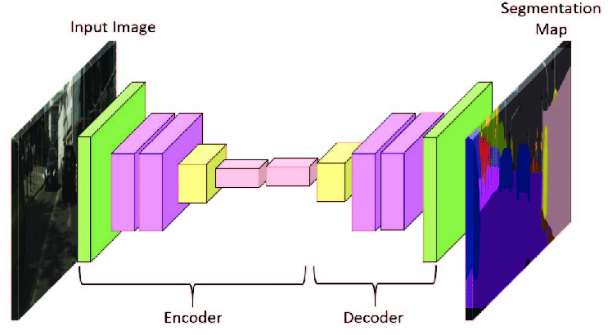
Model Components
CNN Encoder: Captures local audio patterns
Transformer: Accounts for global dependencies across audio sequences
CNN Decoder: Deconvolution from feature maps

Slide 8
Model Architecture
Input: Paired lossy and lossless audio segments
CNN Encoder: 4 Convolution Layers with ReLU Activation
Transformer: 2 Layers with 8 attention heads each
CNN Decoder: 4 Deconvolution Layers with Tanh Activation for the last layer.

Slide 9
Experimental Settings
Key Parameters:
Epochs: 20
Batch Size: 4
Loss Functions: Mean Squared Error and Perceptual Loss
Evaluation Metrics:
Quantitative: MSE and Perceptual Loss Values
Qualitative: Subjective feedback from 8 Humans

Slide 10
Experimental Results
Quantitative Findings:
Resampling approach achieved the highest MSE but the lowest Perceptual Loss
Padding Based Methods introduce Instability and Noisy Signals
Qualitative Feedback:
Padding based methods introduce audible noise.
Resampling based method got close to Lossless quality.

Slide 11
Conclusion
Limitations and Future Work

Slide 12
Thank You

