Slide 1
AWT
*
‹#›

Slide 2
Abstract Window Toolkit acronymed as AWT is a toolkit of classes in Java which helps a programmer to develop Graphics and Graphical User Interface components.
It is a part of JFC (Java Foundation Classes) developed by Sun Microsystems.
The AWT API in Java primarily consists of a comprehensive set of classes and methods that are required for creating and managing the Graphical User Interface(GUI) in a simplified manner.
It was developed for providing a common set of tools for designing the cross-platform GUIs. One of the important features of AWT is that it is platform dependent.
‹#›

Slide 3
This means that the AWT tools use the native toolkits of the platforms they are being implemented.
This approach helps in preserving the look and feel of each platform.
But as said everything comes with a price, there is a major drawback of this approach.
When executed on various platforms because of platform dependency it will look different on each platform.
This hampers the consistency and aesthetics of an application.
‹#›

Slide 4
Features of AWT in Java
AWT is a set of native user interface components
It is based upon a robust event-handling model
It provides Graphics and imaging tools, such as shape, color, and font classes
AWT also avails layout managers which helps in increasing the flexibility of the window layouts
Data transfer classes are also a part of AWT that helps in cut-and-paste through the native platform clipboard
Supports a wide range of libraries that are necessary for creating graphics for gaming products, banking services, educational purposes, etc.
‹#›

Slide 5
AWT UI Aspects
Any UI will be made of three entities:
UI elements: These refers to the core visual elements which are visible to the user and used for interacting with the application. AWT in Java provides a comprehensive list of widely used and common elements.
Layouts: These define how UI elements will be organized on the screen and provide the final look and feel to the GUI.
Behavior: These define the events which should occur when a user interacts with UI elements.
‹#›

Slide 6
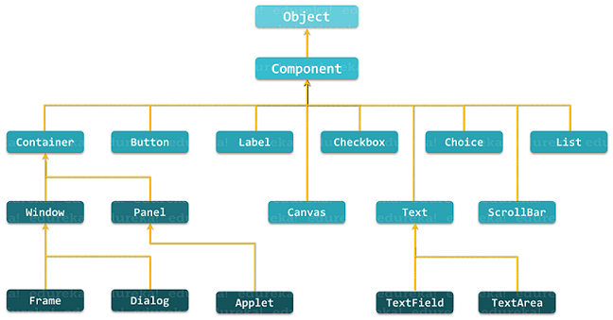
Hierarchy Of AWT
‹#›

Slide 7
As you can see in the above diagram, Component is the superclass of all the GUI controls. It is an abstract class which encapsulates all the attributes of a visual component and represents an object with graphical representation. A component class instance is basically responsible for the look and feel of the current interface.
Below I have shown the general class description of java.awt.Component:
public abstract class Component extends Object
implements ImageObserver, MenuContainer, Serializable{
//class body
}
‹#›

Slide 8
AWT Components
Containers
Container in Java AWT is a component that is used to hold other components such as text fields, buttons, etc.
It is a subclass of java.awt.Component and is responsible for keeping a track of components being added.
There are four types of containers provided by AWT in Java.
‹#›

Slide 9
Types of Containers
Window:
It is an instance of the Window class having neither border nor title.
It is used for creating a top-level window.
‹#›

Slide 10
Frame:
Frame is a subclass of Window and contains title, border and menu bars.
It comes with a resizing canvas and is the most widely used container for developing AWT applications.
It is capable of holding various components such as buttons, text fields, scrollbars, etc.
You can create a Java AWT Frame in two ways:
By Instantiating Frame class
By extending Frame class
‹#›

Slide 11
Creating Frame Window by Instantiating Frame class
import java.awt.*;
public class Testawt
{
Testawt()
{
Frame fm=new Frame(); //Creating a frame
Label lb = new Label("welcome to java graphics"); //Creating a label
fm.add(lb); //adding label to the frame
fm.setSize(300, 300); //setting frame size.
fm.setVisible(true); //set frame visibilty true
}
public static void main(String args[])
{
Testawt ta = new Testawt();
}
}
‹#›

Slide 12
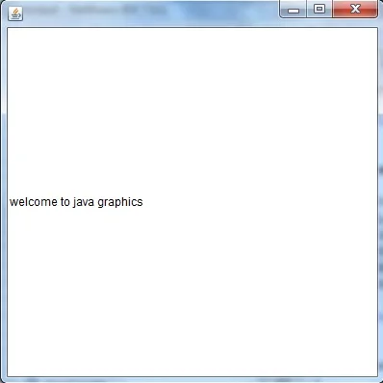
‹#›

Slide 13
Creating Frame window by extending Frame class
import java.awt.*;
import java.awt.event.*;
public class Testawt extends Frame
{
public Testawt()
{
Button btn=new Button("Hello World");
add(btn); //adding a new Button.
setSize(400, 500); //setting size.
setTitle("Test awt"); //setting title.
setLayout(new FlowLayout()); //set default layout for frame.
setVisible(true); //set frame visibilty true.
}
public static void main (String[] args)
{
Testawt ta = new Testawt(); //creating a frame.
}
}
‹#›

Slide 14
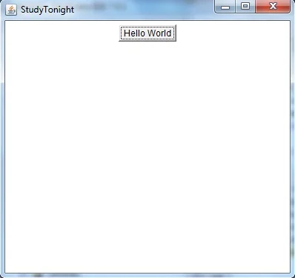
‹#›

Slide 15
Points to Remember:
While creating a frame (either by instantiating or extending Frame class), Following two attributes are must for visibility of the frame:
setSize(int width, int height);
setVisible(true);
When you create other components like Buttons, TextFields, etc. Then you need to add it to the frame by using the method - add(Component's Object);
You can add the following method also for resizing the frame - setResizable(true);
‹#›

Slide 16
Dialog:
Dialog class is also a subclass of Window and comes with the border as well as the title.
Dialog class’s instance always needs an associated Frame class instance to exist.
‹#›

Slide 17
Panel:
Panel is the concrete subclass of Container and doesn’t contain any title bar, menu bar or border.
Panel class is a generic container for holding the GUI components.
You need the instance of the Panel class in order to add the components.
‹#›

Slide 18
2. Button
java.awt.Button class is used to create a labeled button. GUI component that triggers a certain programmed action upon clicking it. The Button class has two constructors:
//Construct a Button with the given label
public Button(String btnLabel);
//Construct a Button with empty label
public Button();
‹#›

Slide 19
A few of the methods provided by this class have been listed below:
//Get the label of this Button instance
public String getLabel();
//Set the label of this Button instance
public void setLabel(String btnLabel);
//Enable or disable this Button. Disabled Button cannot be clicked
public void setEnable(boolean enable);
‹#›

Slide 20
import java.awt.*;
public class ButtonDemo1
{
public static void main(String[] args)
{
Frame f1=new Frame("studytonight ==> Button Demo");
Button b1=new Button("Press Here");
b1.setBounds(80,200,80,50);
f1.add(b1);
f1.setSize(500,500);
f1.setLayout(null);
f1.setVisible(true);
}
}
‹#›

Slide 21
3. Text Field
A java.awt.TextField class creates a single-line text box for users to enter texts. The TextField class has three constructors which are:
‹#›

Slide 22
//Construct a TextField instance with the given initial text string with the number of columns.
public TextField(String initialText, int columns);
//Construct a TextField instance with the given initial text string.
public TextField(String initialText);
//Construct a TextField instance with the number of columns.
public TextField(int columns);
‹#›

Slide 23
A few of the methods provided by TextField class are:
// Get the current text on this TextField instance
public String getText();
// Set the display text on this TextField instance
public void setText(String strText);
//Set this TextField to editable (read/write) or non-editable (read-only)
public void setEditable(boolean editable);
‹#›

Slide 24
import java.awt.*;
class TextFieldDemo1{
public static void main(String args[]){
Frame TextF_f= new Frame(“TextFieldFrameName");
TextField text1,text2;
text1=new TextField("Welcome to MIT");
text1.setBounds(60,100, 230,40);
text2=new TextField("This class is of Java");
text2.setBounds(60,150, 230,40);
TextF_f.add(text1);
TextF_f.add(text2);
TextF_f.setSize(500,500);
TextF_f.setLayout(null);
TextF_f.setVisible(true);
}
}
‹#›

Slide 25
4. Label
The java.awt.Label class provides a descriptive text string that is visible on GUI.
An AWT Label object is a component for placing text in a container.
Label class has three constructors which are:
‹#›

Slide 26
// Construct a Label with the given text String, of the text alignment
public Label(String strLabel, int alignment);
//Construct a Label with the given text String
public Label(String strLabel);
//Construct an initially empty Label
public Label();
‹#›

Slide 27
This class also provides 3 constants which are:
public static final LEFT; // Label.LEFT
public static final RIGHT; // Label.RIGHT
public static final CENTER; // Label.CENTER
‹#›

Slide 28
Below I have listed down the public methods provided by this class:
public String getText();
public void setText(String strLabel);
public int getAlignment();
//Label.LEFT, Label.RIGHT, Label.CENTER
public void setAlignment(int alignment);
‹#›

Slide 29
import java.awt.*;
class LabelDemo1
{
public static void main(String args[])
{
Frame l_Frame= new Frame(" Label Demo");
Label lab1,lab2;
lab1=new Label("Welcome to studytonight.com");
lab1.setBounds(50,50,200,30);
lab2=new Label("This Tutorial is of Java");
lab2.setBounds(50,100,200,30);
l_Frame.add(lab1);
l_Frame.add(lab2);
l_Frame.setSize(500,500);
l_Frame.setLayout(null);
l_Frame.setVisible(true);
}
}
‹#›

Slide 30
5. Canvas
A Canvas class represents the rectangular area where you can draw in an application or receive inputs created by the user.
‹#›

Slide 31
import java.awt.*;
public class CanvasDemo1
{
public CanvasDemo1()
{
Frame canvas_f= new Frame("Canvas");
canvas_f.add(new CanvasDemo());
canvas_f.setLayout(null);
canvas_f.setSize(500, 500);
canvas_f.setVisible(true);
}
public static void main(String args[])
{
new CanvasDemo1();
}
}
‹#›

Slide 32
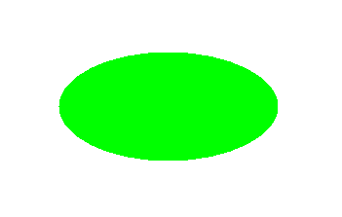
class CanvasDemo extends Canvas
{
public CanvasDemo() {
setBackground (Color.WHITE);
setSize(300, 200);
}
public void paint(Graphics g)
{
g.setColor(Color.green);
g.fillOval(80, 80, 150, 75);
}
}
‹#›

Slide 33
6. Choice
Choice class is used to represent a pop-up menu of choices. The selected choice is shown on the top of the given menu.
‹#›

Slide 34
import java.awt.*;
public class ChoiceDemo
{
ChoiceDemo()
{
Frame choice_f= new Frame();
Choice obj=new Choice();
obj.setBounds(80,80, 100,100);
obj.add("Red"); obj.add("Blue");
obj.add("Black"); obj.add("Pink");
obj.add("White"); obj.add("Green");
choice_f.add(obj);
choice_f.setSize(400,400);
choice_f.setLayout(null);
choice_f.setVisible(true);
}
public static void main(String args[])
{
new ChoiceDemo();
}
}
‹#›

Slide 35
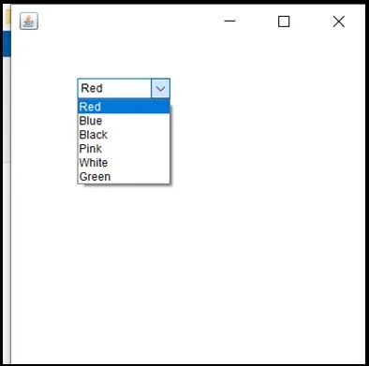
‹#›

Slide 36
7. Scroll Bar
The Scrollbar class object is used to add horizontal and vertical scrollbar in the GUI. It enables a user to see the invisible number of rows and columns.
‹#›

Slide 37
8. List
The object of List class represents a list of text items. Using the List class a user can choose either one item or multiple items.
‹#›

Slide 38
import java.awt.*;
public class ListDemo
{
ListDemo()
{
Frame list_f= new Frame();
List obj=new List(6);
obj.setBounds(80,80, 100,100);
obj.add("Red"); obj.add("Blue");
obj.add("Black"); obj.add("Pink");
obj.add("White"); obj.add("Green");
list_f.add(obj);
list_f.setSize(400,400);
list_f.setLayout(null);
list_f.setVisible(true);
}
public static void main(String args[])
{
new ListDemo();
}
}
‹#›

Slide 39
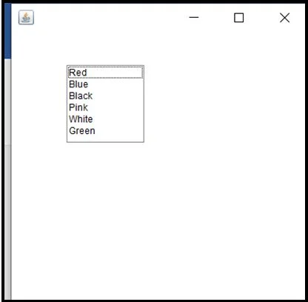
‹#›

Slide 40
9. CheckBox
The Checkbox is a class is a graphical component that is used to create a checkbox.
It has two state options; true and false.
At any point in time, it can have either of the two.
‹#›

Slide 41
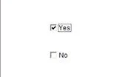
import java.awt.*;
public class CheckboxDemo1
{
CheckboxDemo1(){
Frame checkB_f= new Frame("Checkbox Example");
Checkbox ckbox1 = new Checkbox("Yes", true);
ckbox1.setBounds(100,100, 60,60);
Checkbox ckbox2 = new Checkbox("No");
ckbox2.setBounds(100,150, 60,60);
checkB_f.add(ckbox1);
checkB_f.add(ckbox2);
checkB_f.setSize(400,400);
checkB_f.setLayout(null);
checkB_f.setVisible(true);
}
public static void main(String args[])
{
new CheckboxDemo1();
}
}
‹#›

Slide 42
CheckboxGroup
AWT contains a CheckboxGroup Class.
It is used to group a set of Checkbox.
When Checkboxes are grouped then only one box can be checked at a time.
‹#›

Slide 43
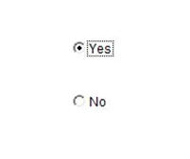
import java.awt.*;
public class CheckboxGroupDemo
{
CheckboxGroupDemo(){
Frame ck_groupf= new Frame("CheckboxGroup");
CheckboxGroup obj = new CheckboxGroup();
Checkbox ckBox1 = new Checkbox("Yes", obj, true);
ckBox1.setBounds(100,100, 50,50);
Checkbox ckBox2 = new Checkbox("No", obj, false);
ckBox2.setBounds(100,150, 50,50);
ck_groupf.add(ckBox1);
ck_groupf.add(ckBox2);
ck_groupf.setSize(400,400);
ck_groupf.setLayout(null);
ck_groupf.setVisible(true);
}
public static void main(String args[])
{
new CheckboxGroupDemo();
}
}
‹#›

Slide 44
MVC
The Model View Controller (MVC) design pattern specifies that an application consist of a data model, presentation information, and control information. The pattern requires that each of these be separated into different objects.
MVC is more of an architectural pattern, but not for complete application. MVC mostly relates to the UI / interaction layer of an application. You’re still going to need business logic layer, maybe some service layer and data access layer.

Slide 45
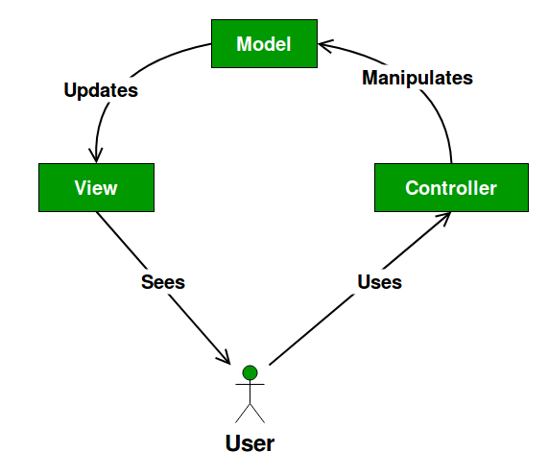
UML Diagram MVC Design Pattern

Slide 46
The Model contains only the pure application data, it contains no logic describing how to present the data to a user.
The View presents the model’s data to the user.
The view knows how to access the model’s data, but it does not know what this data means or what the user can do to manipulate it.

Slide 47
The Controller exists between the view and the model.
It listens to events triggered by the view (or another external source) and executes the appropriate reaction to these events.
In most cases, the reaction is to call a method on the model. Since the view and the model are connected through a notification mechanism, the result of this action is then automatically reflected in the view

Slide 48
Advantages
Multiple developers can work simultaneously on the model, controller and views.
MVC enables logical grouping of related actions on a controller together.
The views for a specific model are also grouped together.
Models can have multiple views.

Slide 49
Disadvantages
The framework navigation can be complex because it introduces new layers of abstraction and requires users to adapt to the decomposition criteria of MVC.
Knowledge on multiple technologies becomes the norm.
Developers using MVC need to be skilled in multiple technologies.

Slide 50
AWT and Swing in Java
AWT and Swing are used to develop window-based applications in Java.
Awt is an abstract window toolkit that provides various component classes like Label, Button, TextField, etc., to show window components on the screen.
All these classes are part of the Java.awt package.

Slide 51
On the other hand, Swing is the part of JFC (Java Foundation Classes) built on the top of AWT and written entirely in Java.
The javax.swing API provides all the component classes like JButton, JTextField, JCheckbox, JMenu, etc.

Slide 52
The components of Swing are platform-independent, i.e., swing doesn't depend on the operating system to show the components.
Also, the Swing's components are lightweight.
The main differences between AWT and Swing are given in the following table.

Slide 53
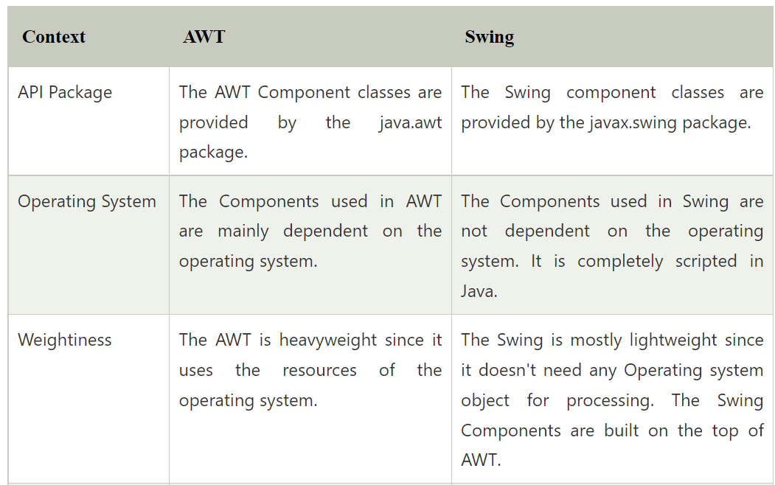

Slide 54
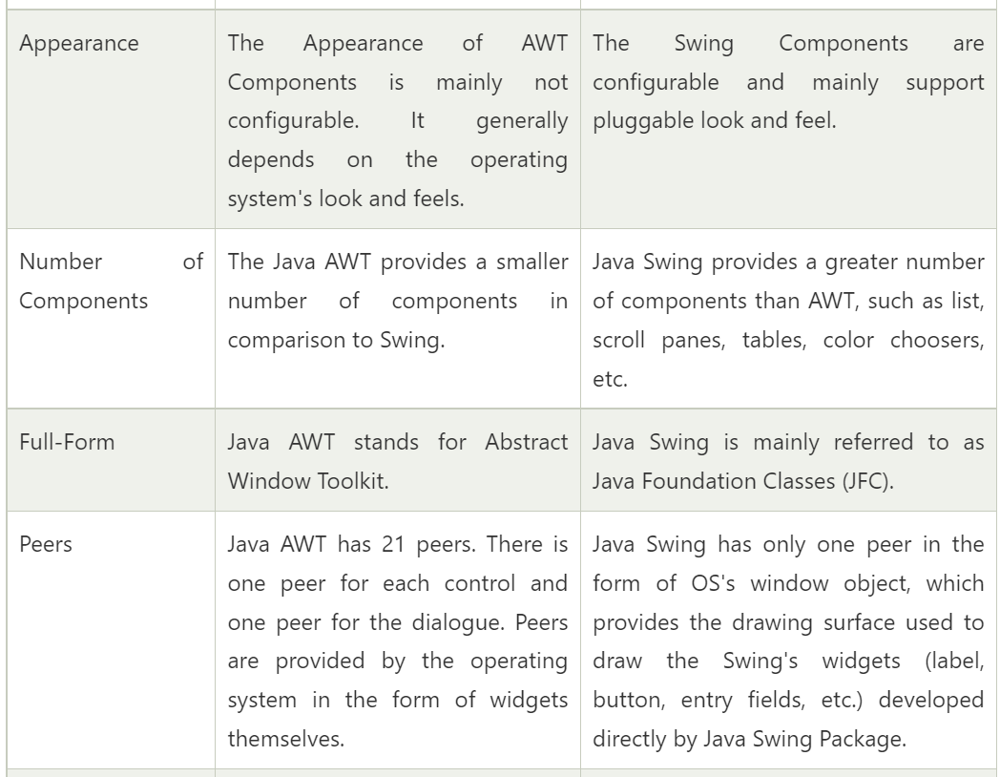

Slide 55
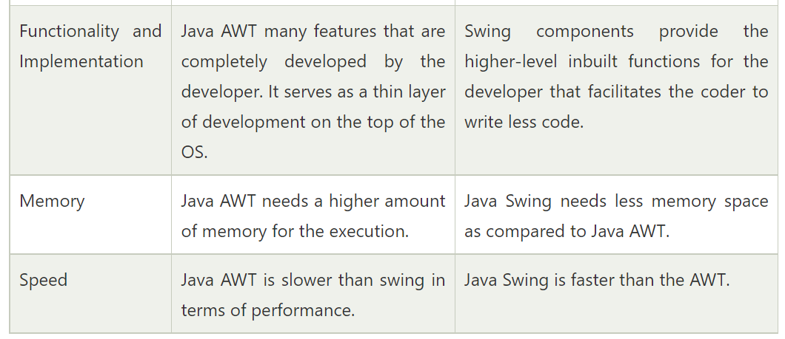

Slide 56
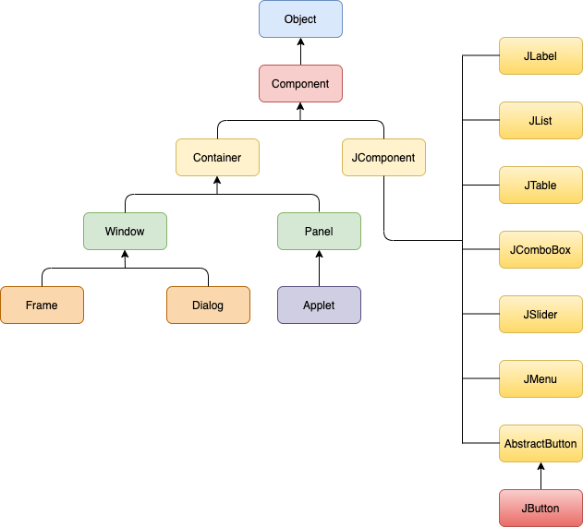
Java Swing Hierarchy

