Slide 1
Java Database Connectivity (JDBC)
*
‹#›

Slide 2
JDBC
Allows the programmer to connect to a database and query or update it through a Java application.
Programs developed using Java & JDBC API are platform & vendor independent.
JDBC API is implemented in java.sql package.
JDBC helps you to write Java applications that manage these three programming activities:
Connect to a data source, like a database
Send queries and update statements to the database
Retrieve and process the results received from the database in answer to your query
‹#›

Slide 3
JDBC Architecture
In the three-tier model, commands are sent to a "middle tier" of services, which then sends the commands to the data source.
The data source processes the commands and sends the results back to the middle tier, which then sends them to the user.
The three-tier model is very attractive because the middle tier makes it possible to maintain control over access and the kinds of updates that can be made to corporate data.
Another advantage is that it simplifies the deployment of applications. Finally, in many cases, the three-tier architecture can provide performance advantages.
JDBC API is being used more and more in the middle tier of three-tier architecture. It also allows access to a data source from a Java middle tier.
‹#›

Slide 4
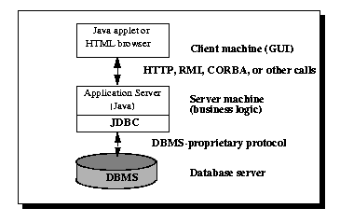
JDBC Architecture
‹#›

Slide 5
Two-tier model
A java application communicates directly to the data source. The JDBC driver enables the communication between the application and the data source.
When a user sends a query to the data source, the answers for those queries are sent back to the user in the form of results.
The data source can be located on a different machine on a network to which a user is connected.
This is known as a client/server configuration, where the user’s machine acts as a client, and the machine has the data source running acts as the server.

Slide 6
Three-tier model
In this, the user’s queries are sent to middle-tier services, from which the commands are again sent to the data source. The results are sent back to the middle tier, and from there to the user.
This type of model is found very useful by management information system directors.

Slide 7
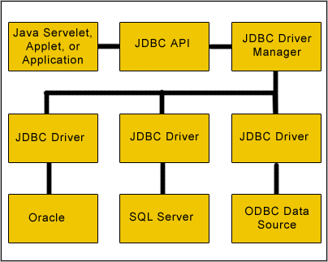
JDBC Components (3-tier Architecture)
‹#›

Slide 8
JDBC Components
JDBC includes four components:
The JDBC API:
The JDBC API gives programmatic access to relational data from Java. Using the JDBC API, applications can execute SQL statements, retrieve results, and propagate changes back to an underlying data source.
The JDBC API can also interact with multiple data sources in a distributed, heterogeneous environment.
The JDBC API is part of the Java platform; it includes the Java Standard Edition (Java SE) and Java Enterprise Edition (JEE). The JDBC 4.0 API is divided into two packages: java.sql and javax.sql. Both packages are included in the Java SE and Java EE platforms.
‹#›

Slide 9
JDBC Components
JDBC Driver Manager :
The JDBC DriverManager class defines objects which can connect Java applications to a JDBC driver.
DriverManager has traditionally been the backbone of the JDBC architecture. It is quite small and simple.
JDBC Test Suite:
The JDBC driver test suite helps JDBC drivers to run your program.
These tests are not comprehensive or exhaustive, but they do exercise many of the important features in the JDBC API.
‹#›

Slide 10
Open Database Connectivity (ODBC) is an open standard Application Programming Interface (API) for accessing a database.
ODBC is an SQL-based Application Programming Interface (API) created by Microsoft that is used by Windows software applications to access databases via SQL.
JDBC is an SQL-based API created by Sun Microsystems to enable Java applications to use SQL for database access.

Slide 11
JDBC Components
JDBC-ODBC Bridge:
The Java Software bridge provides JDBC access via ODBC drivers. Note that you need to load ODBC binary code onto each client machine that uses this driver.
As a result, the ODBC driver is most appropriate on a corporate network where client installations are not a major problem, or for application server code written in Java in three-tier architecture.
‹#›

Slide 12
Interfaces of JDBC API
A list of popular interfaces of JDBC API is given below:
Driver interface
Connection interface
Statement interface
PreparedStatement interface
CallableStatement interface
ResultSet interface
ResultSetMetaData interface
DatabaseMetaData interface
RowSet interface

Slide 13
JDBC Drivers
What is JDBC Driver ?
JDBC drivers implement the defined interfaces in the JDBC API for interacting with your database server.
For example, using JDBC drivers enable you to open database connections and to interact with it by sending SQL or database commands then receiving results with Java.
The java.sql package that ships with JDK contains various classes with their behaviours defined and their actual implementaions are done in third-party drivers.
Third party vendors implements the java.sql.Driver interface in their database driver.
‹#›

Slide 14
JDBC Drivers
There are four distinct types of JDBC drivers.
JDBC-ODBC Bridge (Type 1)
Native-API partly Java Driver (Type 2)
Net-Protocol All-Java Driver (Type 3)
Native Protocol Pure Java Driver (Type 4)
‹#›

Slide 15
Type 1 Driver – JDBC-ODBC Bridge
The JDBC- ODBC Bridge provides JDBC access using most standard ODBC drivers. In a Type 1 driver, a JDBC bridge is used to access ODBC drivers installed on each client machine.
Using ODBC requires configuring on your system a Data Source Name (DSN) that represents the target database.
The driver converts JDBC method calls into ODBC function calls. The driver is platform-dependent as it makes use of ODBC which in turn depends on native libraries of the underlying operating system the JVM is running upon.
Also, use of this driver leads to other installation dependencies; for example, ODBC must be installed on the computer having the driver and the database must support an ODBC driver.
‹#›

Slide 16
Type 1 Driver – JDBC-ODBC Bridge
When Java first came out, this was a useful driver because most databases only supported ODBC access but now this type of driver is recommended only for experimental use or when no other alternative is available.
Advantages:
Almost any database for which ODBC driver is installed, can be accessed.
Disadvantages:
Performance overhead since the calls have to go through the JDBC overhead bridge to the ODBC driver, then to the native database connectivity interface.
The ODBC driver needs to be installed on the client machine
‹#›

Slide 17
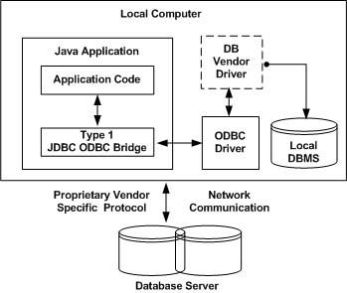
Type 1 Driver – JDBC-ODBC Bridge
‹#›

Slide 18
Type 2 Driver - JDBC-Native API
In a Type 2 driver, JDBC API calls are converted into native C/C++ API calls which are unique to the database.
It converts the JDBC calls into a database specific call for databases such as SQL, ORACLE etc. This driver communicates directly with the database server.
It requires some native code to connect to the database.
These drivers typically provided by the database vendors and used in the same manner as the JDBC-ODBC Bridge, the vendor-specific driver must be installed on each client machine.
‹#›

Slide 19
Type 2 Driver - JDBC-Native API
If we change the Database we have to change the native API as it is specific to a database and they are mostly obsolete now but you may realize some speed increase with a Type 2 driver, because it eliminates ODBC's overhead.
Advantages:
Better performance than Type 1 since no JDBC to ODBC translation is needed.
Disadvantages
The vendor client library needs to be installed on the client machine.
Cannot be used in internet due the client side software needed.
Not all databases give the client side library.
‹#›

Slide 20
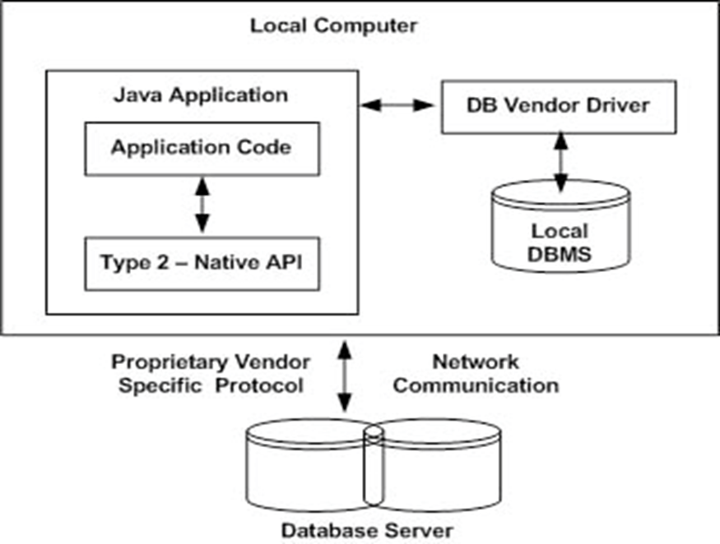

Type 2 Driver - JDBC-Native API
‹#›

Slide 21
Type 3 Driver - Net-Protocol All-Java
In a Type 3 driver, a three-tier approach is used to accessing databases. The JDBC clients use standard network sockets to communicate with an middleware application server. The socket information is then translated by the middleware application server into the call format required by the DBMS, and forwarded to the database server.
This kind of driver is extremely flexible, since it requires no code installed on the client and a single driver can actually provide access to multiple databases.
You can think of the application server as a JDBC "proxy," meaning that it makes calls for the client application. As a result, you need some knowledge of the application server's configuration in order to effectively use this driver type.
‹#›

Slide 22
Type 3 Driver - Net-Protocol All-Java
Advantages
Since the communication between client and the middleware server is database independent, there is no need for the vendor db library on the client machine. Also the client to middleware need'nt be changed for a new database.
The Middleware Server can provide typical middleware services like caching, load balancing, logging, auditing etc.
Can be used in internet since there is no client side software needed.
At client side a single driver can handle any database.
Disadvantages:
Requires database-specific coding to be done in the middle tier.
An extra layer added may result in a time-bottleneck. But typically this is overcome by providing efficient middleware services.
‹#›

Slide 23
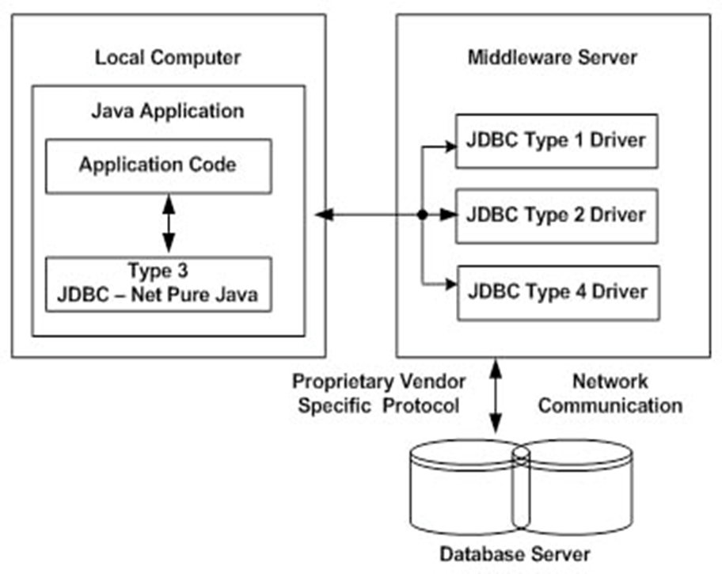
Type 3 Driver - Net-Protocol All-Java
‹#›

Slide 24
Type 4 Driver - Native Protocol Pure Java
In a Type 4 driver, a pure Java-based driver that communicates directly with vendor's database through socket connection. This is the highest performance driver available for the database and is usually provided by the vendor itself.
This kind of driver is extremely flexible, you don't need to install special software on the client or server. Further, these drivers can be downloaded dynamically.
Advantages:
These drivers don't translate the requests into db request to ODBC or pass it to client api for the db, nor do they need a middleware layer for request indirection. Thus the performance is considerably improved.
Disadvantages :
At client side, a separate driver is needed for each database.
‹#›

Slide 25
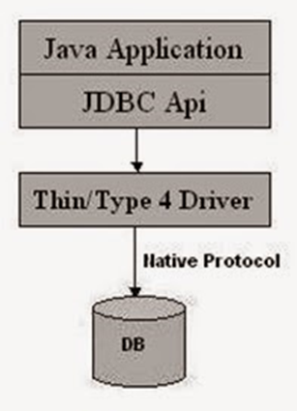
Type 4 Driver - Native Protocol Pure Java
‹#›

Slide 26
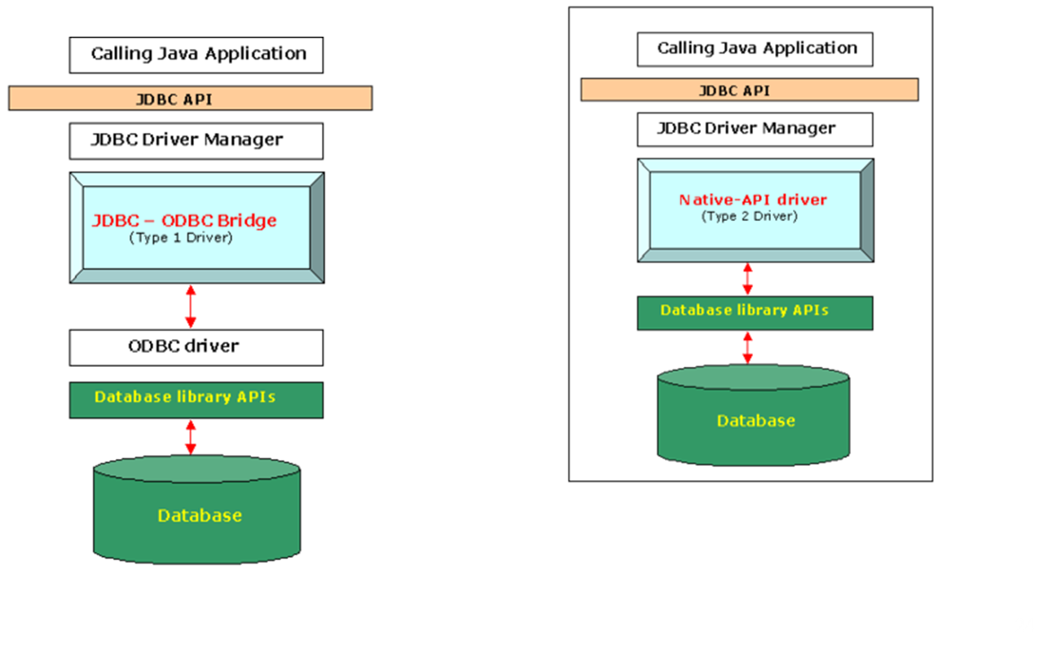

Slide 27
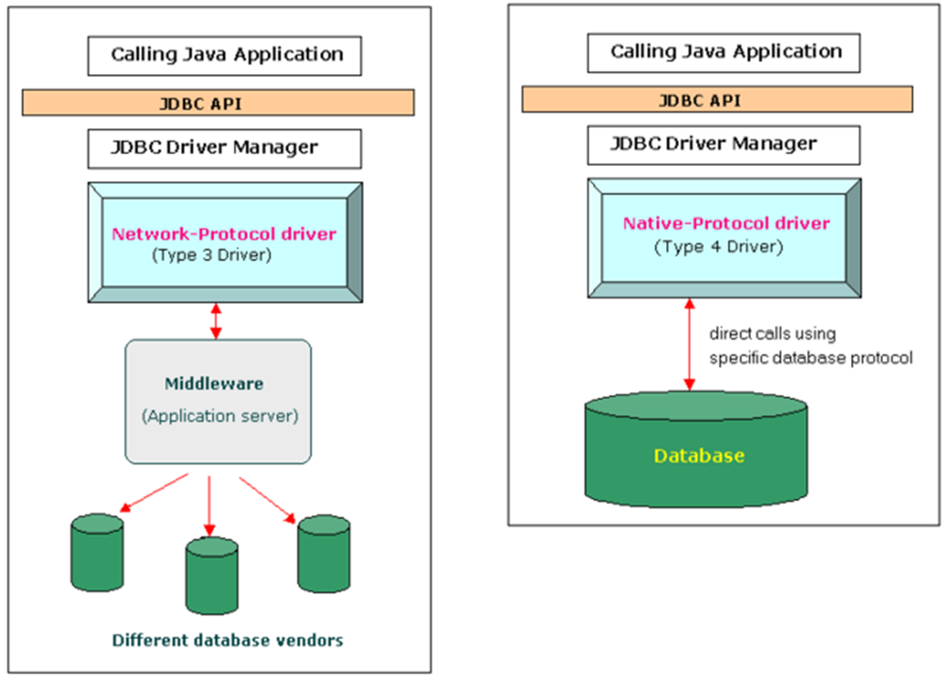

Slide 28
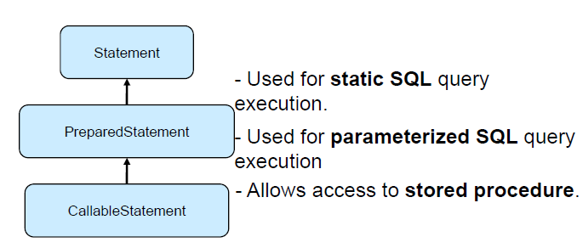
Statements in JDBC
Interfaces | Recommended Use
Statement | Use statement for general-purpose access to your database. Useful when you are using static SQLstatements at runtime. The Statement interface cannot accept parameters.
PreparedStatement | Use when you plan to use the SQL statements many times. The PreparedStatement interface accepts input parameters at runtime.
CallableStatement | Use when you want to access database stored procedures. The CallableStatement interface can also accept runtime input parameters.
‹#›

Slide 29
Statements in JDBC
Once a connection is obtained we can interact with the database.
The JDBC Statement, CallableStatement, and PreparedStatement interfaces define the methods and properties that enable you to send SQL or PL/SQL commands and receive data from your database.
They also define methods that help bridge data type differences between Java and SQL data types used in a database.
‹#›

Slide 30
Why Should We Use JDBC
Before JDBC, ODBC API was the database API to connect and execute the query with the database.
But, ODBC API uses ODBC driver which is written in C language (i.e. platform dependent and unsecured).
That is why Java has defined its own API (JDBC API) that uses JDBC drivers (written in Java language).

Slide 31
We can use JDBC API to handle database using Java program and can perform the following activities:
Connect to the database
Execute queries and update statements to the database
Retrieve the result received from the database.

Slide 32
How to make connect using JDBC?
Handling a connection requires following steps:
Load the driver
Open database connection
Close database connection

Slide 33
1) Load JDBC driver
The easiest way to do this is to use Class.forName() on the class that implements the java.sql.Driver interface.
With MySQL Connector, the name of this class is com.mysql.jdbc.Driver. With this method, you could use an external configuration file to supply the driver class name and driver parameters to use when connecting to a database.

Slide 34
Class.forName("com.mysql.jdbc.Driver");
As part of its initialization, the DriverManager class will attempt to load the driver classes referenced in the “jdbc.drivers” system property. This allows a user to customize the JDBC Drivers used by their applications.

Slide 35
2) Open database connection
After the driver has been registered with the Driver Manager, you can obtain a Connection instance that is connected to a particular database by calling
DriverManager.getConnection():
Connection connection = DriverManager.getConnection("jdbc:mysql://localhost:3306/db_name", "root", "password");
Once a Connection is established, it can be used to create Statement and Prepared Statement objects, as well as retrieve metadata about the database.

Slide 36
3) Close database connection
This step is as much important as opening a connection. Any connection left open is waste of resource and lead to various exceptions.
try
{
if(connection != null)
connection.close();
System.out.println("Connection closed !!");
} catch (SQLException e) {
e.printStackTrace();
}

Slide 37
import java.sql.Connection;
import java.sql.DriverManager;
import java.sql.SQLException;
public class ConnectionDemo {
public static void main(String[] argv) {
System.out.println("-------- MySQL JDBC Connection Example ------------");

Slide 38
try
{
Class.forName("com.mysql.jdbc.Driver");
}
catch (ClassNotFoundException e) {
System.out.println("MySQL JDBC Driver not found !!");
return;
}
System.out.println("MySQL JDBC Driver Registered!");

Slide 39
Connection connection = null;
try {
connection = DriverManager
.getConnection("jdbc:mysql://localhost:3306/Jdb_name", "root", "password");
System.out.println("SQL Connection to database established!");
} catch (SQLException e) {
System.out.println("Connection Failed! Check output console");
return;

Slide 40
} finally {
try
{
if(connection != null)
connection.close();
System.out.println("Connection closed !!");
} catch (SQLException e) {
e.printStackTrace();
}
}
}
}

Slide 41
Output:
-------- MySQL JDBC Connection Example ------------
MySQL JDBC Driver Registered!
SQL Connection to database established!
Connection closed !!

Slide 42
The statement interface is used to create SQL basic statements in Java it provides methods to execute queries with the database. There are different types of statements that are used in JDBC as follows:
Create Statement
Prepared Statement
Callable Statement

Slide 43
1. Create a Statement: From the connection interface, you can create the object for this interface. It is generally used for general–purpose access to databases and is useful while using static SQL statements at runtime.
Syntax:
Statement statement = connection.createStatement();

Slide 44
Implementation: Once the Statement object is created, there are three ways to execute it.
boolean execute(String SQL):
If the ResultSet object is retrieved, then it returns true else false is returned. Is used to execute SQL DDL statements or for dynamic SQL.
int executeUpdate(String SQL):
Returns number of rows that are affected by the execution of the statement, used when you need a number for INSERT, DELETE or UPDATE statements.
ResultSet executeQuery(String SQL):
Returns a ResultSet object. Used similarly as SELECT is used in SQL.
‹#›

Slide 45
2. Prepared Statement represents a recompiled SQL statement, that can be executed many times. This accepts parameterized SQL queries. In this, “?” is used instead of the parameter, one can pass the parameter dynamically by using the methods of PREPARED STATEMENT at run time.
Illustration:
Considering in the people database if there is a need to INSERT some values, SQL statements such as these are used:
INSERT INTO people VALUES ("Ayan",25);
INSERT INTO people VALUES("Kriya",32);

Slide 46
To do the same in Java, one may use Prepared Statements and set the values in the ? holders, setXXX() of a prepared statement is used as shown:
String query = "INSERT INTO people(name, age)VALUES(?, ?)";
Statement pstmt = con.prepareStatement(query);
pstmt.setString(1,"Ayan");
ptstmt.setInt(2,25);
// where pstmt is an object name

Slide 47
Implementation: Once the PreparedStatement object is created, there are three ways to execute it:
execute(): This returns a boolean value and executes a static SQL statement that is present in the prepared statement object.
executeQuery(): Returns a ResultSet from the current prepared statement.
executeUpdate(): Returns the number of rows affected by the DML statements such as INSERT, DELETE, and more that is present in the current Prepared Statement.

Slide 48
3. Callable Statement are stored procedures which are a group of statements that we compile in the database for some task, they are beneficial when we are dealing with multiple tables with complex scenario & rather than sending multiple queries to the database, we can send the required data to the stored procedure & lower the logic executed in the database server itself.
The Callable Statement interface provided by JDBC API helps in executing stored procedures.
Syntax: To prepare a CallableStatement
CallableStatement cstmt = con.prepareCall("{call Procedure_name(?, ?)}");

Slide 49
Implementation: Once the callable statement object is created
execute() is used to perform the execution of the statement.

Slide 50
Why DataSource interface is introduced
If a java program wants to obtain a connection with a database then there are two options for the java program
1. A java program can use DriverManager class of java.sql package to obtain a connection.
2. A java program can use DataSource interface of java.sql package to obtain a connection with a database.

Slide 51
The following are the major drawbacks of DriverManager class
1. DriverManager class takes atleast three or four seconds of time to open database connection in a network so it decreases the burden on or performance of java application.
2. To obtain a connection using DriverManager a programmer has to remember driver class name it's url and username, password so it increase the burden on a programmer.
3. DriverManager class opens a separate connection for each client so number of connections on database server will be increased so it's performance is decrease.
4. DriverManager opens non reusable connections with a database so it increase burden on database server.

Slide 52
Why connection pooling:
When we use driver manager or datasource the connection opened with a datasource is a non reusable. For each client if a new connection is opened then burden on database server will be increase so to reduce the burden on database server we use connection pooling.
What is connection pooling:
Connection pooling is a mechanism which makes a database connection as a reusable for more than one client so burden on a database server will be reduced. A connection pooling makes database connections as reusable. A connection pool contains set of pooled connections(reusable connections).

Slide 53
How connection pooling works:
1. A server administrator prepares a connection pool with a setoff connections and also a mediator object as DataSource object to access the pool.
2. An administrator stores DataSource object into JNDI registry (java naming directory interface) .
3. A java application reads DataSource object from JNDI registry and asks for a connection from a pool.
4. A DataSource object takes a connection from a pool and creates a proxy or logical connection do it and then sends the proxy connection to java program.
5. When a java program closes proxy connection the DataSource will done real connection back to the pool.

Slide 54
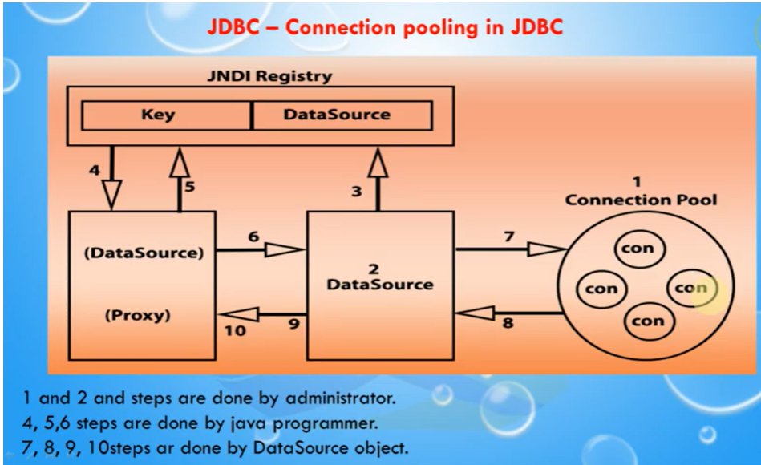

Slide 55
Thank You !!!

