Slide 1
Multithreading
*
‹#›

Slide 2
Multitasking
Multitasking allows several activities to occur concurrently on the computer.
1)Process-based Multitasking
2)Thread-based Multitasking
‹#›

Slide 3
Process- based multitasking
Many processes done simultaneously.
Program is a set of instructions and a “A process is a running instance of a program. “.
Here the CPU is shared between different processes.
E.g. A MS-Word application & MS-Excel application windows opened simultaneously or in general any two applications running simultaneously is Process- based multitasking.
‹#›

Slide 4
Multi processing
The OS provides you with a mechanism called CONTEXT SWITCHING which enables it to switch from process to process.
Here what happens is a program’s entire context (including variables, global variables, functions etc..) are stored separately.
Therefore if one program is running, it is as if other programs aren’t existing at all, because they reside in their own contexts.
‹#›

Slide 5
Thread based multitasking
Different tasks within a task done simultaneously.
Extend the idea of multitasking by taking it one level lower.
Individual programs appear to do multiple tasks at the same time.
Each sub task is called Thread.
Think of each thread running in a separate context - that is, each thread has its own CPU -with registers, memory & own code.
‹#›

Slide 6
Thread
A thread is an entity within a process.
You can say, “A thread within a process executes”.
E.g.
Lets take a typical application like Word. There are various independent processes going on, like showing GUI, saving into file, typing in text.
In your java program main() is a thread & garbage collector is another thread.
‹#›

Slide 7
Process & Thread
Each process has a complete set of its own variables.
It takes more overhead to launch a process
Inter-process communication is slower and restrictive.
Threads may share same data.
It takes much less overhead to create & destroy thread.
Communication between threads is easier.
‹#›

Slide 8
Scheduling of process/thread
Scheduling is decided by OS.
Scheduling algorithm’s basically classified as:
Preemptive scheduling
OS interrupts programs without consulting them eg : win 95,win NT
Non-preemptive scheduling
programs interrupted only when they are ready to yield control. Eg : Sun Solaris, Win 3.1
‹#›

Slide 9
Multithreading In Context With Java
Java supports multithreading.
But Java is platform dependent as far as multithreading goes.
JVM is running on top of OS.
Thus, multithreading capability is totally dependent on what scheduling algorithm is followed by the underlying OS !!
Thus inconsistent behavior is observed in multithreaded programs.
‹#›

Slide 10
Multithreading In Context With Java
Java has a class Thread
It’s a part of java.lang package
Constructors of Thread class –
public Thread()
public Thread(Runnable target)
public Thread(ThreadGroup group, String name)
public Thread(Runnable target, String name)
‹#›

Slide 11
Life Cycle Of Thread
Methods of Thread class –
run() : must be overridden; code should be added which executes in thread.
start() : brings the thread into ready to run condition. When CPU is available for this thread, invokes the run().
stop() : Forces the thread to stop executing.
sleep() : A static method, puts currently executing thread to sleep for specified no. of milliseconds.
‹#›

Slide 12
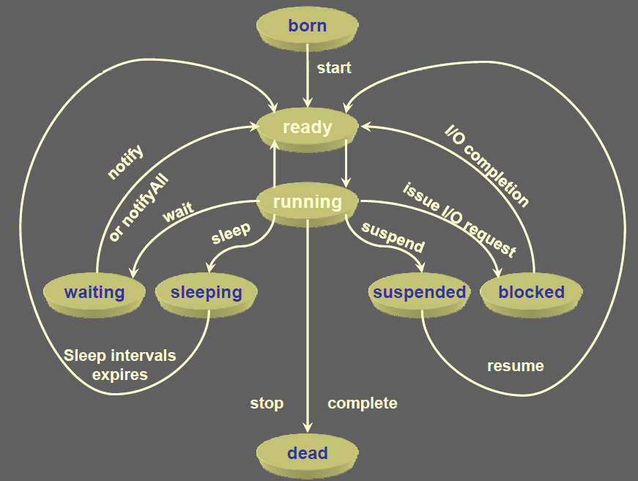
‹#›

Slide 13
Multithreading
class Demo extends Thread{
String word;
public Demo (String w){
word = w;
}
public void run(){
try{
for( ;; ){
System.out .println(word);
Thread.sleep( 1000);
}
}catch(Exception e){System.out.println(e);}
}
‹#›

Slide 14
Multithreading
public static void main(String args[])
{
Thread t1 = new Demo(“Pass”);
t1.start();
Thread t2 = new Demo(“fail”);
t2.start();
}
}
‹#›

Slide 15
Thread Priorities
Thread priorities are used by thread scheduler to decide when each thread should be allowed to run.
At any given time, when multiple threads are ready to be executed, the runtime system chooses the runnable thread with the highest priority for execution.
Priorities are integer values from 1 (lowest priority given by the constant Thread.MIN_PRIORITY) to 10 (highest priority given by the constant Thread.MAX_PRIORITY). The default priority is 5(Thread.NORM_PRIORITY).
‹#›

Slide 16
Thread Priorities
Constant | Description
Thread.MIN_PRIORITY | The maximum priority of any thread (an int value of 10)
Thread.MAX_PRIORITY | The minimum priority of any thread (an int value of 1)
Thread.NORM_PRIORITY | The normal priority of any thread (an int value of 5)
The methods that are used to set the priority of thread shown as:
Method | Description
setPriority() | This is method is used to set the priority of thread.
getPriority() | This method is used to get the priority of thread.
‹#›

Slide 17
Thread Priorities
In Java runtime system, preemptive scheduling algorithm is applied.
If at the execution time a thread with a higher priority and all other threads are runnable then the runtime system chooses the new higher priority thread for execution.
On the other hand, if two threads of the same priority are waiting to be executed by the CPU then the round-robin algorithm is applied in which the scheduler chooses one of them to run according to their round of time-slice.
‹#›

Slide 18
Thread Priorities
In the implementation of threading scheduler usually applies one of the two following strategies:
Preemptive scheduling ? If the new thread has a higher priority then current running thread leaves the runnable state and higher priority thread enter to the runnable state.
Time-Sliced (Round-Robin) Scheduling ? A running thread is allowed to be execute for the fixed time, after completion the time, current thread indicates to the another thread to enter it in the runnable state.
‹#›

Slide 19
currentThread()
static native Thread currentThread() - returns a reference to current thread.
Can be used in run() method to check which thread is currently executing
Eg :
public void run(){
if (Thread.currentThread( ) == t1 )
{
// do something}
}
‹#›

Slide 20
Runnable Interface
In Java a class can extend only one class.
What if we want multithreading support for a class that is already derived from some other class?
Eg class MyFrame extends Frame
Solution ? Runnable interface.
Implementing this gives the ability to treat the new class as a Runnable object.
‹#›

Slide 21
Multithreading
class Demo implements Runnable{
String word;
public Demo(String w){
word = w;
}
public void run(){
try{
for( ;; ){
System.out .println(word);
Thread.sleep( 1000);
}
}catch(Exception e){System.out.println(e);}
}
‹#›

Slide 22
Multithreading
public static void main(String args[])
{
Runnable d1 = new Demo(“Hi”);
Runnable d2 = new Demo(“Hello”);
new Thread( d1 ).start();
new Thread( d2 ).start();
}
}
‹#›

Slide 23
Thread Synchronization
When two or more threads need access to a shared resource, they need some way to ensure that the resource will be used by only one thread at a time. The process by which this is achieved is called synchronization.
Key to synchronization is the concept of the monitor (also called a semaphore).
A monitor is an object that is used as a mutually exclusive lock, or mutex.
Only one thread can own a monitor at a given time. When a thread acquires a lock, it is said to have entered the monitor.
‹#›

Slide 24
Thread Synchronization
All other threads attempting to enter the locked monitor will be suspended until the first thread exits the monitor. These other threads are said to be waiting for the monitor.
‹#›

Slide 25
Using Synchronized Methods
To enter an object’s monitor, just call a method that has been modified with the synchronized keyword.
While a thread is inside a synchronized method, all other threads that try to call it (or any other synchronized method) on the same instance have to wait.
While creating synchronized methods within classes that you create is an easy and effective means of achieving synchronization, it will not work in all cases.
Imagine that you want to synchronize access to objects of a class that was not designed for multithreaded access. That is, the class does not use synchronized methods.
‹#›

Slide 26
Thread Synchronization
Thus, you can’t add synchronized to the appropriate methods within the class.
How can access to an object of this class be synchronized?
Fortunately, the solution to this problem is quite easy: You simply put calls to the methods defined by this class inside a synchronized block.
This is the general form of the synchronized statement:
synchronized(object){ // statements to be synchronized }
Here, object is a reference to the object being synchronized.
‹#›

Slide 27
Inter-thread Communication
Threads also provide a secondary benefit: they do away with polling.
Polling is usually implemented by a loop that is used to check some condition repeatedly. Once the condition is true, appropriate action is taken. This wastes CPU time.
‹#›

Slide 28
Inter-thread Communication
For example, consider the classic queuing problem, where one thread is producing some data and another is consuming it.
To make the problem more interesting, suppose that the producer has to wait until the consumer is finished before it generates more data.
In a polling system, the consumer would waste many CPU cycles while it waited for the producer to produce.
Once the producer was finished, it would start polling, wasting more CPU cycles waiting for the consumer to finish.
‹#›

Slide 29
Inter-thread Communication
Clearly, this situation is undesirable. To avoid polling, Java includes an elegant interprocess communication mechanism via the wait( ), notify( ), and notifyAll( ) methods.
These methods are implemented as final methods in Object, so all classes have them. All three methods can be called only from within a synchronized context.
‹#›

Slide 30
Rules for using wait(), notify() and notifyAll():
wait( ) tells the calling thread to give up the monitor and go to sleep until some other thread enters the same monitor and calls notify( ).
notify( ) wakes up the first thread that called wait( ) on the same object.
notifyAll( ) wakes up all the threads that called wait( ) on the same object. The highest priority thread will run first.
‹#›

