Slide 1
Servlets

Slide 2
Static content
Web Server delivers contents of a file (html)
2. Web Server reads file from disk
1. Browser sends request to Web Server
Web Server
browser
3. Web Server sends HTML to Browser
Notes:
Browser sents request to Web Server, Web Server reads file from Disk and returns HTML to Browser. Browser renders HTML.

Slide 3
Why Build Web Pages Dynamically?
The Web page is based on data submitted by the user
  E.g., results page from search engines and order-confirmation pages at on-line stores
The Web page is derived from data that changes frequently
  E.g., a weather report or news headlines page
The Web page uses information from databases or other server-side sources
  E.g., an e-commerce site could use a servlet to build a Web page that lists the current price and availability of each item that is for sale.

Slide 4
Dynamic Content
Initially, Common Gateway Interface (CGI) scripts were used to generate dynamic content.
Although widely used, CGI scripting technology has a number of shortcomings, including platform dependence and lack of scalability.
To address these limitations, Java servlet technology was created as a portable way to provide dynamic, user-oriented content.

Slide 5
Dynamic Content
CGI(Common Gateway Interface)program generates HTML that is returned to Browser
2. Web Server loads CGI program from disk
1. Browser sends request to Web Server
Web Server
browser
3. Web Server starts CGI program
CGI Program
5. Web Server sends HTML to Browser
4. CGI program generates and returns HTML
Server
User Computer
Notes:
CGI written in Perl, ‘C’, many others
Web Server can deliver and accept data via Forms
CGI program can access external data sources, databases, etc.

Slide 6
Server-Side Java
Big applets require long download time
Applets do not have access to all the system resources
Server-side Java solves problems that applets face
  Code executed on the server side and only the results sent to client
  Servlets can access legacy applications and data sources

Slide 7
Java Servlet
Servlets are generic extensions to Java-enabled servers
Servlets are secure, portable, and easy to use replacement for CGI
Servlet is a dynamically loaded module that services requests from a Web server
Servlets are executed within the Java Virtual Machine
Because the servlet is running on the server side, it does not depend on browser compatibility

Slide 8
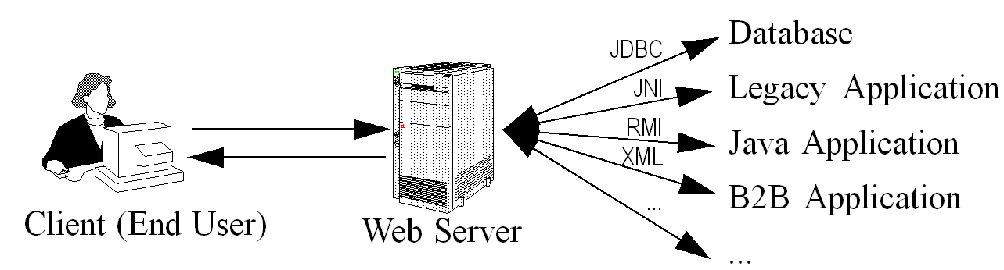
A Servlet’s Job
Read explicit data sent by client (form data)
Read implicit data sent by client
(request headers)
Generate the results
Send the explicit data back to client (HTML)
Send the implicit data to client
(status codes and response headers)

Slide 9
Execution of Java Servlet
Web
Browser
Web
Server
Request
Servlet
Response
Applications of Java Servlets
  Building e-commerce store fronts
    Servlet builds an online catalog based on the contents of a database
    Customer places an order, which is processed by another servlet
  Servlets as wrappers for legacy systems
  Servlets interacting with EJB applications

Slide 10
Advantages of Servlets
Efficiency
  More efficient – uses lightweight java threads as opposed to individual processes
Persistency
  Servlets remain in memory
  Servlets can maintain state between requests
Portability
  Since servlets are written in Java, they are platform independent
Robustness
  Error handling, Garbage collector to prevent problems with memory leaks
  Large class library – network, file, database, distributed object components, security, etc.

Slide 11
Advantages of Servlets
Extensibility
  Creating new subclasses that suite your needs
    Inheritance, polymorphism, etc.
Security
  Security provided by the server as well as the Java Security Manager
  Eliminates problems associated with executing cgi scripts using operating system “shells”
Powerful
  Servlets can directly talk to web server
  Facilitates database connection pooling, session tracking etc.
Convenient
  Parsing and decoding HTML form data, reading and setting HTTP headers, handling cookies, etc.

Slide 12
Java Servlets
The functionality of servlets are:
Receive client request (mostly in the form of HTTP request)
Extract the information from the request
Do content generation or business logic processing (possibly by computing, accessing database, invoking EJBs, and so on)
Create and send responses to clients (mostly in the form of HTTP response) or forward the request to another servlet.

Slide 13
Java Servlet Diagram
3. Servlet Engine runs the servlet
1. Browser sends request to Web Server
Servlet Container
2. Web Server sends request to Servlet Engine
Web Server
Servlet
browser
6. Web Server sends HTML to Browser
Servlet
DB
Servlet
jdbc
5. Servlet generates and returns HTML
4. Servlet can access database
Notes:
- Servlet is loaded either when first requested or optionally when the Servlet Engine is started
- Servlet Container initializes servlet by calling it’s init method
- Web Server receives incoming request and passes it to the Servlet Container
- Servlet Container passes the request to the servlet
- (passes both a Request and a Response object)
- The servlet processes the request and returns the result(HTML)
- The Web Server send the result to the client.
- When shut down, the Servlet Container calls the servlet destroy method
- In our environment the Web Server does authentication via LDAP.
- Can use SSL(https) between Browser and Web Server to encrypt data

Slide 14
Simple Servlet : HelloWorld
public class HelloWorld extends HttpServlet {
public void doGet( HttpServletRequest request,
HttpServletResponse response)
throws ServletException, IOException {
response. setContentType(" text/ html");
PrintWriter out = response. getWriter();
out. println( "< HTML>" );
out. println( "< HEAD>< TITLE> Hello World</ TITLE></ HEAD>”);
out. println( "< BODY>”);
out. println( "< H1> Hello World</ H1>”);
out. println( "</ BODY></ HTML>");
}
}
Notes:
- receives request and response objects.
- indicates what kind of data it’s going to send via the response object
- obtains a PrintWriter object named out from the response object method named getWriter.
- uses the println method of the out object to send html back.

Slide 15
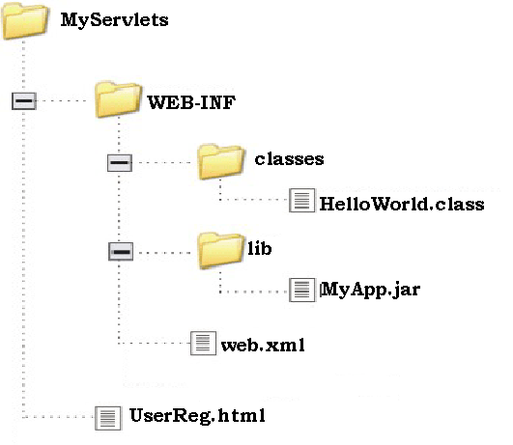
Steps for Running a Servlet:
(Assuming that JDK is already installed with PATH environment variable properly set.)
Download and Install the tomcat server
  Set the path of the servlet-api.jar file in the variable CLASSPATH inside the environment variable.
Create a java source file and a web.xml file in a directory structure.

Slide 16
Steps for Running a Servlet:
Run Tomcat Server
  Go to C:\Program Files\Apache Software Foundation\Tomcat 6.0\bin and double click on tomcat6
  OR
  Go to Start->Programs->Apache Tomcat 6.0 -> Monitor Tomcat. You will notice an icon appear on the right side of your Status Bar. Right click on this icon and click on Start service.
  Open your Browser (e.g. MS Internet Explorer) and type the following URL :
  http://localhost/ (If you have changed to port # to 80)
  OR
  Open your Browser (e.g. MS Internet Explorer) and type the following URL :
  http://localhost:8080/ (If you have NOT changed the default port #)

Slide 17
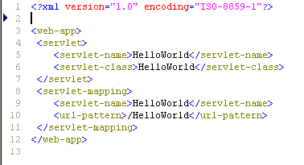
Steps for Running a Servlet:
Compile your Servlet. (e.g. javac HelloWorld.java)
Copy the class file (e.g. HelloWorld.class) to the classes folder
Edit web.xml to include servlets name and url pattern
Execute your servlet
http://localhost:8080/MyServlets/HelloWorld

Slide 18
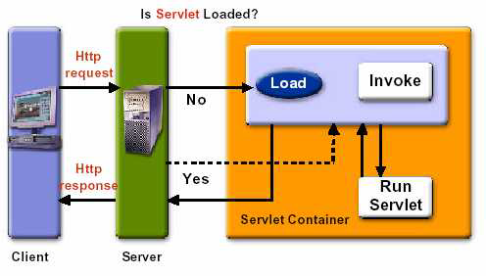
Calling a servlet
When a request is mapped to the servlet, the container:
Looks for the instance of the servlet class.
If it does not exists, container loads the servlet class and instantiates it.
Initializes the servlet class by calling the init method.
Invokes the service method when the servlet needs to be removed the container.
Terminates the servlet by calling the destroy method.

Slide 19
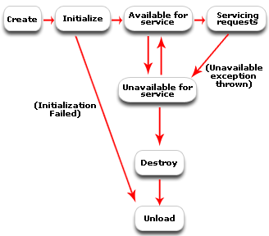
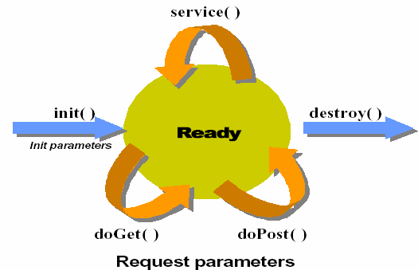
Servlet Life Cycle
The life cycle of a servlet can be categorized into four parts:
Loading and Instantiation
Initialization
Servicing the Request
Destroying the Servlet

Slide 20
Servlet Life Cycle
Loading and Instantiation
  The servlet container loads the servlet during startup or when the first request is made.
  The loading of the servlet depends on the attribute <load-on-startup> of web.xml file. If the attribute <load-on-startup> has a positive value then the servlet is loaded at the time container is loaded otherwise it is loaded when the first request comes for service. After loading of the servlet, the container creates the instances of the servlet.
Initialization
  After creating the instances, the servlet container calls the init() method and passes the servlet initialization parameters to the init() method.
  The init() must be called by the servlet container before the servlet can service any request.
  The initialization parameters persist until the servlet is destroyed.
  The init() method is called only once throughout the life cycle of the servlet.

Slide 21
Servlet Life Cycle
Servicing the Request
  After successfully completing the initialization process, the servlet will be available for service. Servlet creates seperate threads for each request.
  The servlet container calls the service() method for servicing any request. The service() method determines the kind of request and calls the appropriate method (doGet() or doPost()) for handling the request and sends response to the client using the methods of the response object.
Destroying the Servlet
  If the servlet is no longer needed for servicing any request, the servlet container calls the destroy() method .
  Like the init() method this method is also called only once throughout the life cycle of the servlet.

Slide 22
Servlet Life Cycle
  Calling the destroy() method indicates to the servlet container not to send any request for service and the servlet releases all the resources associated with it.
  Java Virtual Machine claims for the memory associated with the resources for garbage collection.

Slide 23
Servlet Life Cycle Summary
init
  Executed once when the servlet is first loaded.
  Not called for each request.
service
  Called in a new thread by server for each request. Dispatches to doGet, doPost, etc.
  Do not override this method!
doGet, doPost, doXxx
  Handles GET, POST, etc. requests.
  Override these to provide desired behavior.
destroy
  Called when server deletes servlet instance.
  Not called after each request.

Slide 24
Java Servlet Architecture
Two packages make up the servlet architecture
  javax.servlet
    Contains generic interfaces and classes that are implemented and extended by all servlets
  javax.servlet.http
    Contains classes that are extended when creating HTTP-specific servlets
The heart of servlet architecture is the interface class javax.servlet.Servlet
It provides the framework for all servlets
Defines five basic methods – init, service, destroy, getServletConfig() and getServletInfo()

Slide 25
Object model of Servlet Framework
<<Interface>>
javax.servlet.Servlet
<<Interface>>
javax.io.Serializable
<<Interface>>
javax.servlet.ServletConfig
init( )
getServletConfig( )
service( )
getServletInfo( )
destroy( )
getInitParameter( )
getServletContext( )
getInitParameterNames( )
getServletName( )
javax.servlet.GenericServlet
init( )
getServletConfig( )
service( )
getServletInfo( )
destroy( )
getInitParameter( )
getServletContext( )
getInitParameterNames( )
getServletName( )
log( )
javax.servlet.http.HttpServlet
doDelete( )
doGet( )
doOptions( )
doPost( )
doPut( )
doTrace( )
getLastModified( )
service( )
Basic Servlet

Slide 26
GenericServlet & HttpServlet
GenericServlet is protocol independent servlet. It supports for HTTP, FTP and SMTP protocols.
GenericServlet.service() method has been defined as an abstract method
The two objects that the service() method receives are ServletRequest and ServletResponse
ServletRequest Object
  Holds information that is being sent to the servlet
ServletResponse Object
  Holds data that is being sent back to the client
HttpServlet class is extended from GenericServlet class.
HttpServlet is protocol dependent servlet and only supports Http protocols
Unlike the GenericServlet, when extending HttpServlet, don’t have to implement the service() method. It is already implemented for you.
When HttpServlet.service( ) is invoked, it calls doGet( ) or doPost( ), depending upon how data is sent from the client
HttpServletRequest and HttpServletResponse classes are just extensions of ServletRequest and ServletResponse with HTTP-specific information stored in them.

Slide 27
Why You Should Not Override service
You can add support for other services later by adding doPut, doTrace, etc.
You can add support for modification dates by adding a getLastModified method
The service method gives you automatic support for:
  HEAD requests
  OPTIONS requests
  TRACE requests
Alternative: have doPost call doGet

Slide 28
Session Tracking
Session tracking is the capability of a server to maintain the current state of a single client’s sequential requests. The HTTP protocol used by Web servers is stateless. This means that every transaction is autonomous (each request=new request, connect→send request→get response→close connection). This type of stateless transaction is not a problem unless you need to know the sequence of actions a client has performed while at your site.
In session management, when the client makes first request for any servlet/ or page, the container generates a unique session ID and gives it back to the client along with the response. This ID gets stores on the client machine.
Thereafter when the client again sends a request to the server, it also sends the session Id with the request. There the container sees the Id and sends back the request.
Session Tracking can be done in three ways:
  Hidden Form Fields
  URL Rewriting
  Cookies

Slide 29
Session Management
Hidden Form Fields:
  This is one of the way to support the session tracking.
  Hidden fields are not viewed by the user on the web page but they are sent back to the server (in request object) when the form is submitted.
  In hidden form fields the html entry will be like this:
  <input type=“hidden” name=“jsessionid” value=“00988988”>.
  This means that when you submit the form, the specified name and value will be get included in get or post method.
  In this session ID information would be embedded within the form as a hidden field and submitted with the Http POST command.

Slide 30
Session Management
URL Rewriting
  This is another way to support the session tracking. URL rewriting can be used in place where we don't want to use cookies.
  E.g. http://mywebsite.com?jsessionid=00988988
  Use the following methods of the doXXX response object to rewrite URLs:
    String encodeURL(String url)
      Use for HTML hyperlinks
    String encodeRedirectURL(String url)
      Use for HTTP redirections
  These methods contain the logic to determine whether the session ID needs to be encoded in the URL
  For example, if the request has a cookie, then url is returned unchanged
  Some servers implement the two methods identically

Slide 31
Session Management
Cookies:
  When cookie based session management is used, a token is generated which contains user's information, is sent to the browser by the server with every request.
  By this cookie, the server is able to identify the user. In this way the session is maintained.
  Cookie is nothing but a name- value pair, which is stored on the client machine. By default the cookie is implemented in most of the browsers.
  Cookies are not a security threat but they can be privacy threat.
  You can disable cookies if required.

Slide 32
Cookie Class
The cookie class provides an easy way for servlet to read, create, and manipulate HTTP-style cookies, which allows servlets to store small amount of data.
Cookies are small bits of textual information that a Web server sends to a browser and that the browser returns unchanged when visiting the same Web site.
The Servlet API includes a Cookie class to wrap up the contents of a cookie plus a few attributes.
You can set the age of cookie by setMaxAge() method.
  Probably the most commonly-set attribute is the maximum life span of the cookie. This is set via the setMaxAge() method, which takes an integer value in seconds.
  So to make a cookie expire after 30 minutes (a possible value for the timeout of a 'session'), we could call: ck.setMaxAge(30 * 60);

Slide 33
Cookie Class
The class javax.servlet.http.Cookie represents a cookie
  Getter methods:
    getName(), getValue(), getPath(), getDomain(), getMaxAge(), getSecure()…
  Setter methods:
    setValue(), setPath(), setDomain(), setMaxAge()…
  Get the cookies from the service request:
Cookie[] HttpServletRequest.getCookies()
  Add a cookie to the service response:
  HttpServletResponse.addCookie(Cookie cookie)

Slide 34
HttpSession
Web containers provide an implementation of this interface to provide session tracking.
Session objects can be retrieved from the HttpRequest object also provided by the container.
HttpSession session = request.getSession();
If a session object does not exist for the client, one will be created.
The duration of this session object can be configured in the web.xml file or in a servlet, setMaxInactiveInterval( int interval );

