Slide 1

SRS Document of makemoney.com
By System86

Slide 2
Presented by
Name | Id
ALIMUL MAHFUZ TUSHAR | 19-39831-1
EHSANUZZAMAN SHAWON | 19-39823-1
JIHAD SHAHARIAR JOY | 19-40068-1
AHMED, MD. KAUSHIQ | 18-37891-2
REYA, RUBINA ISLAM | 19-39811-1

Slide 3
Outline
What is an SRS?
Purpose of SRS
Content of SRS
Introduction
Overall description
External interface requirements
System features
Others non-functional requirements
Other requirements

Slide 4
What is an SRS?
A software requirement specification (SRS) is a document that outlines the functions and performance standards for the software.
It also outlines the functionality the product needs to have in order to meet the needs of both business and user stakeholders.

Slide 5
Purpose of SRS
SRS used to be familiar with all the specifications for creating software, which helped in software design.
SRS used to be familiar with all the specifications for creating software, which aided in the process of designing the software.
SRS used to be familiar with all the specifications for creating software and was able to assist in its design.

Slide 6
Content of SRS (1/2)
Introduction
Purpose
Document Convention
Intended Audience and Reading suggestion
Product Scope
References
Definitions, acronyms and abbreviation
Overall description
Product perspective
product function
User classes and characteristic
Operating environment
design and implementation
User Documentation
Assumption and dependences

Slide 7
Content of SRS (2/2)
External interface requirements
User interfaces
Hardware interfaces
Software interfaces
Communications Interfaces
System features
Others non-functional requirements
Performance Requirements
Safety Requirements
Security Requirements
Software Quality Attributes
Business Rules
Other requirements

Slide 8
Introduction (1/2)
Purpose
To enable consumers to search for the products they need from a single interface, we wish to build responsive software. Additionally, give owners and borrowers who wish to rent or buy their products a simple interface.
Document Convention
In this section how the document is written the convention like font size, font family, margin and layout are discussed here.
Intended Audience and Reading suggestion
User group
Tester
Marketing manager
Project manager

Slide 9
Introduction (2/2)
Product Scope
Product scope identifies the characteristics and functions of a product or service
References
Definitions, acronyms and abbreviation

Slide 10
Overall Description (1/2)
Product perspective
Is the system being follow up or completely new product or not and is this will going to replace any existing system.
Product function
Overall high-level function of the product
User registration
Login,
Profile management
User class and characteristics
Customer
Renter
Admin

Slide 11
Overall Description (2/2)
Operating environment
What is be the software operating environment such as OS version or system version
Design and implementation and constraints.
Corporate or regulatory policies how the system will develop. What hardware limitations or software can occur.
User documentation
Assumption and dependencies
How the system is related to third-party software or libraries.

Slide 12
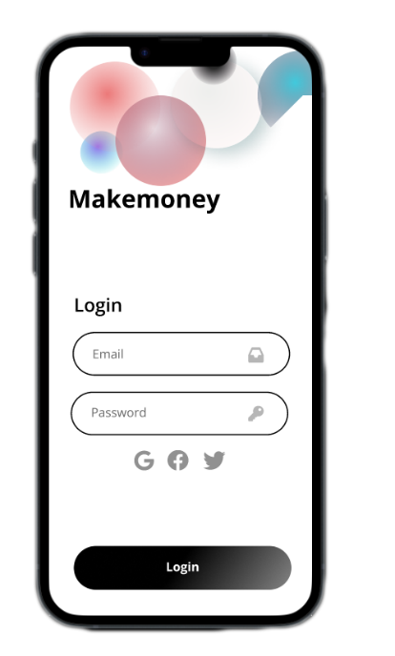
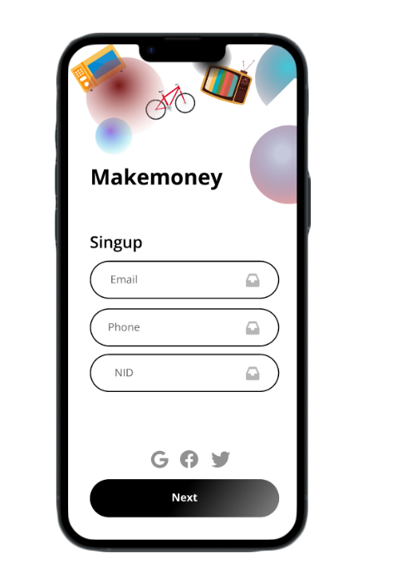
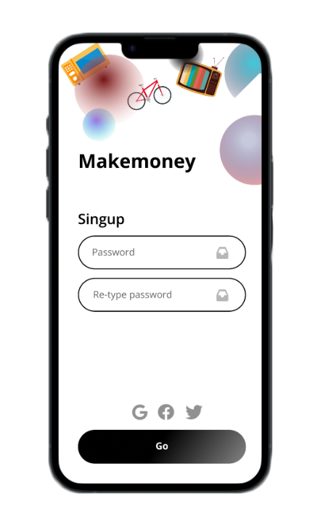
External interface requirements (1/2)
User interfaces
UI will support both English and Bengali
How the GUI will look like.

Slide 13
External interface requirements (2/2)
Hardware interface.
CPU
Camera
Sensors (GPS, Proximity)
Software interface
Supported Operation system, server operating system
Communication interface.
How the system will communicate throughout the system or other external system.

Slide 14
System Features (1/2)
Authentication and Authorization (User Registration and Login)
Users are authenticated by registration and authorized by login.
Both has high priority of 8 in a 1 to 9 scale
Search
Users finds specific items through this feature
Medium priority of 5 in a 1 to 9 scale
Profile Management
Users manages and updates their profile information through this feature.
High priority of 8 in a 1 to 9 scale
Upload Product Information
Users who want to provide rent, can upload the item's information with pictures.
As a core feature, this has the highest priority of 9 in a 1 to 9 scale

Slide 15
System Features (2/2)
Renting a Product
To rent an item, this feature is necessary.
Like 'Uploading Product Information' this also has highest priority of 9 in a 1 to 9 scale
Payments
Another core feature is payment, which is used to pay for the rented items.
Highest priority of 9 in a 1 to 9 scale
Admin Control Panel
Admin manages, monitors, and controls the whole system through here.
From adding staff to banning a user, from viewing logistics to revenue everything admin can do through his dashboard
This feature for admin has a high priority of 8 in a 1 to 9 scale

Slide 16
Other nonfunctional requirements (1/2)
Performance Requirements
The system should always load in less than 0.01 seconds.
Safety Requirement
Users of the system shouldn't be harmed by it.
Important information should also be kept in hard copy.
Security Requirement
Private and crucial information relating to clients and staff must be stirred in encrypted form.
A current version of the software for systems and stakeholders must be utilized.

Slide 17
Other nonfunctional requirements (2/2)
Software Quality Attributes
The software should be user-friendly.
Software should have used easy interfaces.
Business Rules
Existing business policies should be maintained properly.
Shouldn’t keep any kind of feature which can be harmful in the future.

Slide 18
Other Requirements (1/3)
Database Requirement
Object Oriented Approach
Appendix A: Glossary
All the term that is necessary to explain the SRS is defined here. Including API, HTTP, HTTPS, SMTP, TDP, MFS, CRUD, OTP, NID, RAM, ROM, UI, IOS, CPU, GPS, GPU, SDK, and JDK.
Appendix B: Analysis Model
A state diagram has been drawn here to express the scenario.

Slide 19
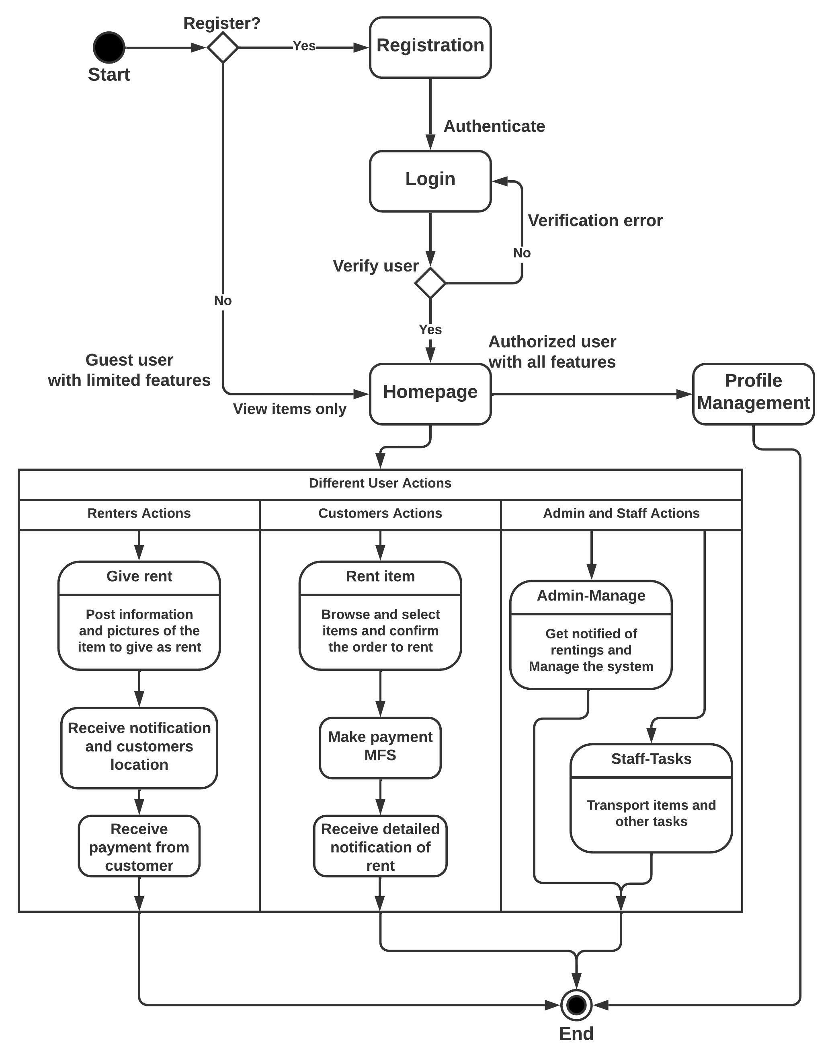
Other Requirements (2/3)

Slide 20
Other Requirements (3/3)
Appendix C: To be Determined List
Here Product Backlog is given. If any adjustments needed to be made, any form of clarification that will be necessary is given in this part of the SRS.

Slide 21
Other nonfunctional requirements (1/2)
Performance Requirements
Safety Requirement
Security Requirement

Slide 22
THANK YOU

