Slide 1
SE801 · MIDTERM PRESENTATION · AUGUST 2026
MIT OCMS
Rule-Driven Academic Enrollment,
Result & Financial Management Platform
Manage course enrollment, grades, CGPA, and fees online.
PRESENTED BY
SUPERVISED BY
Md. Jihad Hossain
Dr. Md. Nurul Ahad Tawhid
BSSE-1413
Professor, IIT, DU
Notes:
Title slide. Introduce the project: a SaaS platform that detects microservice anomalies with ML and auto-remediates them inside the tenant's own Kubernetes cluster.

Slide 2
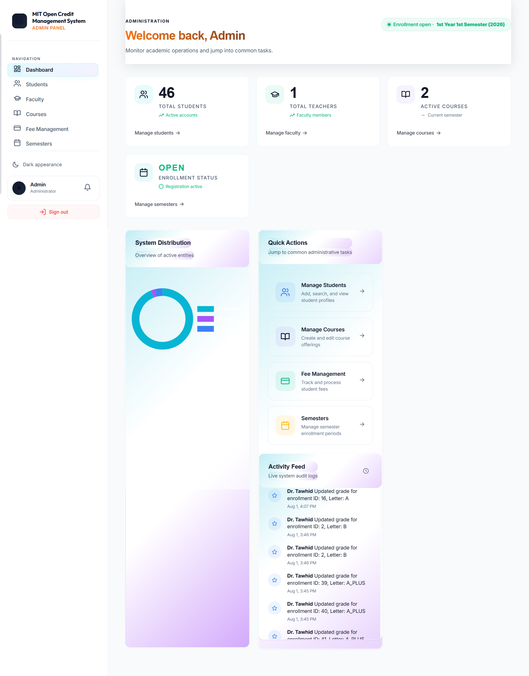
Admin Portal
Notes:
Frame the problem, then the three-part solution: in-cluster agent, hosted classifier, agent-side remediation. Objectives O1-O6 come straight from SRS Section 1.3.

Slide 3
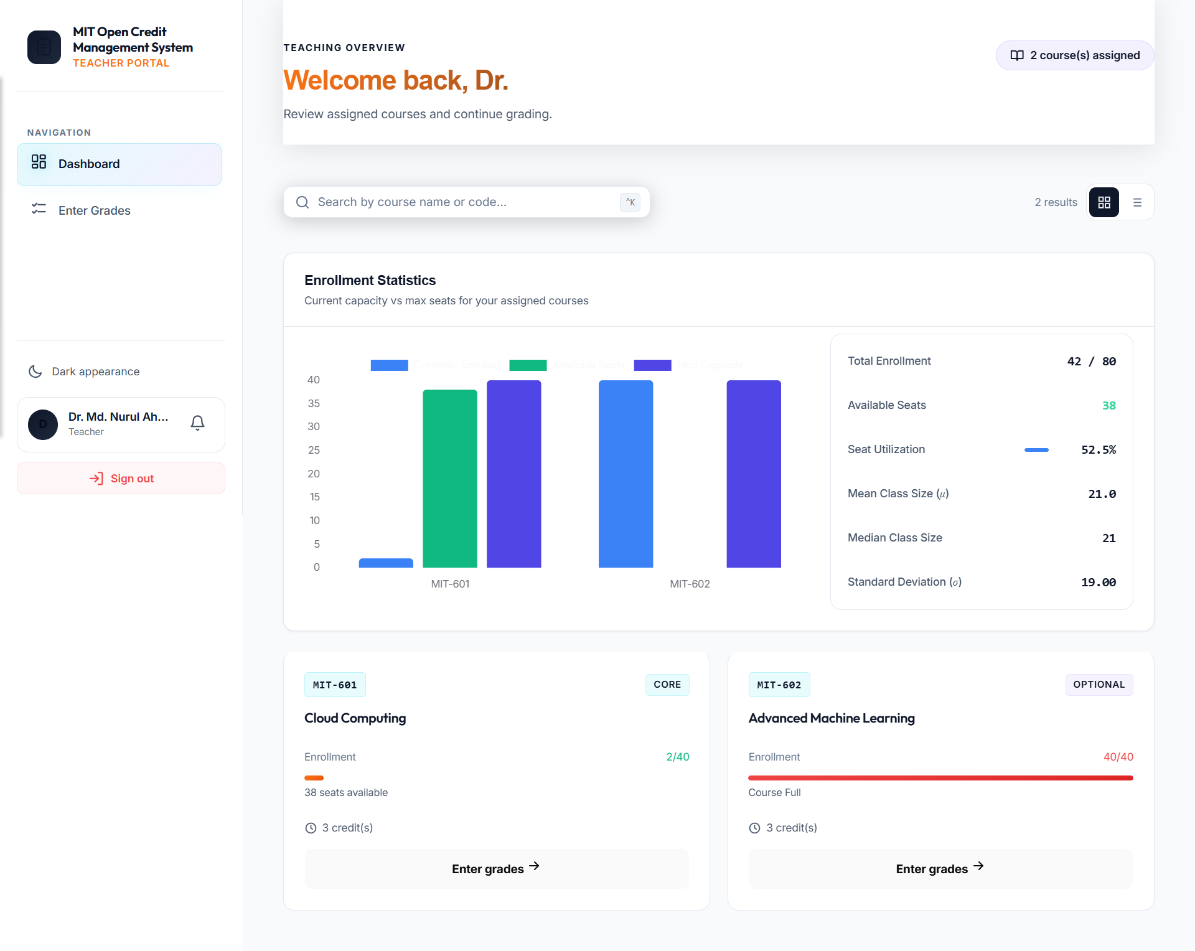
Teacher Portal
Notes:
Walk the requirements quickly — highlight FR-8 (classification) and FR-10 (autonomous remediation) as the differentiating ones.

Slide 4
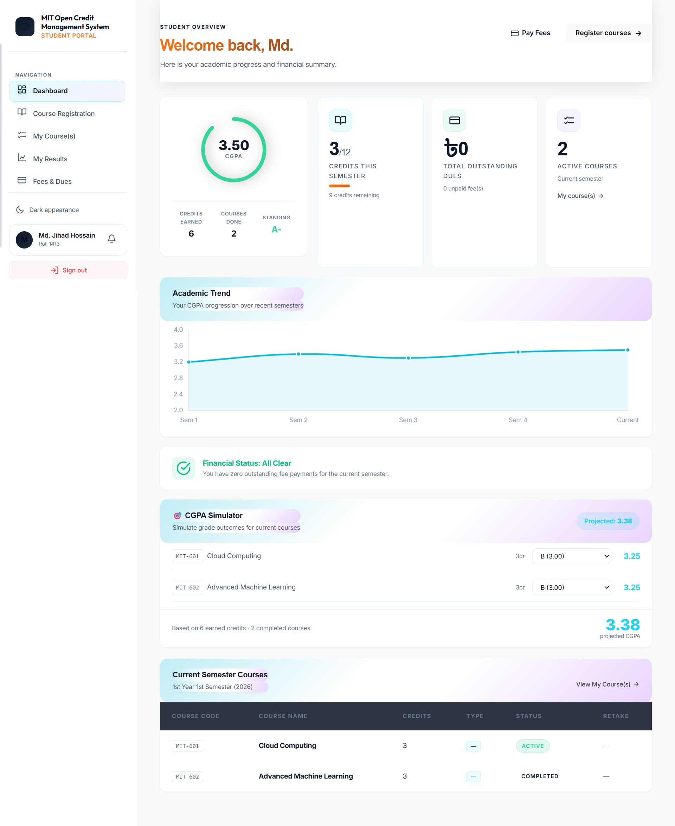
Student Portal
Notes:
Walk the requirements quickly — highlight FR-8 (classification) and FR-10 (autonomous remediation) as the differentiating ones.

Slide 5
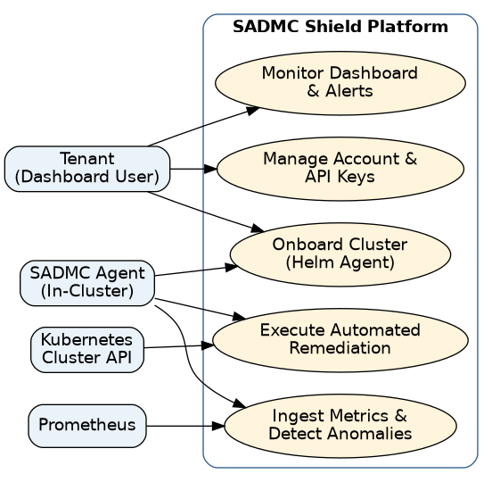
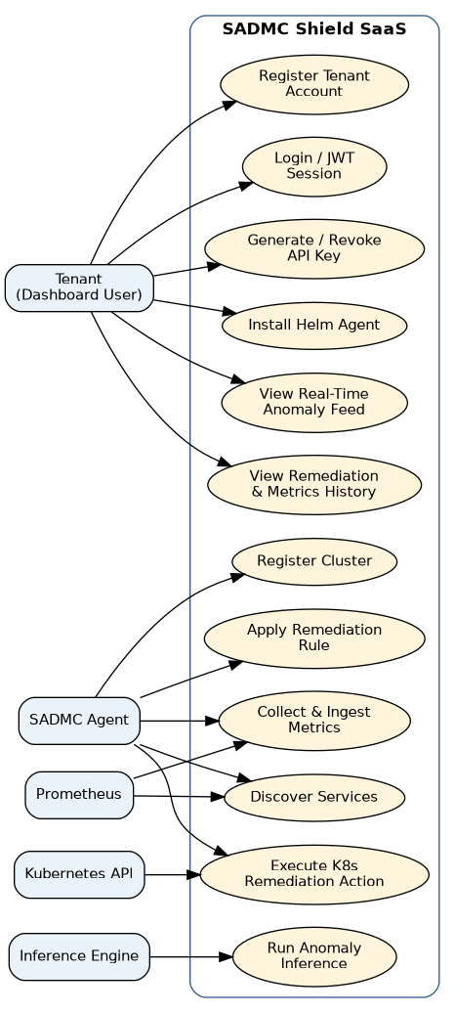
Thank You
MIT OCMS · Midterm Presentation
Notes:
Level 0 shows the actor-to-bubble view: Tenant, SADMC Agent, Prometheus and the Kubernetes API against the platform. Level 1 expands each bubble into the concrete use cases, adding the Inference Engine as the actor behind classification.

