Slide 1


SE801 · SOFTWARE PROJECT LAB 3
MIT Open Credit
Management System
Presented by
MD. Jihad Hossain
BSSE Roll No.: 1413 · Session: 2021–22
Rule-Driven Academic Enrollment, Result & Financial Management Platform
Supervised by
Dr. Md. Nurul Ahad Tawhid
Associate Professor
Institute of Information Technology
University of Dhaka
02-08-2026
A concise, image-backed presentation following the supplied 1407 deck style, final SRS, and UI/model screenshots.

Slide 2
PRESENTATION MAP
How the deck is organized
From academic problem to rule-driven implementation and visual proof.
01
02
03
04
05
Project need
Core requirements
Architecture
System models
Prototype evidence
Manual enrollment, seat control, results and dues create ambiguity.
Student, Teacher and Admin workflows with secure RBAC.
Angular frontend, Spring Boot backend and PostgreSQL persistence.
Use case and activity modelling from the SRS.
All supplied UI screenshots are shown in the exact given order.
MIT Open Credit Management System · SE801 SPL3
02

Slide 3
PROJECT OVERVIEW
The academic management gap
MIT OCMS turns open-credit operations into traceable, validated workflows.
!
Current pain points
✓
MIT OCMS response
• Manual semester course selection creates mistakes
• Optional seats can be overbooked without strict capacity control
• Teacher marks, results and CGPA need consistent academic processing
• Retake and semester-gap fees require transparent calculation
• Students need one reliable place for courses, results and dues
• Role-secured portal for Student, Teacher and Admin
• Rule-driven enrollment and credit validation
• Seat-aware course registration and monitoring
• Teacher grade-entry workspace
• Results, GPA/CGPA and finance visibility
• Dashboard evidence for presentation and viva
MIT Open Credit Management System · SE801 SPL3
03

Slide 4
SYSTEM OBJECTIVES
Six goals that drive the design
Objectives are aligned with the final SRS: access, rules, results, finance and maintainability.
1
O1 — Secure Access
2
O2 — Credit Control
3
O3 — Seat Control
JWT authentication and role-based frontend/backend access.
Exact 12-credit target and 36-credit programme tracking.
40-seat optional capacity and clear utilization views.
4
O4 — Academic Results
5
O5 — Finance
6
O6 — Usability
Teacher marks, grades, GPA and CGPA visibility.
Retake/gap fees, payments and outstanding dues.
Clean dashboards and maintainable Angular/Spring structure.
MIT Open Credit Management System · SE801 SPL3
04

Slide 5
ACTORS & SCOPE
Three role portals, one validated academic core
Use-case diagrams use Student, Teacher and Admin as principal actors.
S
T
A
Student
Teacher
Admin
Registers courses, views enrollments, results, CGPA, dues and financial status.
Views assigned courses, loads roster, enters midterm/final marks and reviews grade data.
Manages students, teachers, courses, semesters, fees and system monitoring.
Role-isolated access
Role-isolated access
Role-isolated access
MIT Open Credit Management System · SE801 SPL3
05

Slide 6
ACADEMIC RULE ENGINE
Rules that make the project more than CRUD
The browser can assist, but backend services and PostgreSQL must remain the final authority.
12
Semester credits
36
Programme credits
40
Optional seat cap
Target exact 12-credit package validation with all-or-nothing persistence.
Progress toward full MIT credit completion.
Prevent overflow and show real-time seat pressure.
JWT
Secure access
GPA
Result engine
৳
Finance engine
Signed access token and role-protected portal routing.
Marks become grades, GPA, CGPA and academic history.
Retake/gap fees, payment records and dues visibility.
MIT Open Credit Management System · SE801 SPL3
06

Slide 7
SOFTWARE ARCHITECTURE
Angular → Spring Boot → PostgreSQL
A production-minded modular monolith that keeps business rules on the server.
1
Frontend Layer
Angular 18 + TypeScript
Role dashboards · guards · forms · UI state
2
Backend Layer
Spring Boot 3.3 + Java 21
Controllers · services · validation · JWT/RBAC
3
Data Layer
PostgreSQL 16 + Flyway V1–V7
Entities · constraints · migrations · reports
Student
Teacher
Admin
Enrollment · Results · Dues
Assigned Courses · Marks
Academic · Finance Control
MIT Open Credit Management System · SE801 SPL3
07

Slide 8
REQUIREMENTS & TRACEABILITY
What the evaluation can verify
The SRS connects features to actors, APIs, data, tests and presentation evidence.
FR
Functional core
NFR
Quality attributes
✓
Evidence shown
• Authentication and RBAC
• Course registration
• Teacher marks entry
• Results / CGPA
• Fee and dues management
• Admin monitoring
• Security
• Accuracy
• Transaction safety
• Maintainability
• Usability
• Testability
• UI screenshots
• Use-case diagram
• Activity diagram
• Architecture view
• Testing plan
• Timeline and next tasks
MIT Open Credit Management System · SE801 SPL3
08

Slide 9
VISUAL EVIDENCE
Prototype Screens
& System Models
The following slides keep every supplied image in the exact uploaded order. Each image is placed inside a dedicated frame and fitted without stretching or overflowing the slide.
16 dedicated image slides
09

Slide 10
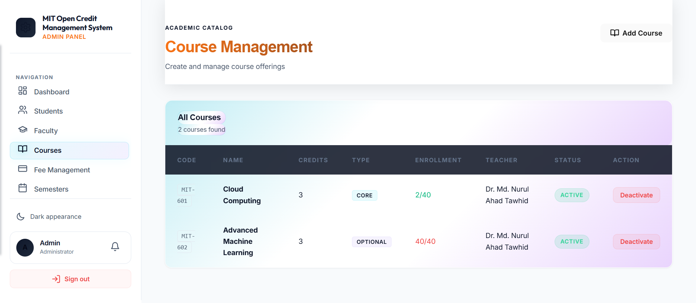
VISUAL EVIDENCE · IMAGE 01
Admin Course Management
ADMIN PANEL
Create and manage offerings, seat counts, teacher assignment and active/deactivate state.
10

Slide 11
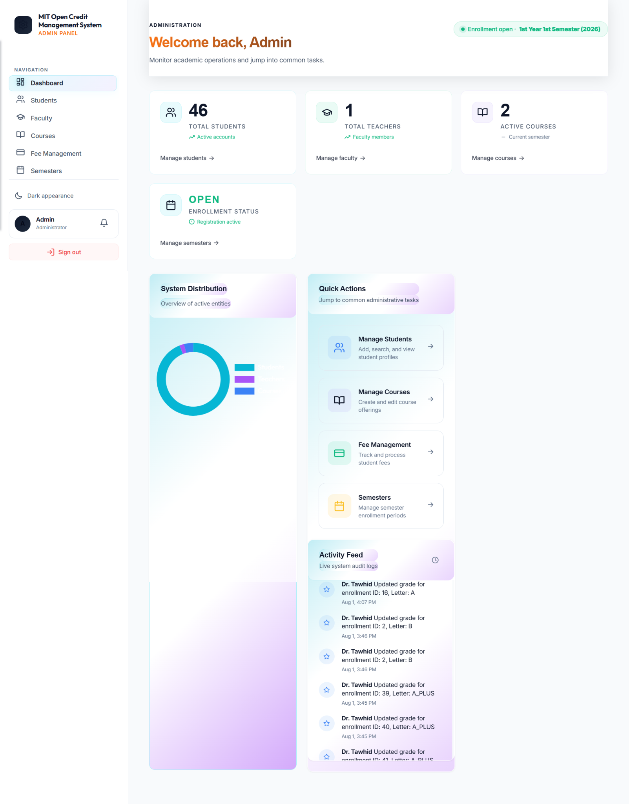
VISUAL EVIDENCE · IMAGE 02
Admin Operations Dashboard
ADMIN PANEL
Total students, teachers, courses, enrollment status, quick actions and activity feed.
11

Slide 12
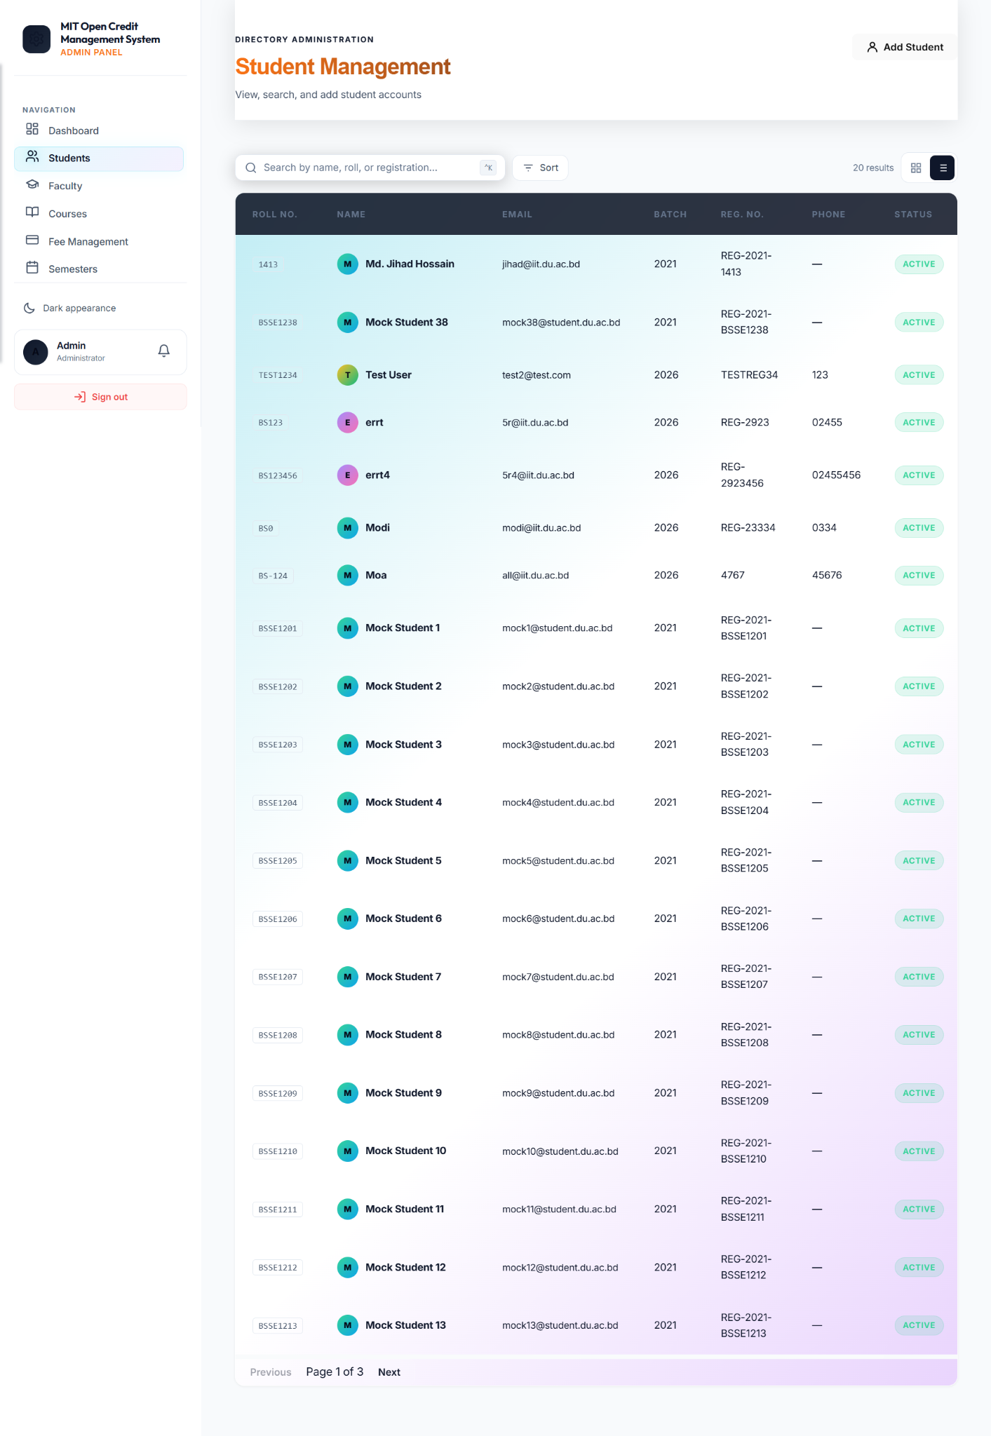
VISUAL EVIDENCE · IMAGE 03
Student Management Directory
ADMIN PANEL
Searchable student list with roll, registration, batch, phone and account status.
12

Slide 13
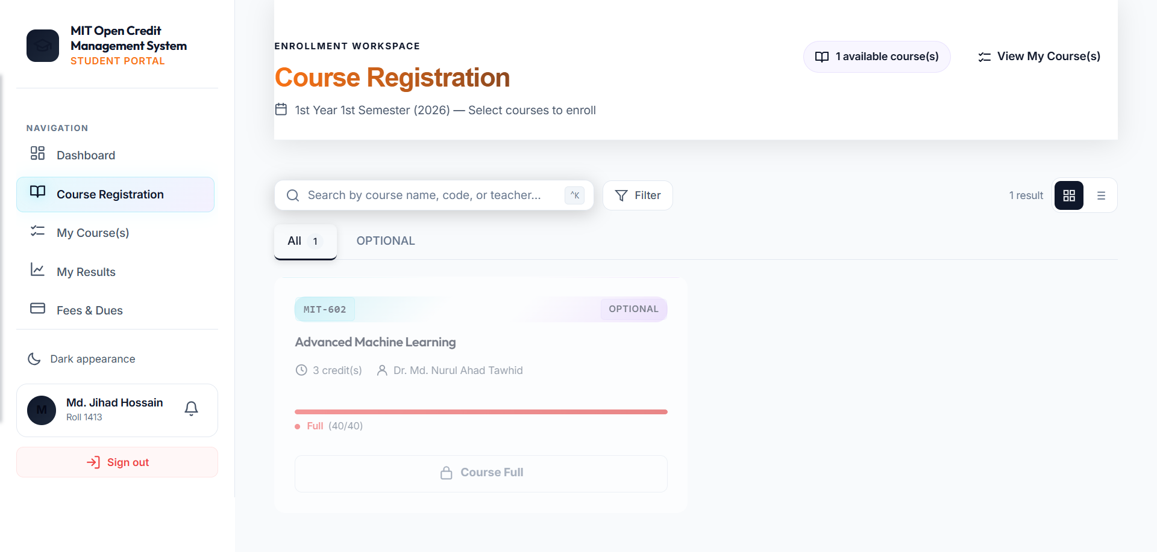
VISUAL EVIDENCE · IMAGE 04
Student Course Registration
STUDENT PORTAL
Course selection workspace with filter, seat status, and blocked state for full courses.
13

Slide 14
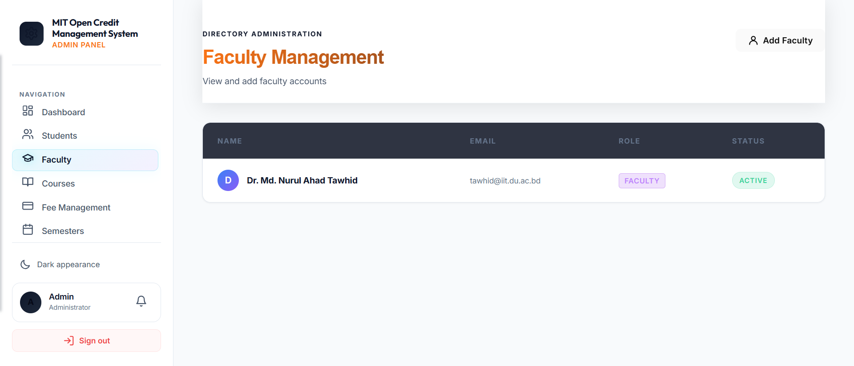
VISUAL EVIDENCE · IMAGE 05
Faculty Management
ADMIN PANEL
Teacher account listing and status management from the administrator workspace.
14

Slide 15
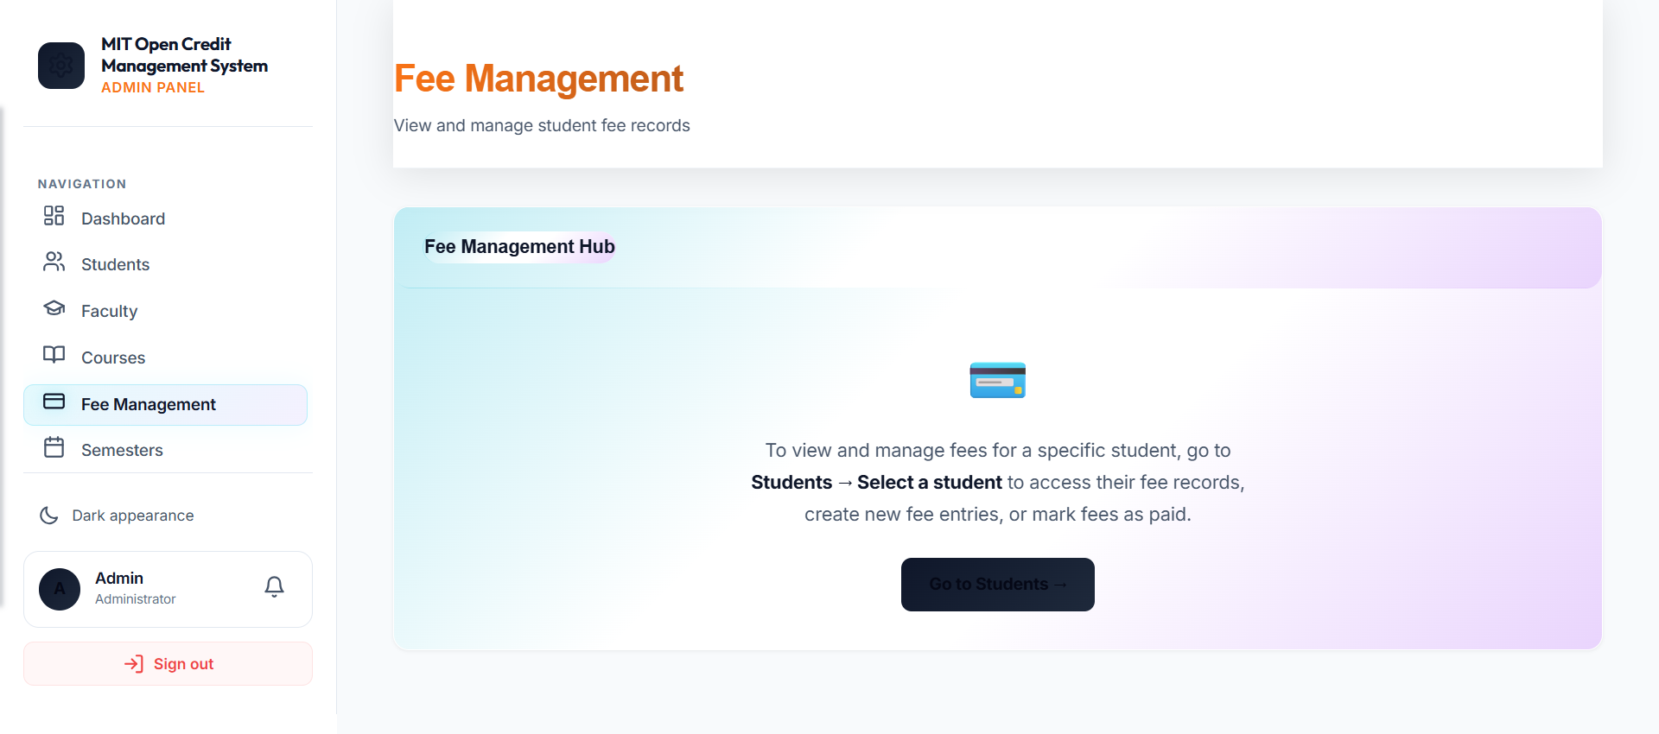
VISUAL EVIDENCE · IMAGE 06
Admin Fee Management Hub
ADMIN PANEL
Fee workflow routes from student selection to fee creation, update and payment actions.
15

Slide 16
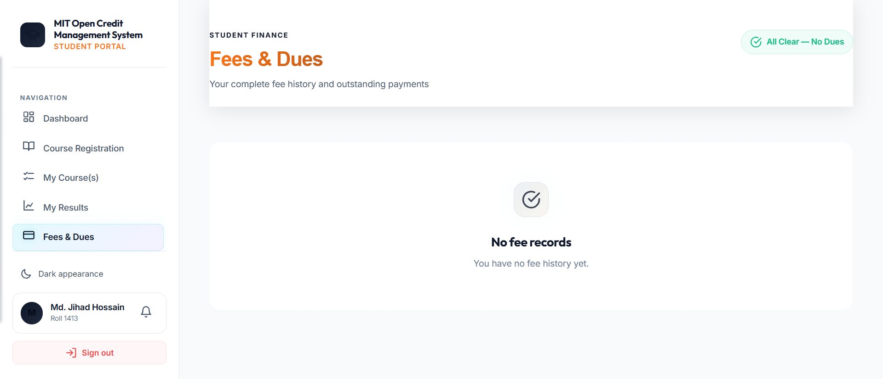
VISUAL EVIDENCE · IMAGE 07
Student Fees & Dues
STUDENT PORTAL
Student-facing finance view that displays fee history and outstanding dues status.
16

Slide 17
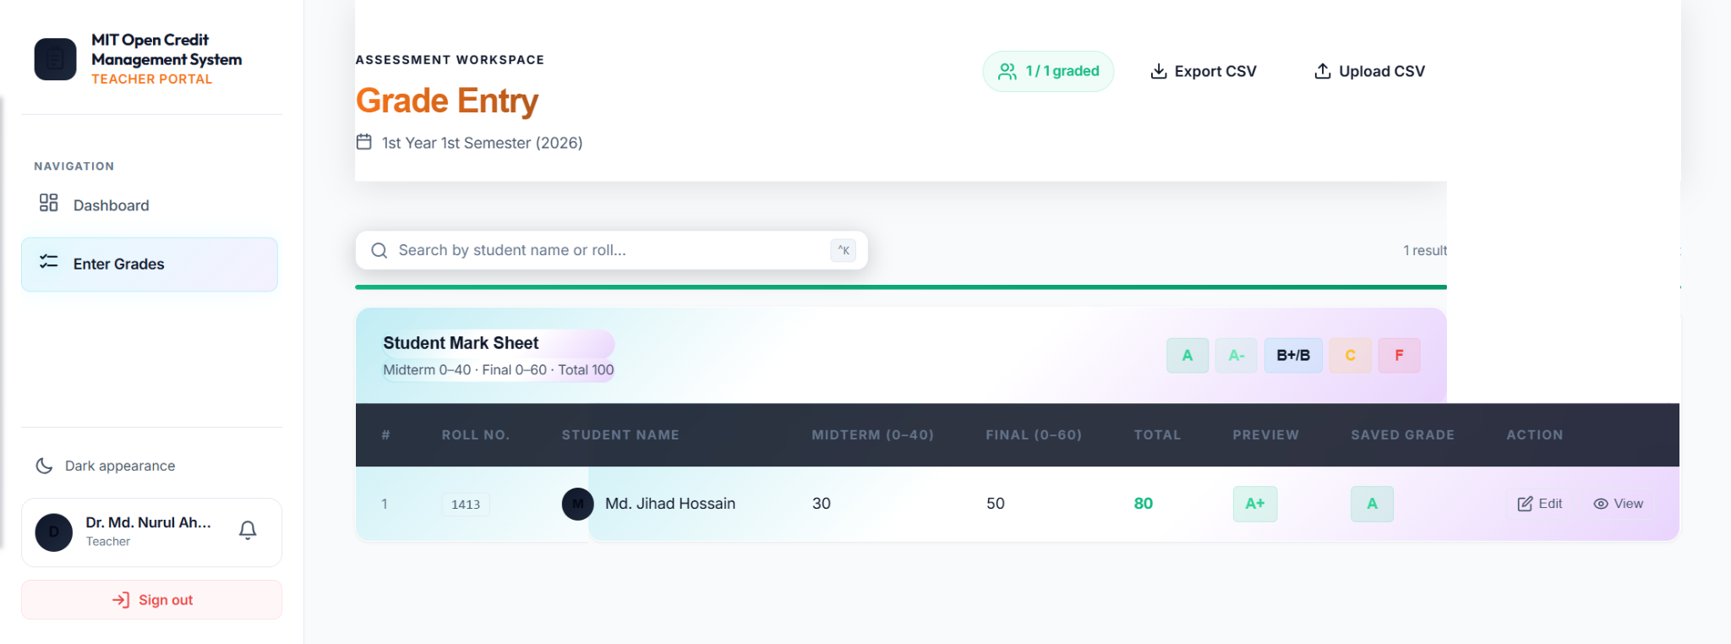
VISUAL EVIDENCE · IMAGE 08
Teacher Grade Entry
TEACHER PORTAL
Assessment workspace with midterm, final, total, preview and saved grade evidence.
17

Slide 18
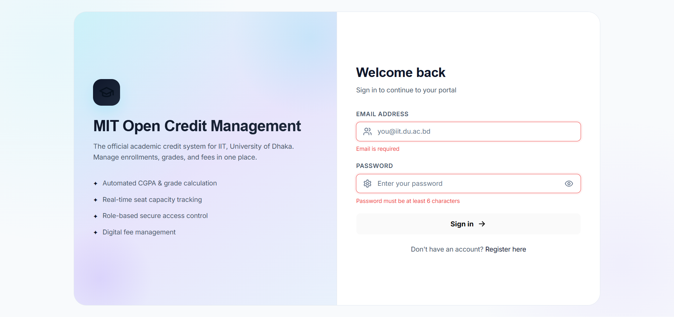
VISUAL EVIDENCE · IMAGE 09
Secure Login Experience
AUTHENTICATION
A role-based entrance with validation, academic system message and secure access intent.
18

Slide 19
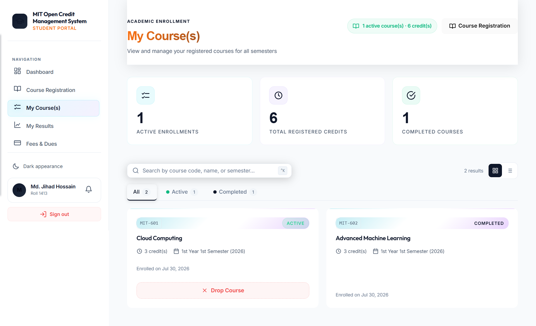
VISUAL EVIDENCE · IMAGE 10
Student My Course(s)
STUDENT PORTAL
Registered courses, active/completed states, credit totals and drop-course action.
19

Slide 20
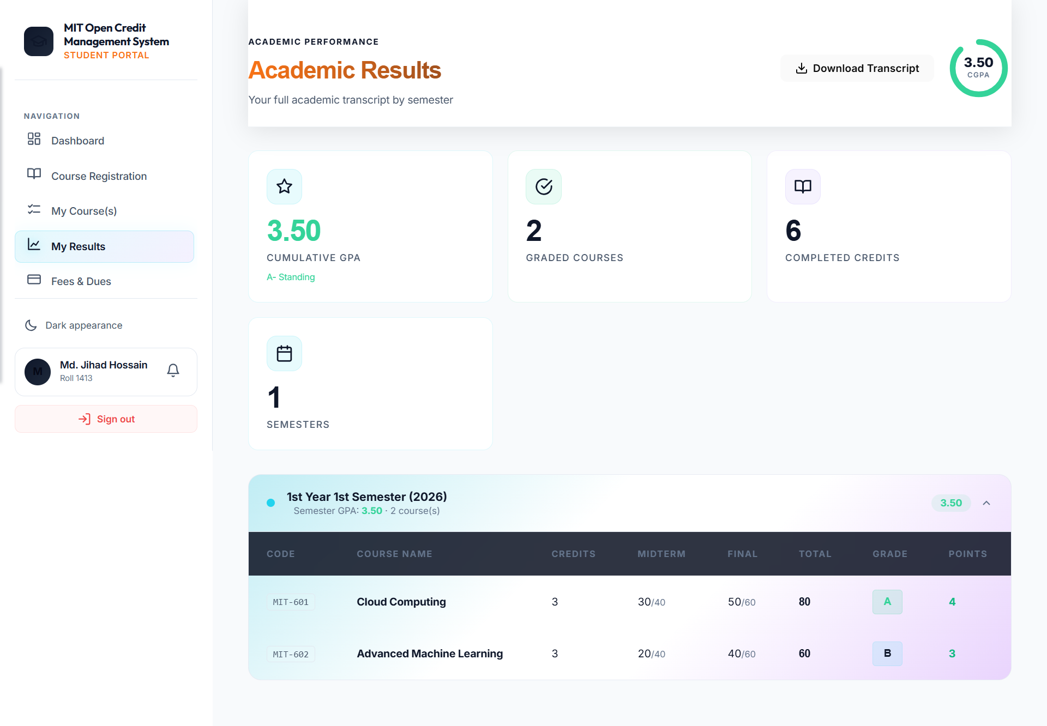
VISUAL EVIDENCE · IMAGE 11
Academic Results
STUDENT PORTAL
CGPA, graded courses, completed credits and semester-wise result table.
20

Slide 21
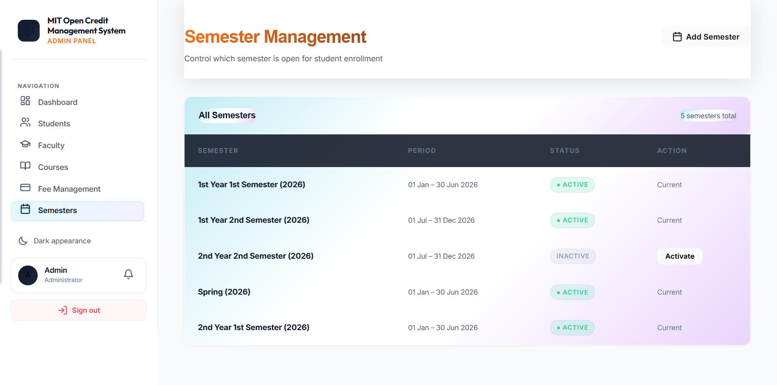
VISUAL EVIDENCE · IMAGE 12
Semester Management
ADMIN PANEL
Enrollment windows, active semester status, period definitions and activation controls.
21

Slide 22
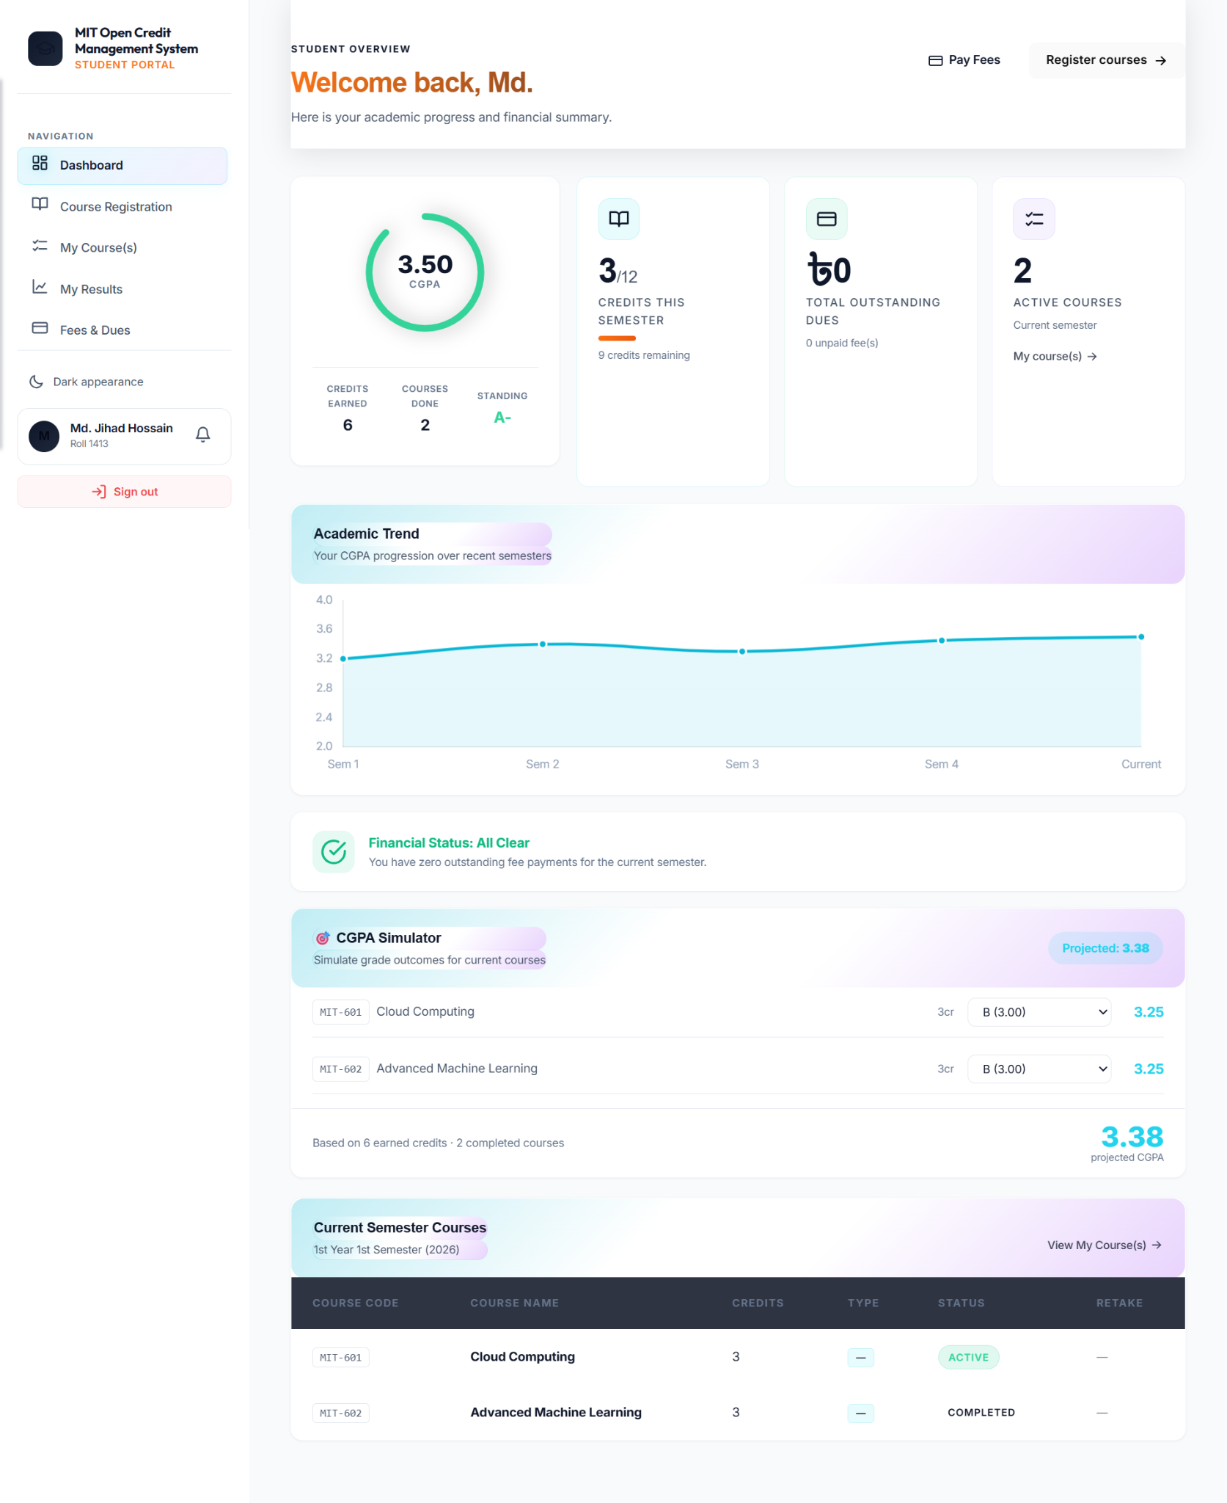
VISUAL EVIDENCE · IMAGE 13
Student Dashboard
STUDENT PORTAL
CGPA card, credit progress, dues, trend, simulator and current semester courses.
22

Slide 23
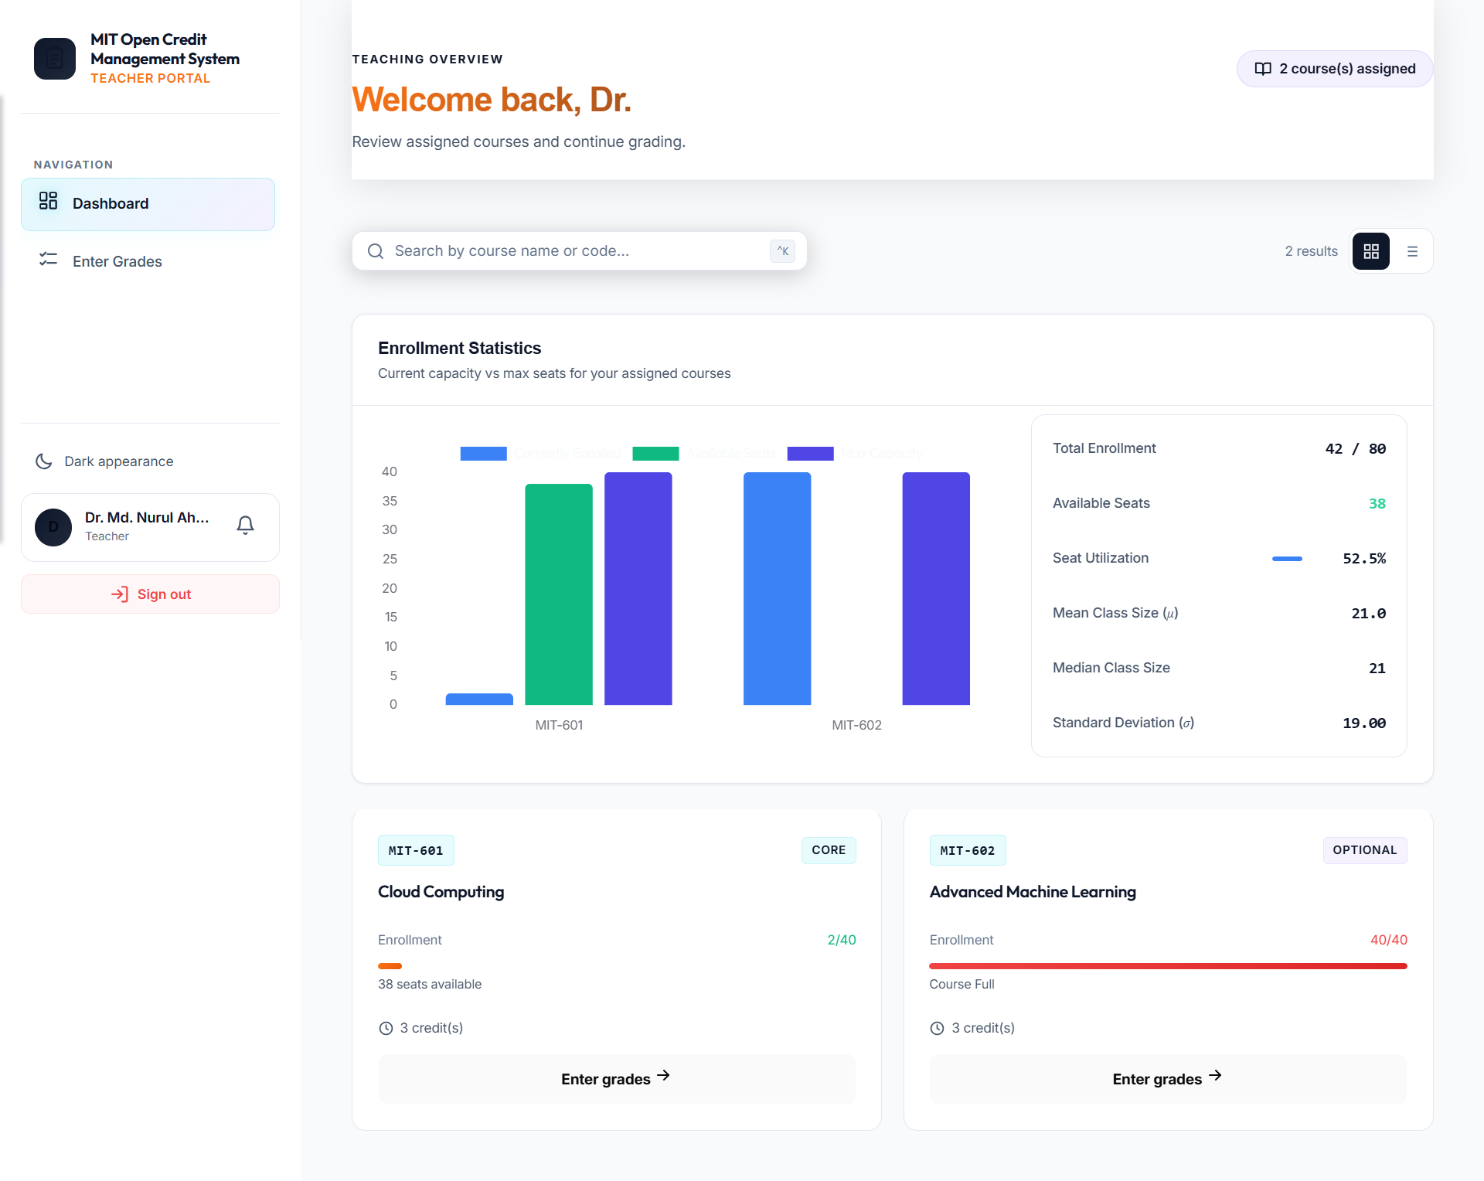
VISUAL EVIDENCE · IMAGE 14
Teacher Dashboard
TEACHER PORTAL
Enrollment statistics, assigned course cards, seat pressure and grade-entry entrypoints.
23

Slide 24
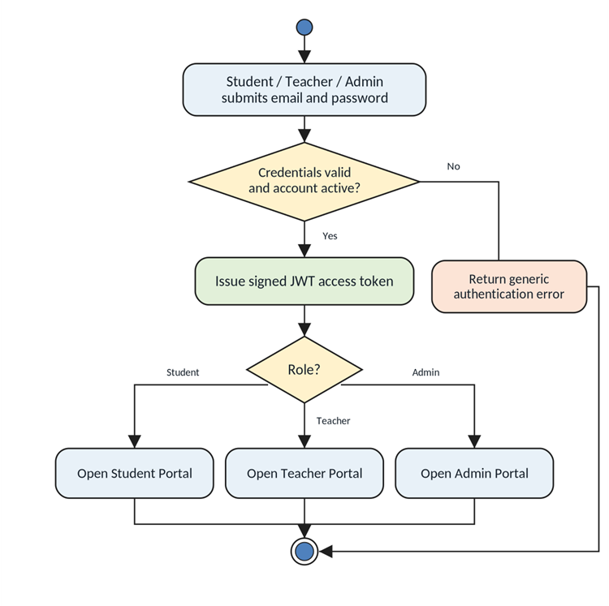
VISUAL EVIDENCE · IMAGE 15
Activity Diagram — Authentication & Role Routing
ACTIVITY DIAGRAM
Student, Teacher or Admin submits credentials; the system validates and routes to the correct portal.
24

Slide 25
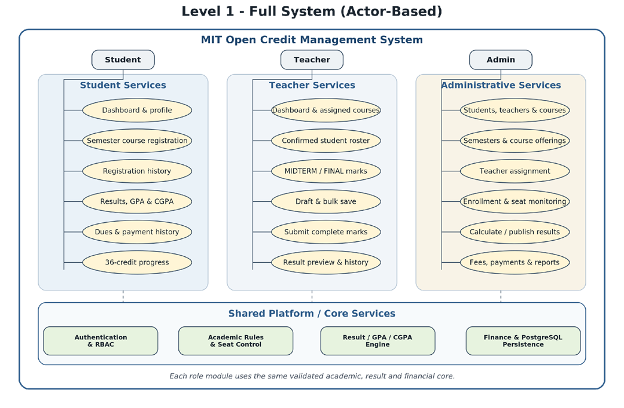
VISUAL EVIDENCE · IMAGE 16
Use Case Diagram — Full Actor-Based System
USE CASE DIAGRAM
Student, Teacher and Admin services share one authenticated platform and validated academic core.
25

Slide 26
IMPLEMENTATION STATUS
Current build + priority corrections
This slide is worded safely for viva: separate what is shown from what remains to be hardened.
✓
Implemented / Visible
!
Implemented with limits
→
Next engineering focus
• Role portals and dashboards
• Student course views and registration UI
• Teacher grade-entry screen
• Admin academic screens
• Results and dues pages
• Angular–Spring Boot–PostgreSQL baseline
• Course-by-course enrollment in baseline
• ≤ 12-credit validation vs exact package target
• Seat control and result lifecycle require formal hardening
• Payment verification needs audit-grade workflow
• Semester-specific CourseOffering
• Atomic exact-12 registration
• Concurrency-safe last-seat control
• Derived retake/gap fees
• Explicit result publication
• Verified payment allocation
MIT Open Credit Management System · SE801 SPL3
26

Slide 27
DEMO STORYLINE
How to present the system confidently
A clear role-by-role demonstration is stronger than jumping between random screens.
1
Login
2
Admin
3
Student
Show validation and role-based entry.
Create/monitor students, teachers, courses, semesters and fees.
Open dashboard, register courses, view courses, results and dues.
4
Teacher
5
Explain models
6
Close honestly
Open assigned courses and enter midterm/final marks.
Use the use-case and activity diagrams to connect UI to SRS.
Mention current limitations and next implementation priorities.
MIT Open Credit Management System · SE801 SPL3
27

Slide 28
Thank You
MIT Open Credit Management System · SE801 SPL3 Midterm Presentation
Questions welcome
Presented by: MD. Jihad Hossain · BSSE Roll No. 1413
28

