Slide 1
SE801 · MIDTERM PRESENTATION · JULY 2026
SADMC Shield
Anomaly Detection & Auto-Remediation SaaS
for Microservices Architecture
Detect · Explain · Remediate — autonomously, inside your own cluster.
PRESENTED BY
SUPERVISED BY
Md. Nowsad Hossen Munna
Dr. Naushin Nower
BSSE-1407
Professor, IIT, DU
Notes:
Title slide. Introduce the project: a SaaS platform that detects microservice anomalies with ML and auto-remediates them inside the tenant's own Kubernetes cluster.

Slide 2
Project Overview
The problem, and what SADMC Shield does about it
Objectives
The Problem
As microservices scale, individual services degrade in ways teams miss until they cascade into outages — a runaway CPU, a slow memory leak, a creeping network delay. Existing stacks show raw metrics but stop short of recognising the anomaly and acting on it.
O1
Zero-config monitoring
Every microservice in the cluster, no per-service setup
O2
ML anomaly classification
4 classes with a confidence score, model hosted centrally
O3
Autonomous remediation
Throttle, restart or scale without a human operator
Our Solution
O4
Privacy-preserving design
A lightweight Helm-installed agent collects metrics inside the tenant cluster
A hosted ML model classifies each service: NORMAL, CPU_HOG, MEMORY_LEAK, NETWORK_DELAY
The agent — not the SaaS — executes the corrective Kubernetes action
Only numerical metric vectors ever leave the cluster boundary
Cluster-modifying logic stays in the tenant's trust boundary
O5
One-command onboarding
A single helm install with only the API Key
O6
Real-time observability
Live WebSocket dashboard of health, events and history
2
Notes:
Frame the problem, then the three-part solution: in-cluster agent, hosted classifier, agent-side remediation. Objectives O1-O6 come straight from SRS Section 1.3.

Slide 3
Functional Requirements
Tenant & Agent onboarding
Platform, onboarding & metrics collection · FR-1 to FR-7
FR-1
Tenant registration with organisation name, email and password
FR-2
Login issuing a short-lived access token and a refresh token
FR-3
Generate, list and revoke API Keys for the in-cluster agent
FR-4
Helm chart installing agent, RBAC and optional Prometheus in one command
FR-5
Agent registers with its API Key and receives a cluster identifier
FR-6
Automatic discovery of every Deployment in non-excluded namespaces
FR-7
Collect CPU, memory, latency, request and error rate every 15 seconds
3
Notes:
Walk the requirements quickly — highlight FR-8 (classification) and FR-10 (autonomous remediation) as the differentiating ones.

Slide 4
Functional Requirements
Intelligence & observability
Detection, remediation & the dashboard · FR-8 to FR-14
FR-8
Classify metrics as NORMAL, CPU_HOG, MEMORY_LEAK or NETWORK_DELAY with confidence
FR-9
Persist every anomaly event with its metrics snapshot and timestamp
FR-10
Auto-execute throttle / restart / scale above the confidence threshold, with cooldown
FR-11
Report every remediation attempt and its outcome back to the SaaS
FR-12
Live real-time feed of anomaly and remediation events over WebSocket
FR-13
Time-series metric charts and a searchable remediation history log
FR-14
Immediate toast alert for anomalies detected above 0.9 confidence
4
Notes:
Walk the requirements quickly — highlight FR-8 (classification) and FR-10 (autonomous remediation) as the differentiating ones.

Slide 5
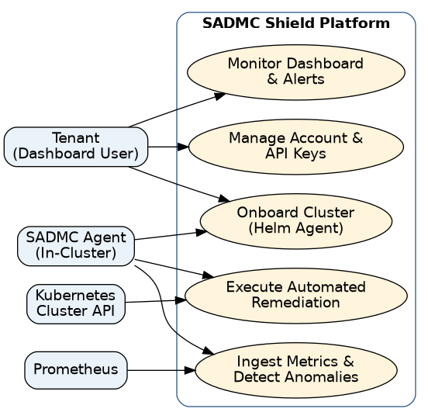
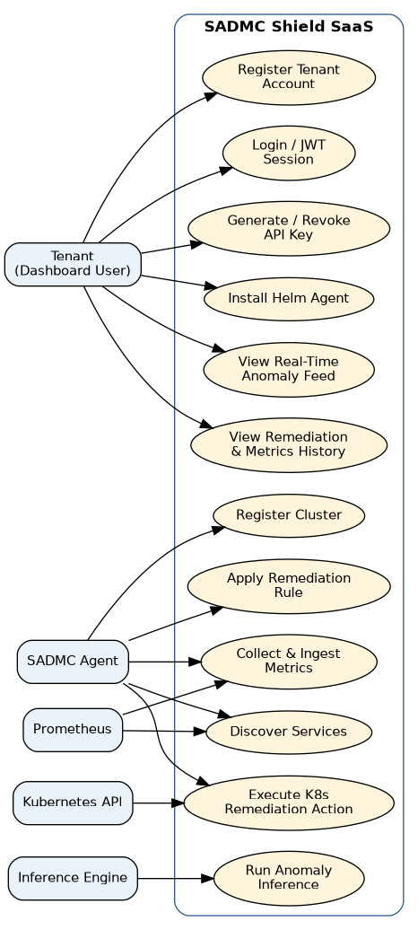
Use Case Diagram
Level 0 system overview and Level 1 full system (SRS Figures 1-2)
Level 0 — System Overview
Level 1 — Full System (Actor-Based)
5
Notes:
Level 0 shows the actor-to-bubble view: Tenant, SADMC Agent, Prometheus and the Kubernetes API against the platform. Level 1 expands each bubble into the concrete use cases, adding the Inference Engine as the actor behind classification.

Slide 6
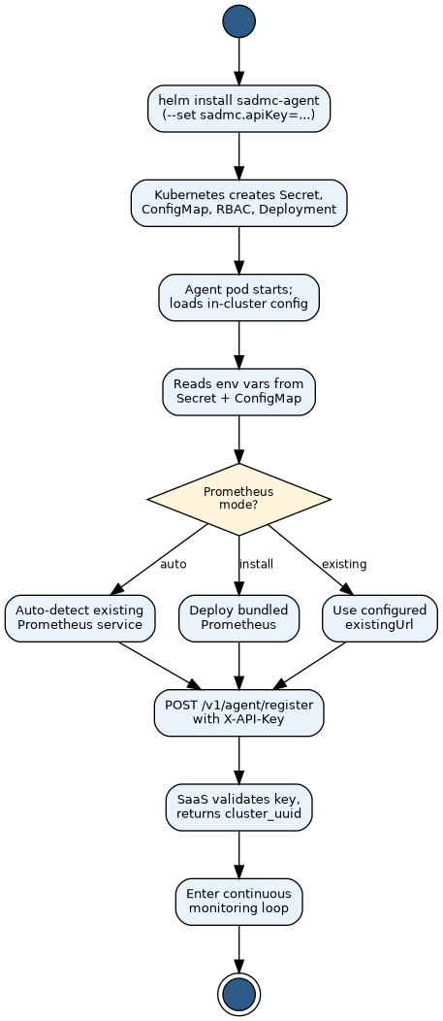
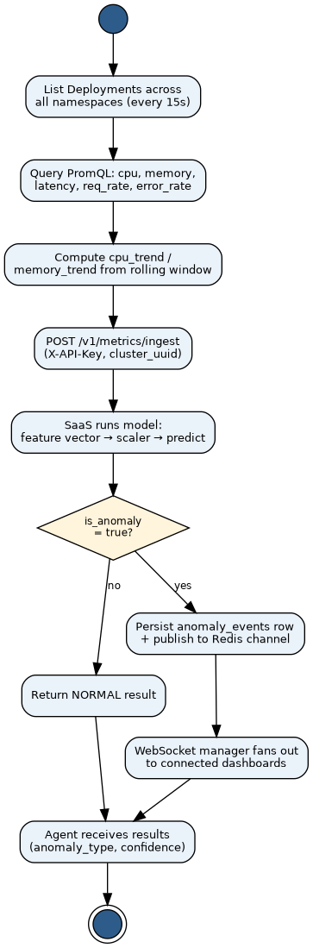
Activity Diagram
Agent bootstrap and the 15-second continuous monitoring loop (SRS Figures 10-11)
Agent Bootstrap
Continuous Monitoring Loop
helm install sadmc-agent (--set sadmc.apiKey)
List Deployments across all namespaces (every 15s)
Kubernetes creates Secret, ConfigMap, RBAC, Deployment
Query PromQL: cpu, memory, latency, req_rate, error_rate
Agent pod starts; loads in-cluster config
Compute cpu_trend / memory_trend from rolling window
Reads env vars from Secret + ConfigMap
POST /v1/metrics/ingest (X-API-Key, cluster_uuid)
next cycle
Prometheus
mode?
SaaS runs model: feature vector -> scaler -> predict
auto-detect
bundled
existing URL
is_anomaly
== true?
Auto-detect existing
Prometheus service
Deploy bundled
Prometheus instance
Use configured
existingUrl
yes
no
POST /v1/agent/register with X-API-Key
Persist anomaly_events row + publish to Redis channel
Return NORMAL result
SaaS validates key, returns cluster_uuid
WebSocket manager fans out to connected dashboards
Enter continuous monitoring loop
Agent receives results (anomaly_type, confidence)
6
Notes:
Left: the Helm install creates the Kubernetes resources and starts the agent, which resolves its Prometheus mode before registering and entering the monitoring loop. Right: every 15 seconds the agent discovers, collects, and ingests; only anomalous results are persisted and pushed to the dashboard.

Slide 7
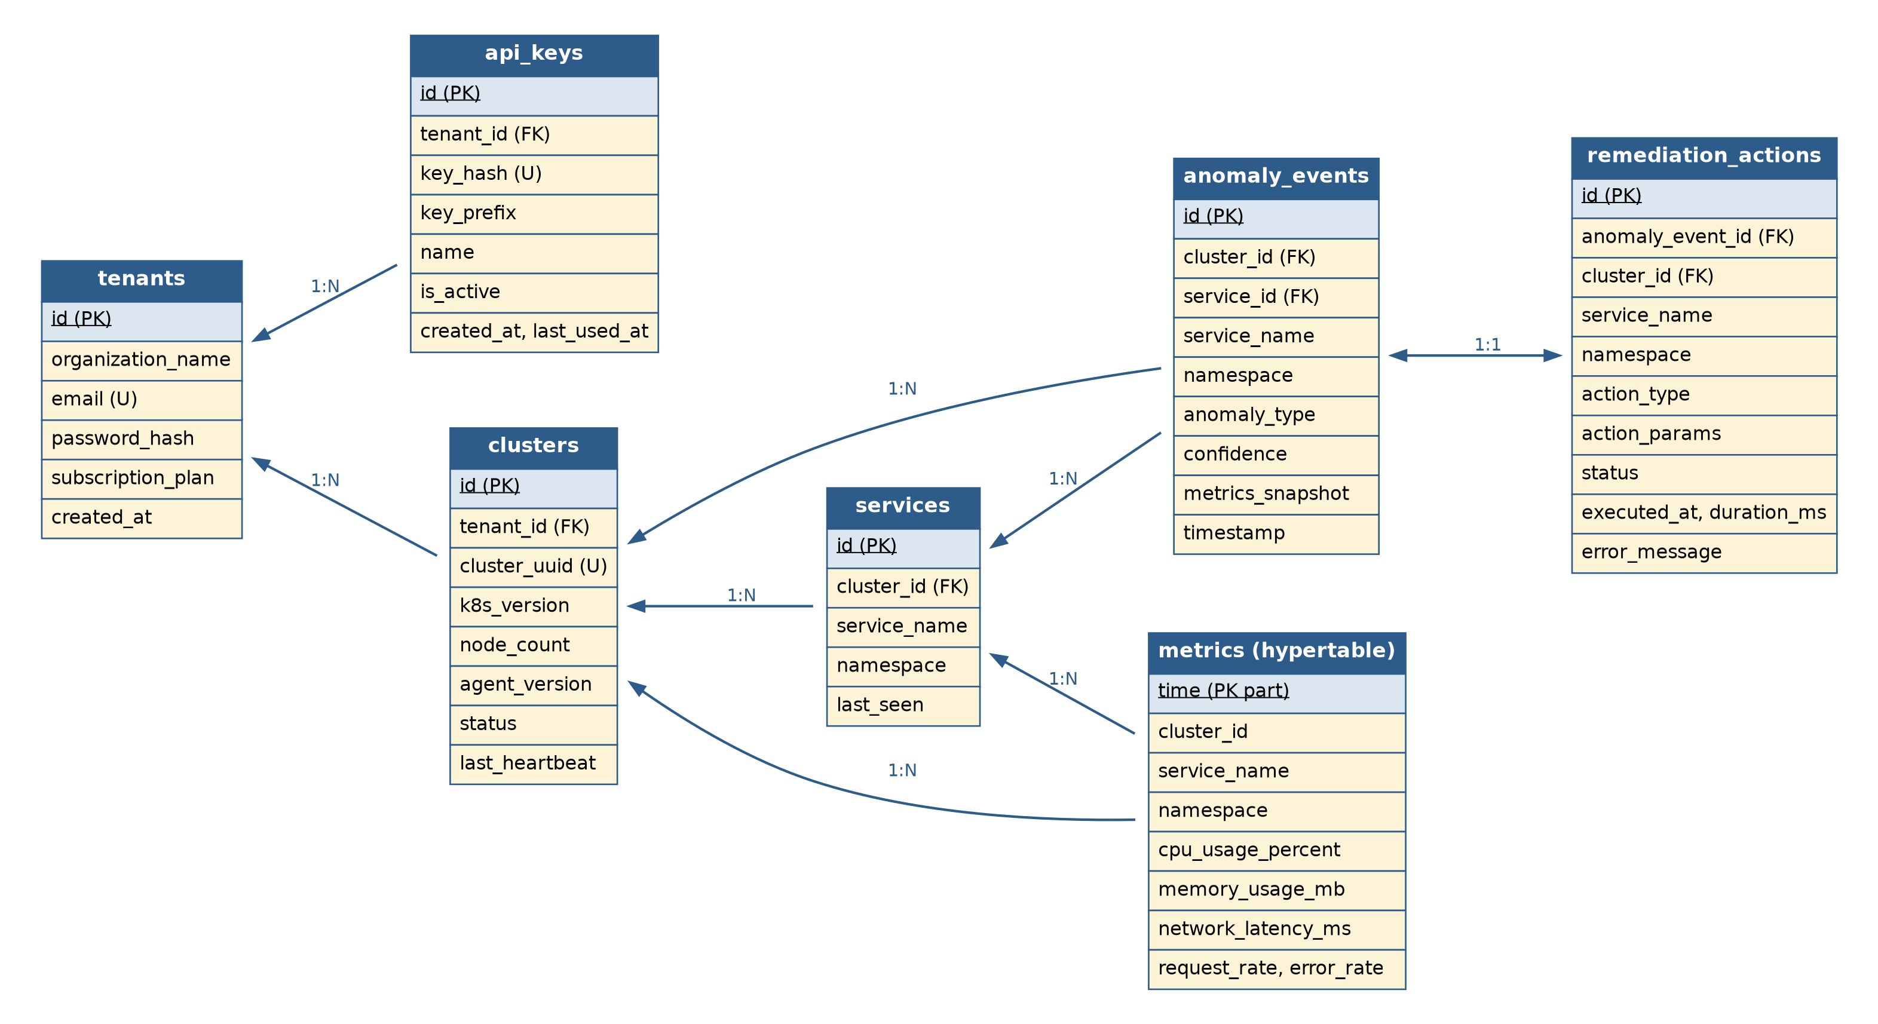
Entity-Relationship Diagram
Seven persistent entities; metrics stored as a TimescaleDB hypertable (SRS Figure 14)
1 : 1 AnomalyEvent → RemediationAction — one attempt per anomaly
1 : N Service → Metric — enables service-level metric queries
90 days retention policy bounds metric storage growth
7
Notes:
Seven data objects derived from the noun analysis. Tenant is the isolation root — cascade deletes flow down, and RLS enforces the boundary at the database level.

Slide 8
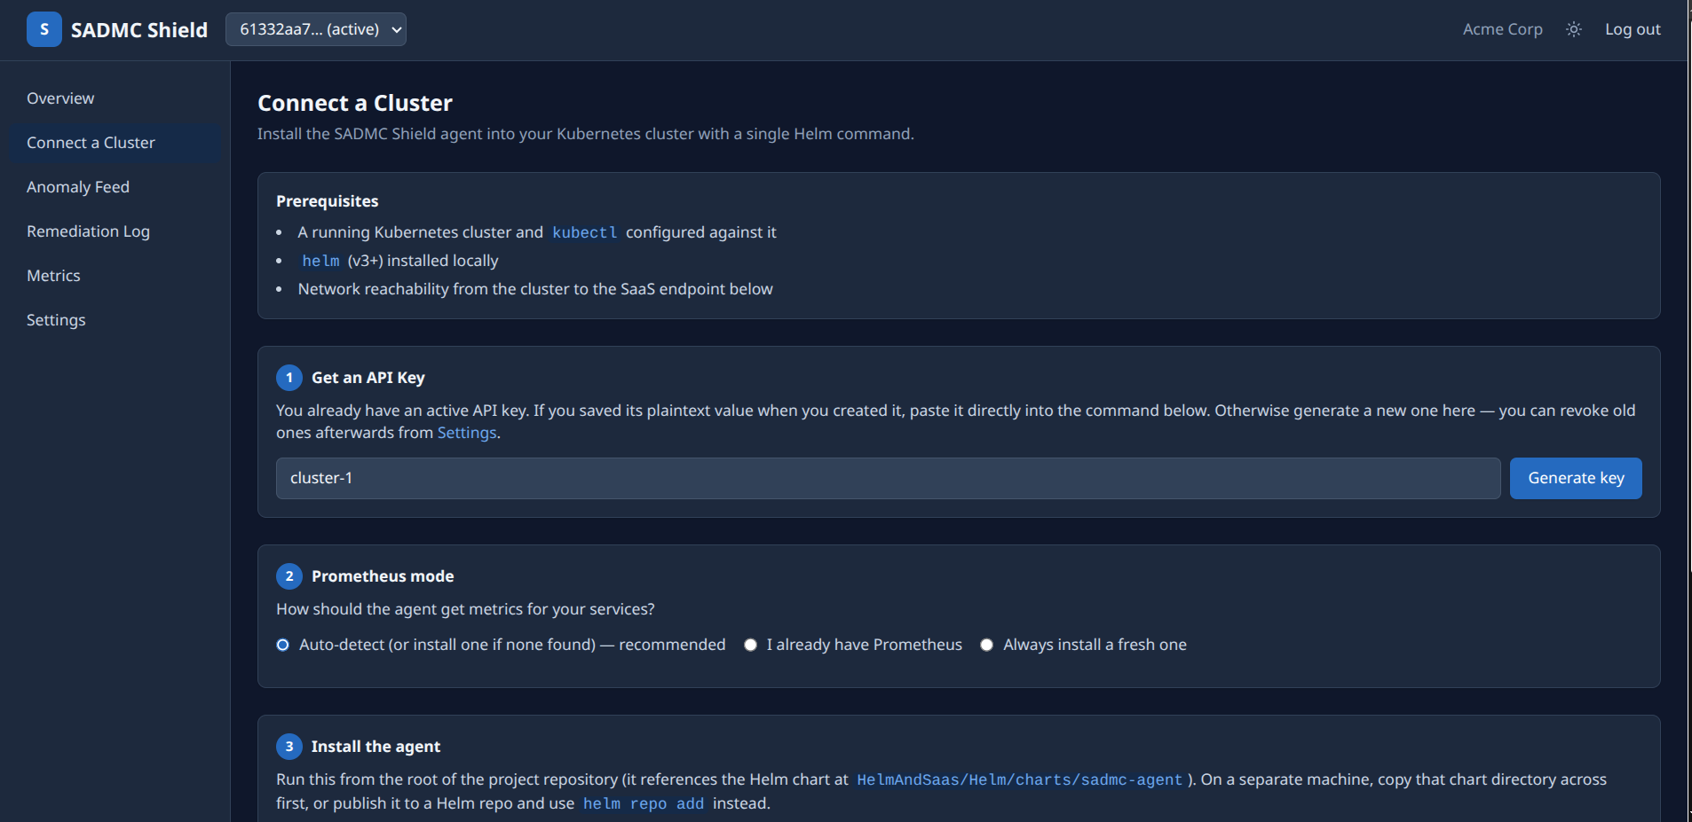
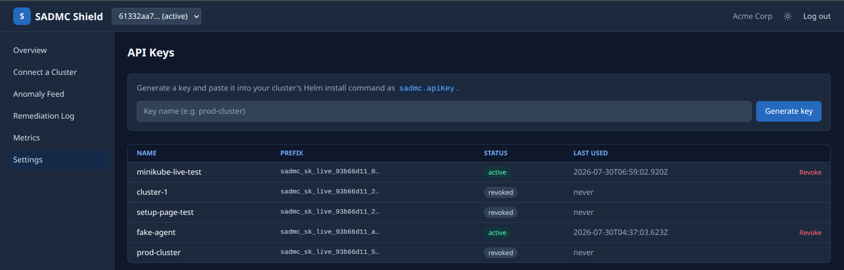
Demo — Onboarding a Cluster
Connect a Cluster and API Key Management
Connect a Cluster
API Key Management
Tenant pastes a pre-filled helm install command; the agent, RBAC, and Prometheus mode are all handled in one step.
Keys are hashed with bcrypt and shown once in plaintext; tenants can revoke any key instantly from Settings.
8
Notes:
Onboarding half of the demo: generate or reuse an API Key, then run the pre-filled Helm command. The API Keys screen under Settings shows prefix, status, and last-used time -- never the plaintext value.

Slide 9
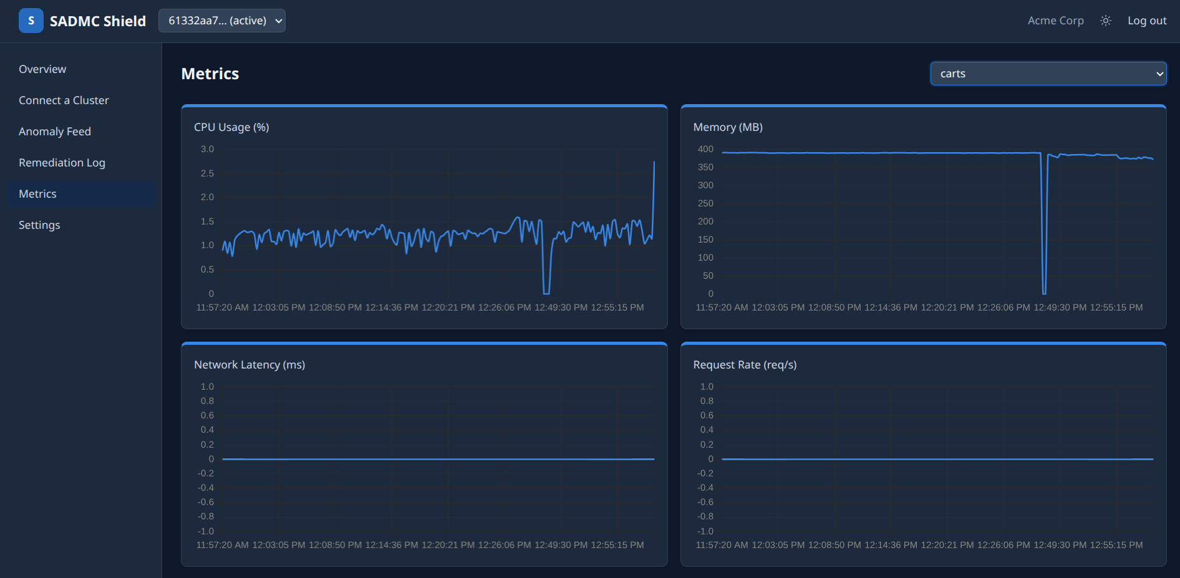
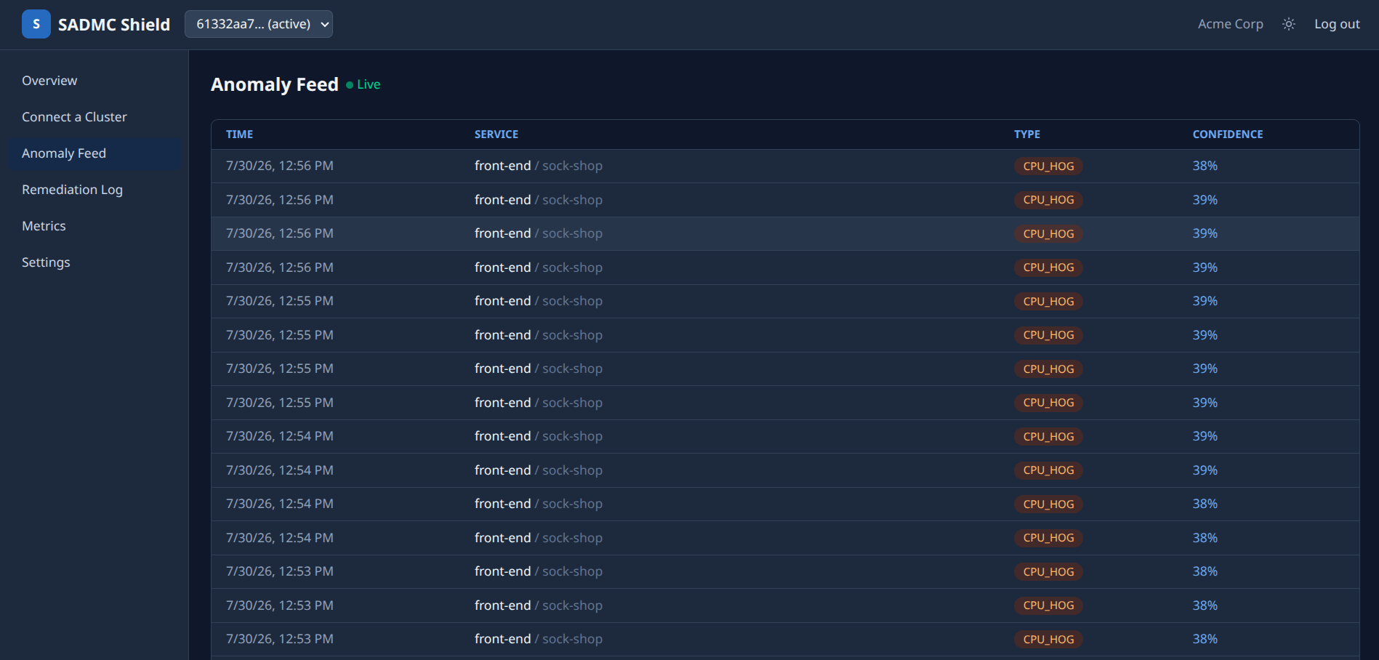
Demo — Live Operation
Metrics dashboard and the real-time anomaly feed
Live Metrics
Anomaly Feed
Per-service CPU, memory, latency, and request-rate charts, refreshed as the agent reports each 15-second batch.
Sock-Shop's front-end service under injected CPU stress -- CPU_HOG detected live, confidence climbing toward the 0.85 remediation threshold.
9
Notes:
Live-operation half of the demo: the Metrics page for the carts service, and the Anomaly Feed showing repeated CPU_HOG detections on front-end as fault injection ramps up -- confidence is climbing toward the 0.85 auto-remediation threshold.

Slide 10
Thank You
SADMC Shield · SE801 Midterm · Questions welcome
Next: complete fault-injection data collection, report per-class accuracy, and ship the Phase 5 dashboard.

