Slide 1
MIT Open Credit Management System
Rule-Driven Academic Enrollment, Result & Financial Management
Presented by: Md. Jihad Hossain (BSSE-1413)
Supervised by: Dr. Md. Nurul Ahad Tawhid

Slide 2
Project Overview & Objectives
• Secure Role-Based Access: Dedicated portals for Students, Teachers, and Admins.
• Credit & Seat Control: Enforces max 12 credits and automated capacity limits.
• Academic Results: Streamlined grading, CGPA calculation, and result publication.
• Financial Transparency: Automated fee calculation for retakes and seamless tracking.

Slide 3
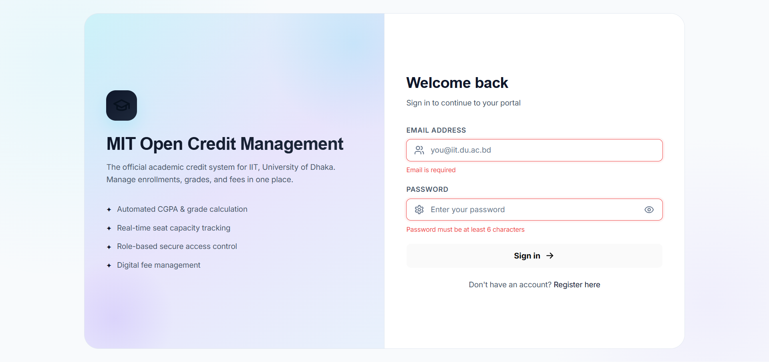
System Home Page

Slide 4
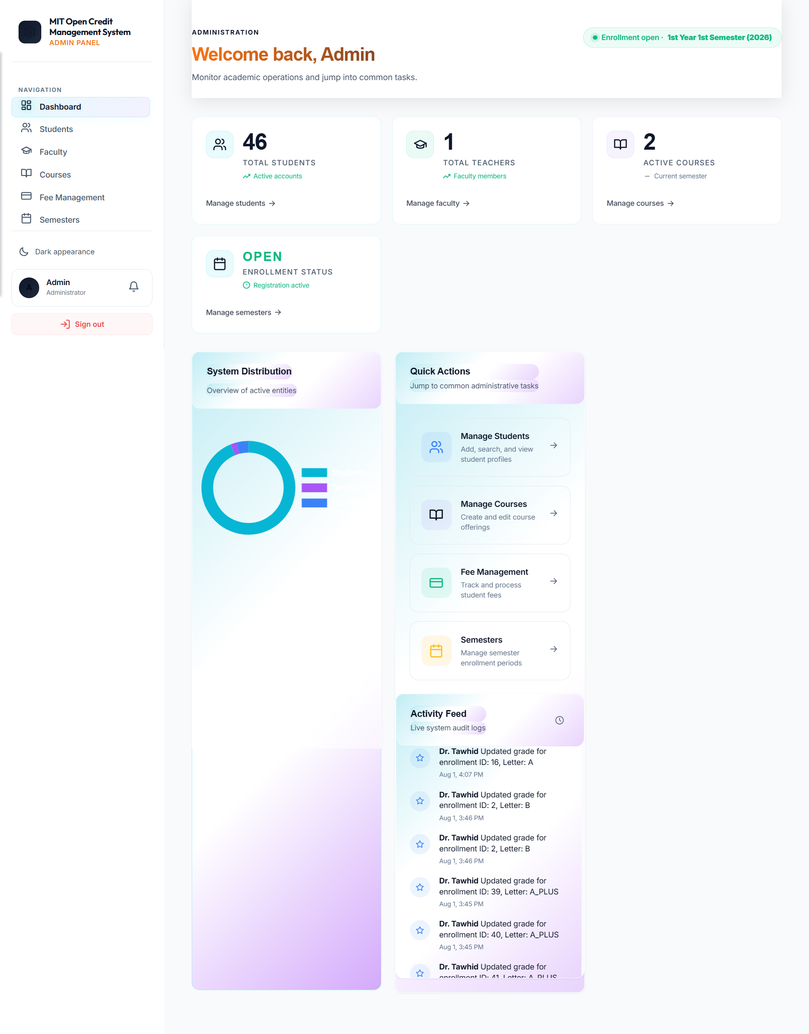
Admin Portal Dashboard

Slide 5
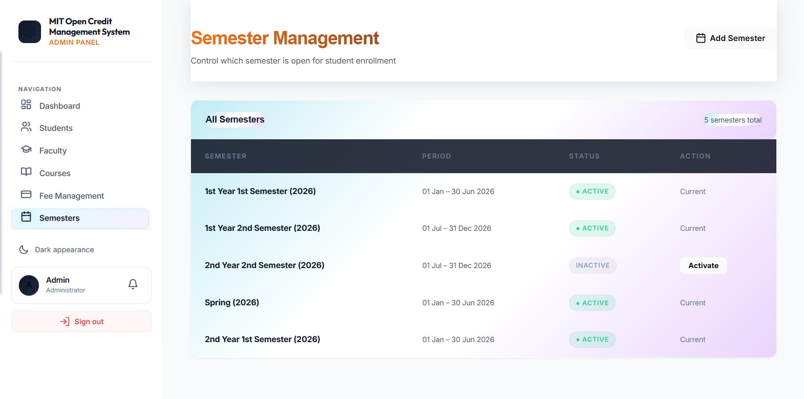
Semester Management

Slide 6
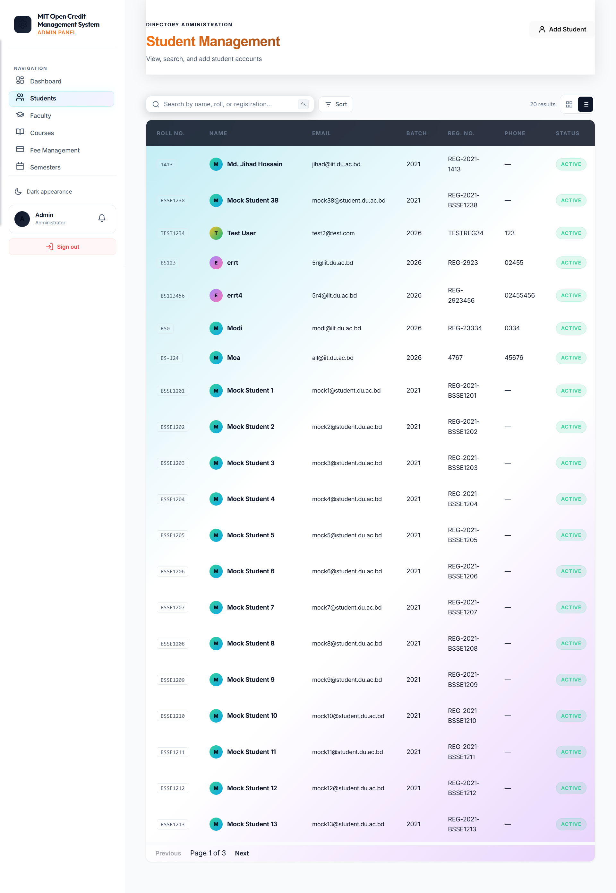
Student Directory & Management

Slide 7
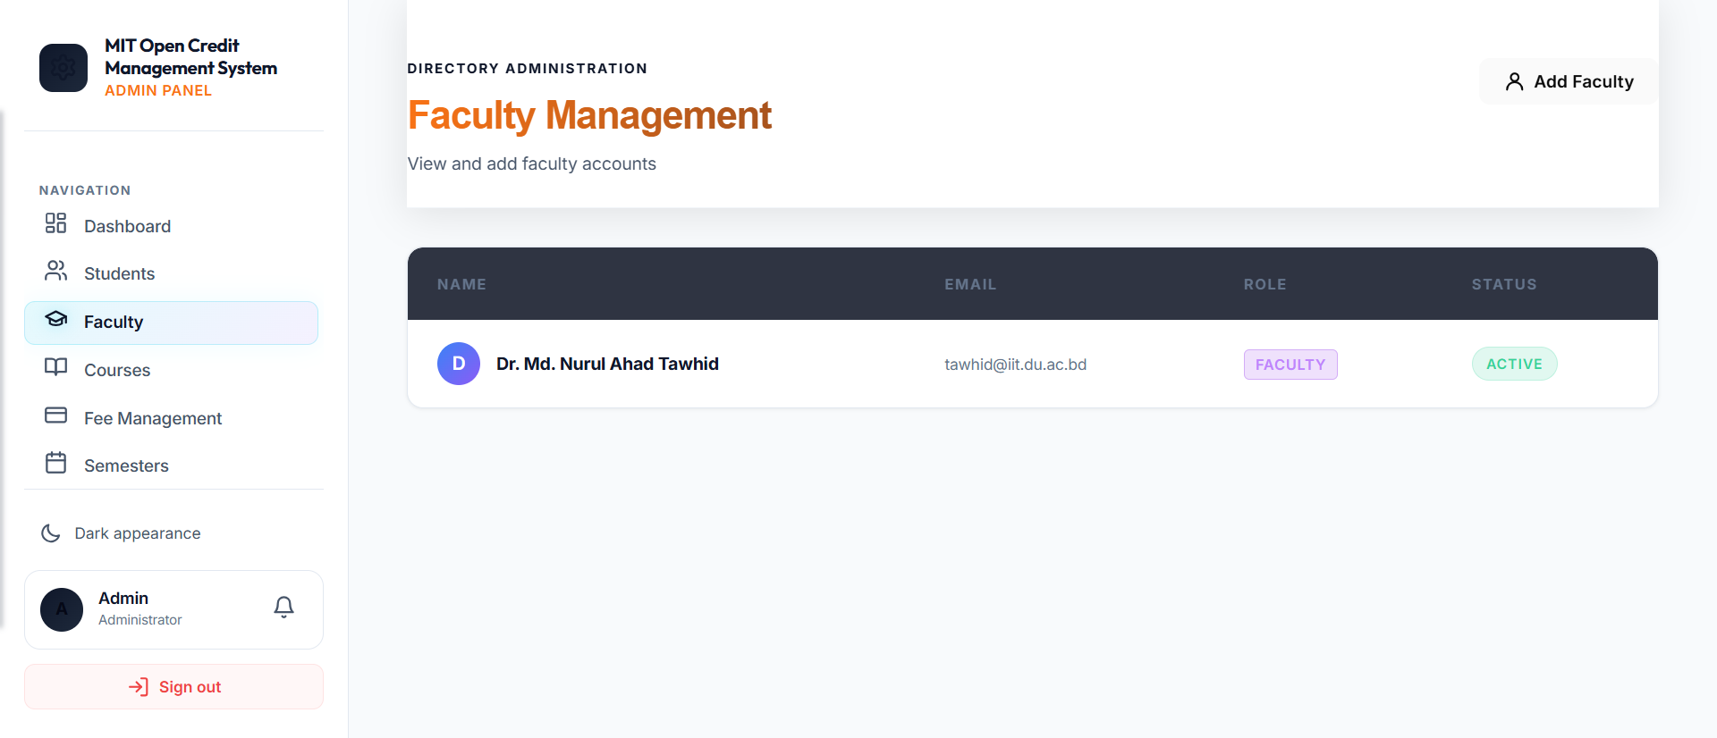
Faculty Onboarding

Slide 8
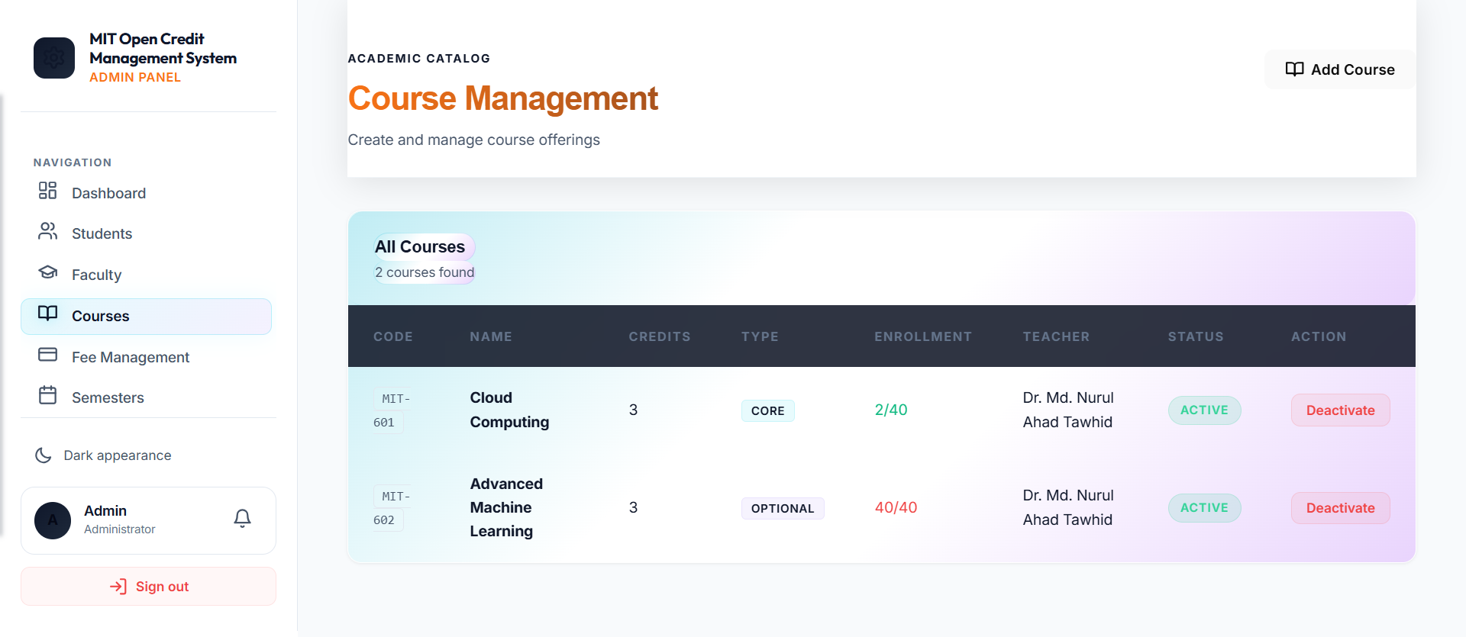
Course Configuration

Slide 9
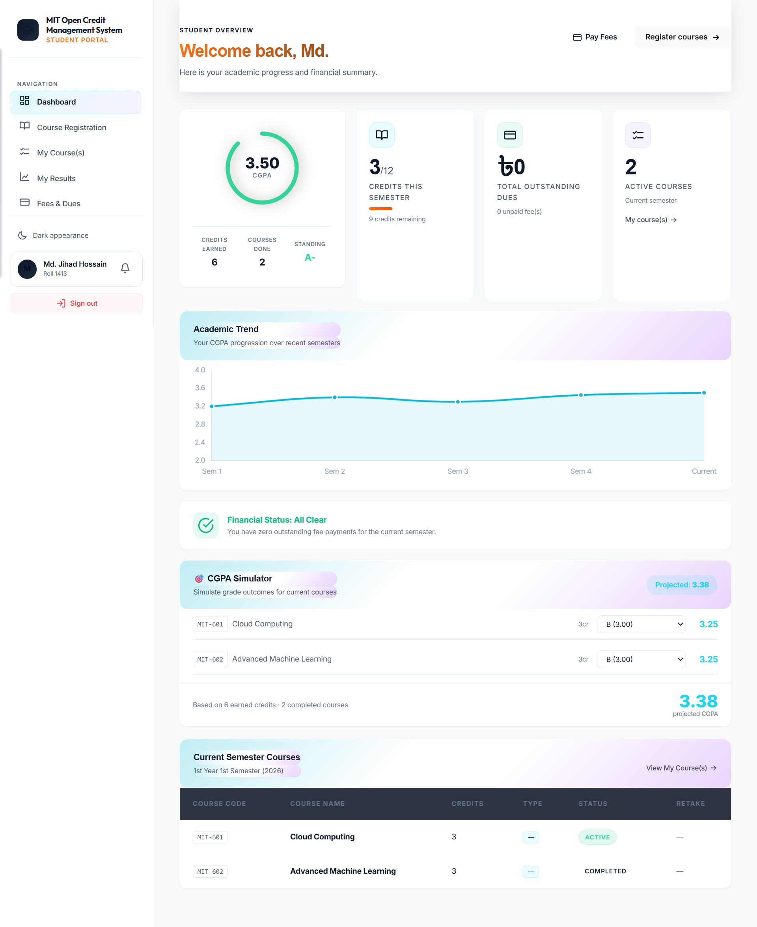
Student Portal Dashboard

Slide 10
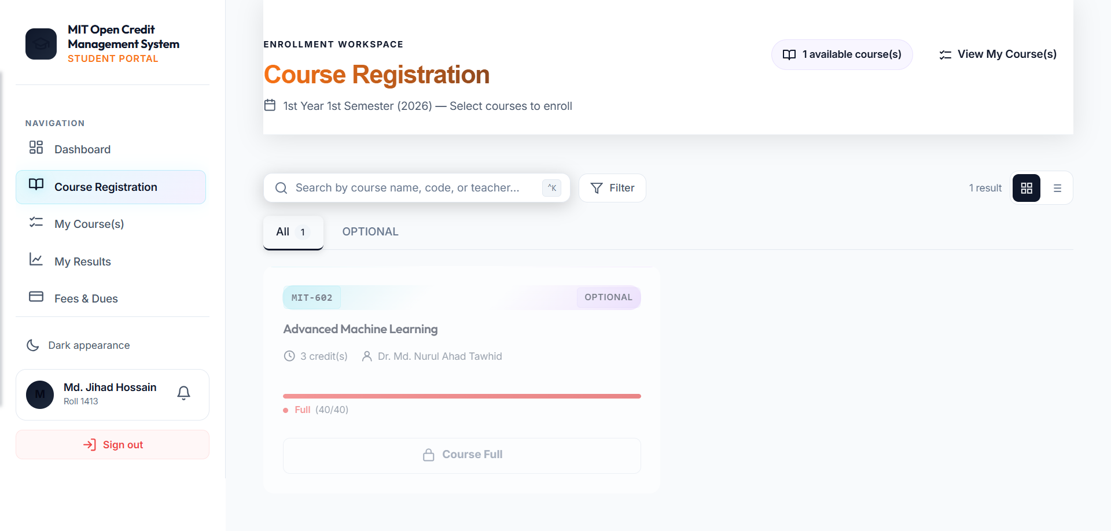
Course Registration & Selection

Slide 11
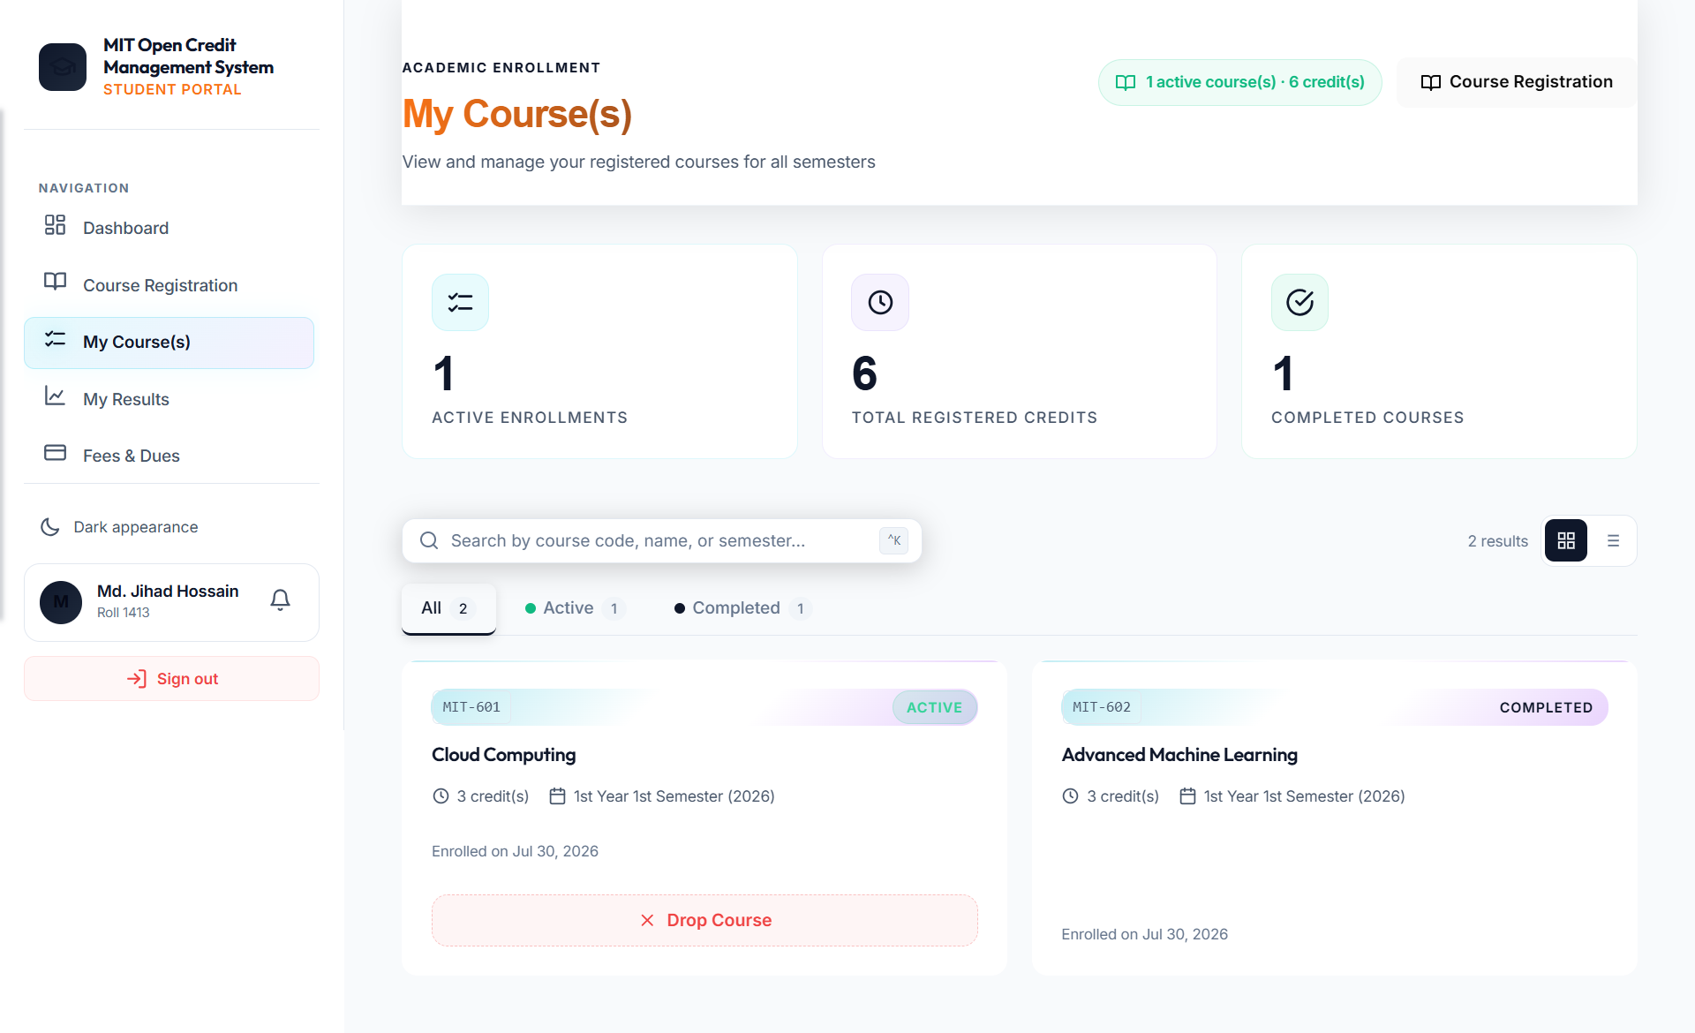
My Enrolled Courses

Slide 12
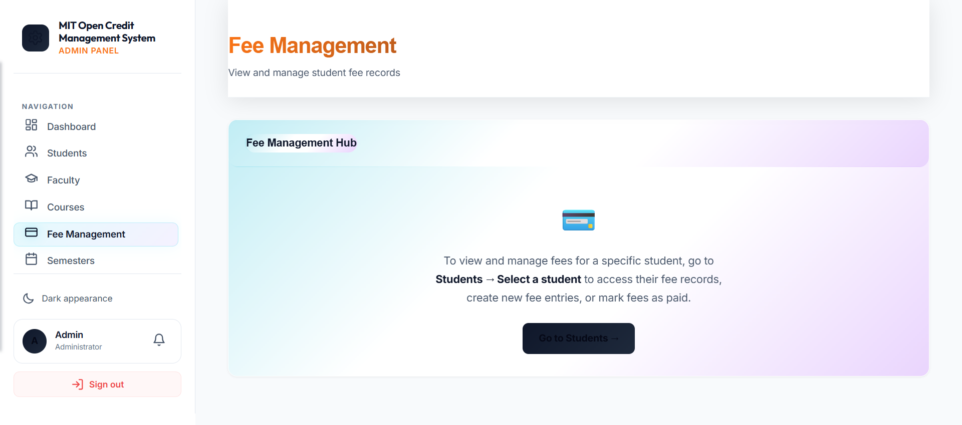
Fee Management & Dues

Slide 13
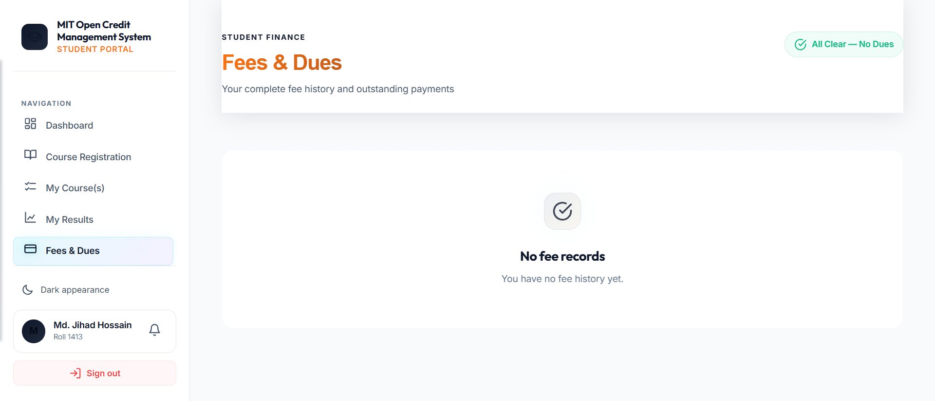
Fee Overview

Slide 14
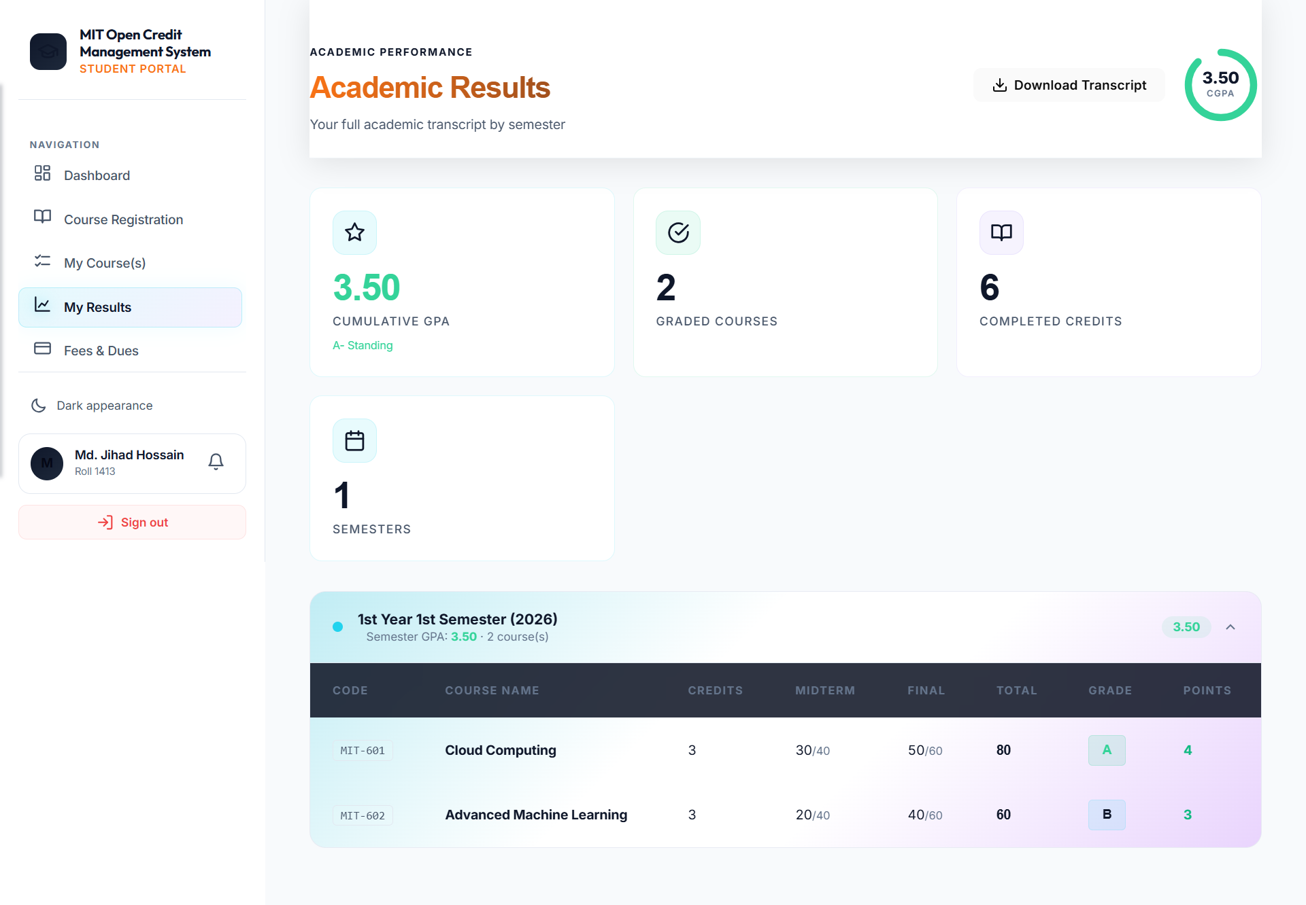
Academic Results & CGPA

Slide 15
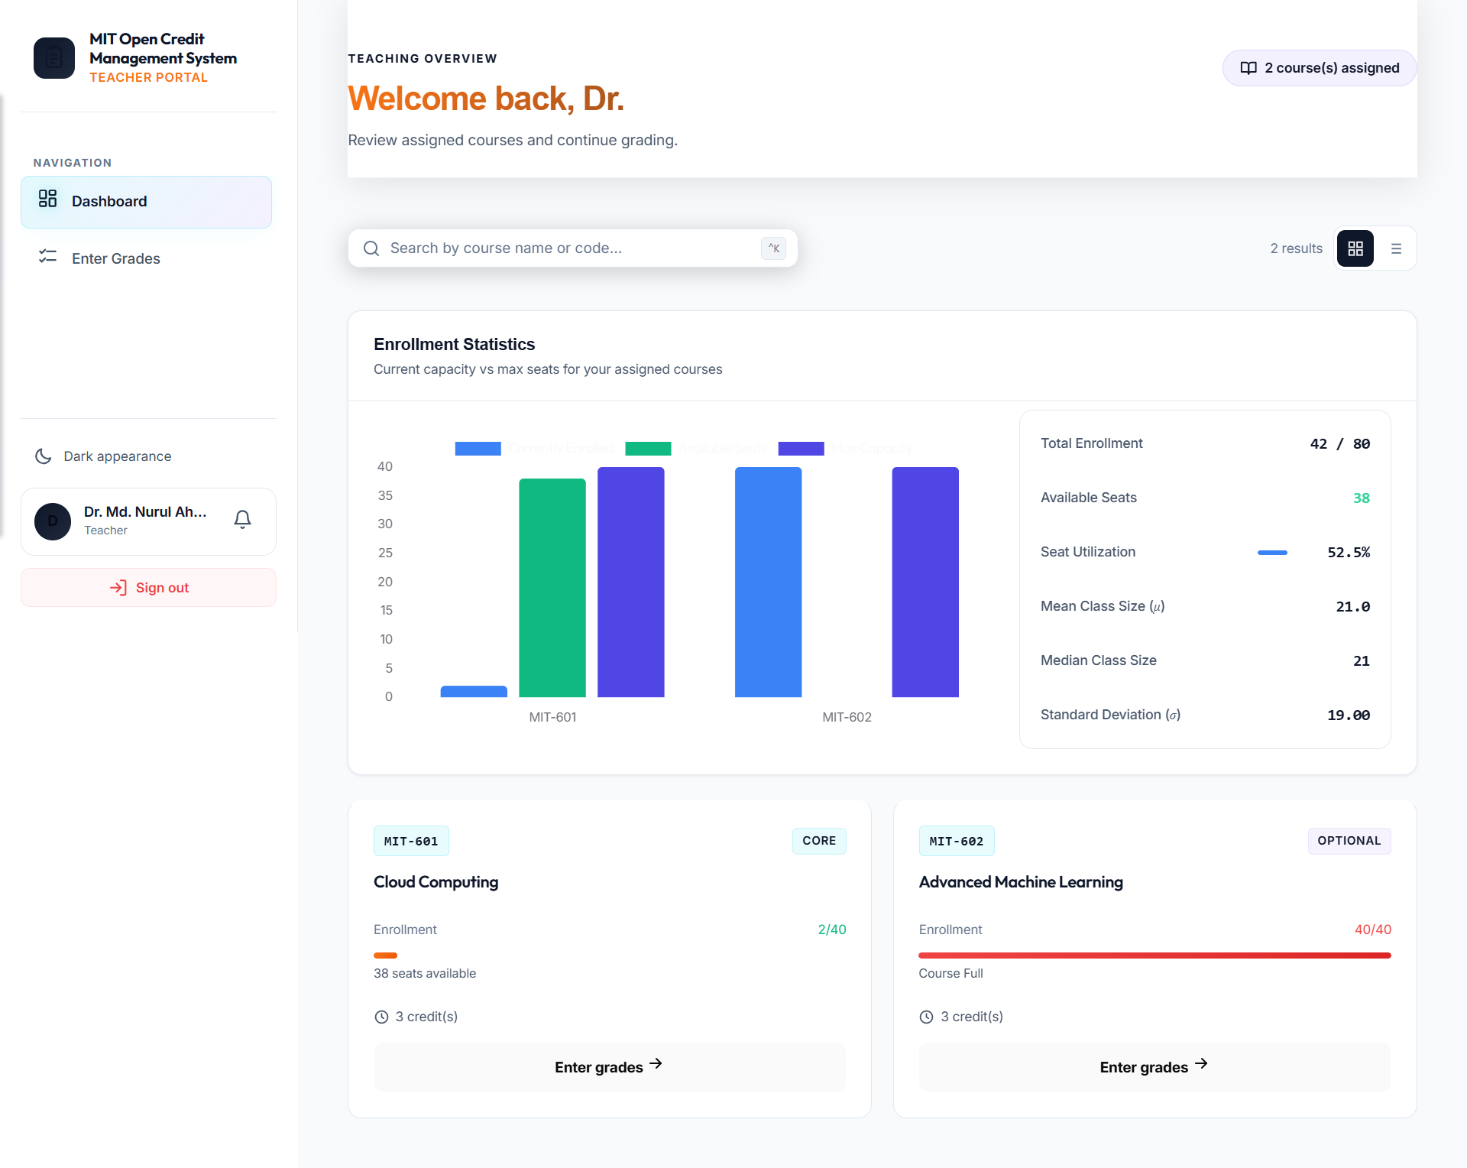
Teacher Portal Dashboard

Slide 16
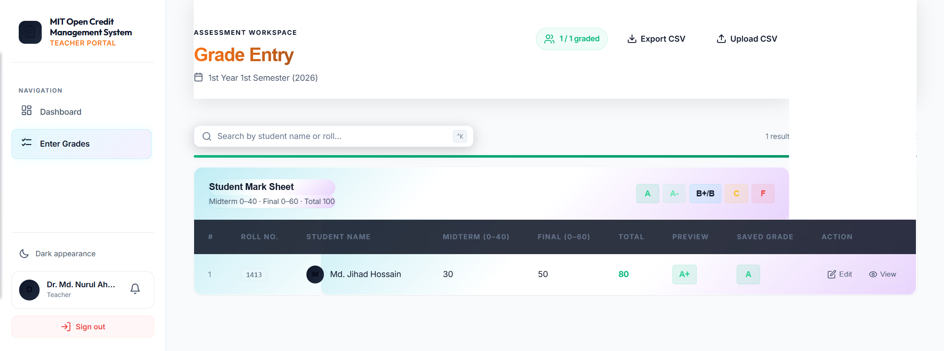
Grade Entry & Submission

Slide 17
Thank You
Q&A

