Slide 1

Approve Members
View Wellness Analytics
Org Admin
View Org Dashboard
Manage Programmes
Coordinator
View Support Tickets
Join Programmes
Open Support Ticket
Login/ Authenticate
Member
Take Stress Assessments
See Stress Assessments Results
<<Include>>
Manage Platform Settings
Sup Admin
Resolve/Close Ticket
WhãnahuWell Platform
WhānauWell Platform

Slide 2
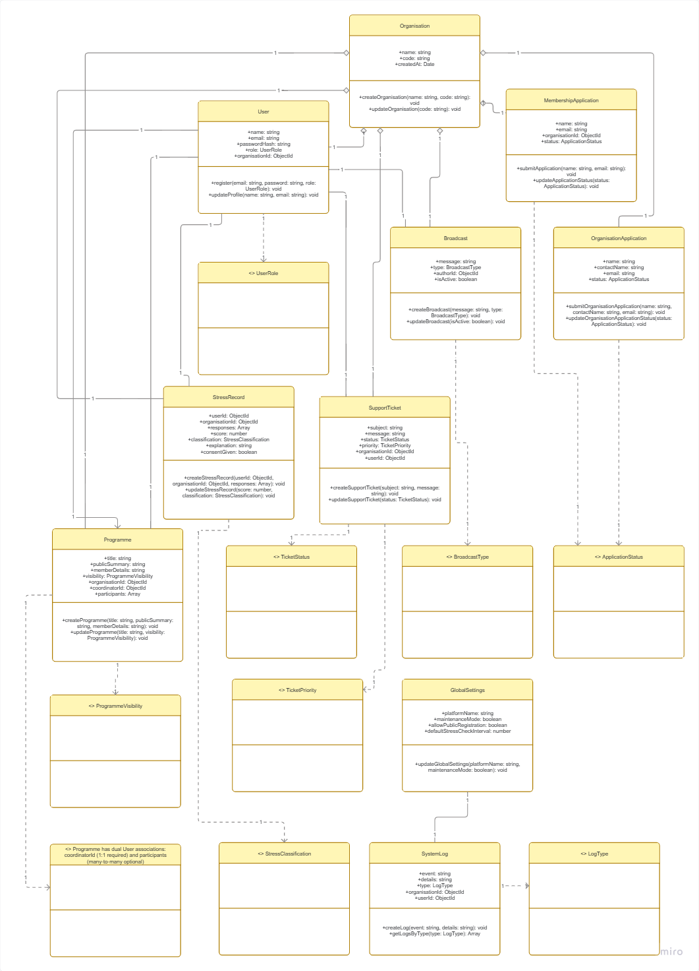

Slide 3
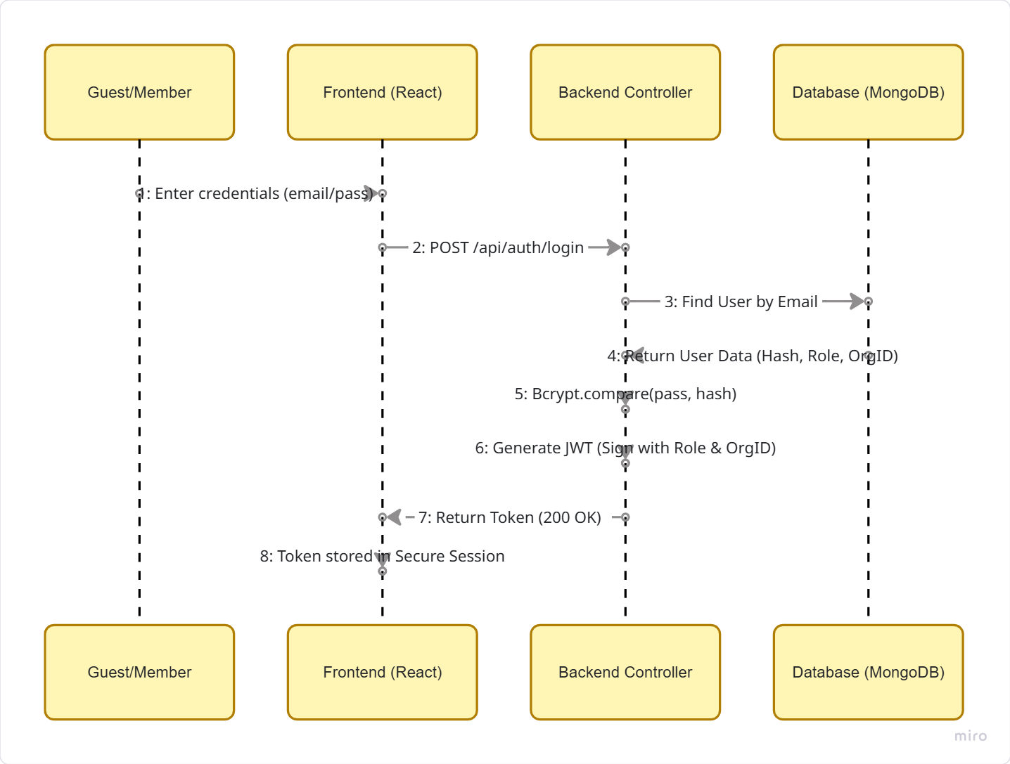

Slide 4
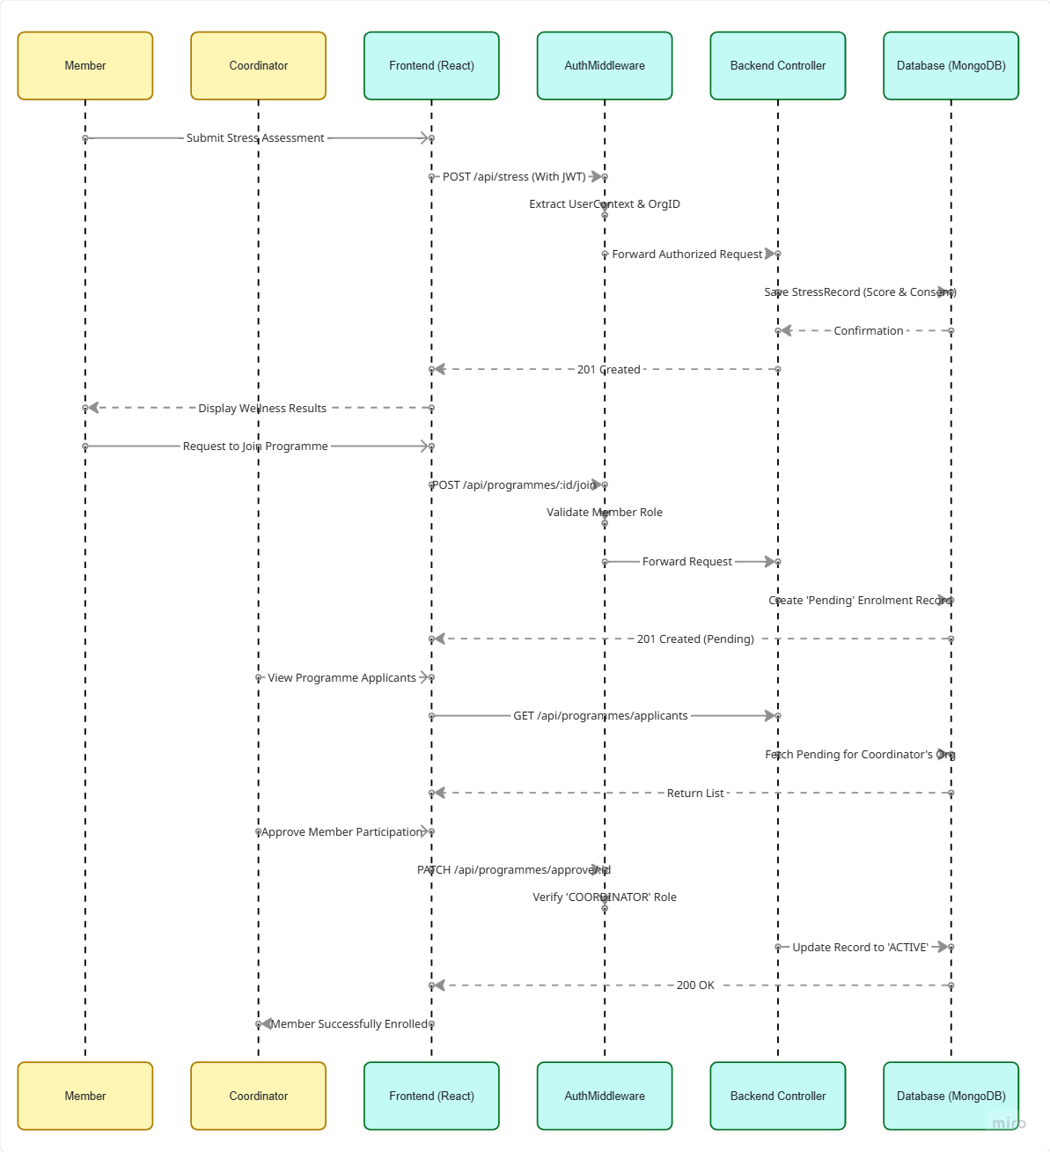
Member
Coordinator
Member
Coordinator

Slide 5
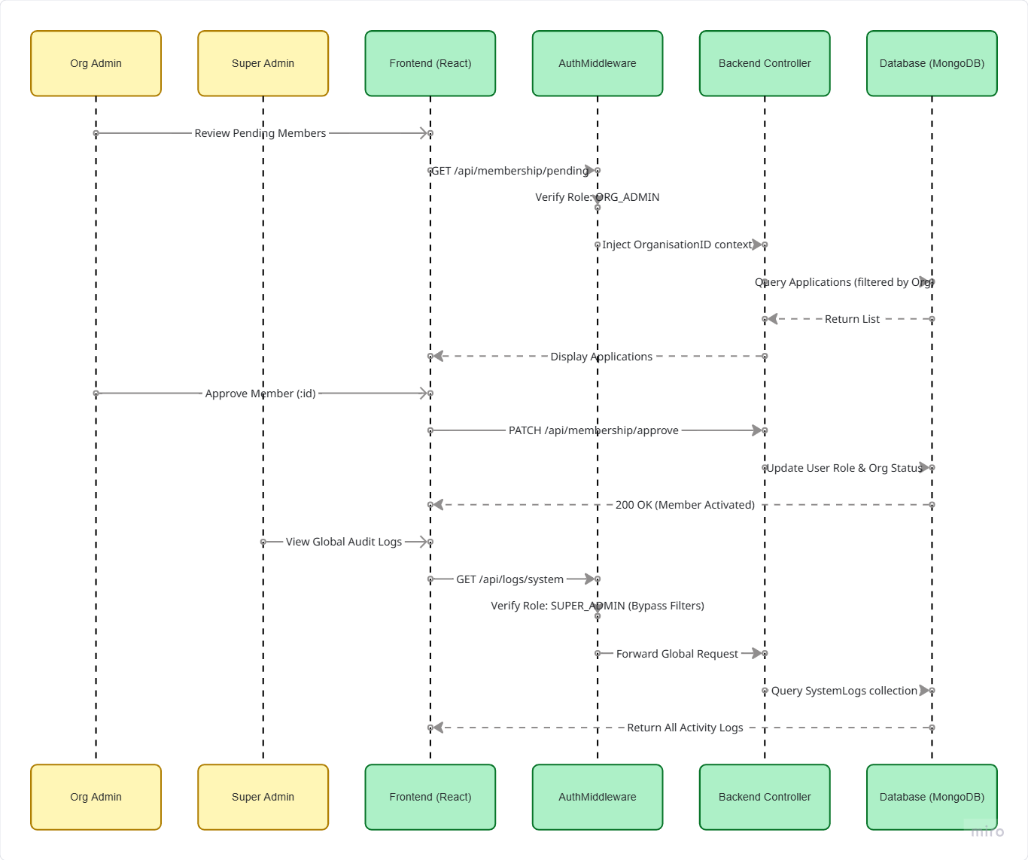
Org Admin
Super Admin
Org Admin
Super Admin

Slide 6
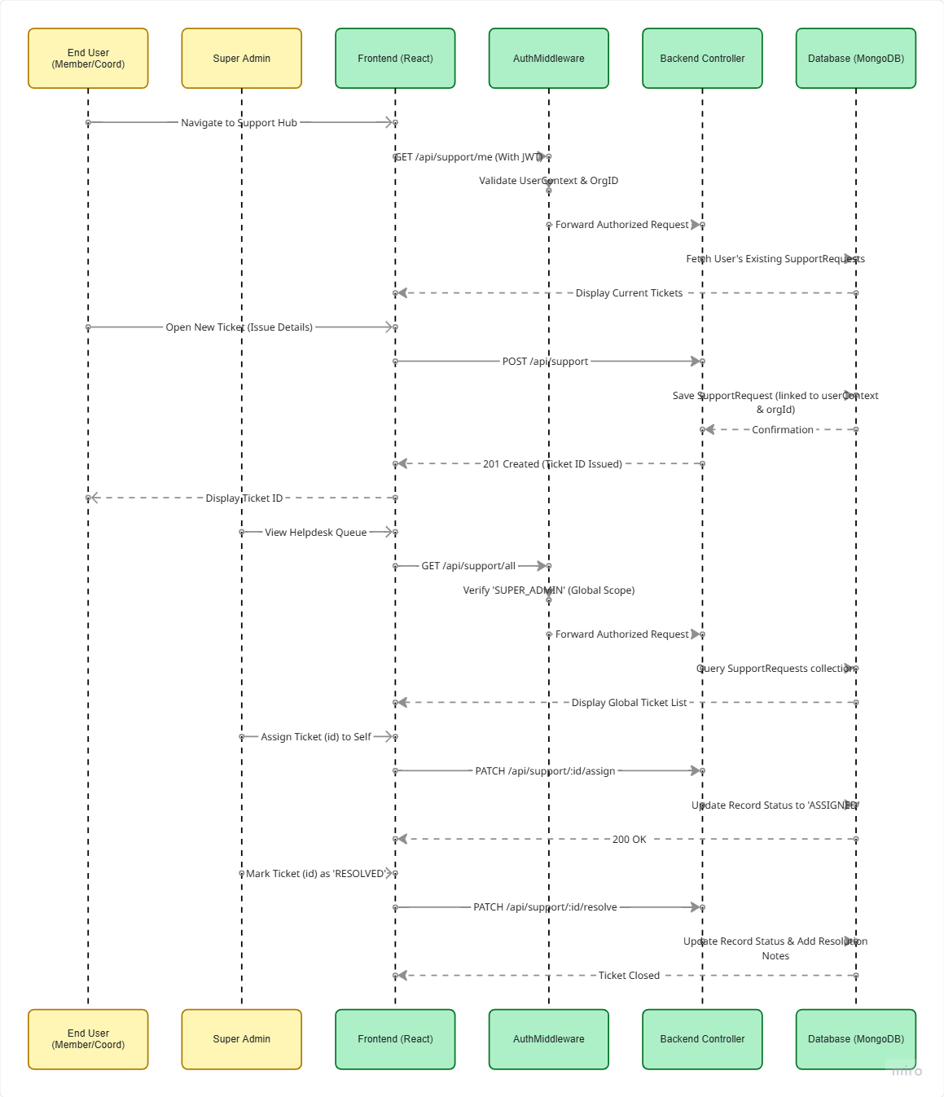
End user
Super Admin
End User
Super Admin

