Slide 1
WELCOME

Slide 2
Hello!
I am JIHAD
ID : 202002082
BATCH : 202 DB
Dept. of CSE
Green University of Bangladesh

Slide 3
INTRODUCTION
The purpose of this project is that company can sell their product online and earn cash. E-commerce is the buying and selling of goods and services, or the transmitting of funds or data, over an electronic network, primarily the Internet.

Slide 4
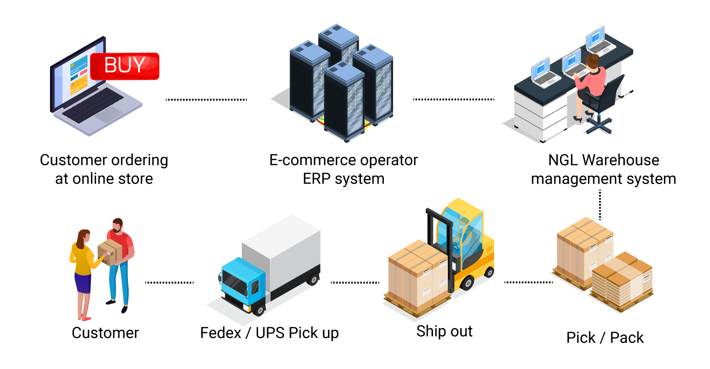
THE PROCESS OF E-COMMERCE

Slide 5
PURPOSE
Our goal is to make this website the best body building cyber store in India to sell high- quality products directly to the public at amazing prices! Bringing supplements from around the world to you.
Discover esnutrition.co.in website stats, rating, details and status online. Nonetheless, it helps any designer and developer to assist in software delivery lifecycle (SDLC) processes.

Slide 6
SCOPE OF THIS PROJECT
Electronic Commerce is more than just buying and selling products online. It also includes the entire online process of developing, marketing, selling, delivering, servicing and paying for products and services.
The standard can be used to create software requirements specifications directly or can be used as a model for defining a organization or project specific standard. It does not identify any specific method, nomenclature or tool for preparing an SRS.

Slide 7
Languages
Tools
HTML 5
CSS 3
JavaScript
Bootstrap
Adobe Photoshop
VS code

Slide 8
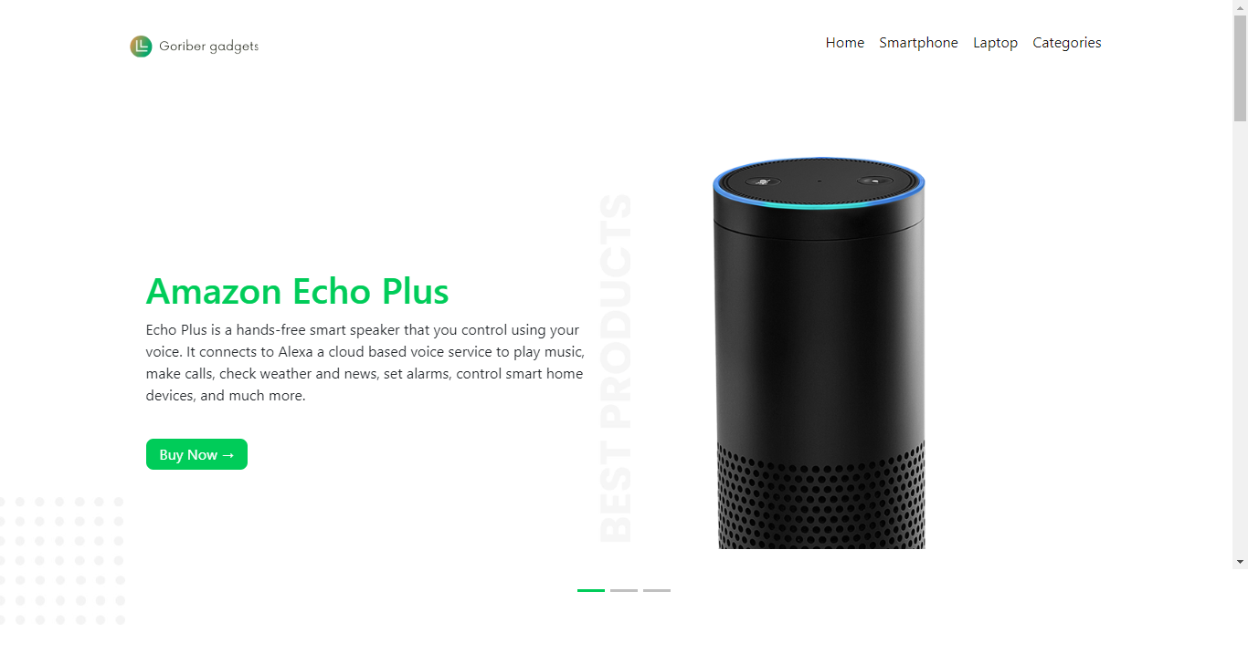
GUI(Graphical User Interface)

Slide 9
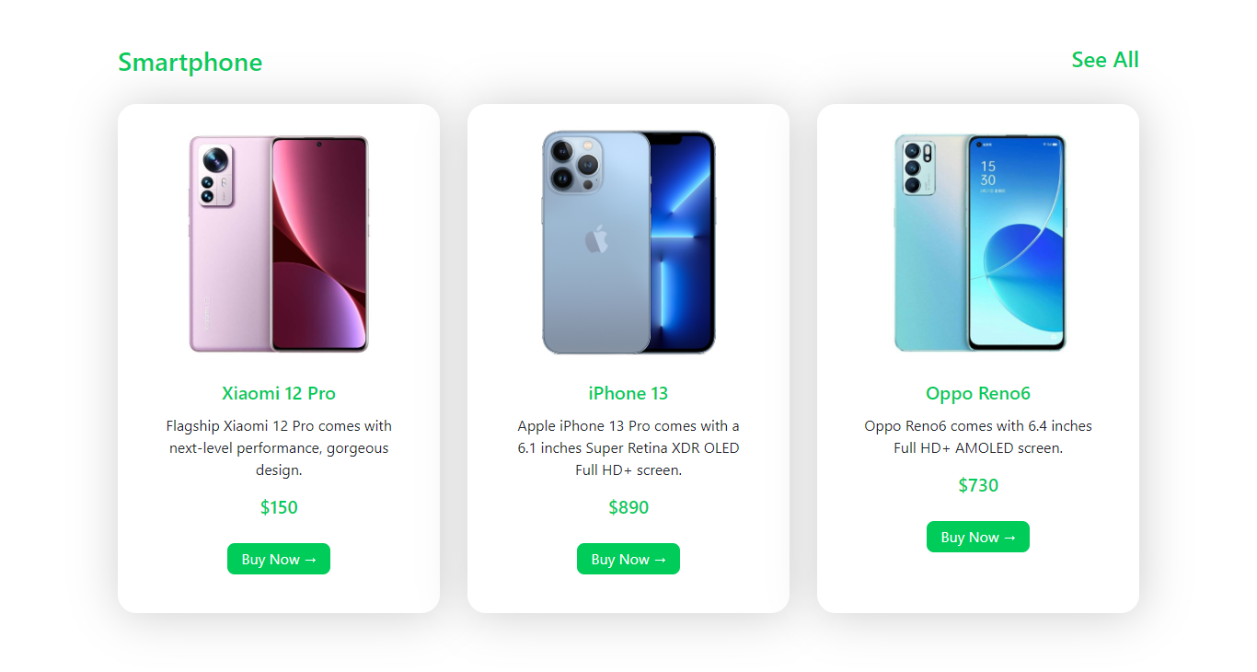

Slide 10
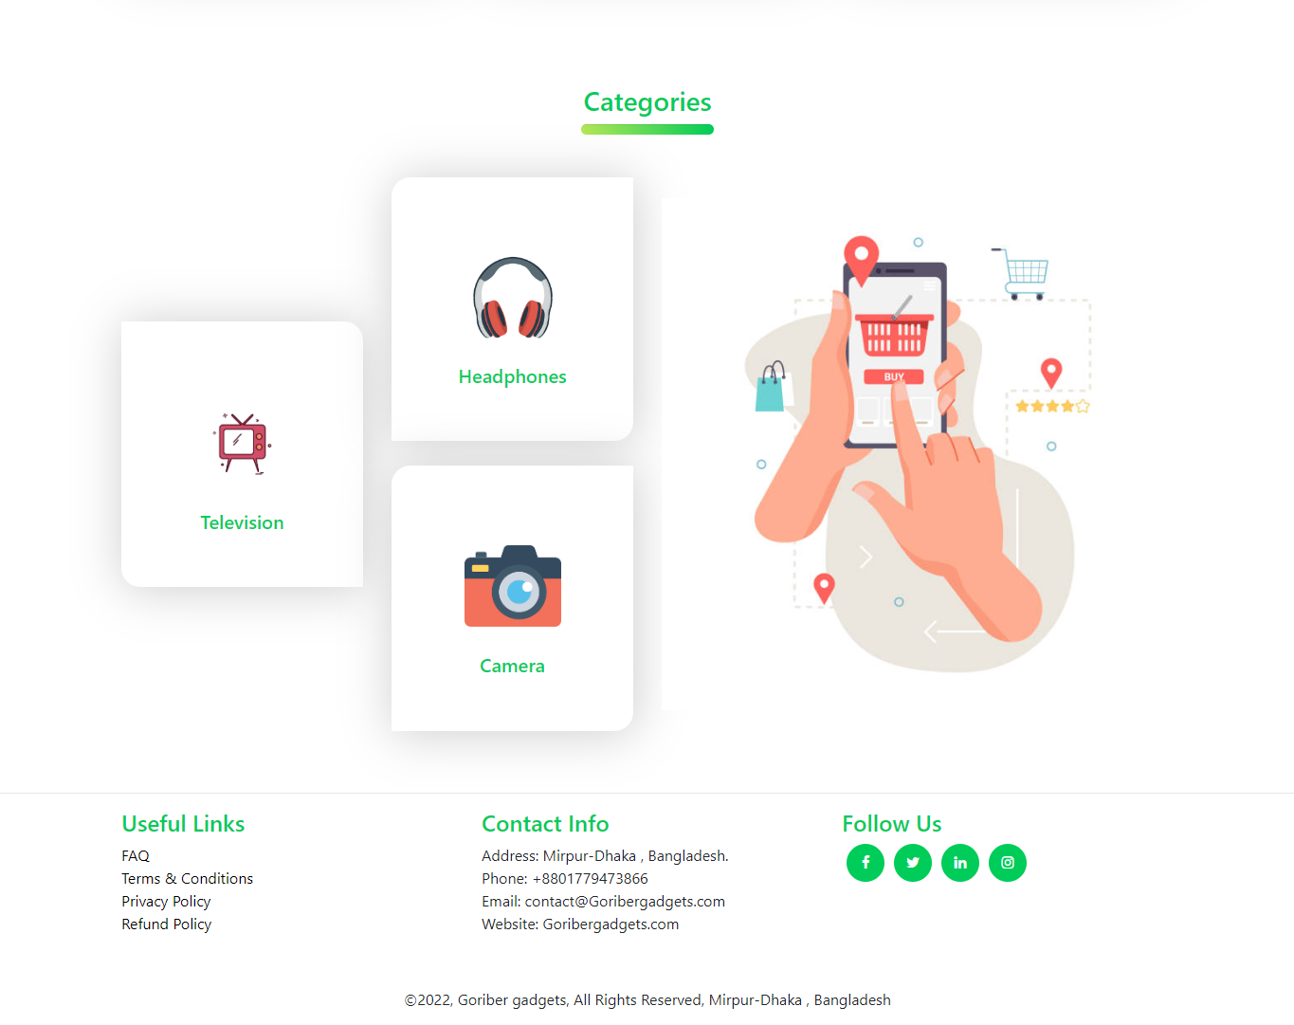

Slide 11
Thanks!
Any questions ?

