Slide 1


Green University of
Bangladesh
Dept. of Computer Science & Engineering
PRESENTED TO
PRESENTED BY
MD. Rajibul Palas
Lecturer
Dept of CSE
Jihad
ID: 202002082
MD Foysal Ahmed
ID: 202002058
1

Slide 2
Index
Introduction
Software Requirement
Block Diagram
Project Output
Limitation
Future Work
Conclusion

Slide 3
Introduction
The bank management system is an application for maintaining a person’s account in a bank . The system provides the access to the customer to create an account, deposit/withdraw the cash from his account, also to view reports of all accounts present The following presentation provides the specification for the system.

Slide 4
Problem Statement
Keeping track the all activites and their record on paper and error. It is also very effecient and a time consuming process of observing continous increase in number of client record client visiting the bank. Recording and maintaining all the client record highly unreadble, ineffecient and error problem.
It is againest this backdrop that autoated application system is being developed to addressed the problem

Slide 5
Software Requirement
Operating System
Language: Assembly language
Software: EMU 8086

Slide 6
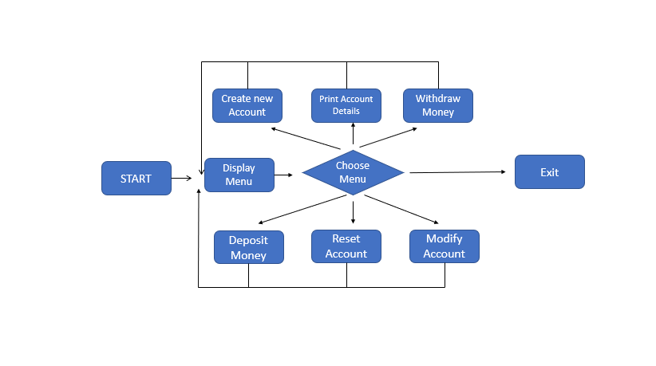
Block Diagram

Slide 7
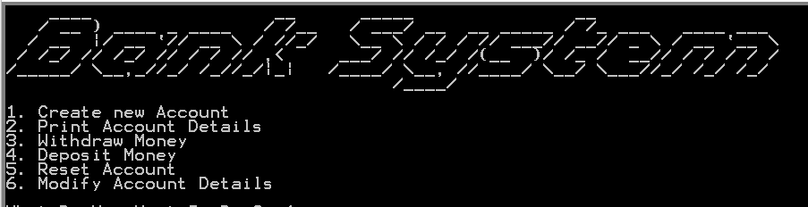
Snapshots

Slide 8
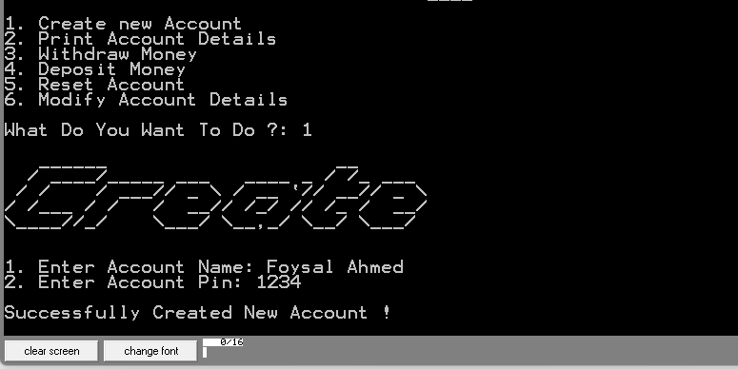

Slide 9
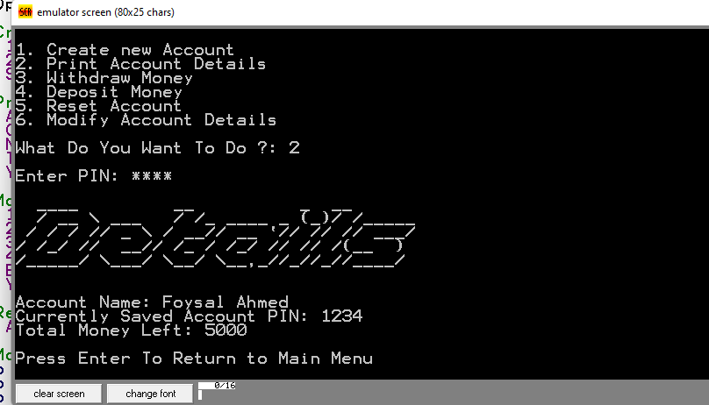

Slide 10
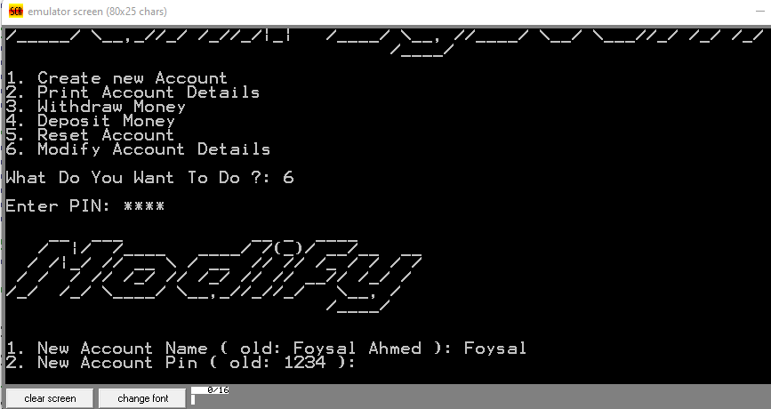

Slide 11
Limitation
Not have Individual User and Admin login system
If user know only pin number anyone can access any account

Slide 12
Future Work
Future version of this application will much be enhanced than the current version.

Slide 13
Conclussion
This project is developed to nurture the needs of a user in a banking sector by embedding all the tasks of transaction taking place in a bank

