Slide 1
28.04.2026
GDV fixed -> updated GDV curves for hypotheses experiments
Synonym experiment
Gender x Emotion experiment
Define Trajectory:
Prompt -> influences clusterability etc.?
Where do concepts live?

Slide 2
Overall findings:
Best GDV is always in language layers 44–47 (mostly 45) , consistent across all 21 experiments.
Synonym test shows large impact on the negative modality suggesting that “overwhelming” workload intensifies the negative-interestingness-mode, whereas in the GDV for extreme_positive doesn’t change significantly, but label distribution differs -> notable qualitative differences in “interestingness” do exist but do not show up in GDV
Gender × Emotion: negative-emotion conditions, anger and sad, show deeper negative GDV than positive emotions, awe and excitement, meaning the model separates interestingness labels more cleanly under negative emotional framing. (My guess: negative emotional framings converge behaviourally, while positive bring out more persona characteristics -> more ”difficult” to cluster by mere “interestingness”)
Male anger vs Female anger: near-identical GDV curves across all layers, but label distribution differs -> notable qualitative differences in “interestingness” do exist but do not show up in GDV
Blank, no persona, sits mid-range, confirming the persona does meaningfully shift label separation on ”interestingness”

Slide 3
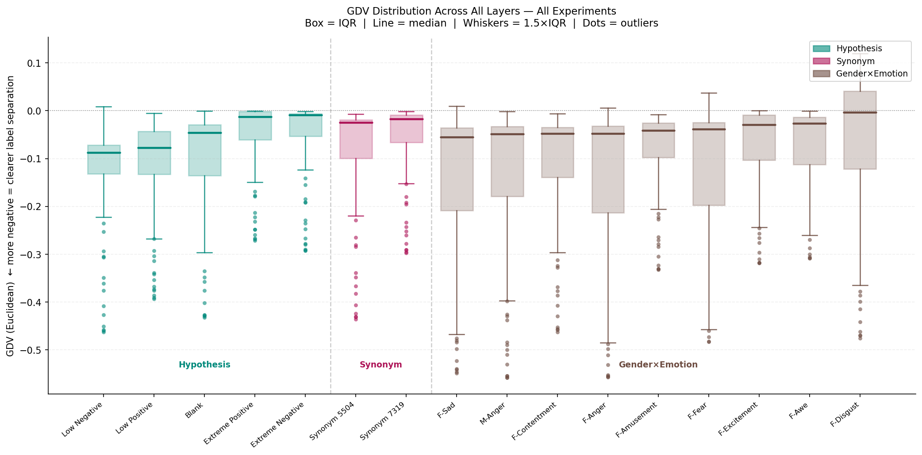
7319 => extreme positive
5504 => extreme negative

Slide 4
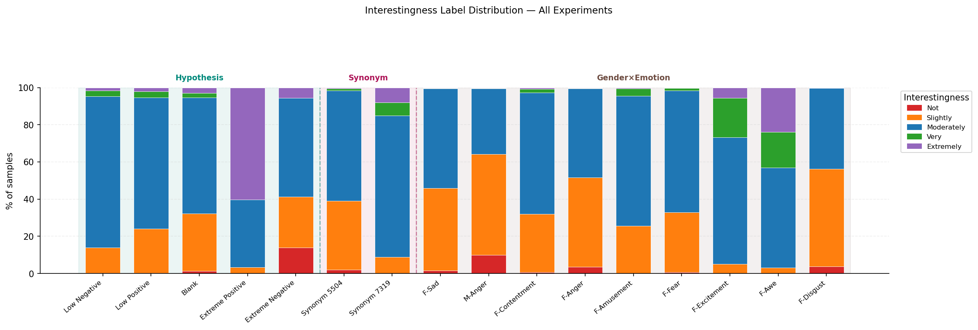

Slide 5
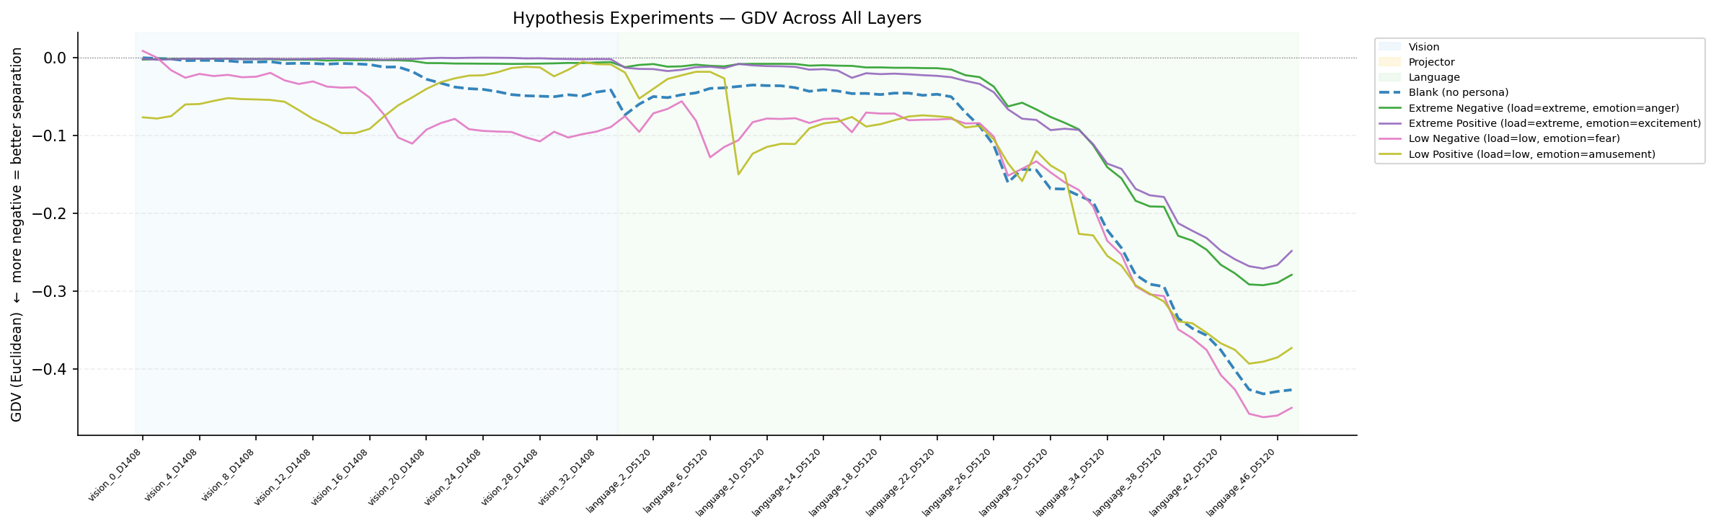
GDV updated for Hypotheses

Slide 6
GDV updated for Hypotheses
Condition | Best GDV | Best Layer
Blank (no persona) | -0.4325 | Language 45
Extreme Negative (load=extreme, emotion=anger) | -0.2927 | Language 45
Extreme Positive (load=extreme, emotion=excitement) | -0.2713 | Language 45
Low Negative (load=low, emotion=fear) | -0.4624 | Language 45
Low Positive (load=low, emotion=amusement) | -0.3936 | Language 44

Slide 7
Synonym Test: Extreme is a confounder?
Testing the label distribution with a changed prompt.
“extreme” mental load => “overwhelming” mental load
Why that choice?
Mental load from low -> extreme has a psychological implication:
psychologically speaking an extreme mental load is unsustainable and thereby has a negative connotation.
(would like to test “immense” as a less “negative-biased” synonym)

Slide 8
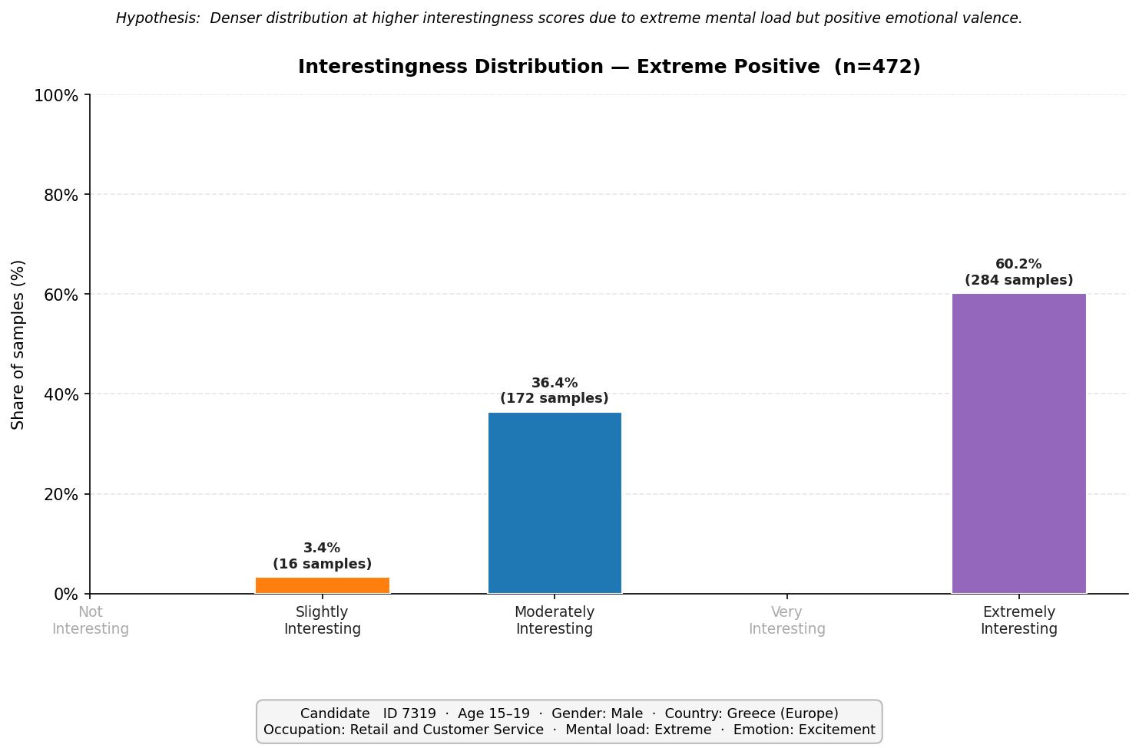
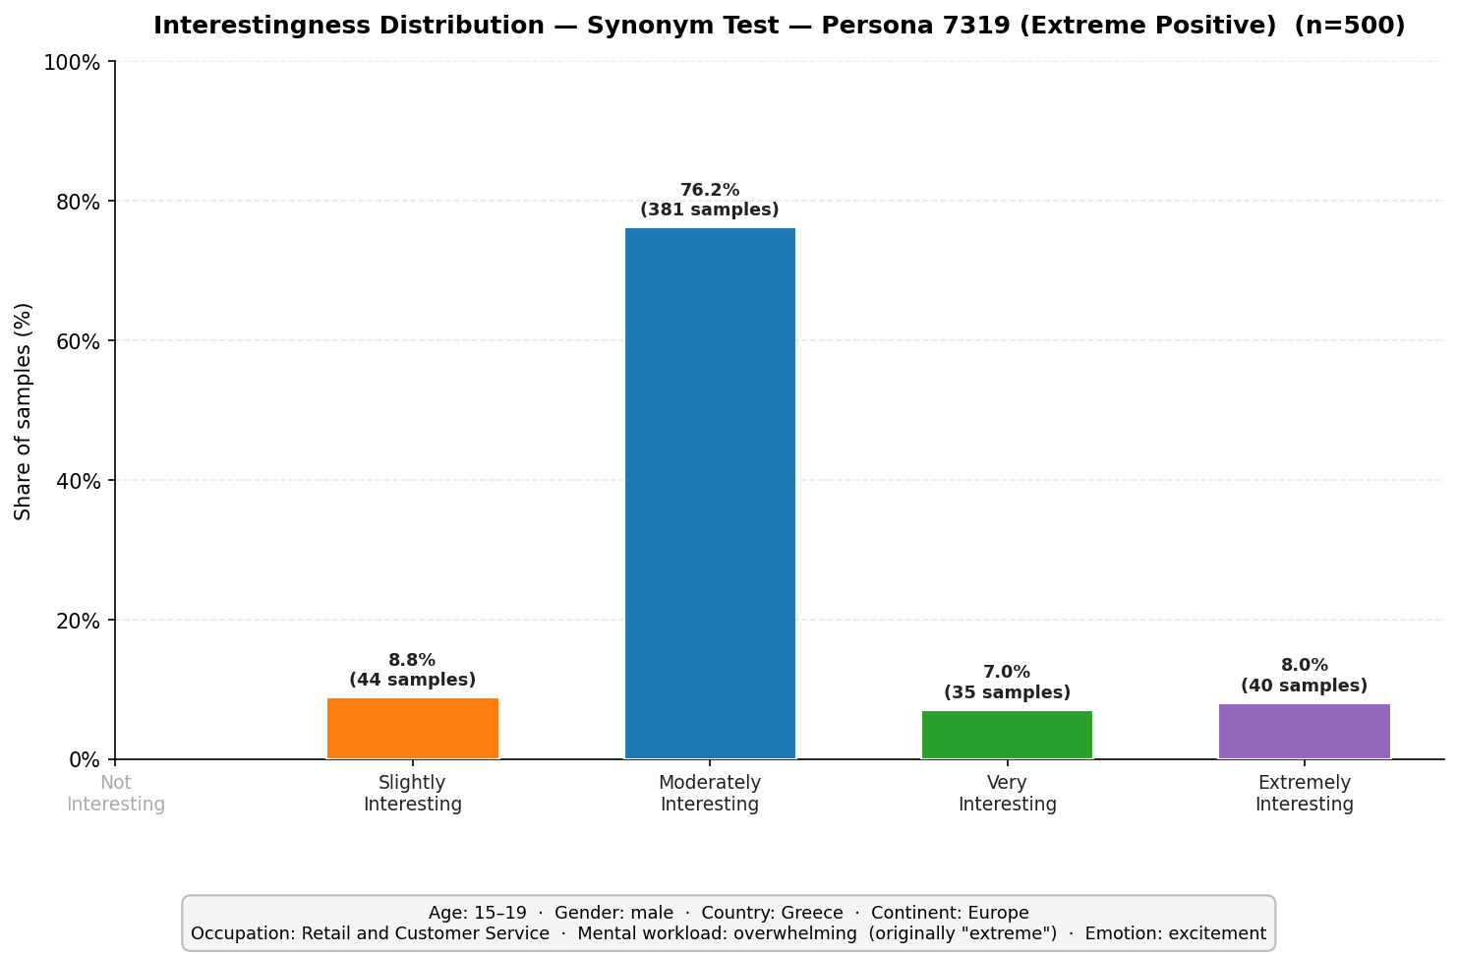
Extreme is a confounder?

Slide 9
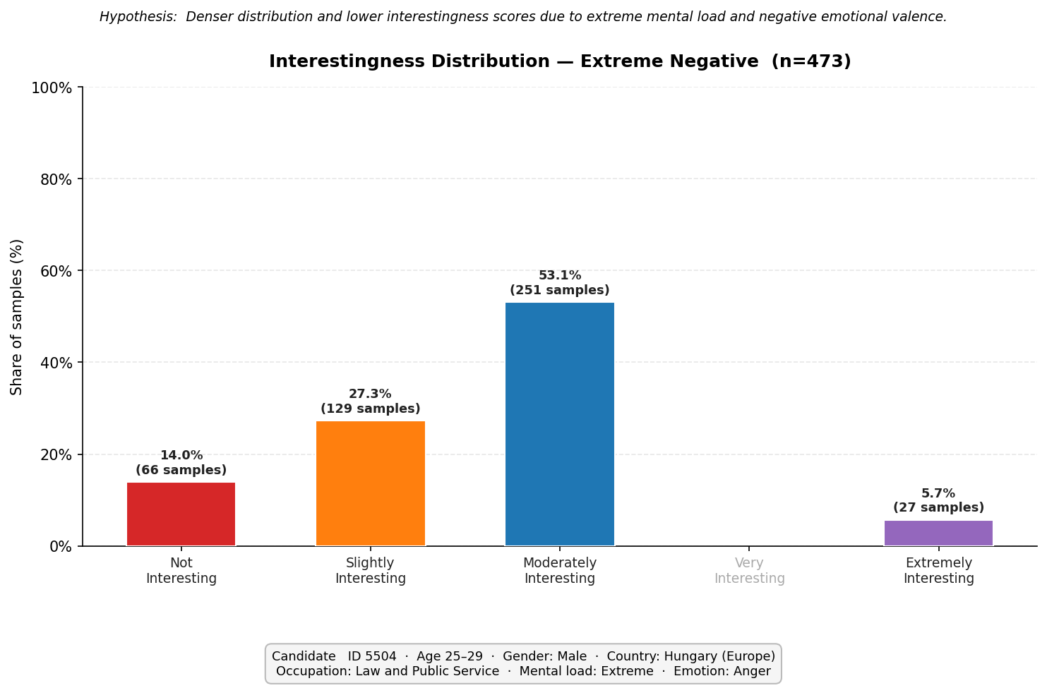
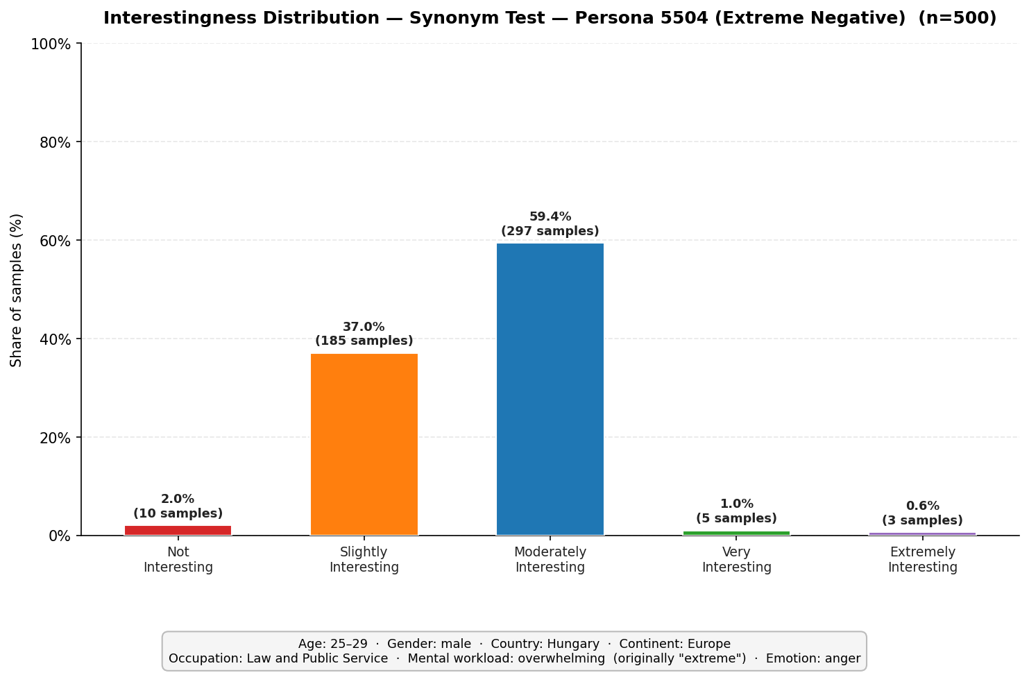
Extreme is a confounder?

Slide 10
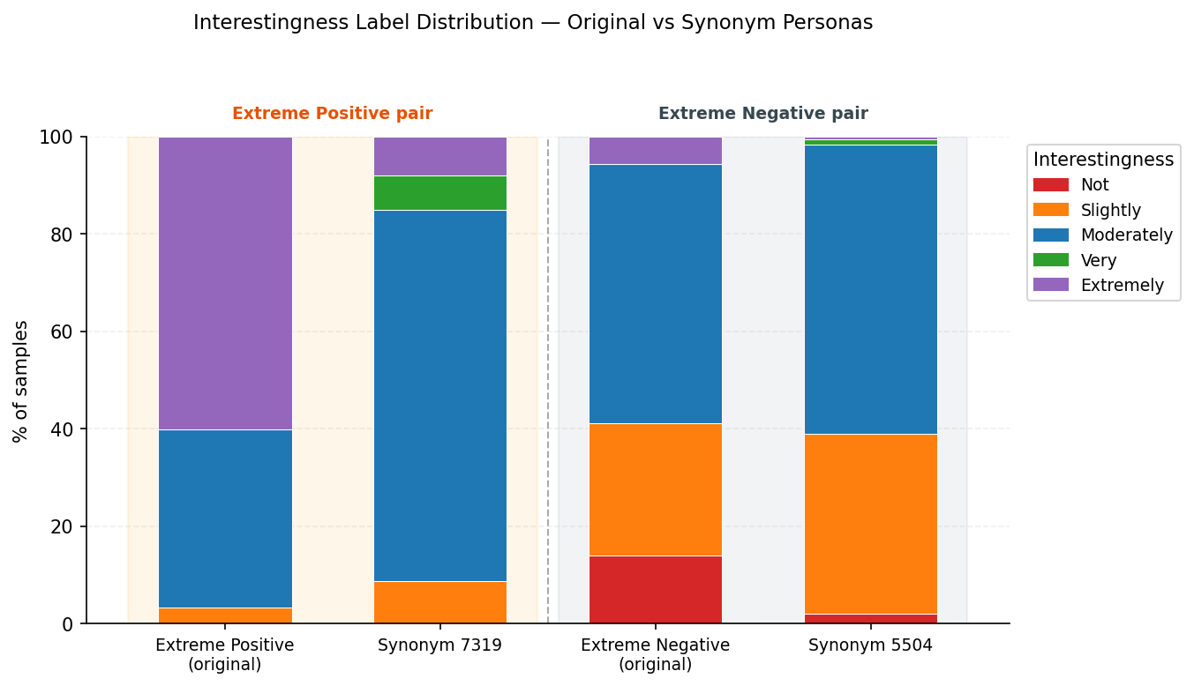
Extreme is a confounder?
Condition | Best GDV | Best Layer | Δ best GDV vs original
Extreme Neg original | -0.2927 | Language 45
Extreme Neg synonym | -0.4355 | Language 45 | -0.1428
Extreme Pos original | -0.2713 | Language 45
Extreme Pos synonym | -0.2970 | Language 45 | -0.0257

Slide 11
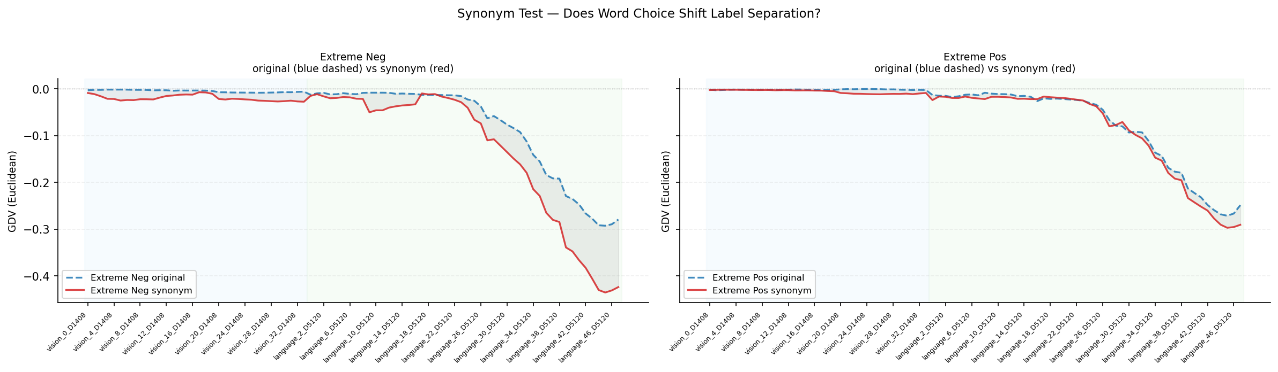
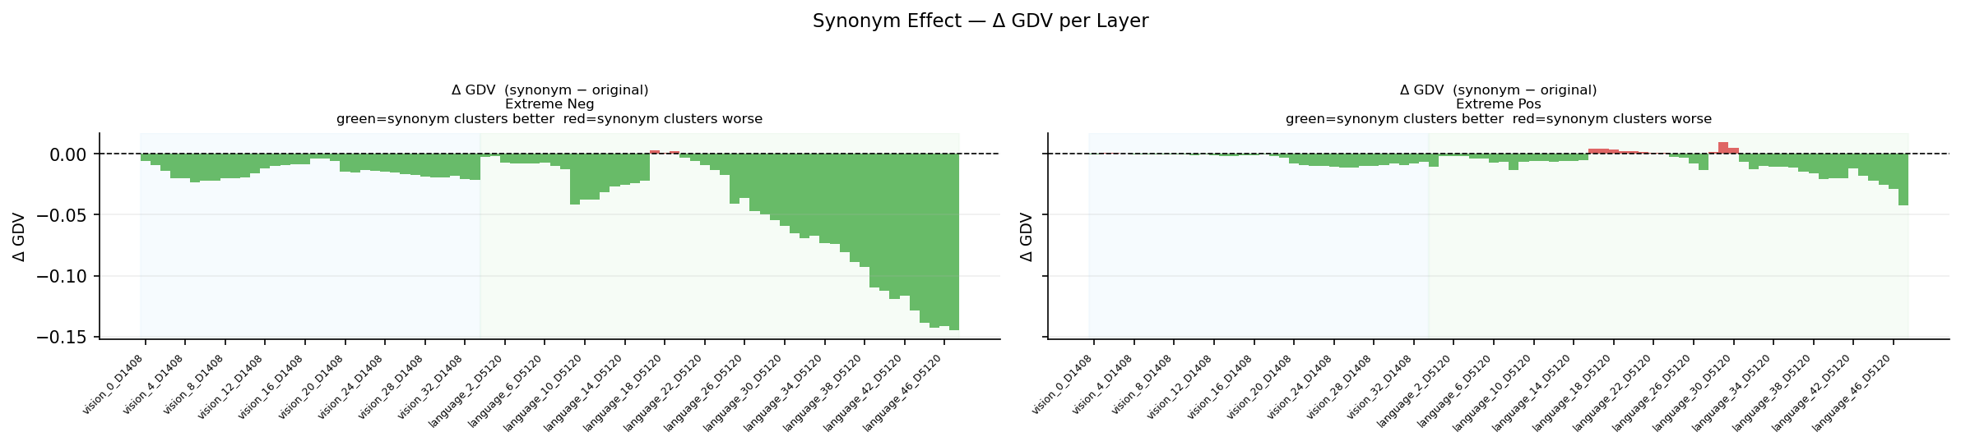

Slide 12
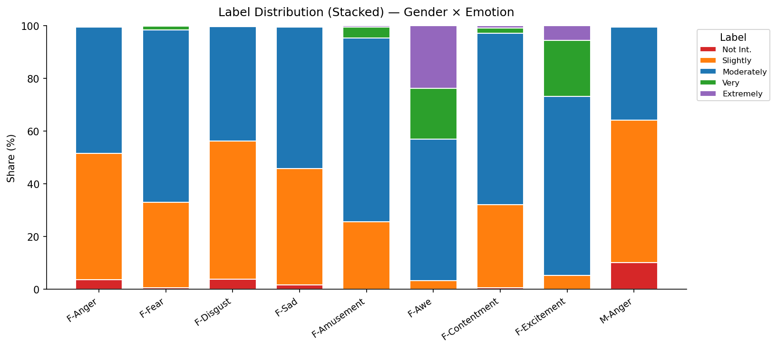
Impact of Gender vs. Emotion

Slide 13
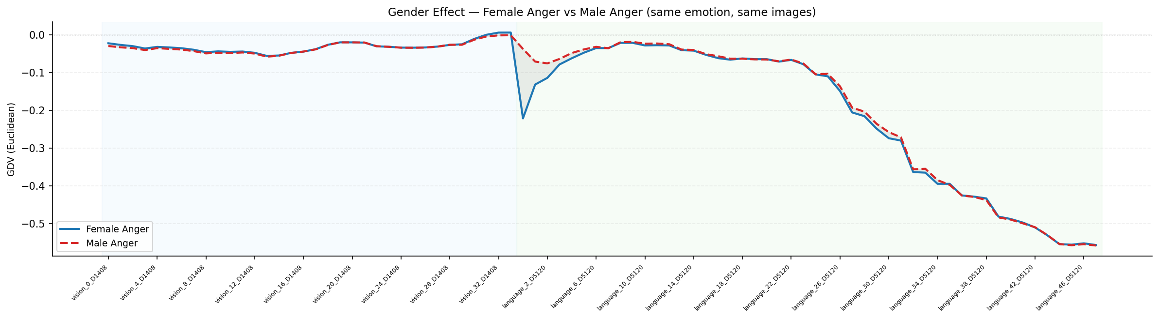
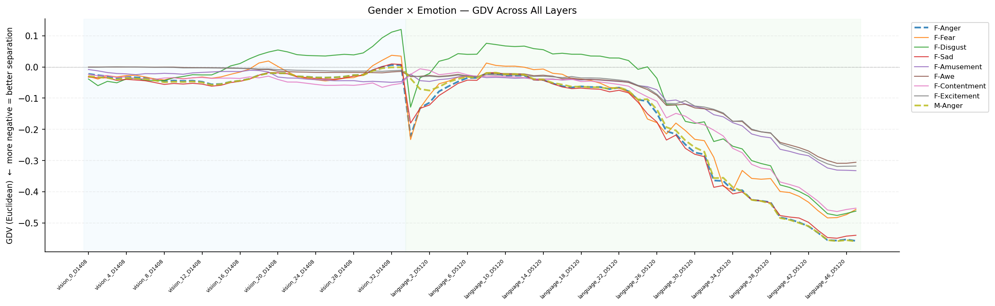

Slide 14
Impact of Gender vs. Emotion
Condition | Best GDV | Best Layer
F-Anger | -0.5569 | Language 47
F-Fear | -0.4832 | Language 44
F-Disgust | -0.4755 | Language 45
F-Sad | -0.5484 | Language 45
F-Amusement | -0.3320 | Language 47
F-Awe | -0.3086 | Language 45
F-Contentment | -0.4629 | Language 45
F-Excitement | -0.3185 | Language 45
M-Anger | -0.5583 | Language 47

Slide 15
2 Ways to identify thematic clusters
Analyse the “explanations” via LDA / TF-IDF and color the dots on the gdv plots -> do they they cluster?
Analyse the clusters on the gdv plot and ex-post try to identify visual or explanation-based unifying characteristics

Slide 16
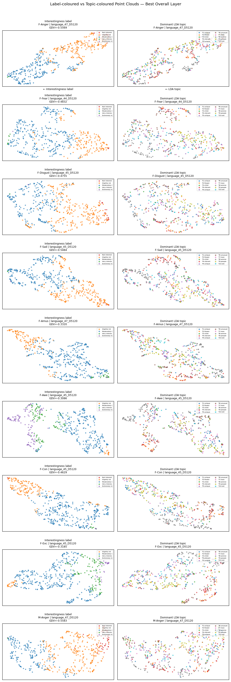
Analyse the “explanations” via LDA / TF-IDF and color the dots on the gdv plots -> do they they cluster?
Thematic Areas exist but no clear thematic clustering by the “LDA” topics
especially “serene” -> correlates with inter-subjective interestingness!
“people” also somewhat clusters
LDA might not be ideal for identifying “themes” from samples

Slide 17
Analyse the “explanations” via LDA / TF-IDF and color the dots on the gdv plots -> do they they cluster?
Thematic Areas exist but no clear thematic clustering by the “LDA” topics
especially “serene” -> correlates with inter-subjective interestingness!
“people” also somewhat clusters
LDA might not be ideal for identifying “themes” from samples

Slide 18
Analyse the “explanations” via LDA / TF-IDF and color the dots on the gdv plots -> do they they cluster?
Thematic Areas exist but no clear thematic clustering by the “LDA” topics
especially “serene” -> correlates with inter-subjective interestingness!
“people” also somewhat clusters
LDA might not be ideal for identifying “themes” from samples

Slide 19
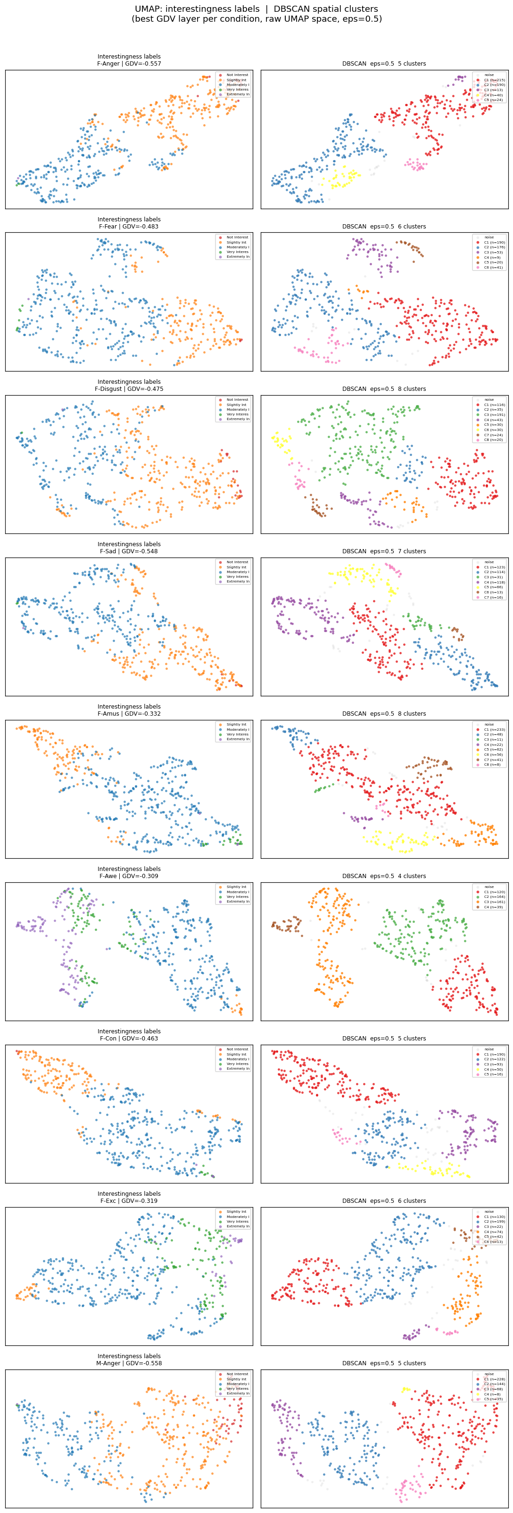
2. ex-post identifying characteristics from existing clusters

Slide 20
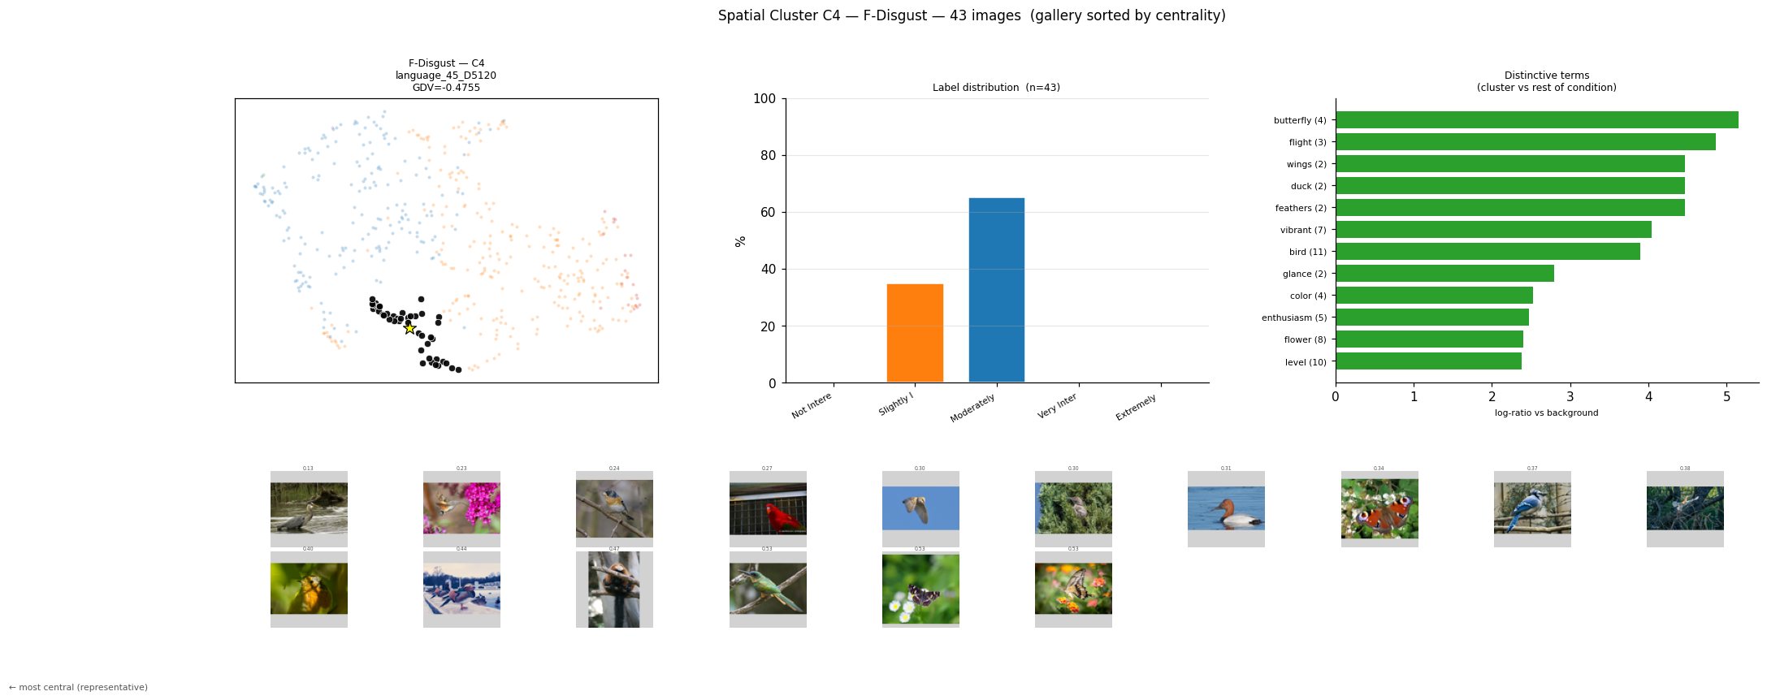

Slide 21
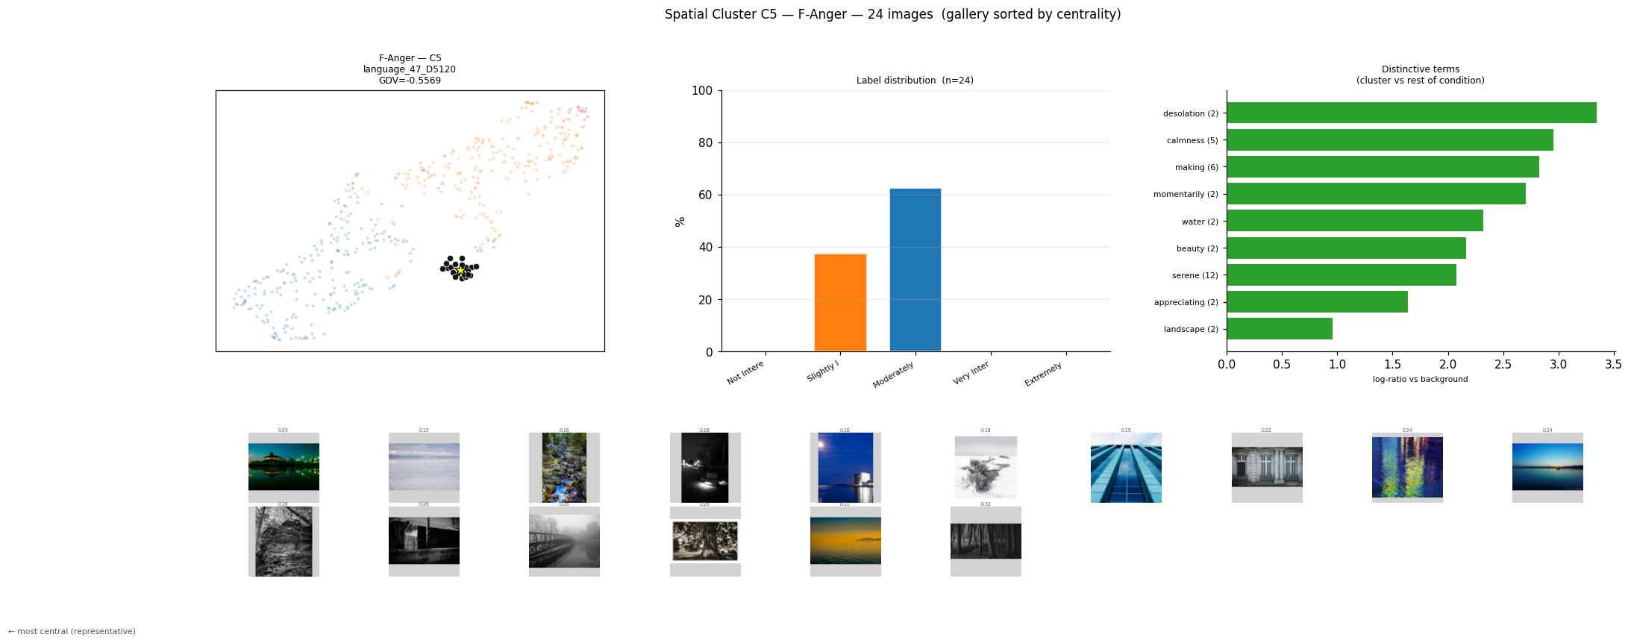

Slide 22
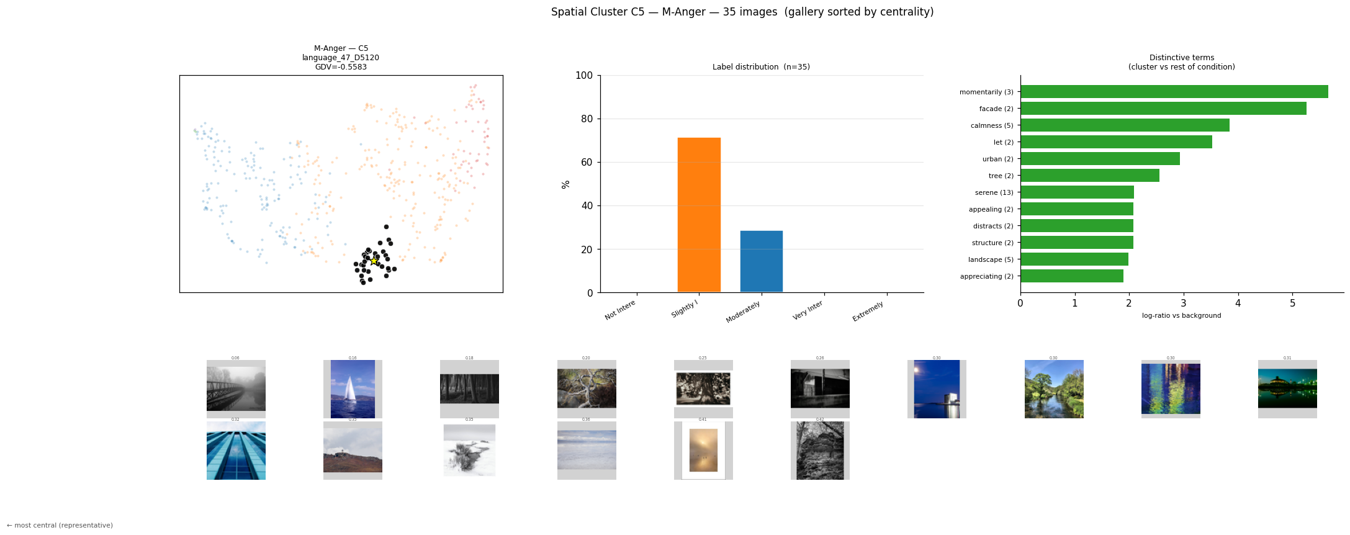

Slide 23
