Slide 1
Tax Data Prediction
Christopher Hyek
7/21/2019
1994 Census Data Set

Slide 2

Goal
Predict annual salary based on data

Slide 3

Data Acquisition
To predict tax data we obtain
census bureau information

Slide 4

Scrubbing
Removing serous outliers
Using proper labels
Removing typos

Slide 5

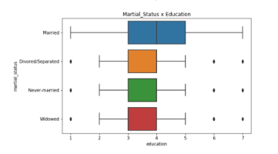
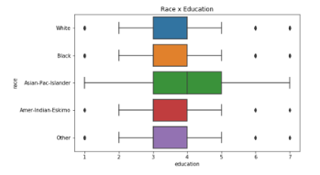
Exploring
There are very peculiar patterns from the data
Most of it is categorical so very few hard connections

Slide 6
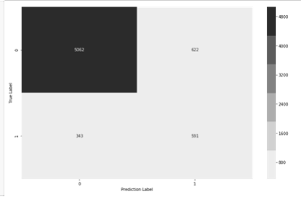

Modeling
Logistic Regression
Focus on precision
Validate Data

Slide 7

Interpreting
85% accuracy
48% precision
67% accuracy

Slide 8
Recommendations
For better Precision we need:
To focus on either martial status or relationship (recommend martial status).
To redo Capital gains and capital loss for clarity
Properly label for unemployed and never-worked people
Why?
Through testing they improved our model by removing these.

Slide 9
Future Recommendations
We should:
Attempt a new model to verify
Try different constraints
Refine the survey data and try again

Slide 10
Thank you

