Slide 1
Project 2: WebNovel Nexus
Danyan Gu, Xing ZHOU

Slide 2
1. Project Objective
Unify Web Fiction Discovery & Management: Create a centralized platform that aggregates novels from disparate sources (Royal Road, Wattpad, AO3, etc.) into a single searchable library, enabling users to track, organize, and manage their reading across all platforms through a personal digital bookshelf.
Enable Precision Content Discovery: Implement web-fiction-specific tagging, filtering, and recommendation systems that understand niche genres (Xianxia, LitRPG, Progression Fantasy) and support both positive tag matching and negative exclusion, allowing readers to find highly specific content while avoiding unwanted tropes.
Build Community-Centric Engagement: Foster a specialized community where users can contribute novel entries, write reviews using domain-specific terminology, create and share curated reading lists, and receive personalized recommendations based on collective reading patterns and tag overlap analysis.

Slide 3
2. User Personas
The Power Reader (Alex, 24)
  Individuals who consume a high volume of serialized web content weekly across multiple hosting sites. Alex wants one dashboard that shows all his novels with a direct link to the source.
Persona 2: The Niche Seeker (Mei, 19)
Mei exclusively reads Xianxia, LitRPG, and Progression Fantasy. She's frustrated that mainstream book sites either don't carry these genres or use generic tags that don't match web fiction conventions.
Persona 3: The Community Member (Jordan, 28)
They want to create curated reading lists to share with their Discord communities, follow trusted readers with similar tastes, and write reviews that reference tropes without having to explain them from scratch.

Slide 4
3. Technical Stack
Frontend: HTML5, Bootstrap
Backend: Node.js, Express
Database: MongoDB

Slide 5
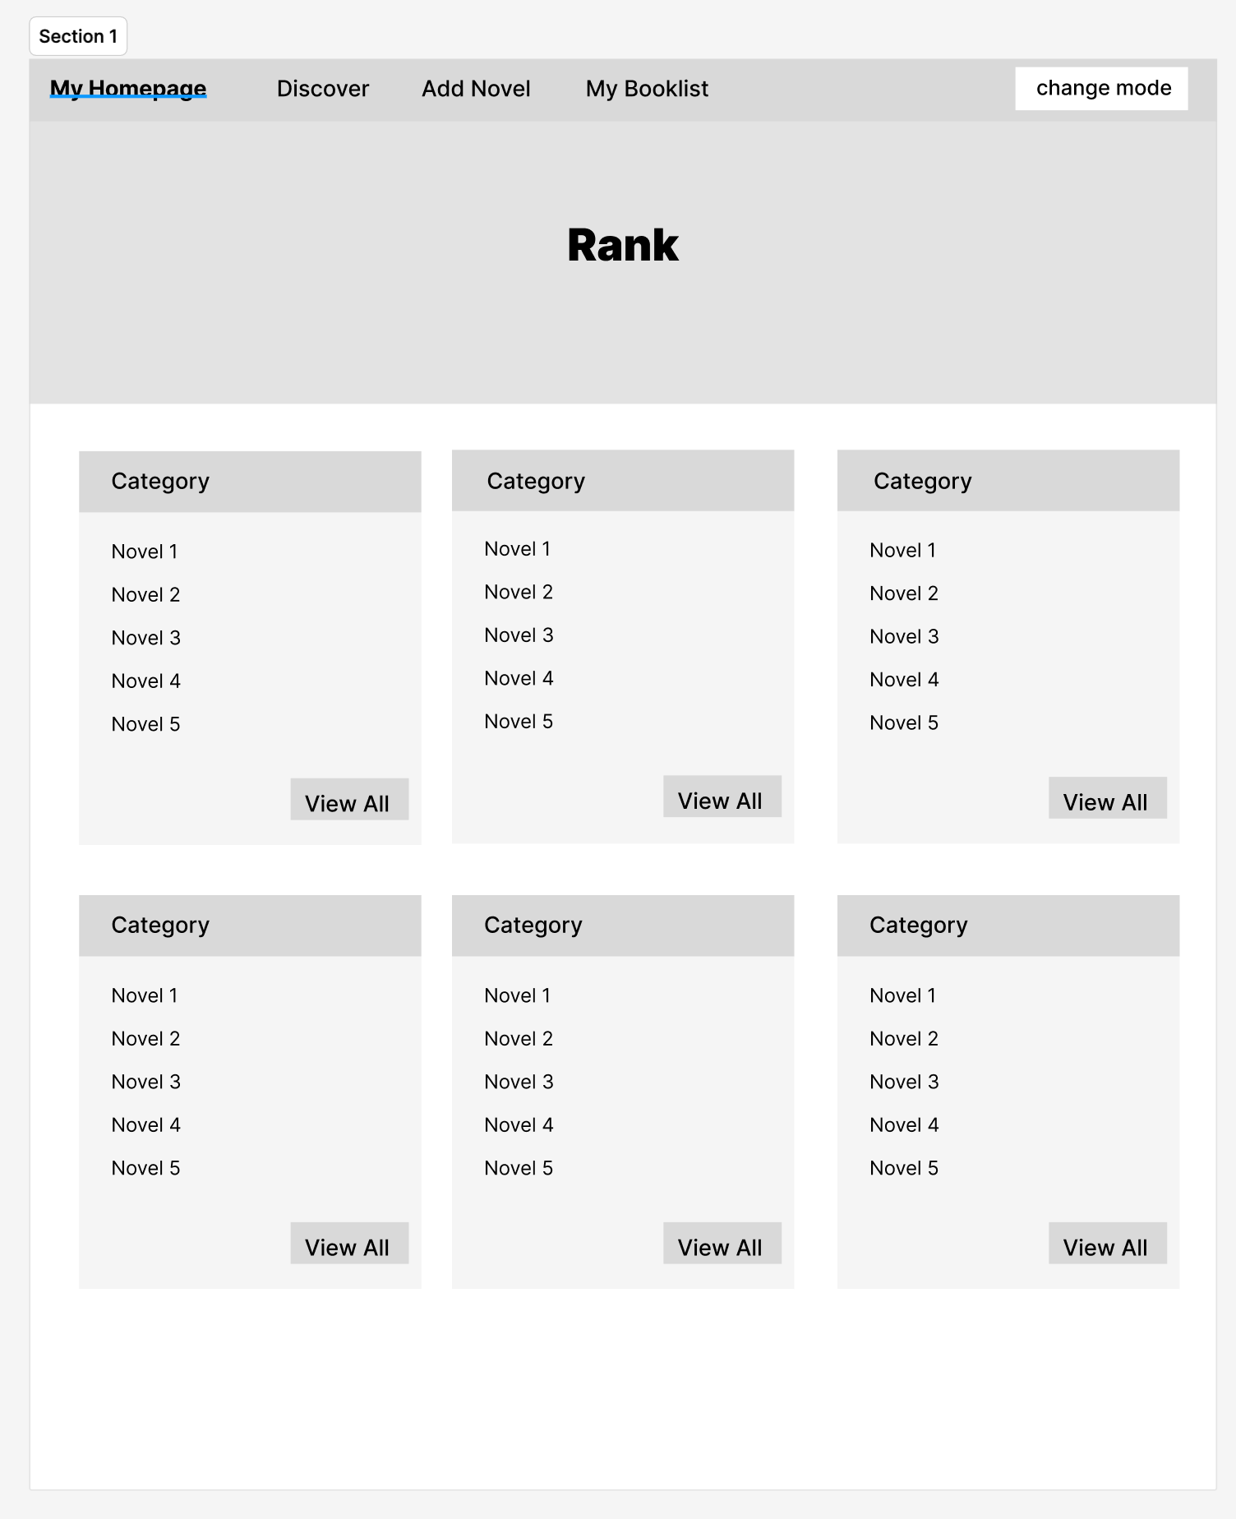
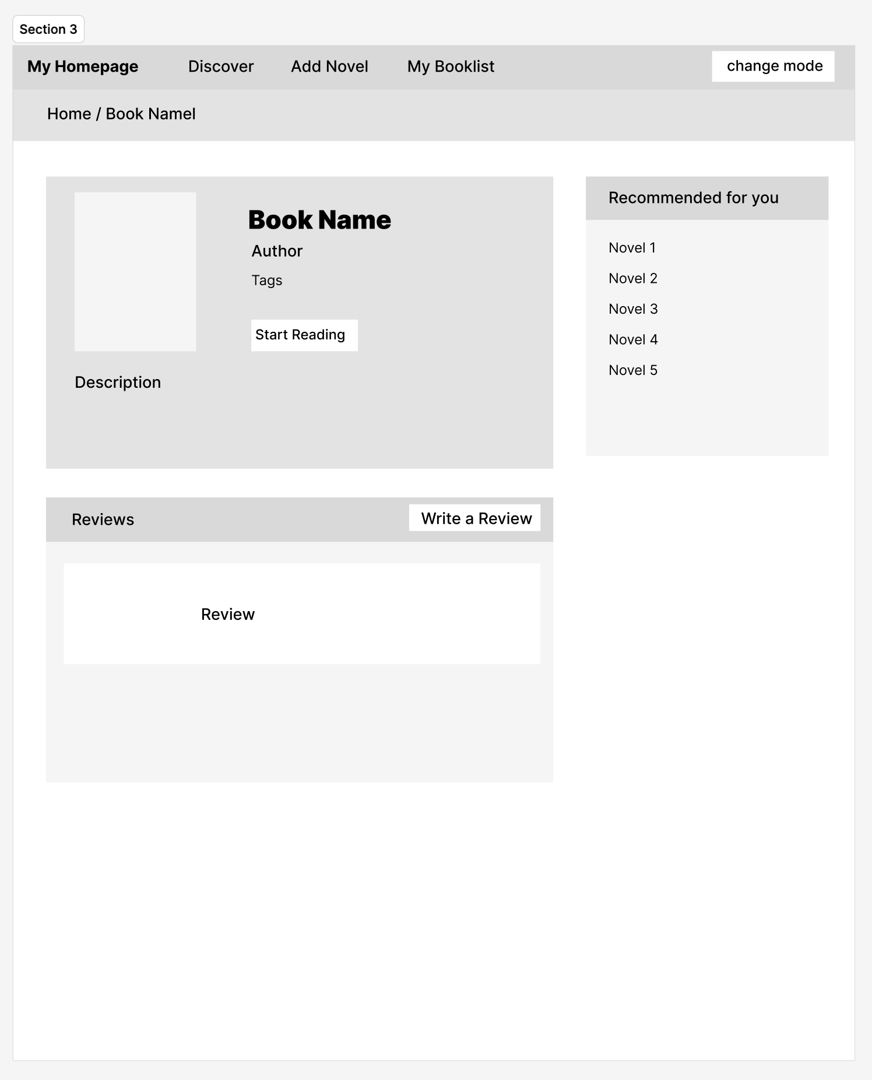
4. Design Mockups
Homepage
  The homepage shows top 5 readings novel of each category
Novel page
  This page displays comprehensive novel details and generates personalized recommendations based on the current novel's attributes and the user's reading preferences.

Slide 6
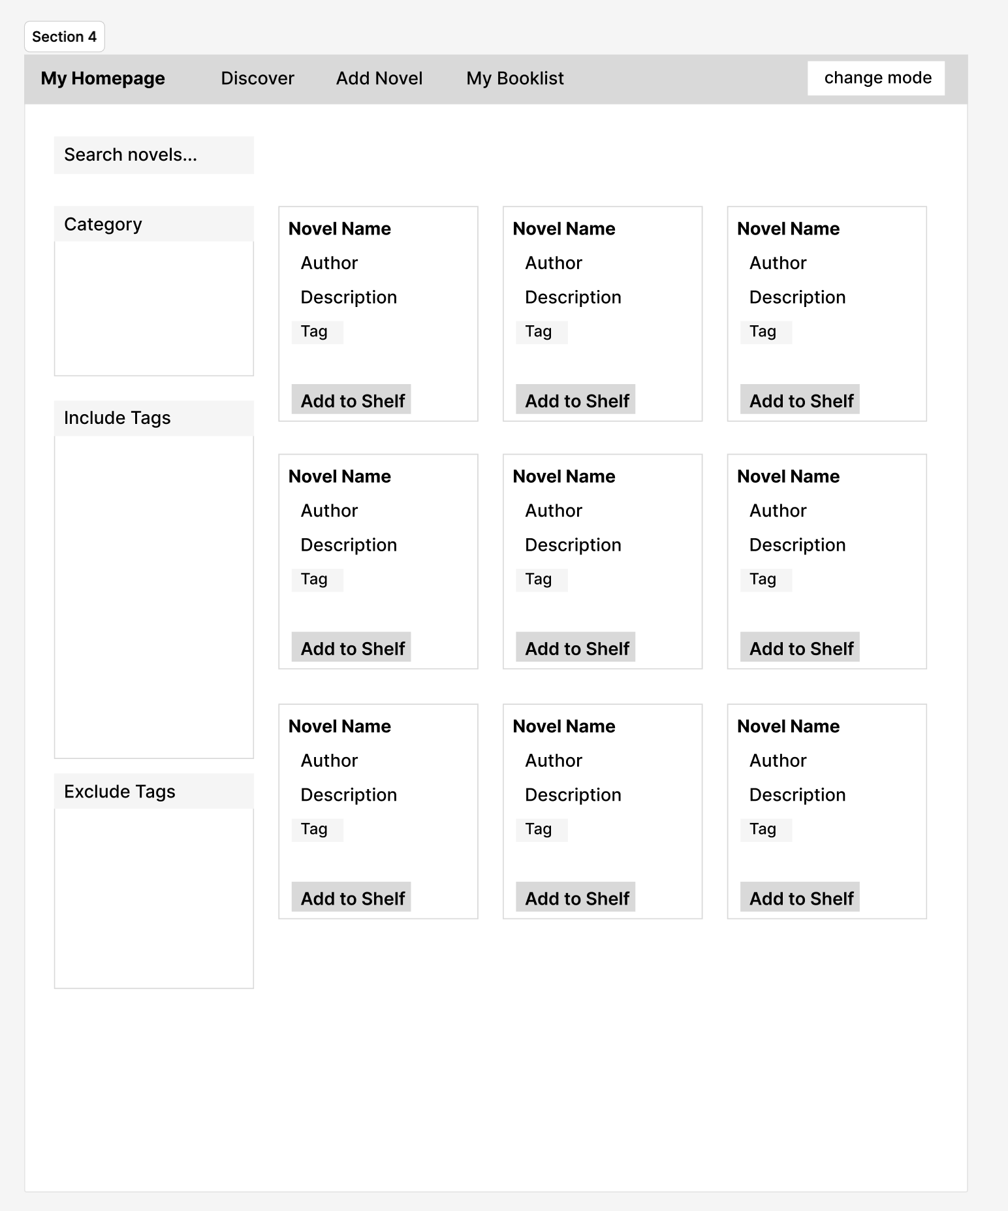
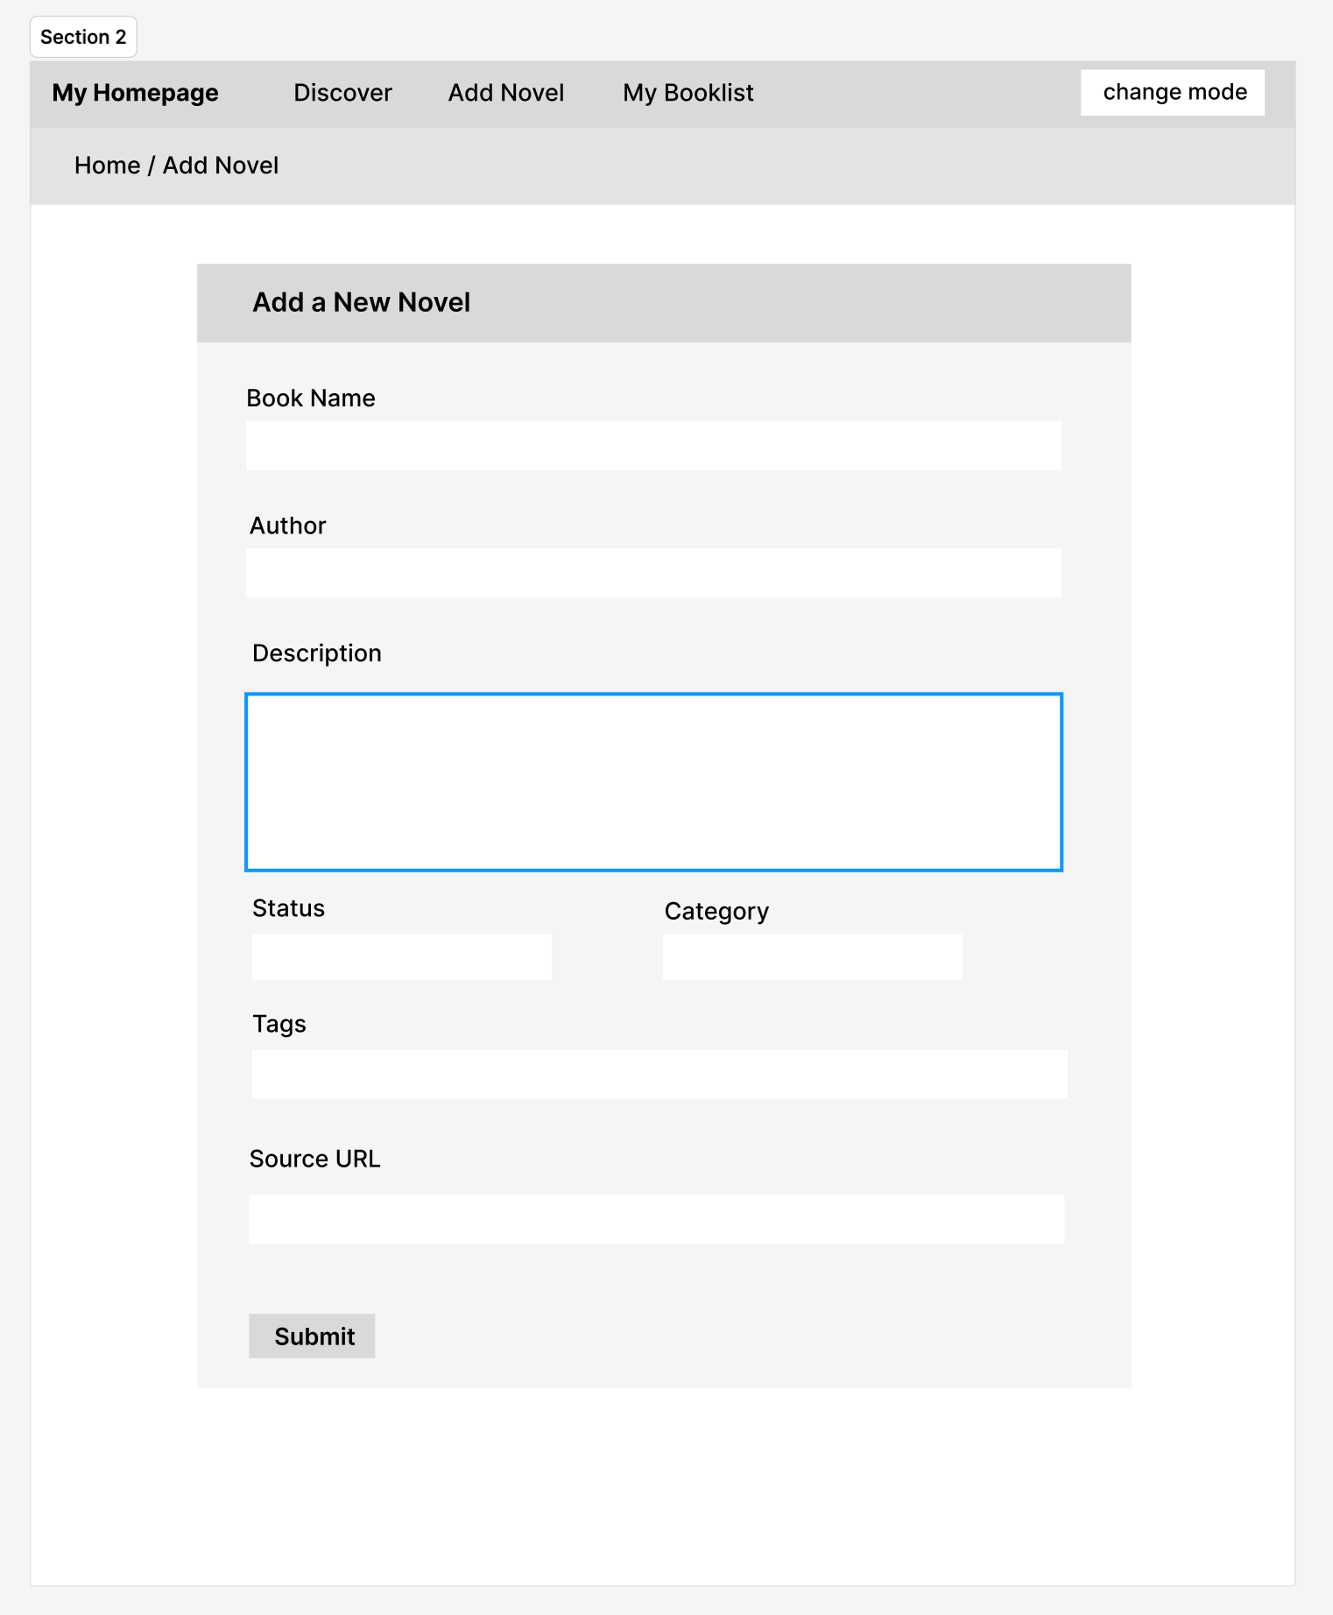
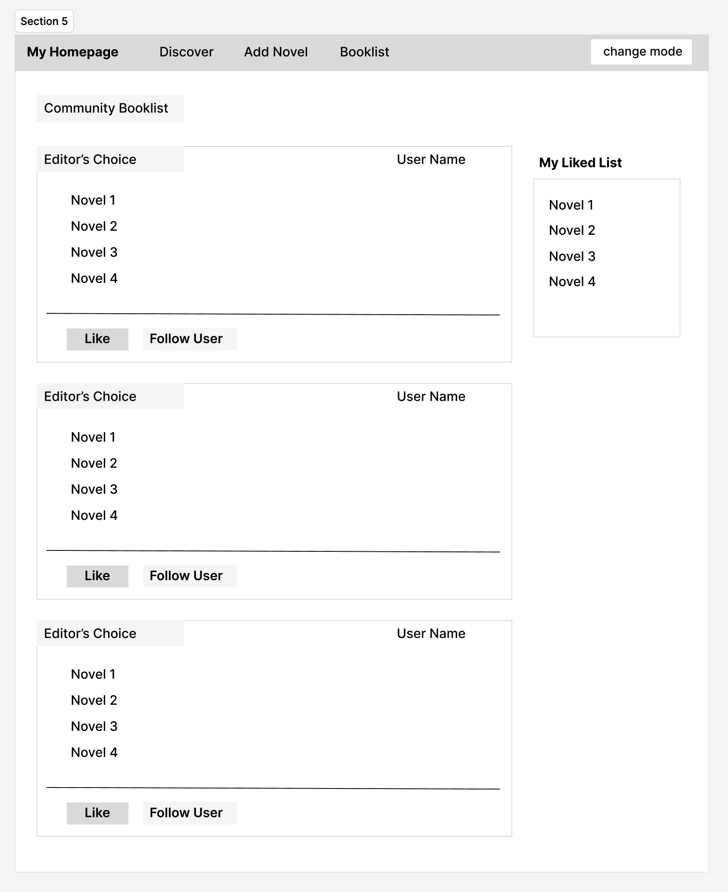
4. Design Mockups
Discover
  Displays the complete novel library with advanced tag filtering, allowing you to include specific genres/tropes you want and exclude unwanted content for precise discovery.
Add Novel
  Add novels to our library.
Booklist
  A community-driven booklist feature enabling users to discover, follow, and curate shared reading collections from other members.

Slide 7
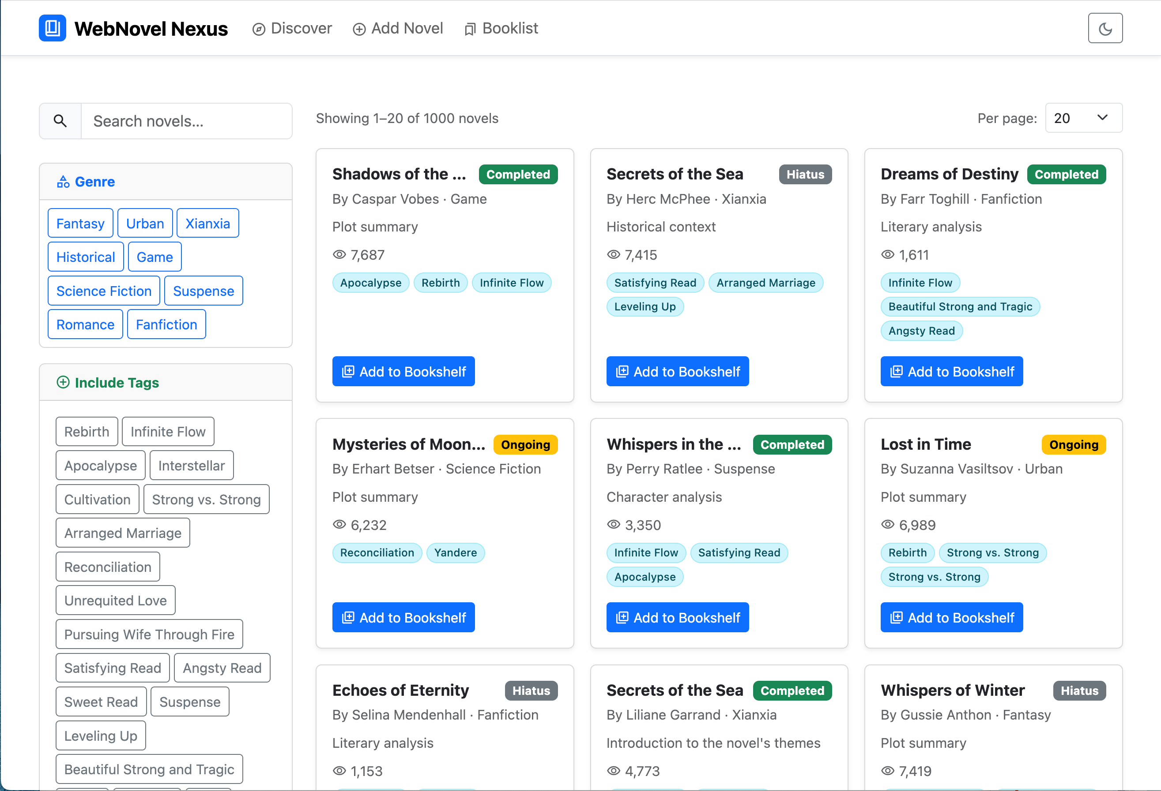
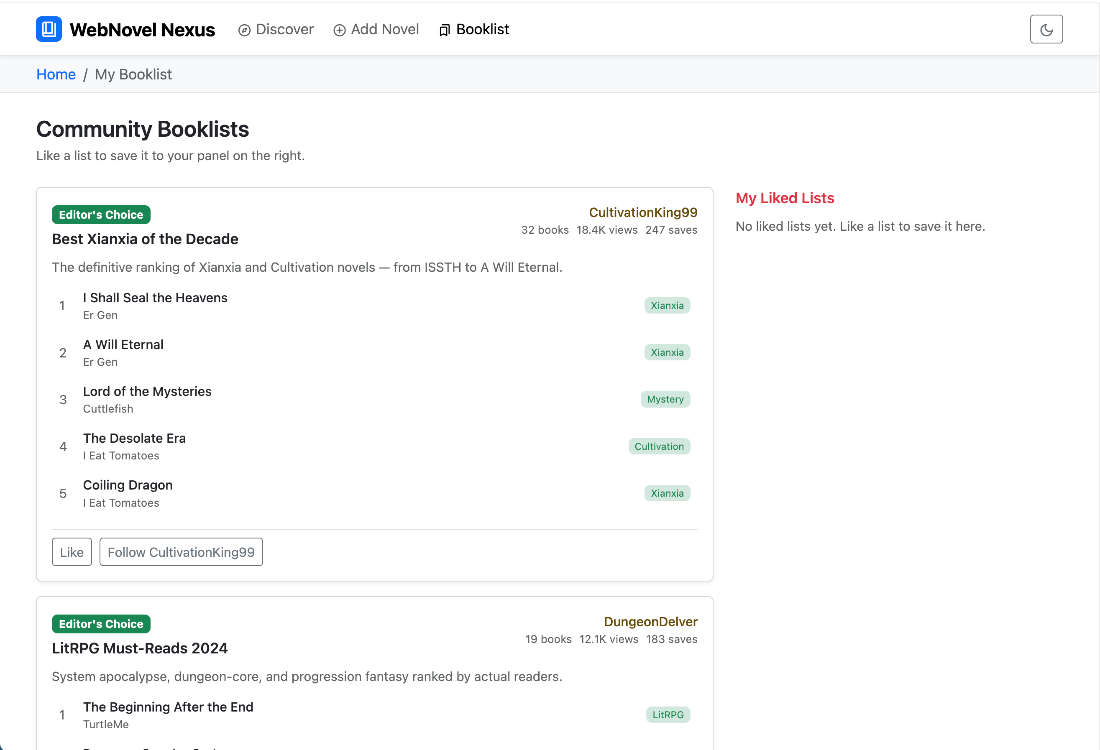
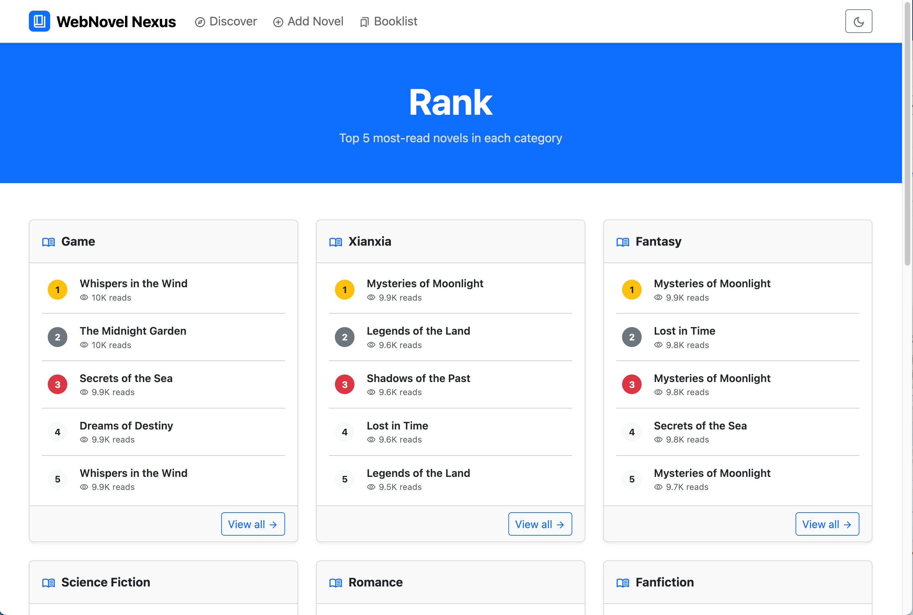
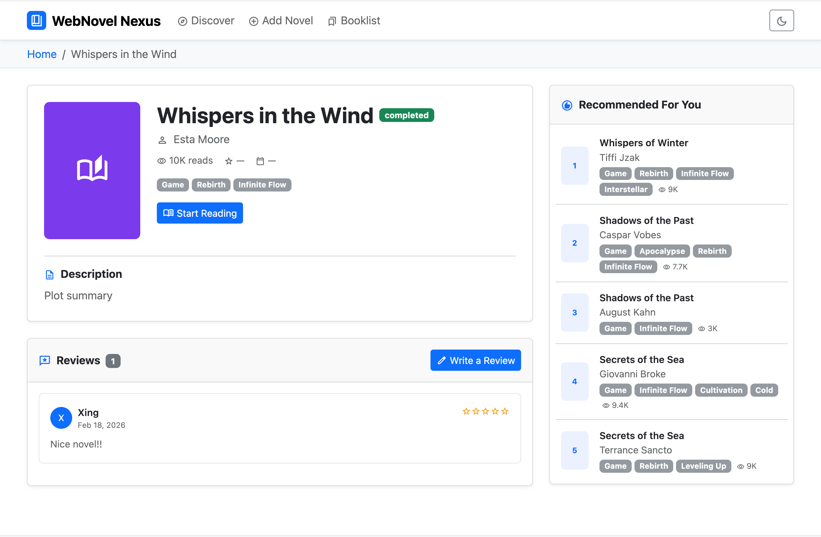
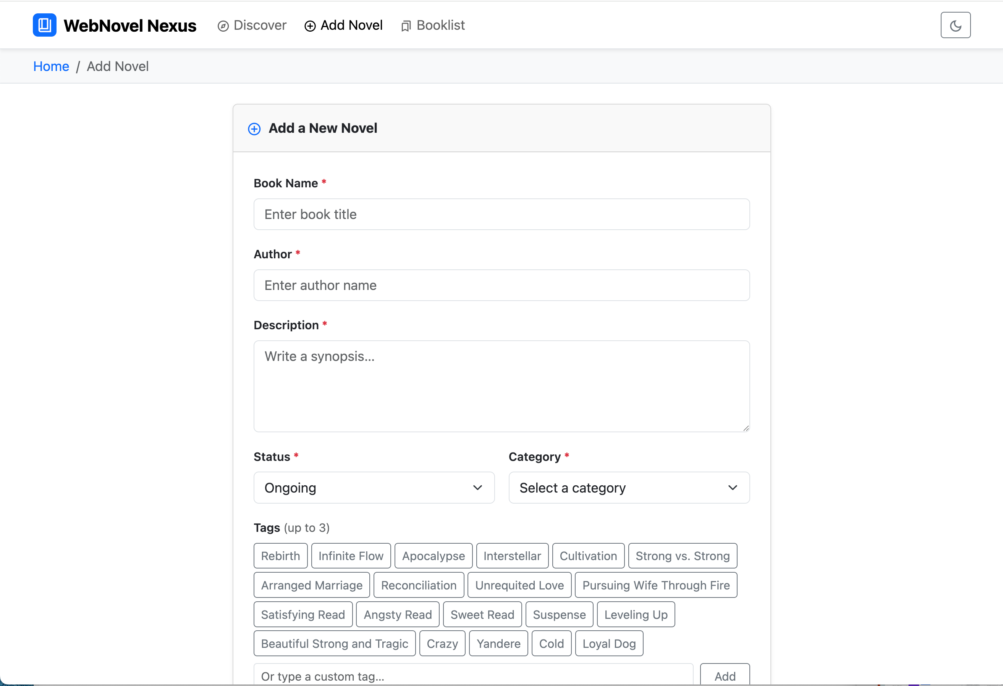
5. Demo
Go to My Website
Demo Video

Slide 8
6. What I’m Most Proud Of
Two Mode Layout: Our website can be viewed in both day and night mode.
Responsive & organized: The page will adapt seamlessly to both desktop browsers and mobile devices, with a clean, well-structured organization

Slide 9
7. Challenges
Recommendation System: Due to the absence of user behavior data at launch, the system implements a content-based filtering approach using machine learning clustering techniques. The algorithm analyzes novel metadata—specifically genre categories and tag combinations—to compute similarity scores between novels. When a user views a specific title, the system identifies and surfaces the top 5 novels with the highest tag overlap and genre alignment

Slide 10
Thanks

