Slide 1
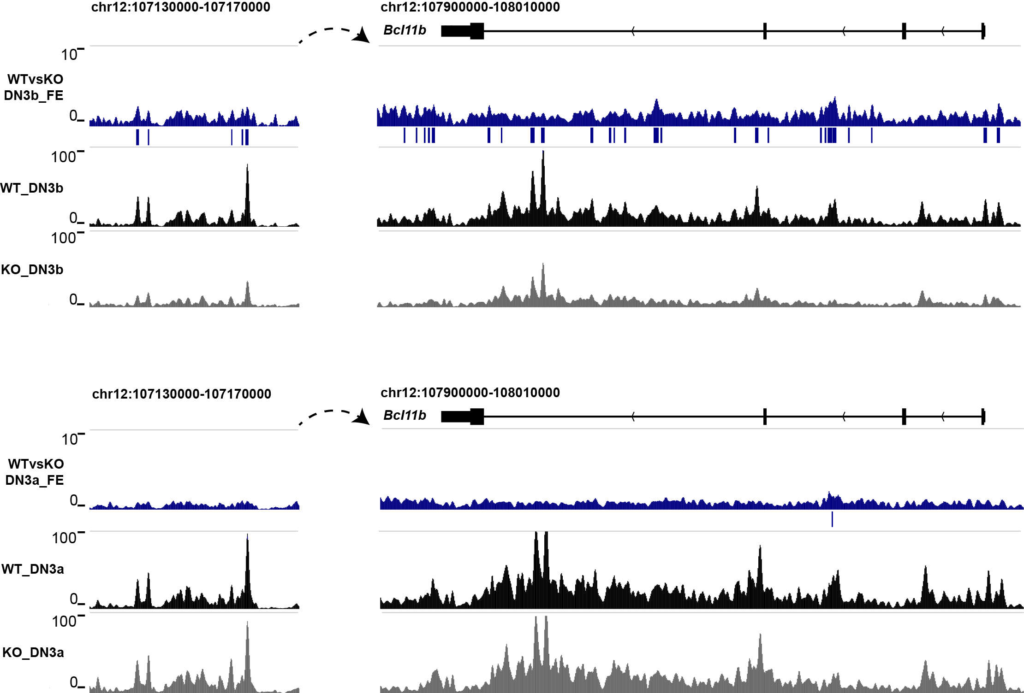
ATAC-seq (Bcl11b)
Fig: ATAC-seq tracks in Bcl11b gene locus and predicted enhancer which is about 800kb downstream of Bcl11b, black and gray tracks are from normalized combined WT and KO(DN3b on the top and DN3a at the bottom) datasets. Blue tracks shows the Fold Enrichment(FE) comparing WT to KO. Blue bars show the peaks called by MACS2 using WT against KO dataset.
More open chromatin state is found from WT DN3b compared to KO in both gene body region and predicted enhancer locus, but there is no change from DN3a.

Slide 2
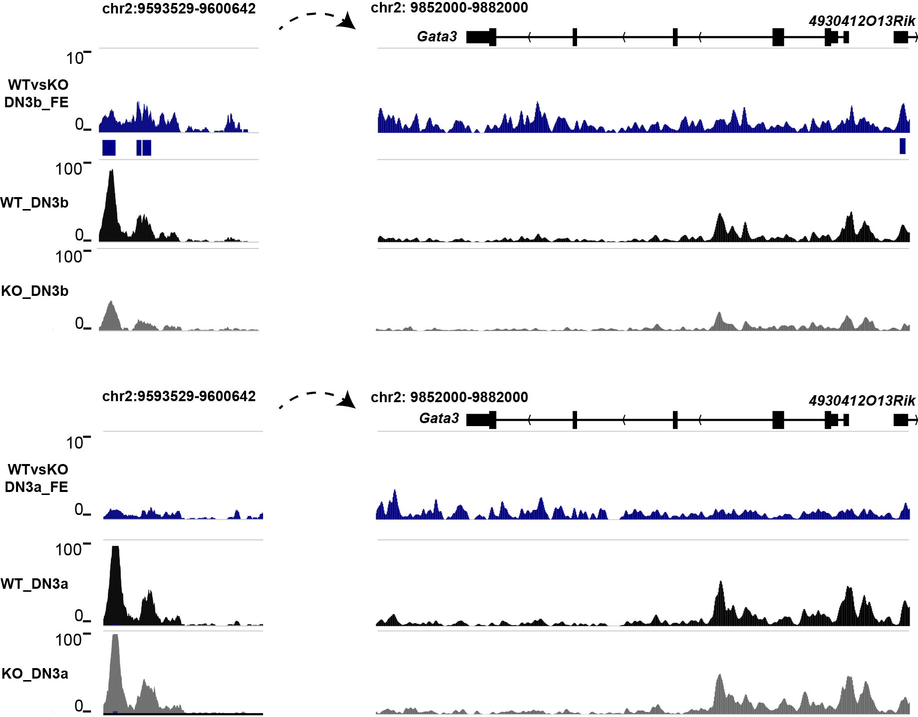
ATAC-seq (Gata3)
Tcf1 binding site
Fig: ATAC-seq tracks in Gata3 gene locus and predicted enhancer(Sakie Ohmura, et al 2016) which is about 250kb downstream of Gata3, black and gray tracks are from normalized combined WT and KO(DN3b on the top and DN3a at the bottom) datasets. Blue tracks shows the Fold Enrichment(FE) comparing WT to KO. Blue bars show the peaks called by MACS2 using WT against KO dataset.
More open chromatin state is found from WT DN3b compared to KO in predicted enhancer locus but not in the gene body.
There is no change from DN3a.

Slide 3
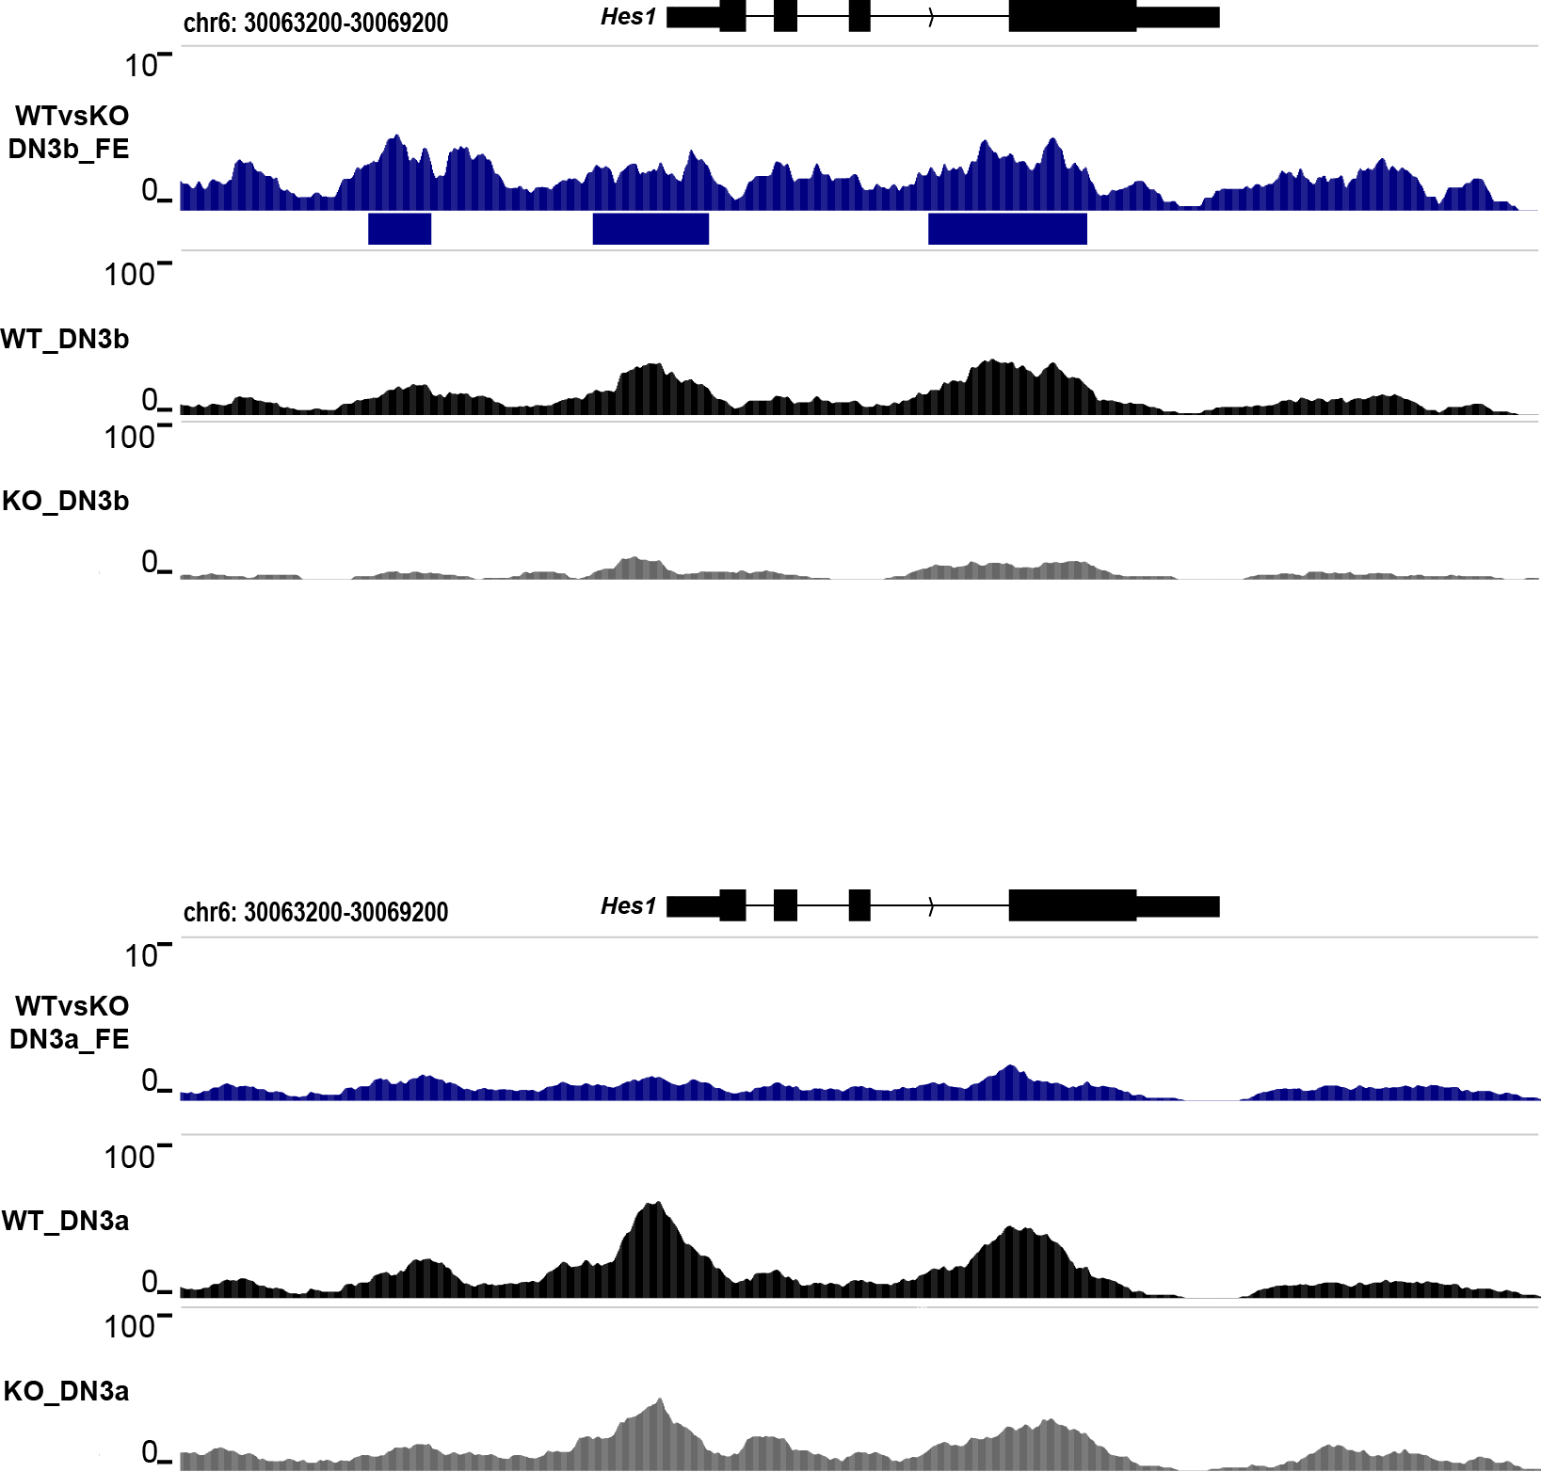
ATAC-seq (Hes1)
Fig: ATAC-seq tracks in Hes1 gene locus, black and gray tracks are from normalized combined WT and KO(DN3b on the top and DN3a at the bottom) datasets. Blue tracks shows the Fold Enrichment(FE) comparing WT to KO. Blue bars show the peaks called by MACS2 using WT against KO dataset.
WT DN3b shows more open chromatin over the gene body of Hes1 compared to KO, but no change is found from DN3a.

Slide 4
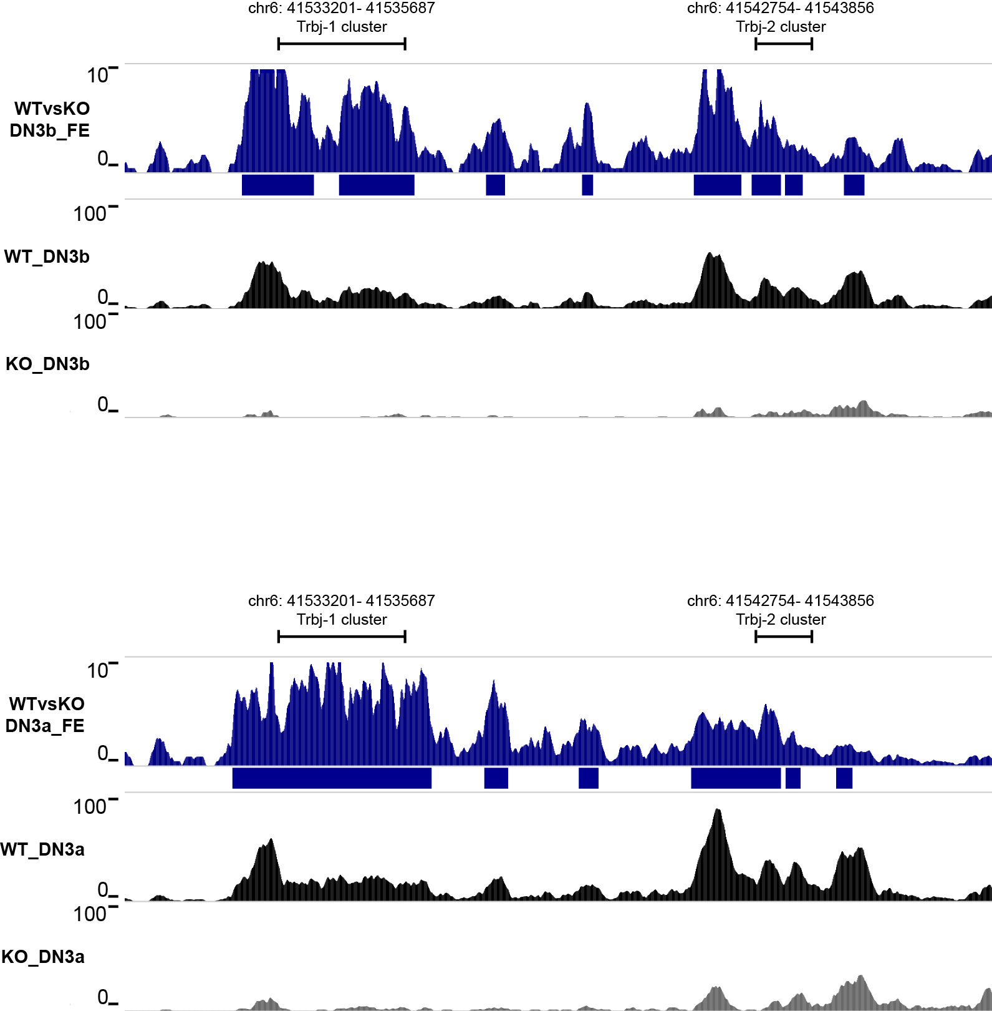
ATAC-seq (Trbj clusters)
Fig: ATAC-seq tracks in Trbj-1 and Trbj-2 clusters, black and gray tracks are from normalized combined WT and KO(DN3b on the top and DN3a at the bottom) datasets. Blue tracks shows the Fold Enrichment(FE) comparing WT to KO. Blue bars show the peaks called by MACS2 using WT against KO dataset.
WT DN3b shows higher signal compared to KO , and so does WT DN3a.

Slide 5
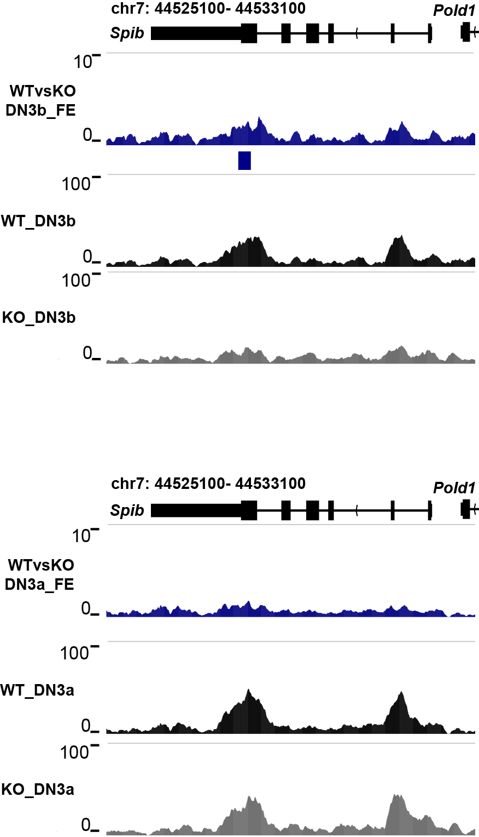
ATAC-seq (Spib)
Fig: ATAC-seq tracks in Spib gene locus, black and gray tracks are from normalized combined WT and KO(DN3b on the top and DN3a at the bottom) datasets. Blue tracks shows the Fold Enrichment(FE) comparing WT to KO. Blue bars show the peaks called by MACS2 using WT against KO dataset.
To me, the change between WT DN3b and KO is not very clear, and no change is found from DN3a.

Slide 6
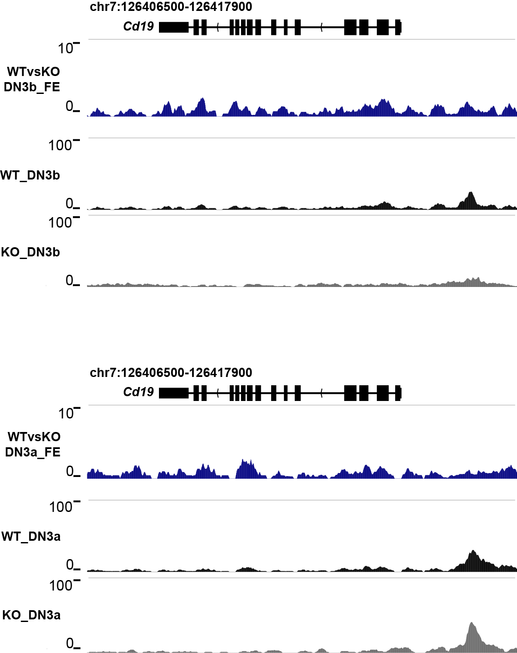
ATAC-seq (Cd19)
Fig: ATAC-seq tracks in Cd19 gene locus, black and gray tracks are from normalized combined WT and KO(DN3b on the top and DN3a at the bottom) datasets. Blue tracks shows the Fold Enrichment(FE) comparing WT to KO. Blue bars show the peaks called by MACS2 using WT against KO dataset.
No change is found from DN3b and 3a.

Slide 7
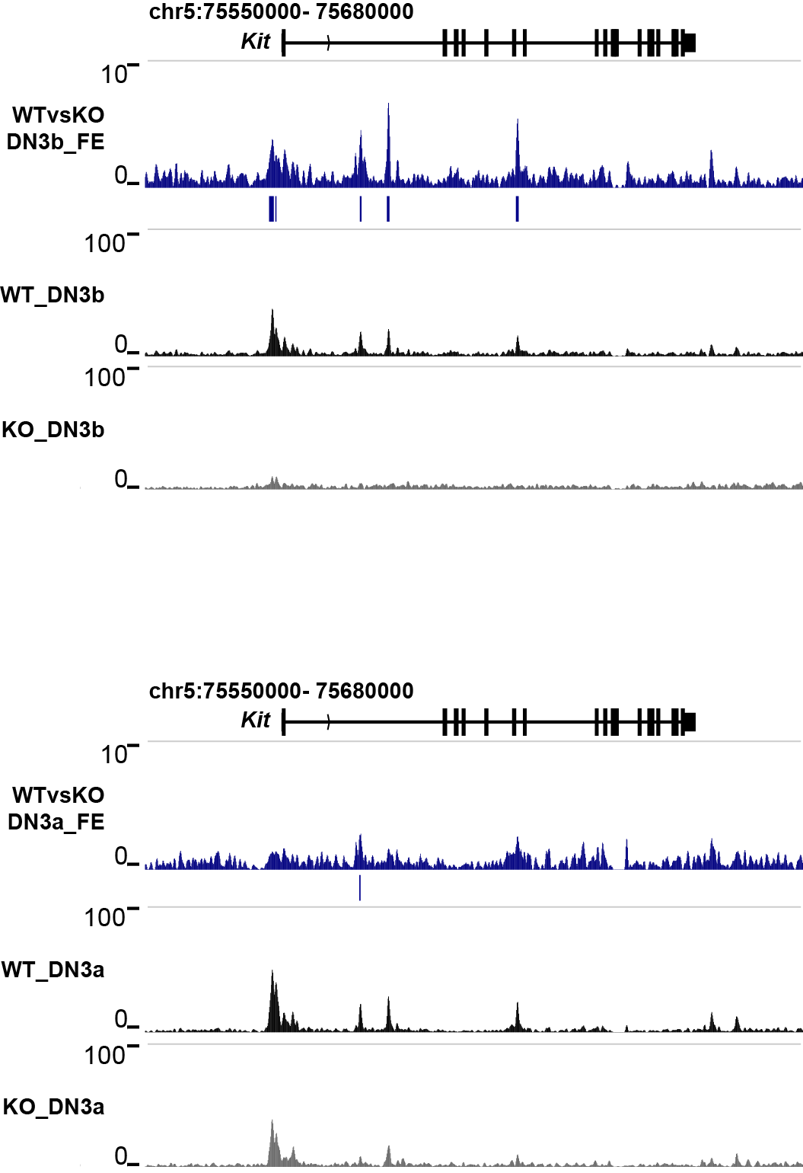
ATAC-seq (Kit)
Fig: ATAC-seq tracks in Kit gene locus, black and gray tracks are from normalized combined WT and KO(DN3b on the top and DN3a at the bottom) datasets. Blue tracks shows the Fold Enrichment(FE) comparing WT to KO. Blue bars show the peaks called by MACS2 using WT against KO dataset.
WT DN3b shows higher signal compared to KO, but there is no big difference between WT and KO DN3a

