Slide 1
Gender, Education, Database and Language Preferences in Programming Today
Suyin Pan
April 17, 2023

Slide 2

OUTLINE
◆ Executive Summary
◆ Introduction
◆ Methodology
◆ Results
◆ Visualization – Charts
◆ Dashboard
◆ Discussion
◆ Findings & Implications
◆ Conclusion
◆ Appendix

Slide 3

EXECUTIVE SUMMARY
◆ The data shows programming to be a male dominated
field.
◆ The top 2 languages used today are also the 2 most
sought after languages to learn
◆ There has been a shift in database popularity
◆ People in the programming field tend to be highly educated on average

Slide 4

INTRODUCTION
We take a look at survey data gathered from programmers to reveal insights into the demographics, education level and programming language preference of programmers today. We also note coming changes database preferences.

Slide 5

METHODOLOGY
◆ This Data has been gathered through a survey conducted by StackOverflow.
◆ The data has been analyzed primarily with graphical analysis through a dashboard in IBM cloud.
◆ The Pandas module in Python was also used to call statistical functions returning correlation, mean, and unique value counts.

Slide 6
RESULTS
In the following sections we will see graphical data from survey respondents regarding their age, gender, programming language/database preference and use, education level and sex.

Slide 7
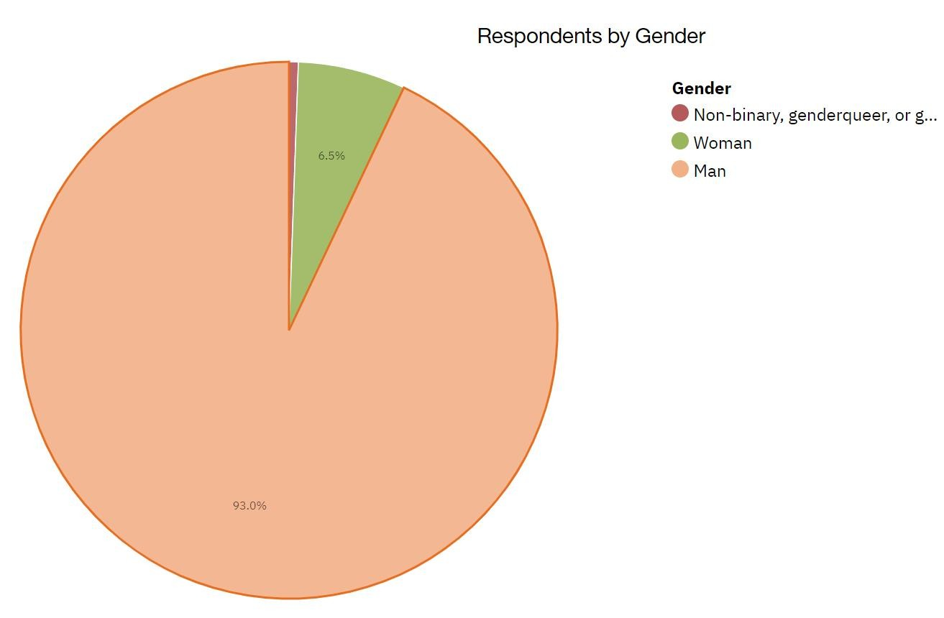
Males in Programming
Over 90% of survey respondents identified
as male. Of those males over 68% are of white or European descent followed by
10% south Asian males and 4% Hispanic or Latino males.

Slide 8
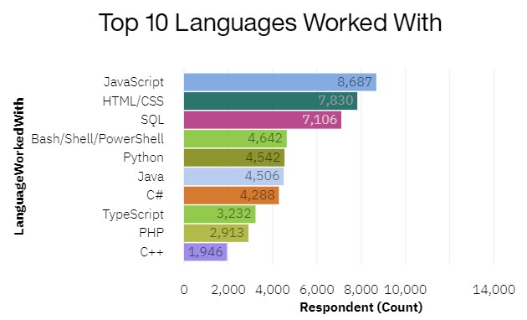
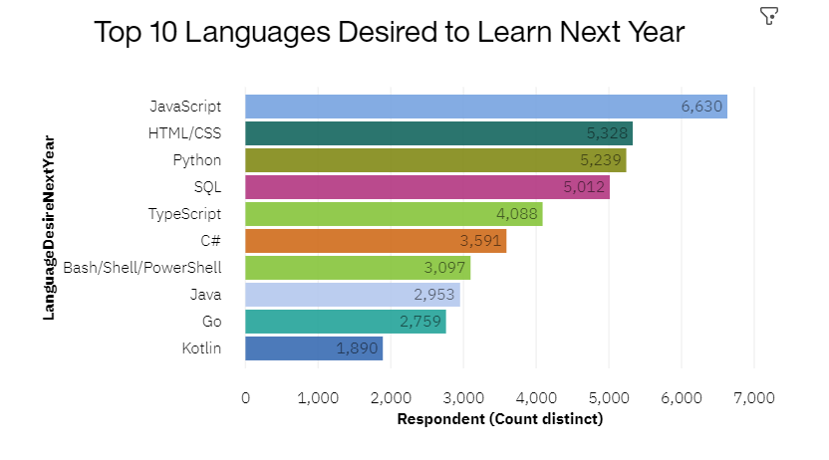
PROGRAMMING LANGUAGE TRENDS
The top 2 programming languages used today are JavaScript and HTML/CSS which are also the top 2 programming languages programmers are looking to learn next year. SQL, Bash/PowerShell and Python are also ranked high as a currently used language and desired future language.

Slide 9
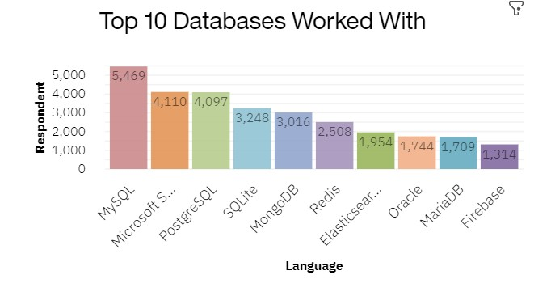
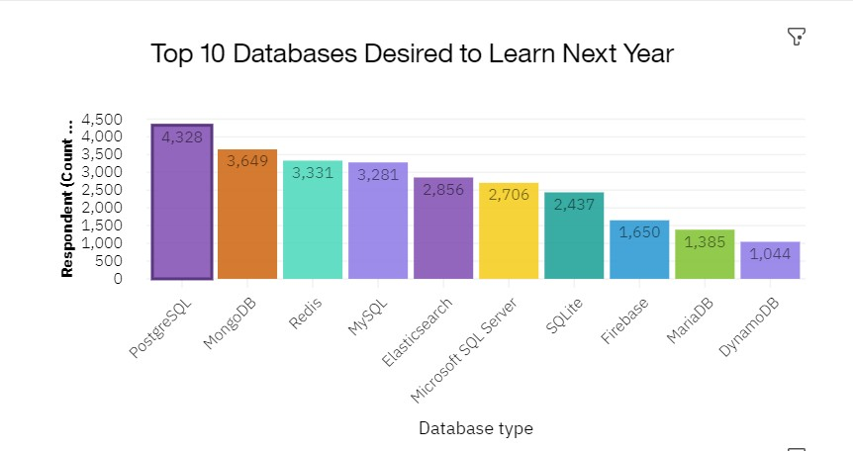
DATABASE TRENDS
PostgreSQL, MongoDB and Redis are be gaining popularity over current databases worked with, but MySQL is the most worked with database.

Slide 10
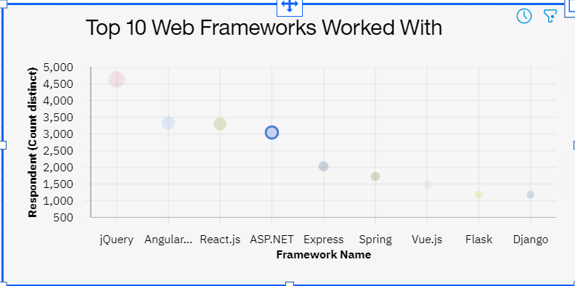
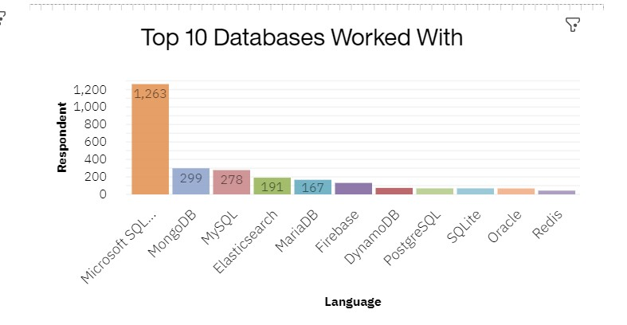
DATABASE TRENDS
We can also see that databases worked with are correlated strongly with certain web frameworks. For example ASP.net framework users work with Microsoft SQL Server Databases mainly.

Slide 11
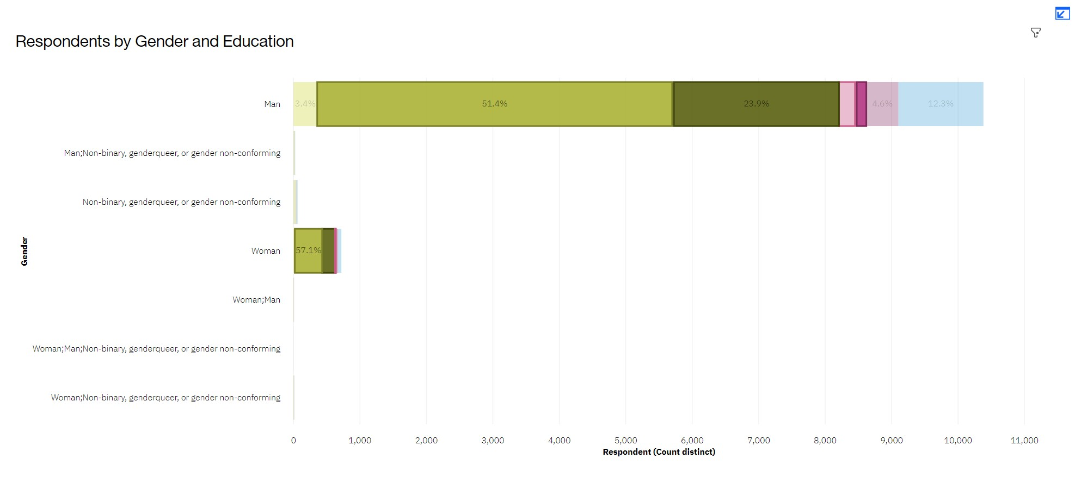
Education Levels of Programmers
With ¾ of Survey respondents holding a 4 year college degree we can see programming is a highly educated field, but a college degree is not a requirement.

Slide 12
DASHBOARD
https://eu- de.dataplatform.cloud.ibm.com/dashboards/e98a244d-8e6e- 4ad8-aced- 31d2cdc55338/view/0164a12122b5239651d4c8e407ca2b057b3 1245be0bbd152d2867b490b317197a93a14c7c82a1f5ddc100635 a2ee1b50c8

Slide 13
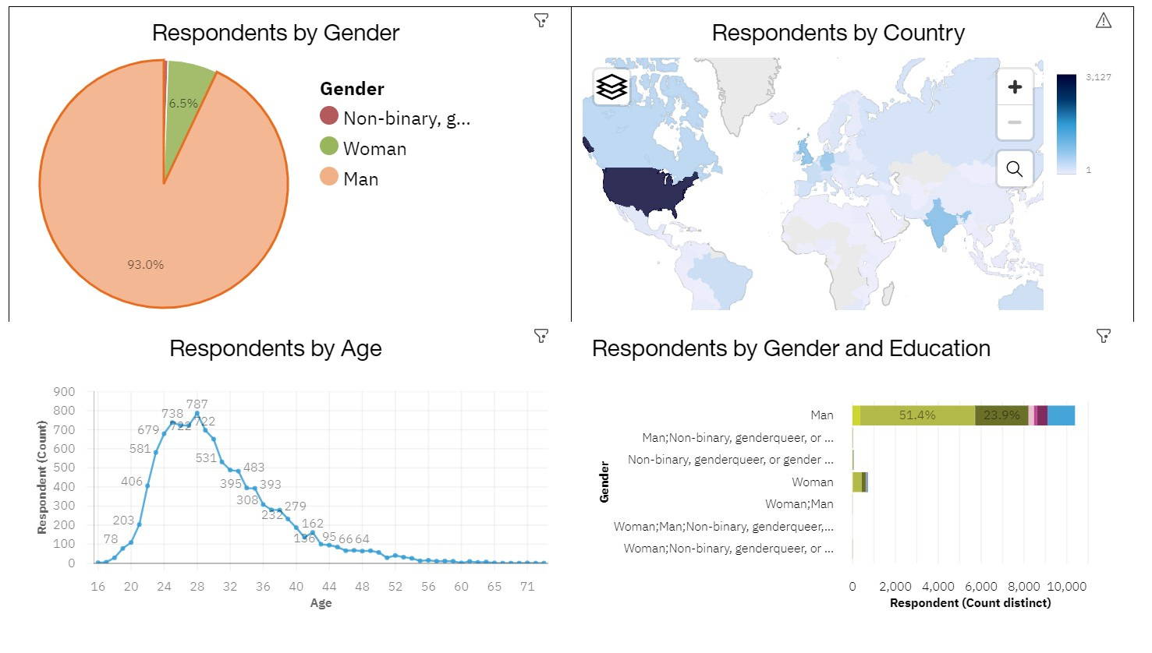
DASHBOARD TAB 1
Screenshot of dashboard tab 1 goes here

Slide 14
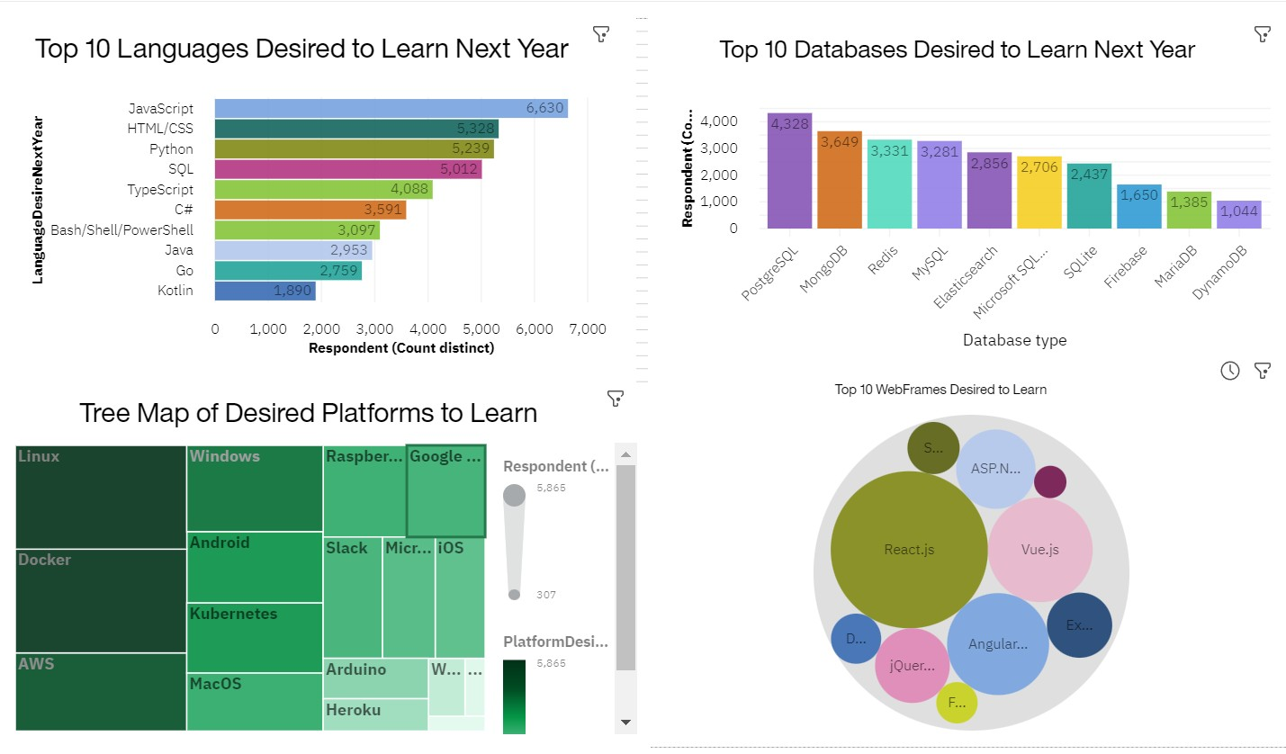
DASHBOARD TAB 2
Screenshot of dashboard tab 2 goes here

Slide 15
DASHBOARD TAB 3
Screenshot of dashboard tab 3 goes here

Slide 16

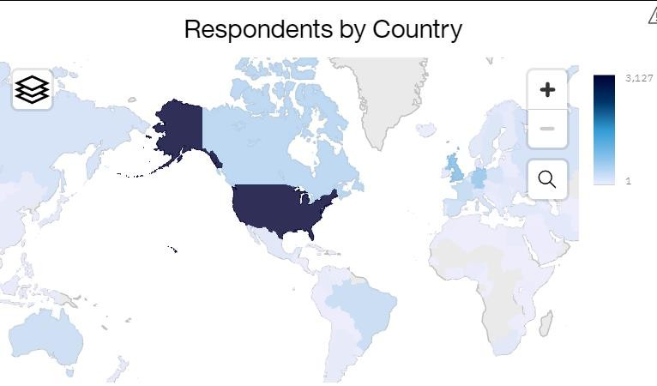
DISCUSSION
◆ Stack Overflow is used around the world and has users in 135 countries but the majority of its users are in the United States. Survey respondents show this weight to be largely from the U.S.. This impacts the results of the dataset as it applies to a global audience.
What reasons are there for so few female programmers?
what can we do to get more women programming?

Slide 17
OVERALL FINDINGS & IMPLICATIONS
Findings Implications
◆ Over 90% of programmers are male, with respondents having an average age of 30 overall.
◆ 3/4s of programmers having a 4 year university degree or higher
◆ JavaScript and HTML/CSS are the most popular languages learned and desired to learn.
◆ PostgreSQL is the most popular Database Language to learn and
web frameworks correlate to databases
◆ More women are needed in the programming fields to increase representation and diversity in the programming field.
◆ Smart people are programmers! And if you are programming you probably love to learn, since most programmers are long time learners.
◆ If you were planning on learning a new language JavaScript and HTML/CSS would probably be a safe bet to get a job with since so many people choose to learn them.

Slide 18

CONCLUSION
◆ Women are very under-represented in the programming world.
◆ If you are programming you likely have a 4 year degree but you don't have to have any degree, there are programmers with no formal education at all.
◆ JavaScript and HTML/CSS are very popular programming languages and will be into the future.
◆ There is shifting preferences from MySQL to Postgre SQL for database usage.

Slide 19

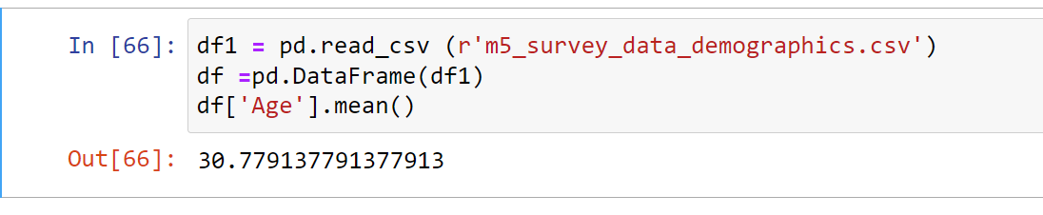
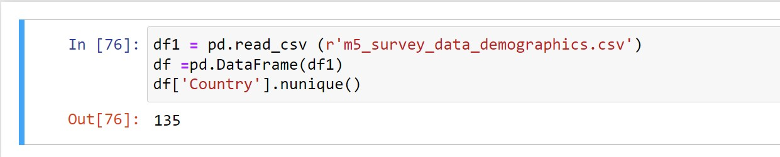
APPENDIX

Slide 20
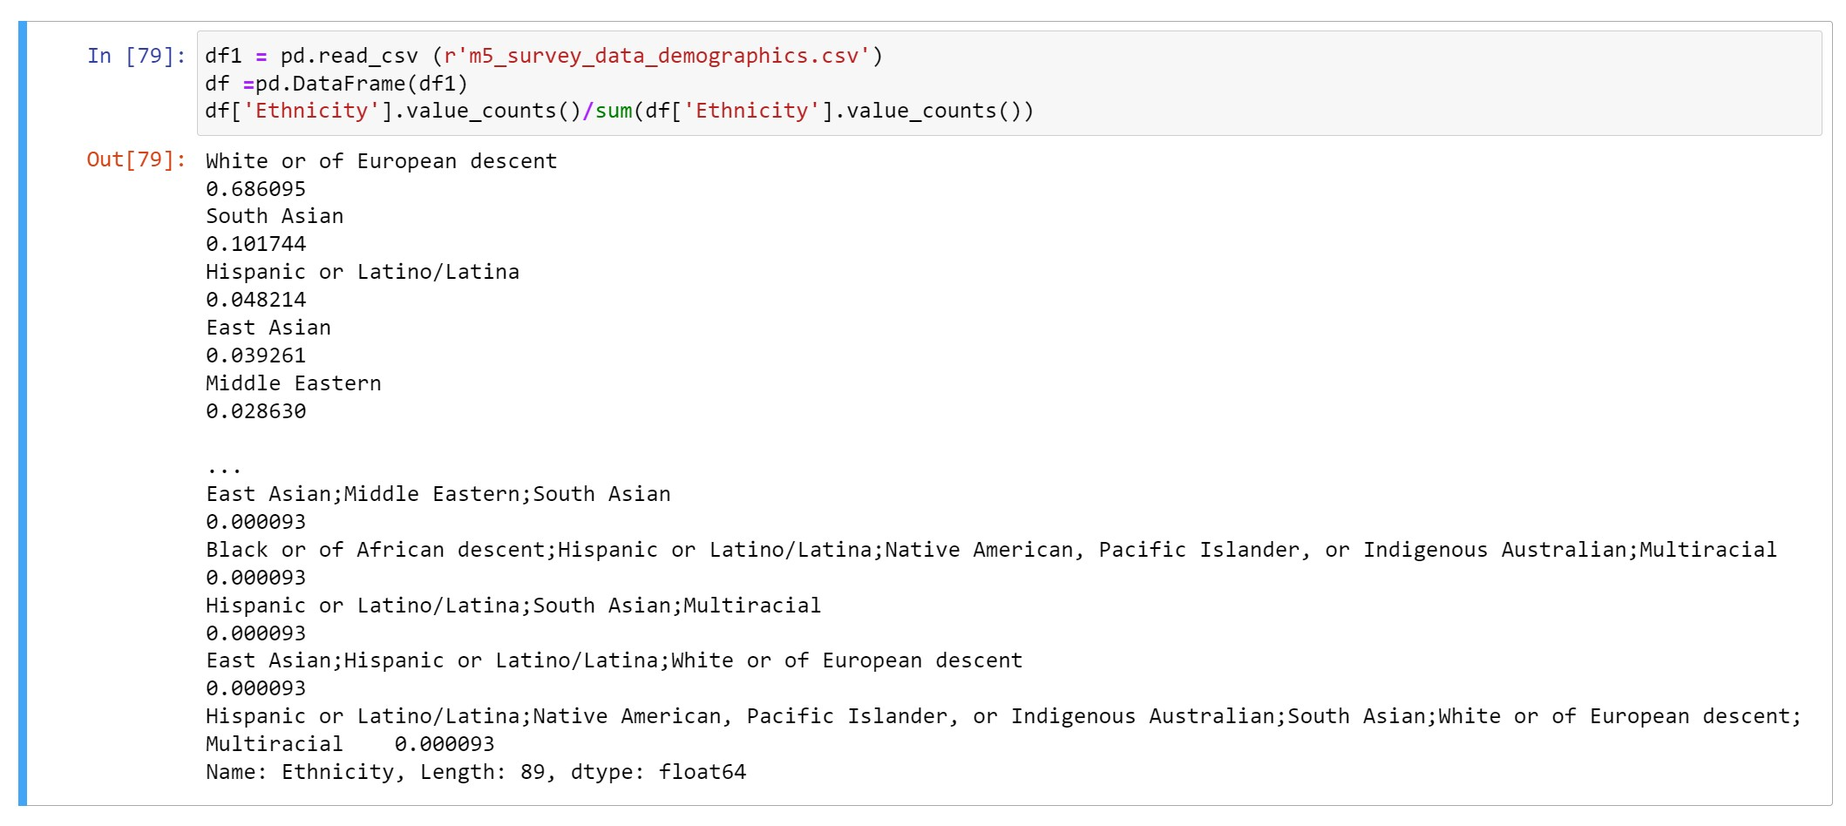
APPENDIX
l ck
The dataset used comes from the following
source: https://stackoverflow.blog/2019/04/09/the-2019- stack-overflow-developer-survey-results-are-in/ under a ODbL: Open Database License.
The dataset is a modified subset of the original survey results.

