Slide 1
Finding Straw Donors
Jiheng Huang, Philipp Kats, Nikhil Kishore,
Kiran Venkatpalla, Alan Polson, Sachin Verma
CUSP Hackday Apr 1, 2016
Notes:
A straw donor is a person who illegally uses another person's money to make a political contribution in their own name.
In this April 2010 image from video provided by C-Span, Jeffrey Thompson speaks at a ceremony to remember Dorothy Height. U.S. Attorney Ronald C. Machen Jr. said that Jeffrey E. Thompson’s accounting firm was an “assembly line” for illegal political donations.
Thompson allegedly directed employees and their relatives to become “straw donors” for numerous fundraising events

Slide 2
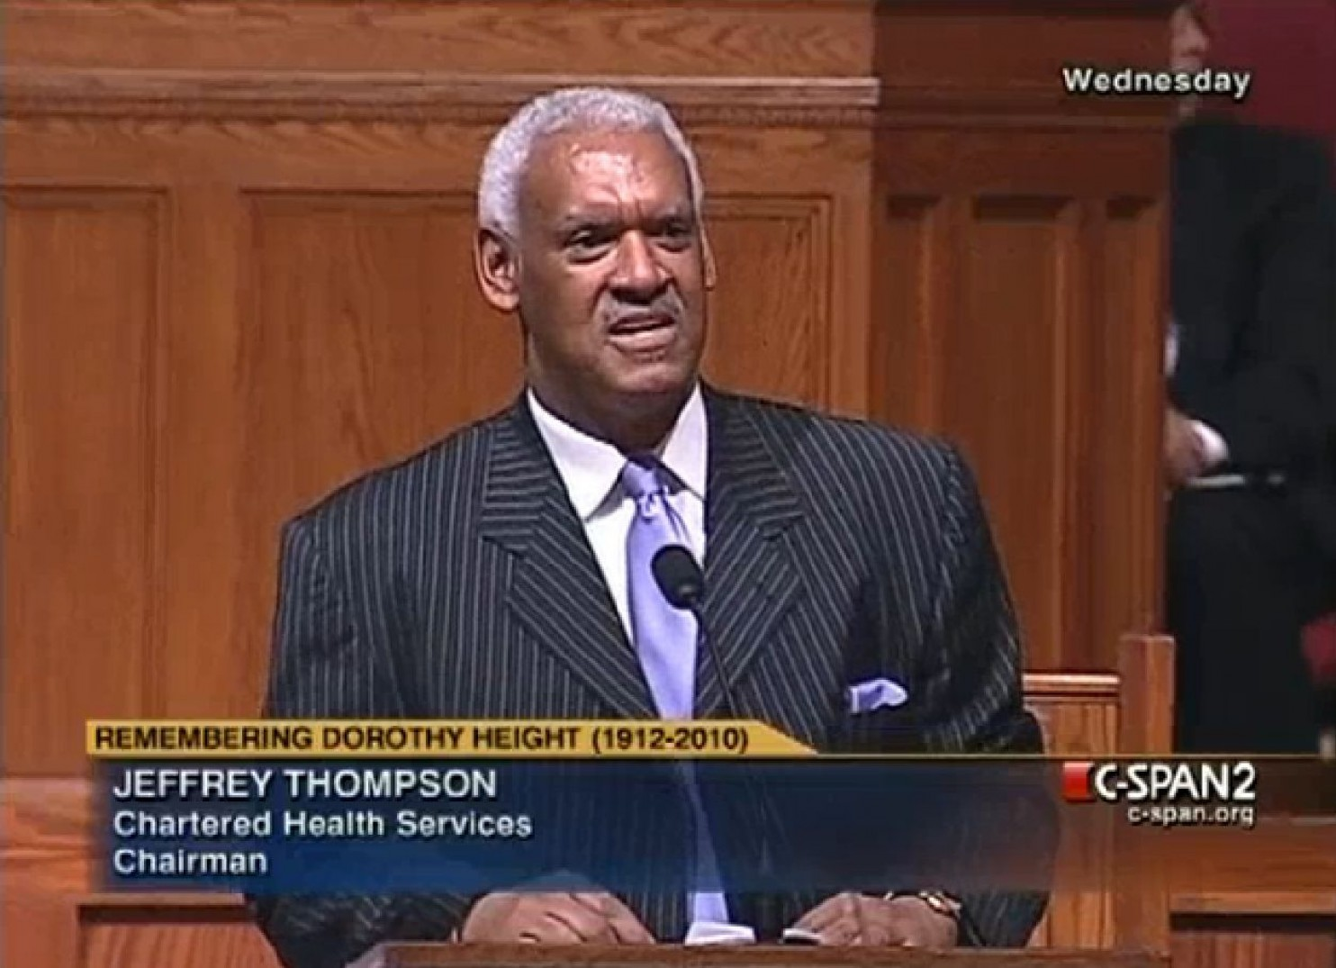
Notes:
A straw donor is a person who illegally uses another person's money to make a political contribution in their own name.
In this April 2010 image from video provided by C-Span, Jeffrey Thompson speaks at a ceremony to remember Dorothy Height. U.S. Attorney Ronald C. Machen Jr. said that Jeffrey E. Thompson’s accounting firm was an “assembly line” for illegal political donations.
Thompson allegedly directed employees and their relatives to become “straw donors” for numerous fundraising events

Slide 3

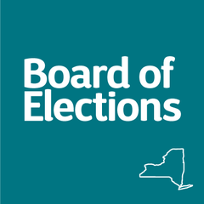
Data Source
Notes:
NYC Campaign Contributions: A concatenated file of all campaign contributions for all years in the publicly available data on the NYC Campaign Finance Board's Data Library.
NY State Campaign Contributions (individual): we want to add an employer record to these campaign contributions.

Slide 4
Fuzzywuzzy

Slide 5
NEW YORK METS NEW YORK MEATS

Slide 7


Slide 8
Assumptions
Data is Accurate
People who contribute at the state also contribute at the city
No other dataset available to match
No lookup table

Slide 9
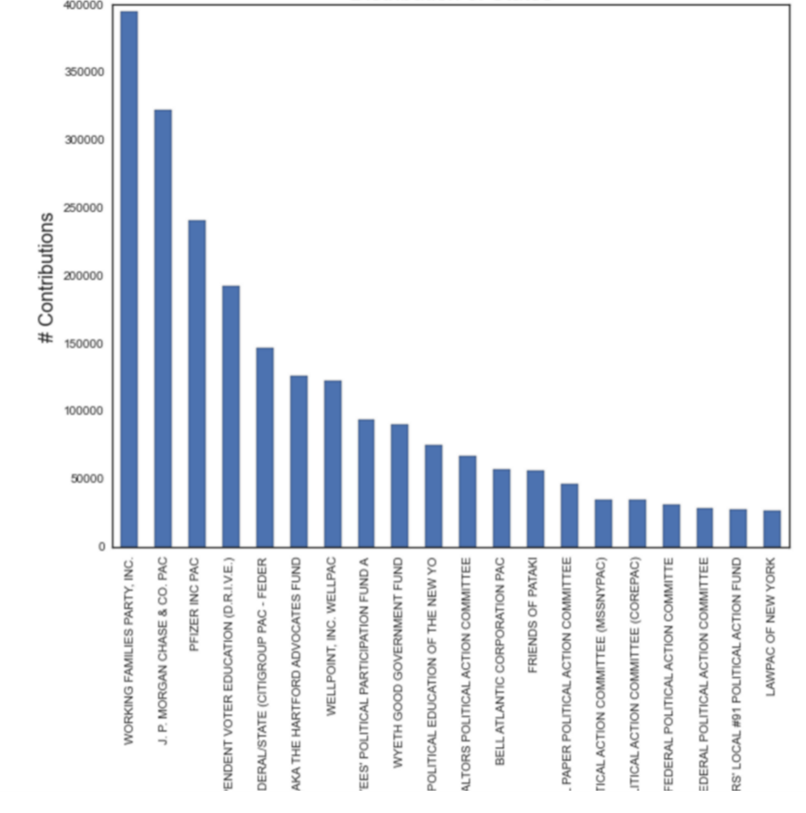
Findings

Slide 10
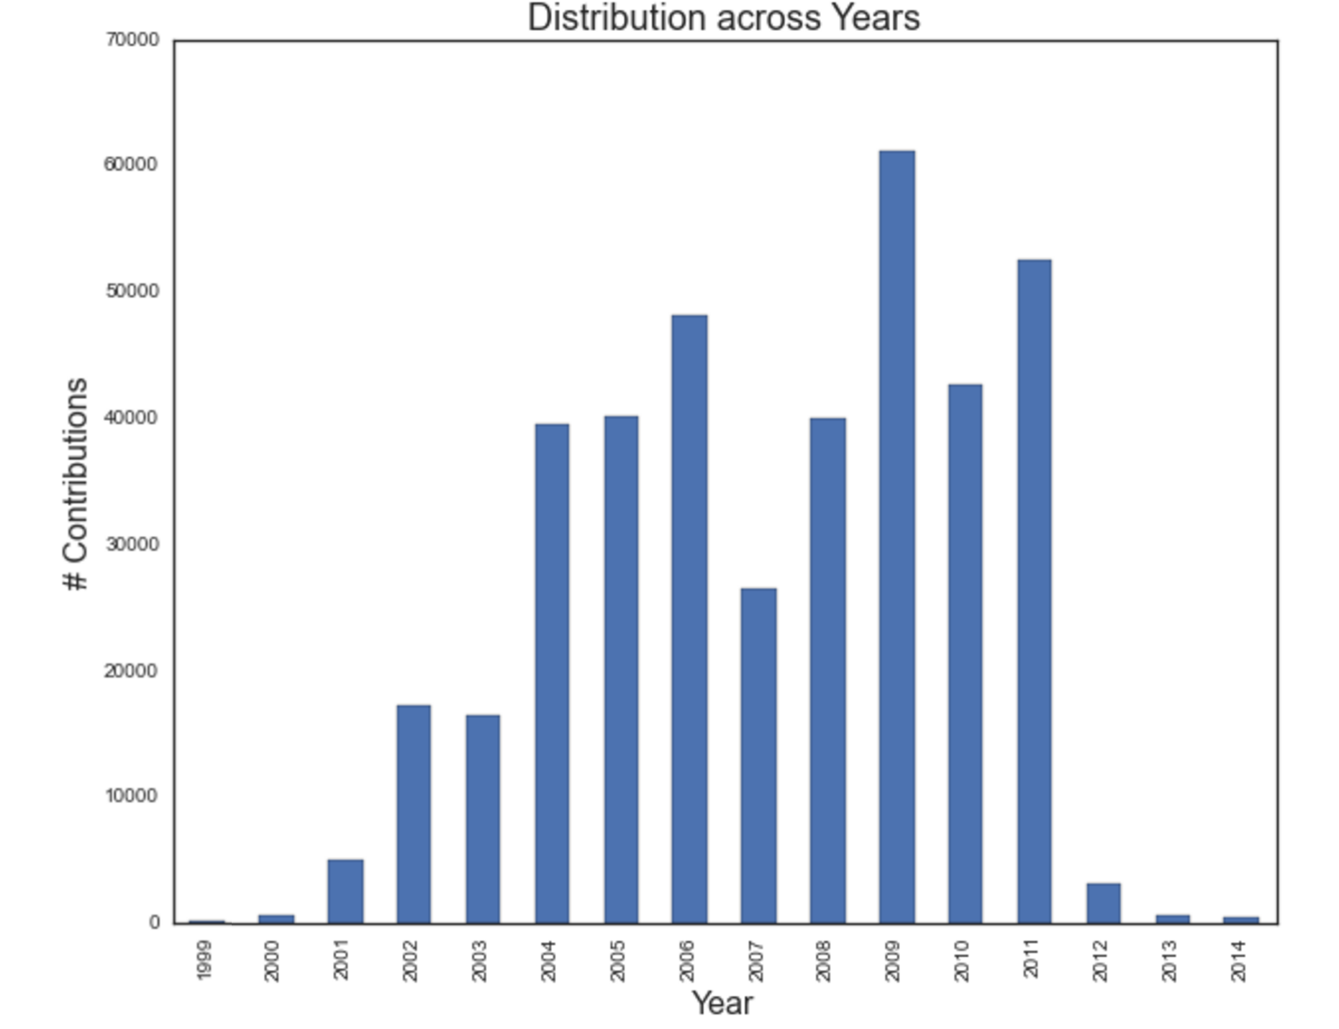

Slide 11
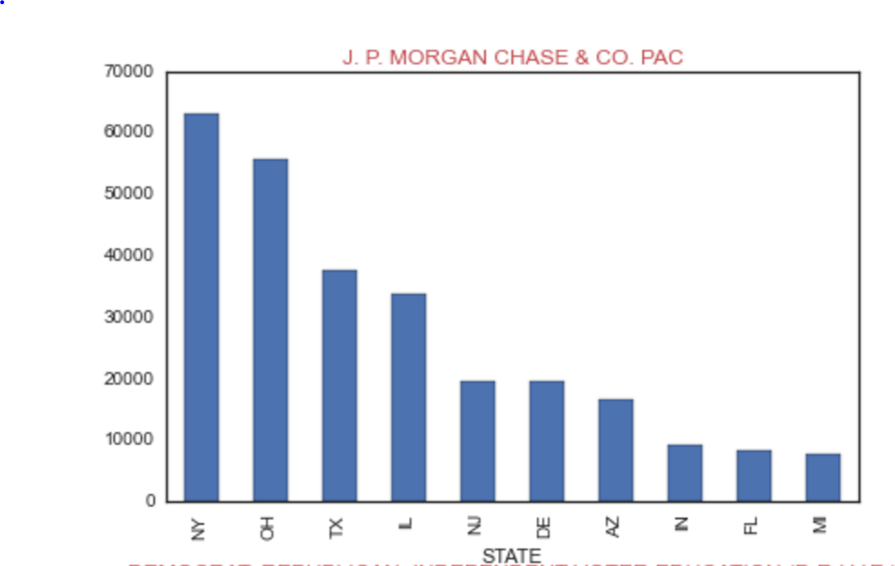

Slide 12
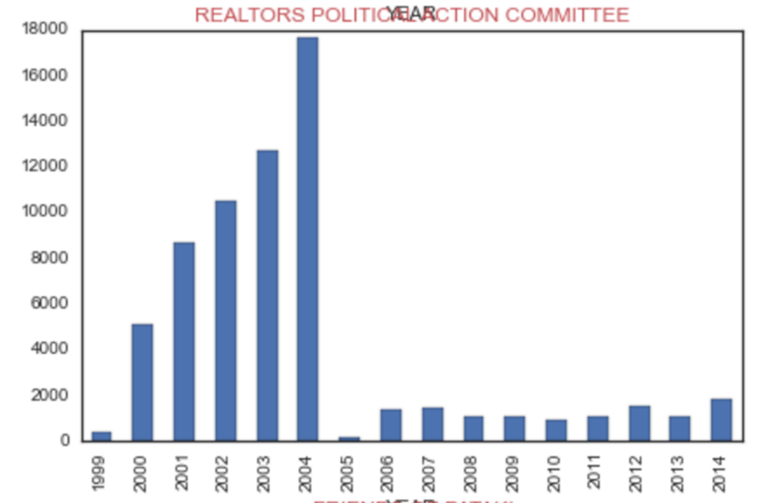

Slide 13
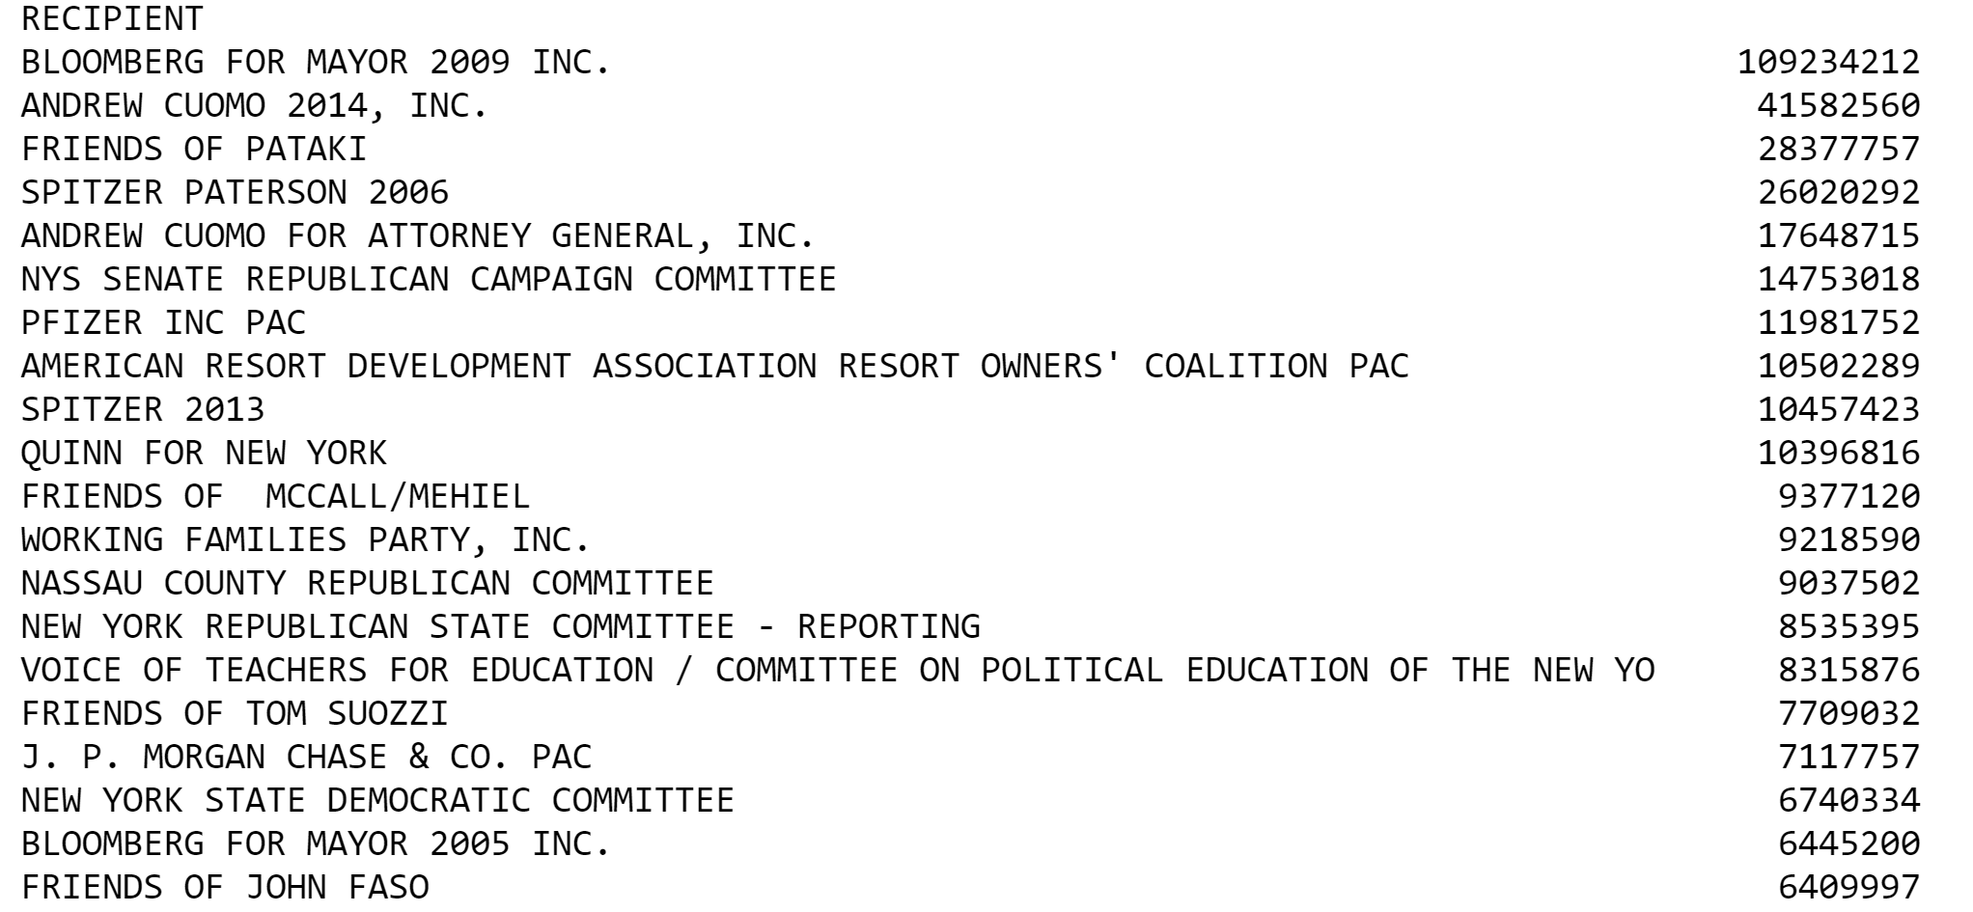

Slide 14
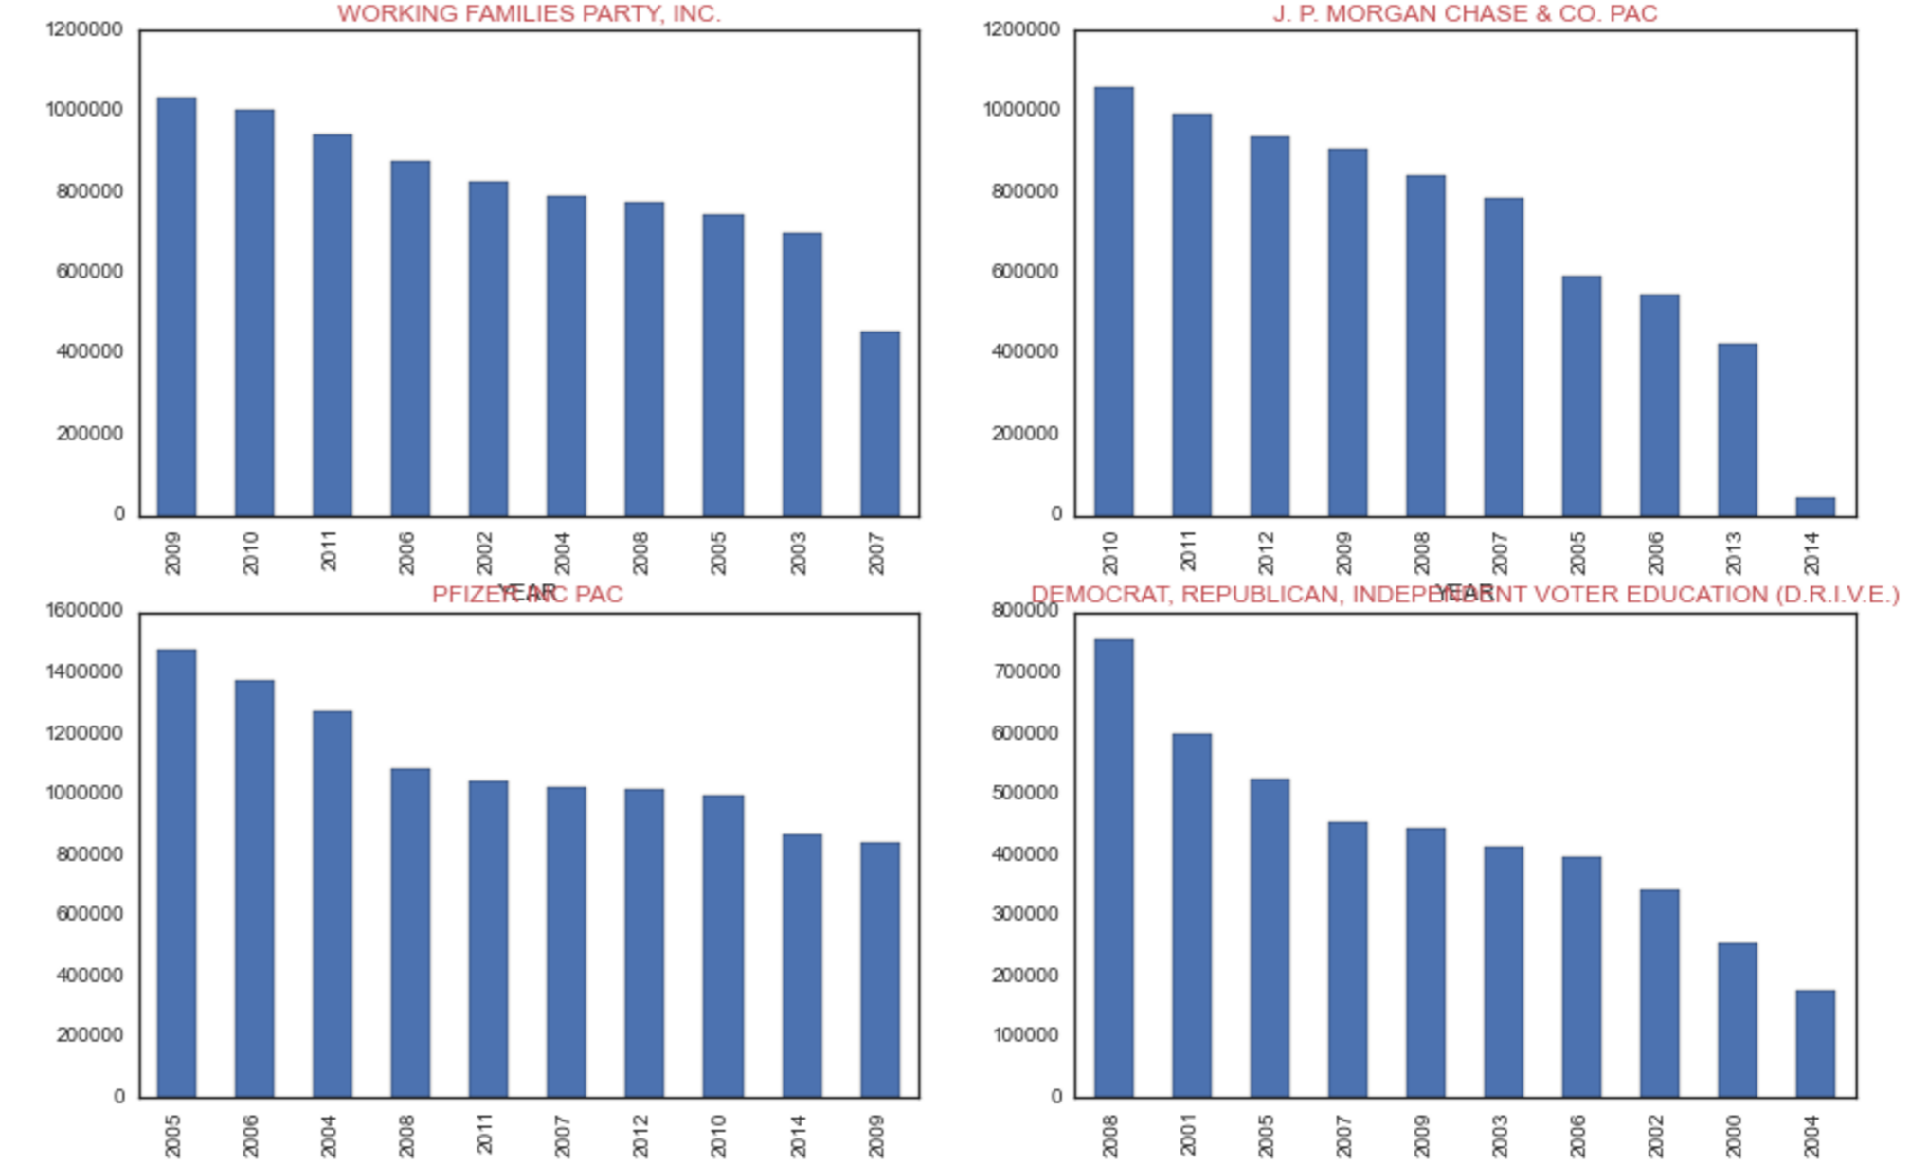

Slide 15
Other findings
https://github.com/Jihenghuang/NY_Straw_Donors/blob/master/Code/Straw%20Donors%20Hackathon%20Analysis.ipynb

Slide 16
Matching Contributors to their Employers
Grouped by first and last names and de-duplicated rows for NYS and NYC Datasets
Subsetted to Working Families Pac, (to reduce time for Fuzzy Wuzzy) and tried to join based on First and Last names
= 0
Redid for the whole data set using Pandas Merge. 18% of the Data (By volume)
Unique names are 5% of the names for the state.

Slide 17
What is needed:
Lookup tables for contribution limits
Lookup tables for role of recipient
Another dataset to match Employers to Employees?

Slide 18
Recommendations
Pass legislation requiring state voters to register employers
Make a system that enforces verifiability such as including SSN/tax numbers, sourcing dates from system.

Slide 19
Future Work
Hadoop it
Executive Summary (with context)
Play the game: Look at State Representatives first

Slide 20
GitHub:
https://github.com/Jihenghuang/NY_Straw_Donors

