Slide 1
Exploration of Closed-Domain Question Answering Explainability Methods with a Sentence-Level Rationale Dataset
Anonymous Authors
Presented by: Jiho Noh

Slide 2
Research Objectives
Improve a Closed-Domain Question Answering (CQA) dataset for assessing the capacity of different methods for Rationale Extraction (RE)
Hotpot-QA (Yang et al. 2018)

Slide 3
Question Answering Subtopics
Open-domain vs. Closed-domain
Conversational QA
Knowledge-based QA
Multimodal QA
Community QA
MCQ / T-F / Long-form / Cloze
Generative QA
Cross-Lingual QA
Mathematical QA
Temporal/Casual QA
Reasoning
Question Quality Assessment

Slide 4
Rationale Extraction
Unique identifiers assigned to a researcher
Links researchers with their publications.
Prevents author ambiguity problems
Types of IDs
Open Researcher and Contributor ID (ORCID)
Web of Science ResearcherID
Scopus Author Identifier

Slide 5
Sentence Similarity Measures
Embedding similarity
TF-IDF embedding
LLM classifier
LLM attention-based

Slide 6
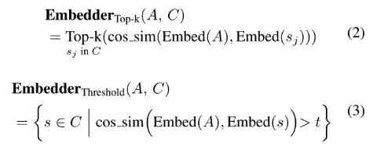
Sentence Embedding
Cos-sim between A and a candidate sentence s

Slide 7
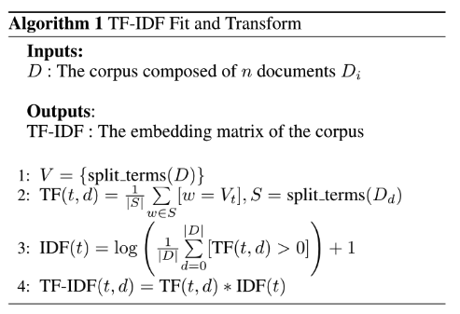
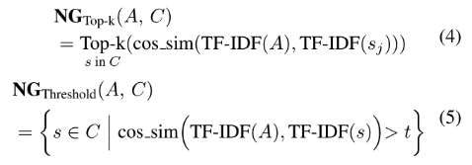
TF-IDF
Cos-sim between TF-IDF embeddings of A and s

Slide 8

LLM classifier
Using pre-trained LLM for binary text classification.

Slide 9
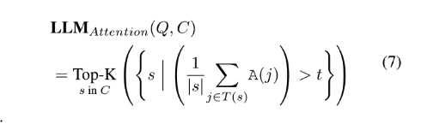
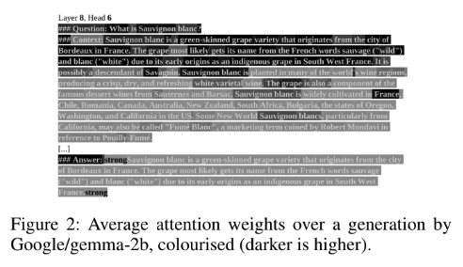
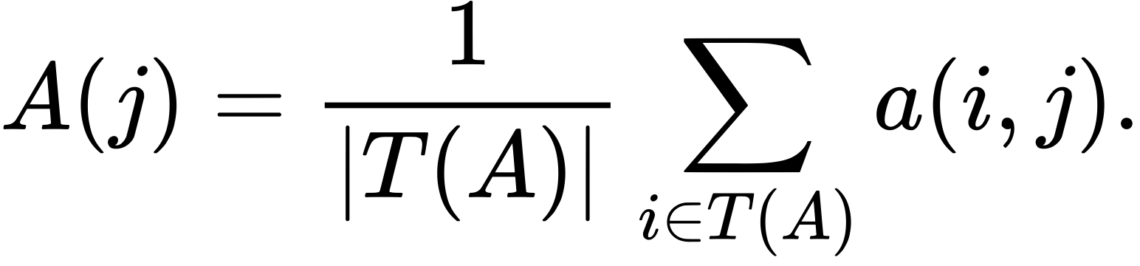
LLM Attention-based

Slide 10
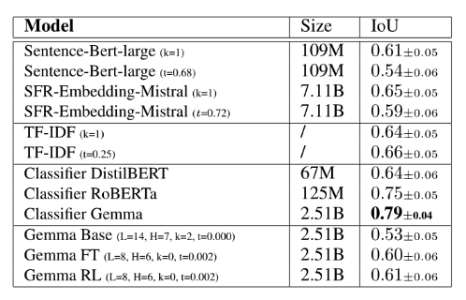
Results

Slide 11
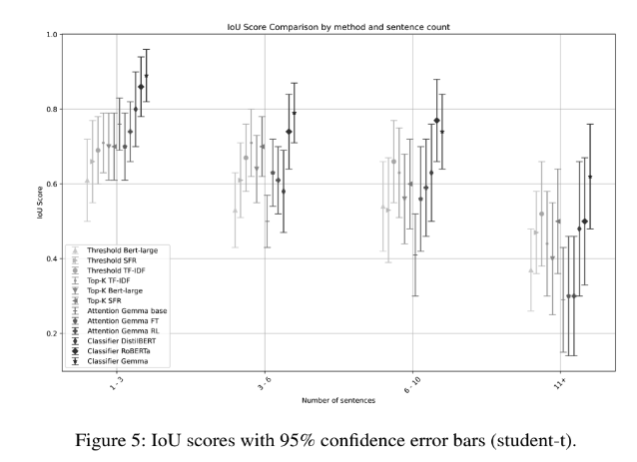

Slide 12
