Slide 1
ACM RecTour Workshop
Recommenders in Tourism
https://workshops.ds-ifs.tuwien.ac.at/rectour24/

Slide 2
CFP
personalization
contextual intelligence (location, time, social dynamics, and environmental conditions)
multi-modal RecSys (diverse data sources)
dynamic pricing and economics
UI-EX
ethical and responsible recommendations
LLM
Emotions
Cold Start
Social media insights

Slide 3
Dates
Event: 9/22 ~ 9/26
Submission deadline: expected to be around mid July
Details (RecTour2024)
Submission Types
Long (up to 16)
Short (up to 8)
Position papers
Demo

Slide 4
RecTour 2024 Challenge
Booking.com data
Ranking Reviews
match given accommodations and users to their respective review IDs
RecSys perspective
present reviews to a new user given the accommodation information

Slide 5
Data
Users
user_id, guest_type, guest_country, room_nights, month, accommodation_id, accommodation_type, accommodation_score, accommodation_country, accommodation_star_rating, location_is_beach, location_is_ski, location_is_city_center
Review
review_id, review_title, review_positive, review_negative, review_score, review_scope, review_helpful_votes
Matches between users and reviews

Slide 6
Metrics
MRR@10
Results of 2024 participants will be released during Oct 14 - 18

Slide 7
BioLaySumm
Summarizing a difficult document (biomedical) into a more readable and easy text
https://biolaysumm.org

Slide 8
Dates
Call for Participation: 01-22-24
Data release: 01-22-24
System submission deadline: 05-06-24
Workshop date: 08-16-24

Slide 9
Task
Highly technical biomedical article as an input
Generate Lay Summarization that is
more readable
contains more general background information
using less jargon
to make it less difficult for non-expert audiences

Slide 10
Datasets
PLOS (24,773/1,376/142)
eLife (4,346/241/142)
available at
https://www.codabench.org/competitions/1920/
https://github.com/TGoldsack1/Corpora_for_Lay_Summarisation
Huggingface Datasets are also available.
https://huggingface.co/datasets/tomasg25/scientific_lay_summarisation

Slide 11
Data format
{
"id": str, # unique identifier
"year": str, # year of publication
"title": str, # title
"sections": List[List[str]], # main text, divided in to sections
"headings" List[str], # headings of each section
"abstract": List[str], # abstract
"summary": List[str], # lay summary
"keywords": List[str] # keywords/topic of article
}

Slide 12
Data format (Cont.)
This example was too long and was cropped:
{
"summary": "In the kidney , structures known as nephrons are responsible for collecting metabolic waste . Nephrons are composed of a ...",
"article": "Kidney function depends on the nephron , which comprises a 'blood filter , a tubule that is subdivided into functionally ...",
"section_headings": "Abstract\nIntroduction\nResults\nDiscussion\nMaterials and Methods'",
"keywords": "developmental biology\ndanio (zebrafish)\nvertebrates\nteleost fishes\nnephrology",
"title": "The cdx Genes and Retinoic Acid Control the Positioning and Segmentation of the Zebrafish Pronephros",
"year": "2007"
}

Slide 13
Evaluation (script)
Relevance
ROUGE (1, 2, and L)
BERTScore
Readability
Flesch-Kincaid Grade Level (FKGL)
Dale-Chall Readability Score (DCRS)
Coleman-Liau Index (CLI)
LENS
Factuality
AlignScore
SummaC

Slide 14
Promising Methods
Retrieval-Augmented Generation (RAG)
external knowledge
Controllable Lay Summarization
Readability controllable text summarization
LLM for Data Augmentation

Slide 15
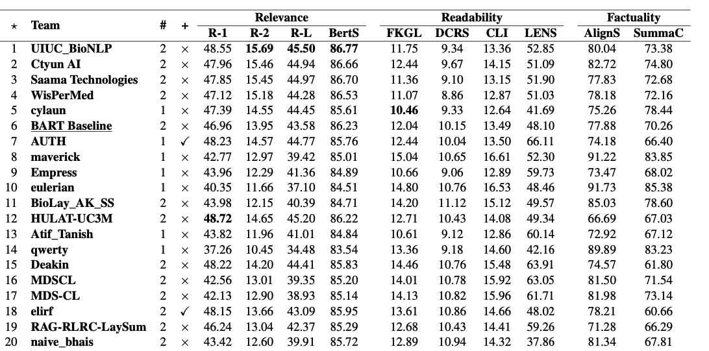
2024 leaderboard

Slide 16
Top Rankers
UIUC
Extract then Summarize (TextRank)
Cytun AI
Fine-tuned LLM
Saama Tech
LoRa with Mistral-7B model
WisPerMed
Fine-tuned BioMistral
AUTH
Utilized external data (the Science Journal for Kids website), Fine-tuned BioBART

Slide 17
Evaluation

Slide 18
Evaluation (script)
Relevance
ROUGE (1, 2, and L)
BERTScore
Readability
Flesch-Kincaid Grade Level (FKGL)
Dale-Chall Readability Score (DCRS)
Coleman-Liau Index (CLI)
LENS
Factuality
AlignScore
SummaC

Slide 19
Bilingual Evaluation Understudy (BLEU)
https://aclanthology.org/P02-1040.pdf
Requires multiple ground truth reference
Depends on modified n-gram precision
Per-corpus n-gram co-occurrence is computed

Slide 20
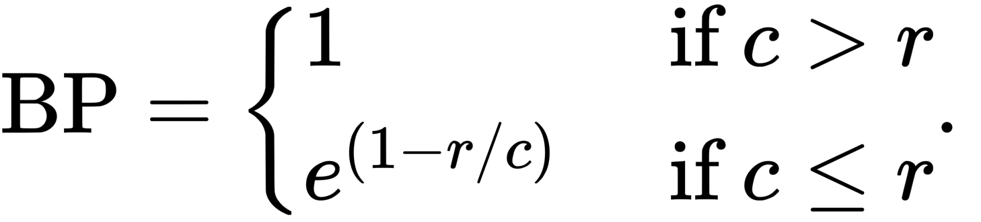

Bilingual Evaluation Understudy (BLEU)
Brevity penalty is applied
Compute,
p_n: geometric average of the modified n-gram precision
the number of n-grams that appear in both the machine-generated translation and the reference translations divided by the total number of n-grams in the machine-generated translation.
w_n: positive weights summing to one (uniform weight: 1/N)

Slide 21
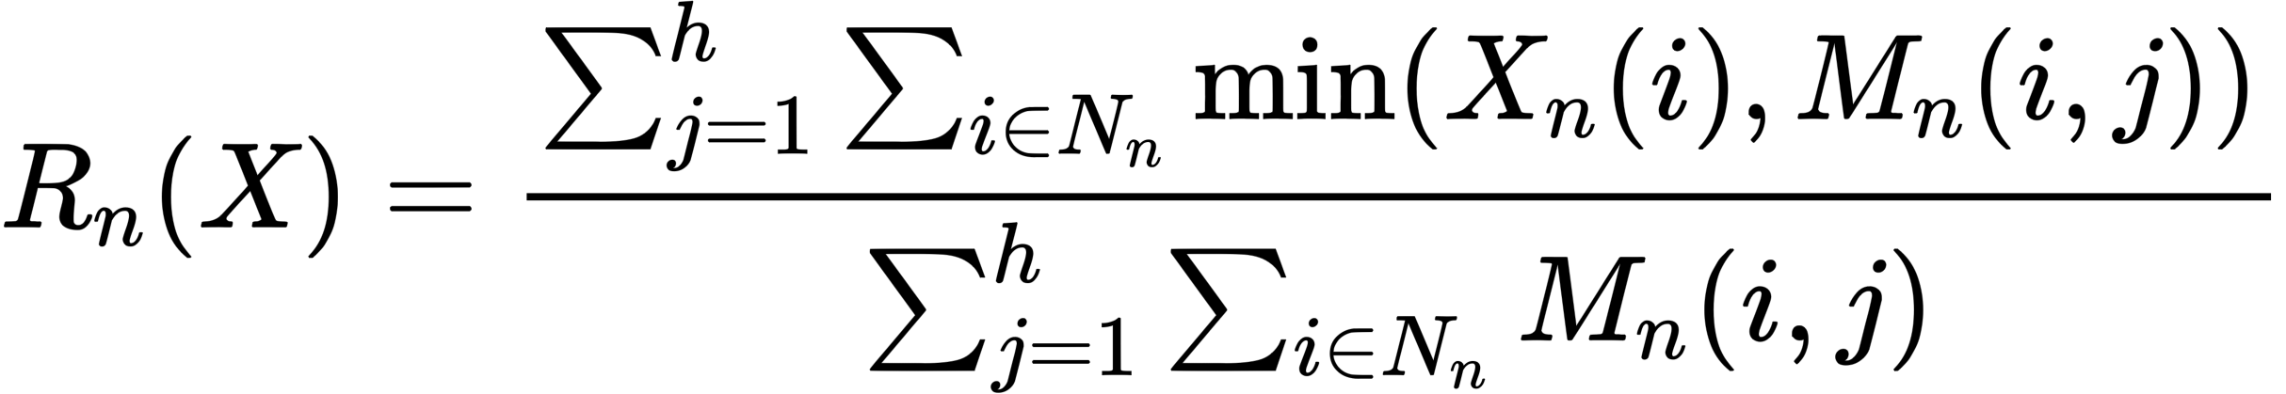
ROUGE-N
n-gram based comparisons between a generated summary X and human summary h.
X_n(i) is the number of the n-gram i occurred in the summary
M_n(i, j) number of n-gram i occurred in jth human summary
https://dl.acm.org/doi/pdf/10.5555/1273073.1273093

Slide 22
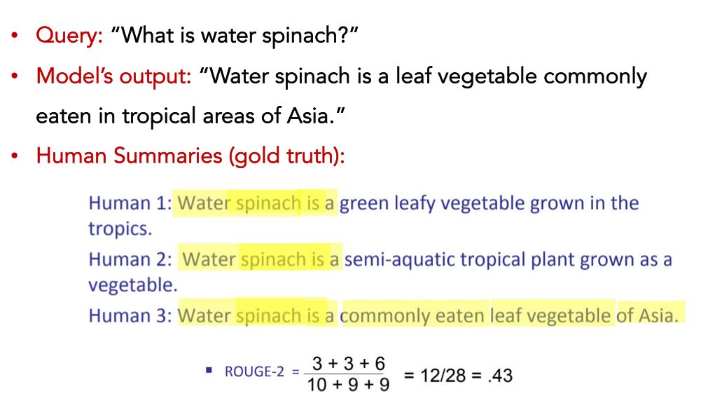

Slide 23
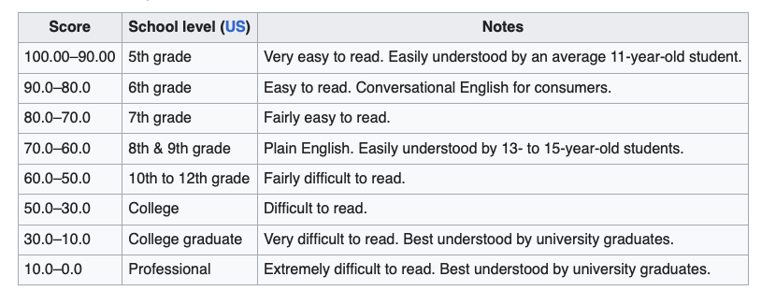
Flesch-Kincaid Grade Level (FKGL)

Slide 24
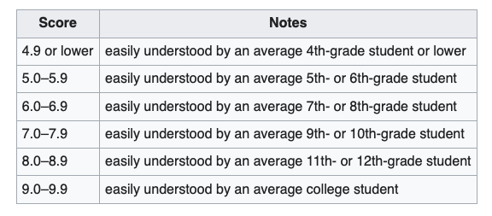
Dale-Chall Readability Score (DCRS)
Difficult words are the words that are not in the pre-defined familiar words, for example, 3,000 familiar words to fourth-grade students.

Slide 25
Coleman-Liau Index (CLI)
Same idea~!!
L is the average number of letters per 100 words
S is the average number of sentences per 100 words
CLI 14.5, roughly appropriate for a second-year undergraduate.
https://www.readabilit.com/readability/coleman-liau-index

