Slide 1
Retrieval Augmented Generation (RAG) for LLMs
Retrieval-Augmented Generation for Large Language Models: A Survey (Gao et al., 2023)

Slide 2
RAG
Enhances LLMs by retrieving relevant document chunks from external knowledge bases through semantic similarity calculation.
Reduces hallucination issues
An augmentation technique

Slide 3
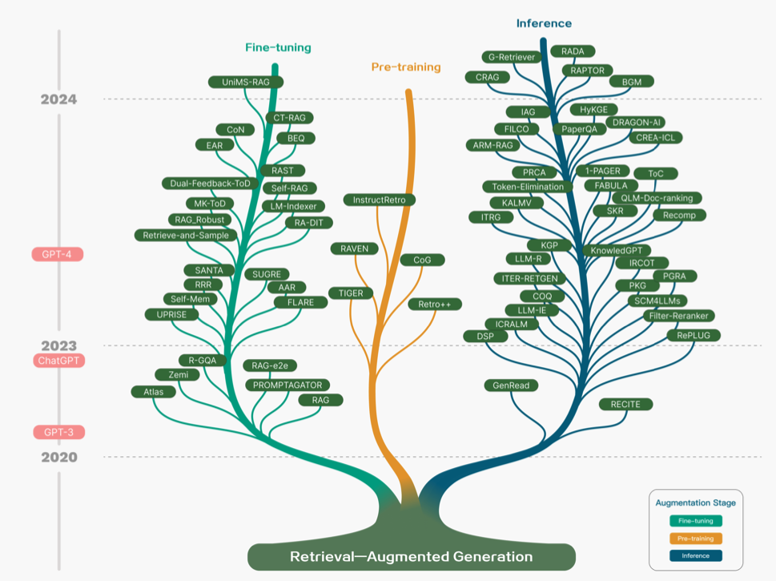
RAG research

Slide 4
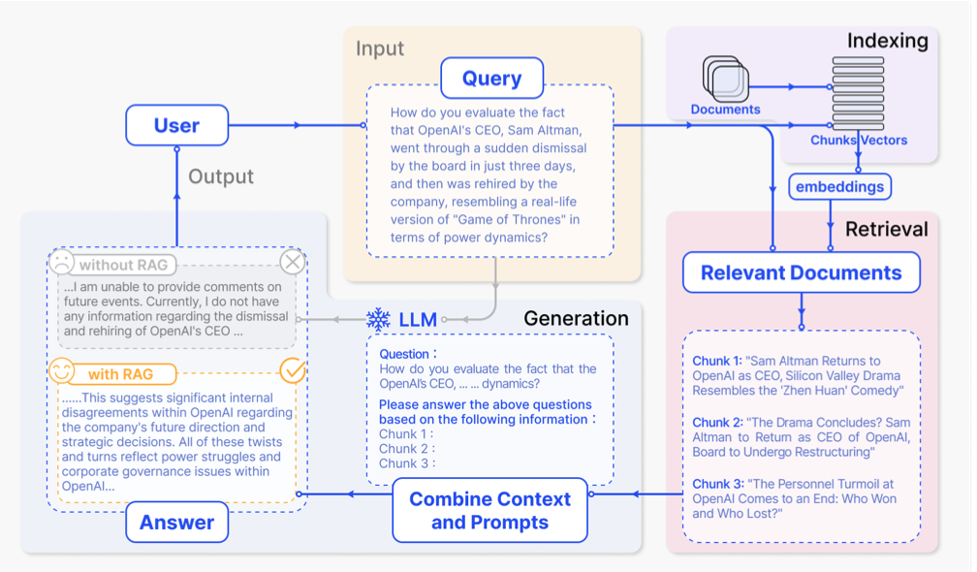
Example RAG applied to Question Answering

Slide 5
Common Retrieval Sources
Wikipedia
Common Crawl
Dataset-base
Scientific article databases (Arxive, PubMed, etc.)
LLMs
MSMARCO

Slide 6
Retrieval Granularity
phrase
proposition
sentence
item-base
chunk (fixed number of tokens)
doc
graph
entity triplet

Slide 7
Augmentation Stage
Pre-training
Fine-Tuning
Inference

Slide 8
Different steps/components
Input: user’s question
Indexing: chunking and generating embeddings. At inference, the query is also embedded in a similar way
Retrieval: find the most relevant chunks and retrieve pieces of documents
Generation: prompt engineering, query modification, etc.

Slide 9
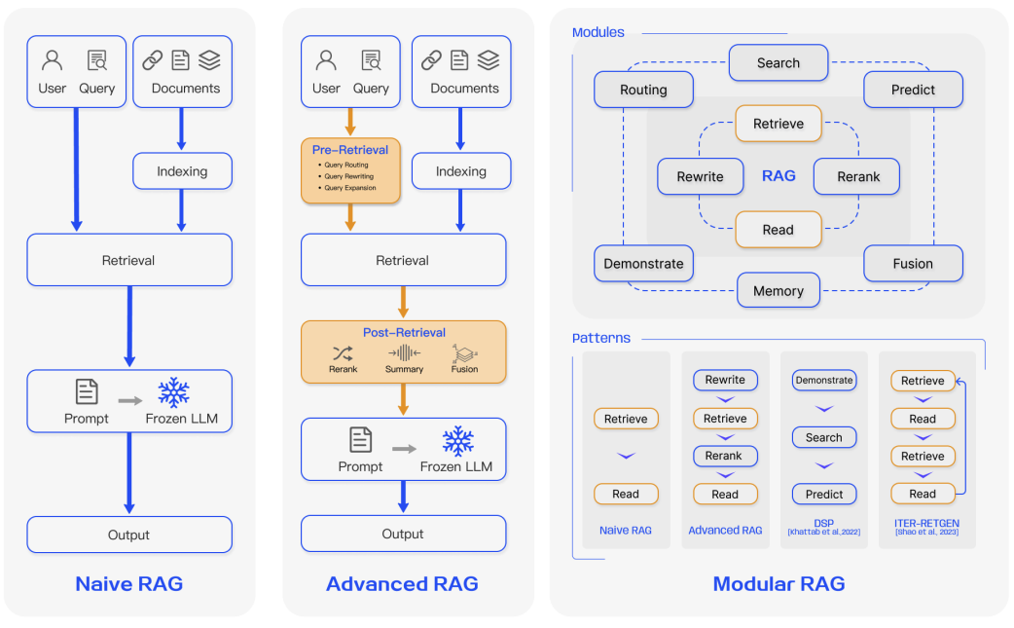
RAG Paradigms

Slide 10
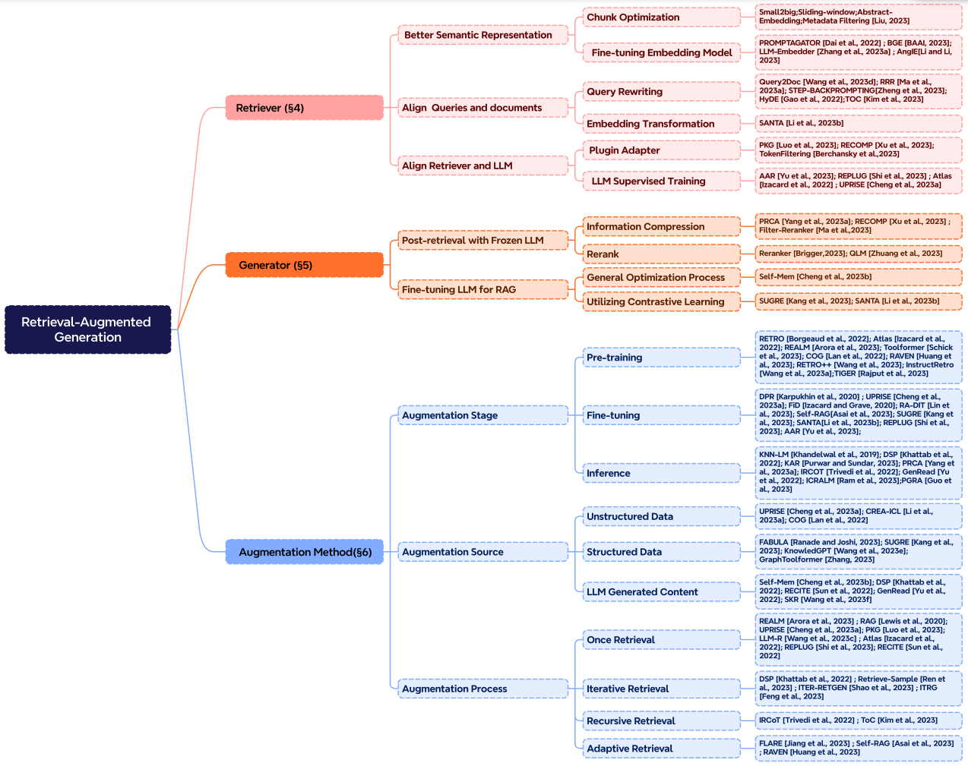

Slide 11
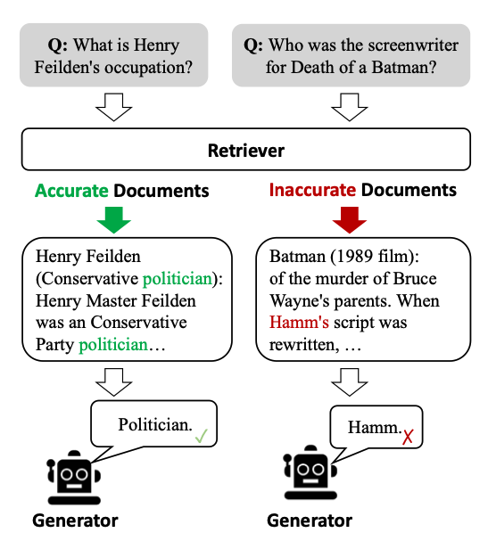
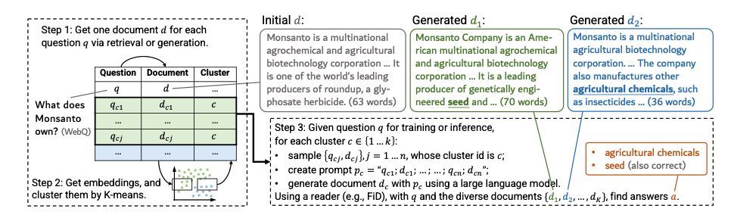
Case Study
“Generate rather than retrieve: Large language models are strong context generators,” ICLR 2023
LLM reads LLM-generated context and produces answers
“Corrective retrieval augmented generation”
Additional lightweight evaluator that assesses the overall quality of retrieved documents for query

Slide 12
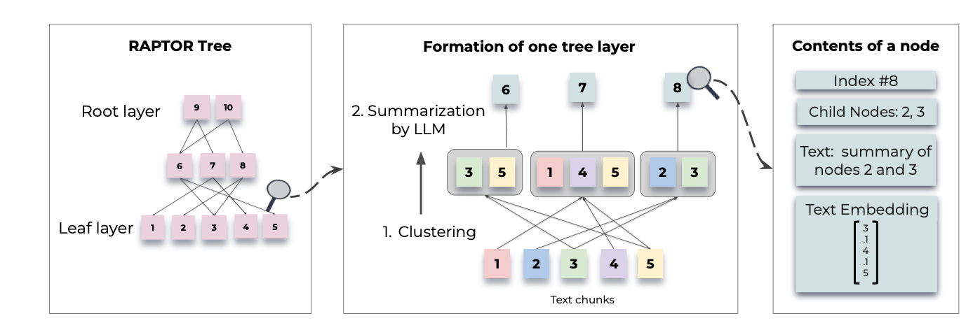
Case Study
“Raptor: Recursive abstractive processing for tree-organized retrieval”
Recursively embedding, clustering, and summarizing chunks of text.

