Slide 1
Exploring quality criteria and evaluation methods in automated question generation: A comprehensive survey
Education and Information Technologies, 2024
Guher Gorgun, Oka Bulut

Slide 2
Research Gaps
The efficacy of Automatic Question Generation (AQG) in educational assessments is mainly focused in many studies, but the evaluation of generated questions is overlooked.
They have no commonly accepted standards and theoretical foundations.

Slide 3
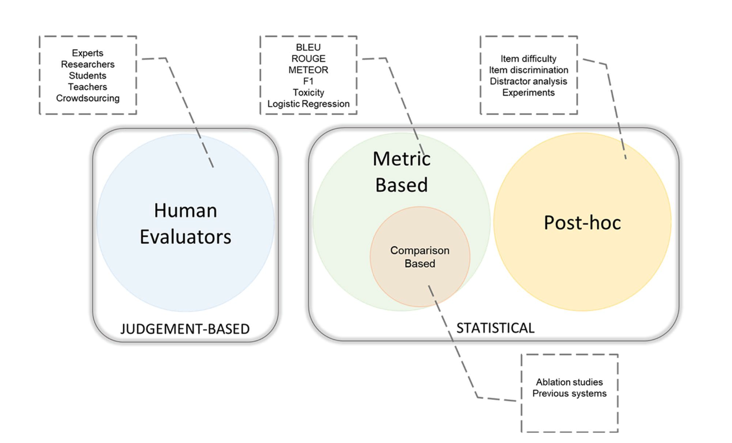
Evaluation Methods

Slide 4
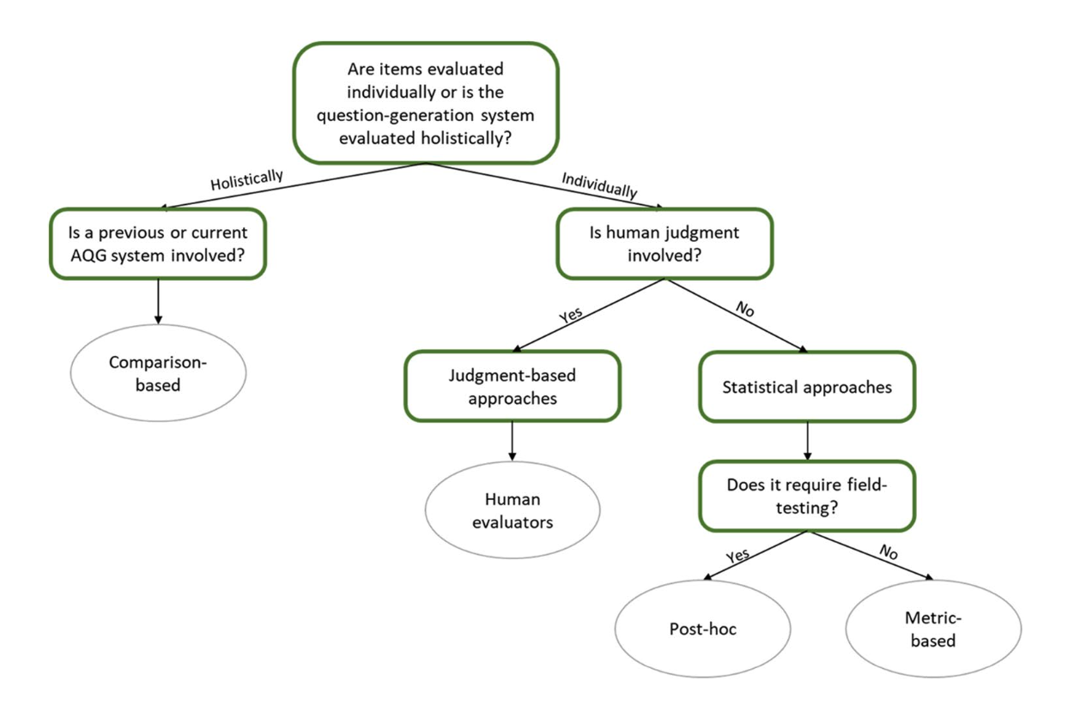
Taxonomy of Eval Methods

Slide 5
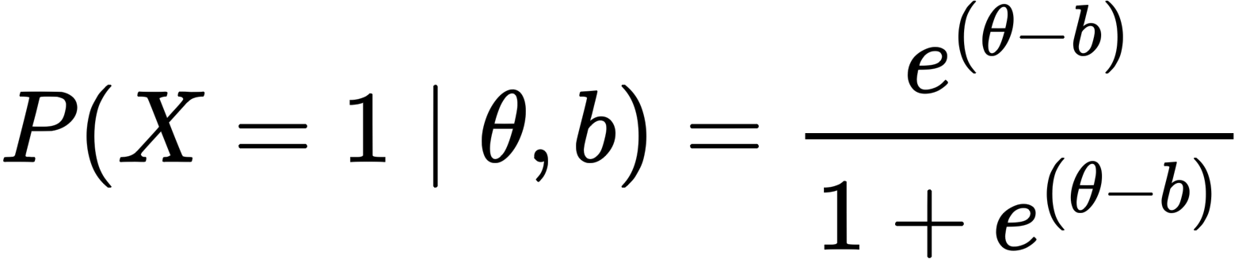
Difficulty
Classical Test Theory
Item Response Theory
theta: examinees’ ability, b: difficulty level

Slide 6
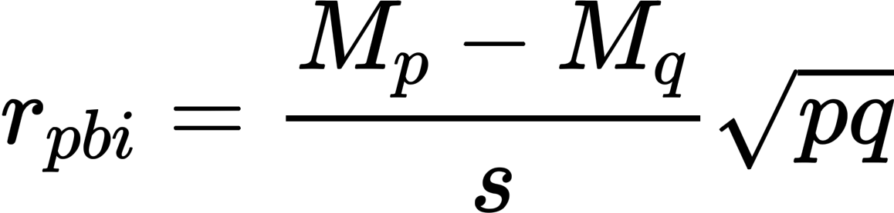
Discrimination
Classical Test Theory
point-biserial correlation
M_p: test average for examinees answering the question correctly
M_q: test average for examinees answering the question incorrectly
p,q: p-values, s: stddev

Slide 7
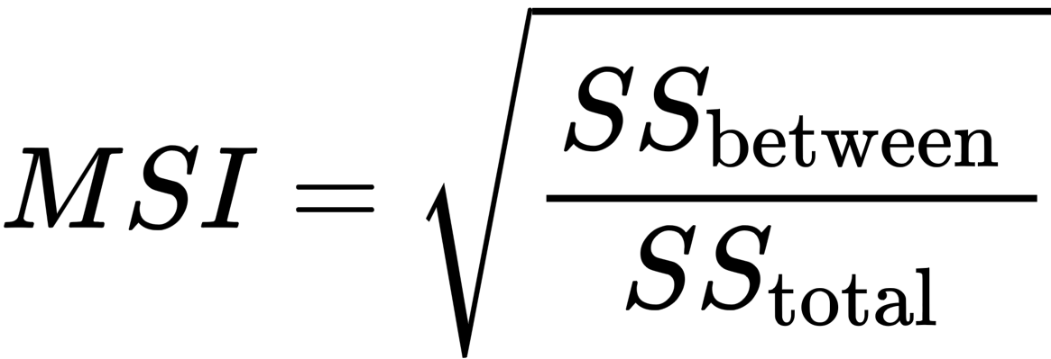
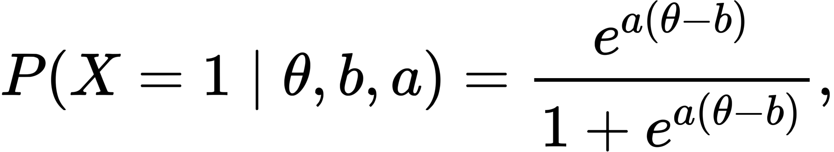
Discrimination (Cont.)
Multi-Serial Index (MSI)
SS: sum of squares
Based on IRT
theta: the ability level of an examinee
a: discrimination of the question
b: the item difficulty

Slide 8
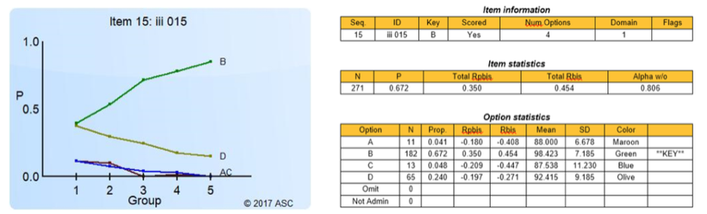
Distractor
Distractor Analysis: examines response patterns of students to each option in a multiple-choice question

Slide 9
Differential item functioning (DIF)
Assumes a group affiliation (e.g., race, gender, or region) impacts the probability of answering the question correctly.
Experts start by identifying focal and reference groups and then investigate whether the probability of correctly answering the question changes between similar members of these groups.

Slide 10
Evaluation Methods

Slide 11
Quality criteria in Judgment-based Methods
grammaticality, correctness, vagueness, ackwardness, fluency, relevancy, cognitive models, question engagement, pedagogical usefulness, difficulty, domain relevance,

Slide 12
Evaluation Methods

Slide 13
Metrics
Standard of measurement to compare the performance of systems; human-authored questions vs. generated
BLUE, METEOR, ROUGE, IR-metrics (F1, recall, precision)
limitations
the necessity of ground truth examples
primarily assess the similarity between a reference and generate questions.

Slide 14
Discussion
Recommendations
publicly available dataset
standardized quality criteria for interpretability of AQG systems
better reporting practices (data collection process, sampling methods, question generation process, etc.)
automatic evaluation

