Slide 1
Academic Author Profiles
Jiho Noh

Slide 2
Learning Objectives
The creation of your own academic author profiles
Scholarly communication platforms
Curating your profile content
Copyright when posting your works

Slide 3
Academic Author Profile
Platforms for online communication among researchers
Share work with a wide audience
Information about an author
Institutional affiliation
Scholarly work
Research interests

Slide 4
Start with an Author Identifier
Unique identifiers assigned to a researcher
Links researchers with their publications.
Prevents author ambiguity problems
Types of IDs
Open Researcher and Contributor ID (ORCID)
Web of Science ResearcherID
Scopus Author Identifier

Slide 5
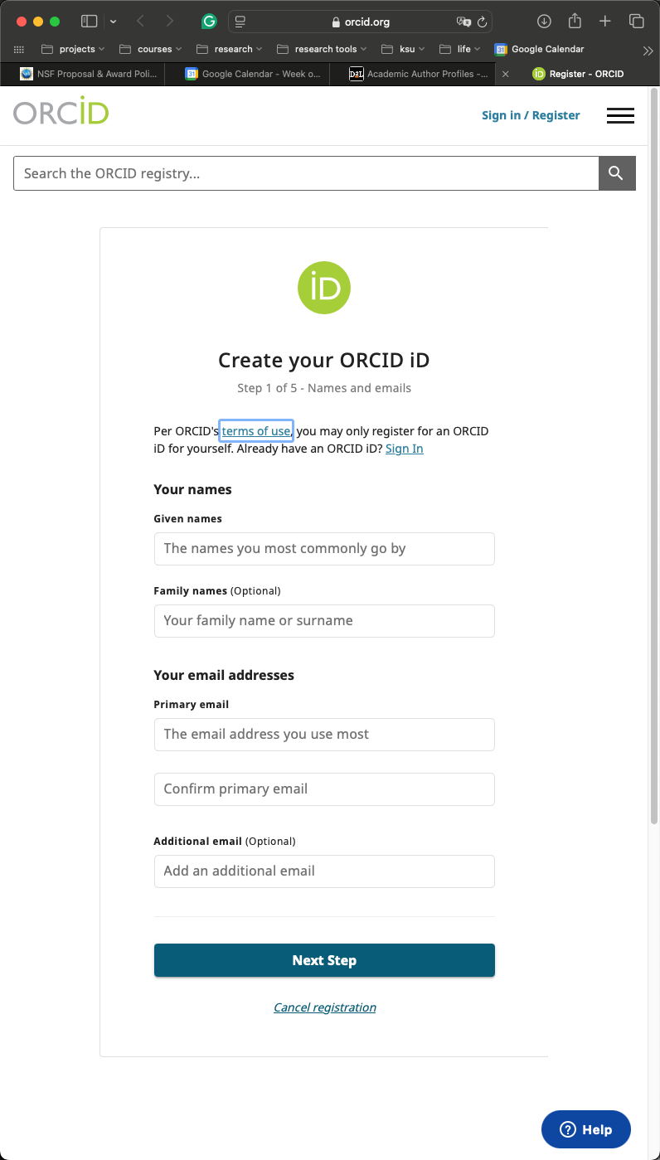
ORCID ID
Central registry of unique author identifiers
Register for an ORCID ID at https://orcid.org/register

Slide 6
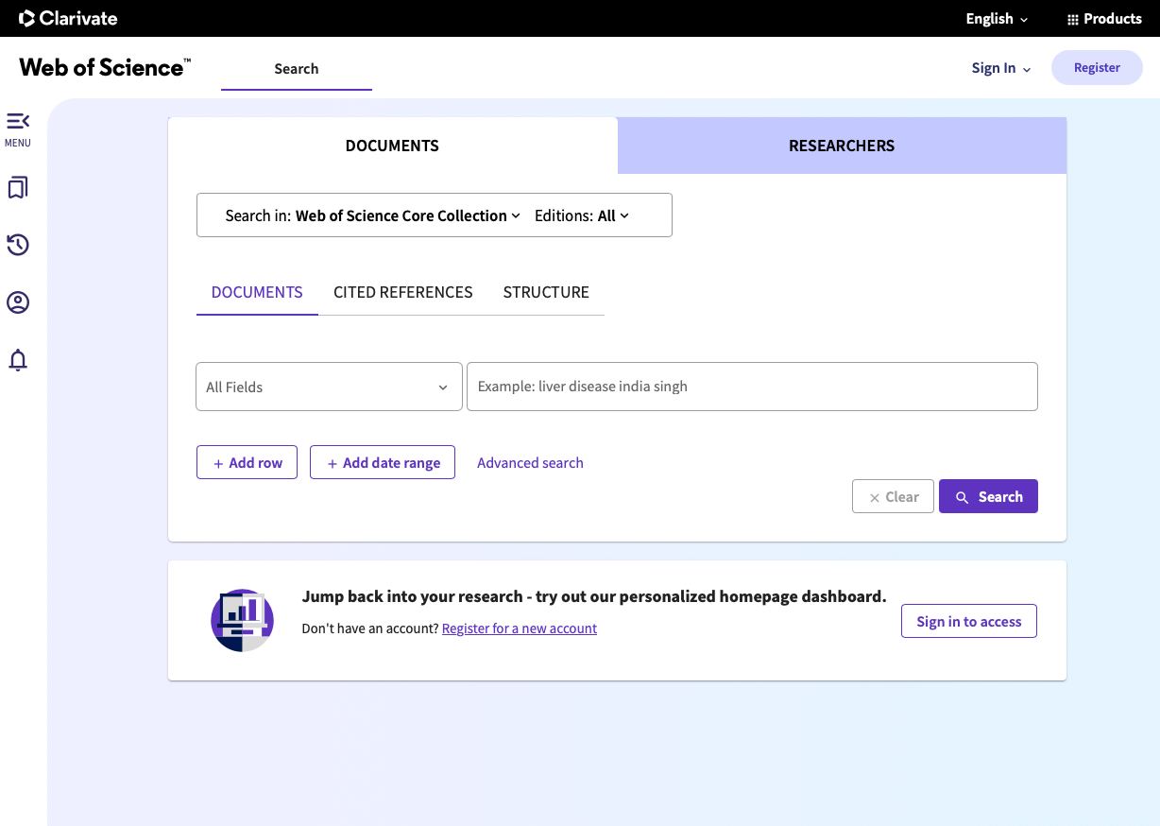
Web of Science
Unique identifier for researchers on Publons, Web of Science, and InCites.
Register at
https://access.clarivate.com/register

Slide 7
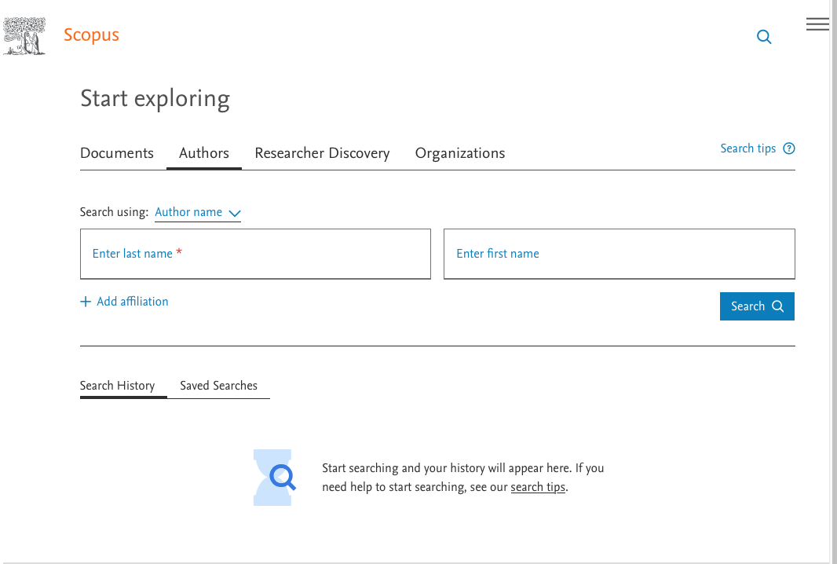
Scopus Author Identifier
Assigns each author in Scopus a unique number.
Groups materials using an algorithm that matches authorship based on certain criteria.
Profiles are automatically generated.
Search for your name and view your profile and ID at https://www.scopus.com/search/form.uri?display=authorLookup#author

Slide 8
Platforms
Web of Science (Publons is now part of WoS)
Scopus/Mendeley
Frontier (Open Access Publisher)
Academia.edu
ResearchGate
Google Scholar

Slide 9
ResearchGate
Commercial social networking platform.
RG Score and H-index on this platform.
RG Score - based on contributions an author posts on the site and calculated by ResearchGate’s algorithm.
Channel to share papers behind paywalls; authors likely to share papers when requested
Create an account at https://www.researchgate.net/signup.SignUp.html

Slide 10
Google Scholar
Free online search engine for scholarly literature
Comprehensive coverage
Automatic citation tracking
Straight-forward access to full-text
Sign into your Google Account and set up a profile at https://scholar.google.com/citations?hl=en

Slide 11
SelectedWorks
Institutional Repository
Often used by universities and other institutions to promote and disseminate the research and scholarship of their faculty and staff.
Share research interests, service contributions, honors and awards, education, etc
Sign up: https://works.bepress.com/account/register/

