Slide 1

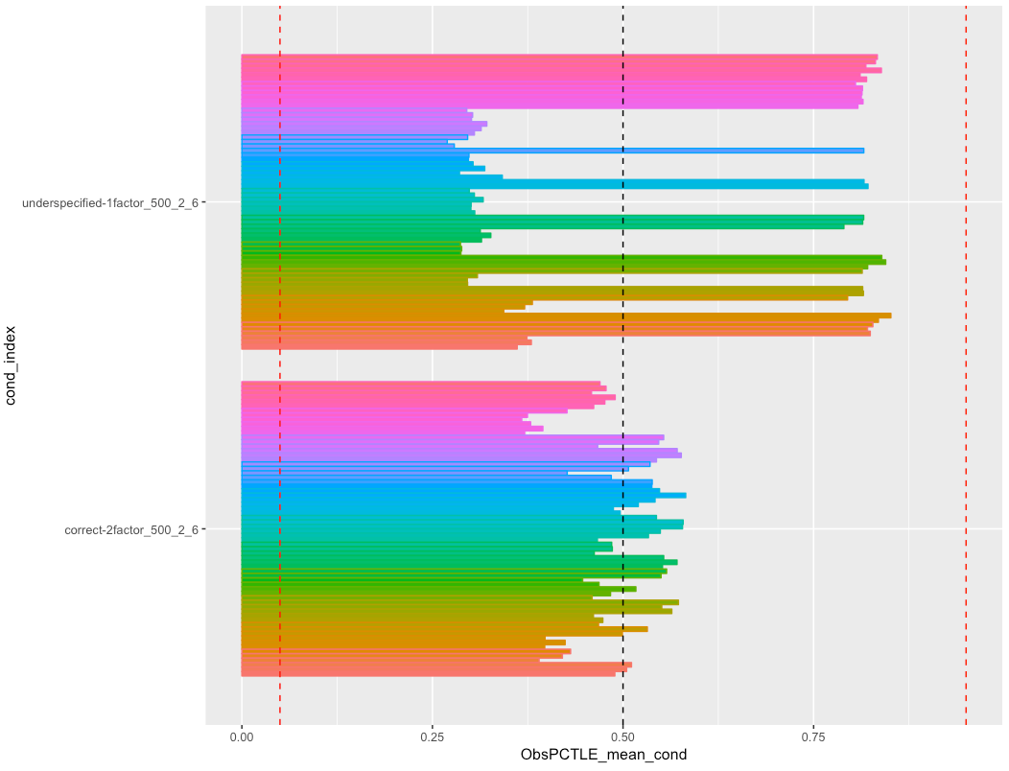
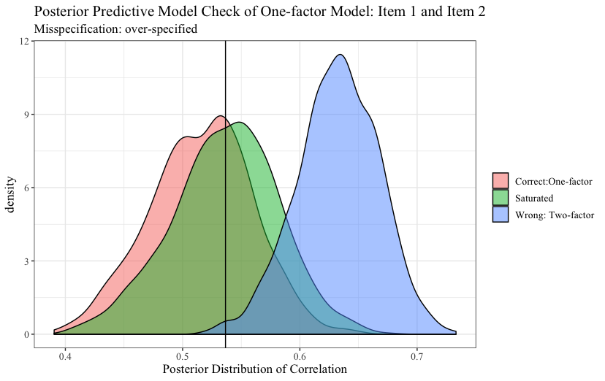
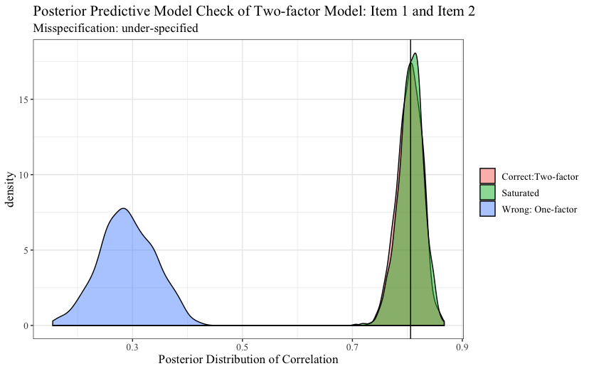
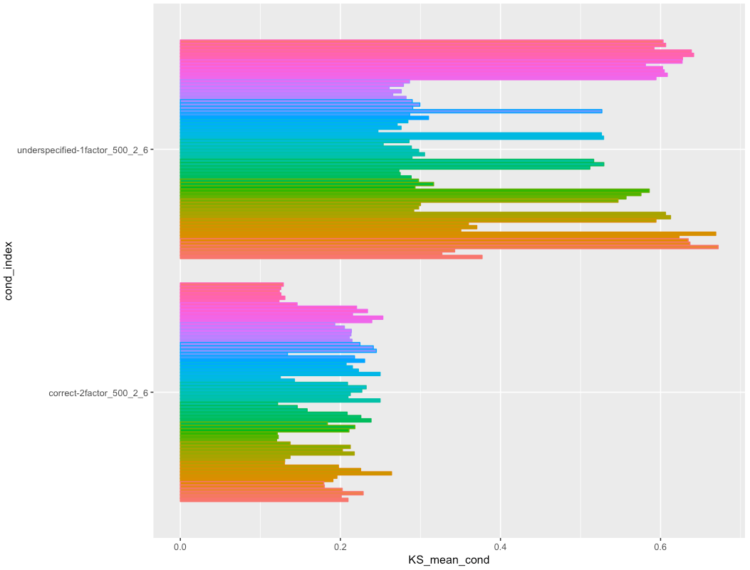
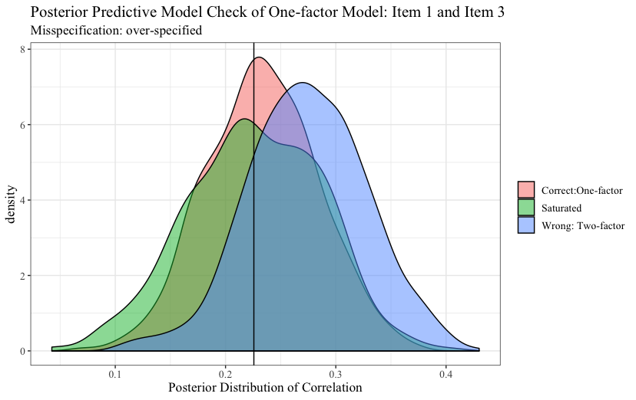
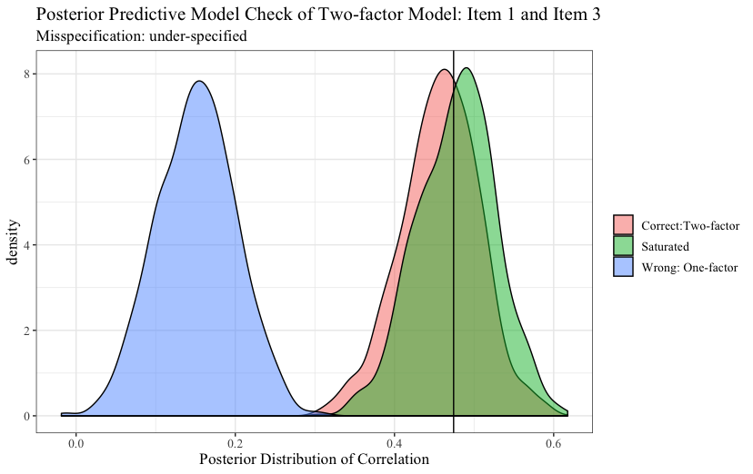
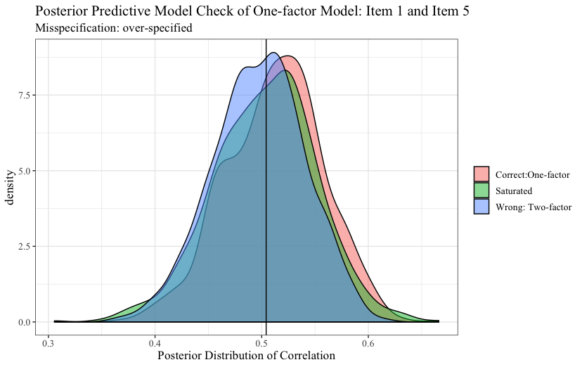
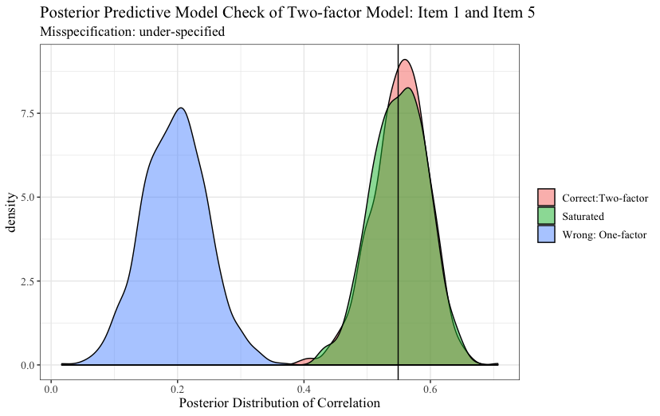
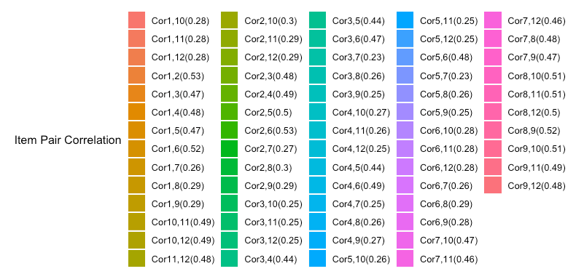

A Bayesian Saturated Model Approach of Posterior Predictive Model Checks in
Confirmatory Factor Analysis
Jihong Zhang, Jonathan Templin, &Catherine E. Mintz
University of Iowa, Iowa City, Iowa
Purpose
Methods
This study aims to propose a new method of posterior predictive model checking (PPMC) for Bayesian confirmatory factor analysis (CFA) models. It employs the predictive distribution from parameters of the posterior distribution of the saturated model as reference to detect the local misfit of the hypothesized models.
For each model, 1000 sets of parameters were sampled from the posterior distributions and simulated posterior predictive data sets from which the corresponding item-pair correlation matrix was calculated. To examine local misfit, the average Kullback-Leibler divergence (KLD) and Kolmogorov-Smirnov (KS) Tests across 100 repetitions for each condition were used to measure the distance of posterior predictive distribution between the model with saturated model.
Simulation Design
Results
Misspecifation Type | Correct Model | Mis-specified Model
Overspecified | One-factor Model | Two-factor Model
Underspecified | Two-factor Model | One-factor Model
Additional Loading | Two-factor Model | Two-factor with incorrect additional loading
Wrong Loading | Two-factor model | incorrect loading item #1
Number of item: 6
Sample Size: 500
Observed Percentile
Items per factor: 6 items or 12 items
Latent trait correlations: random sampling from [.3, .8]
Factor loadings: random sampling from [0.1, 0.8]
Sample Size: n = 50, 500, 2,000
Generate Simulated Data
Factor Loadings and factor correlations are randomly sampled
Run Bayesian Models
Correct Model
Saturated Model
Run PPMC for item pairs
Correct Model vs. Saturated Model
Mis-specified Model vs. Saturated Model
Mis-specified Model
Test Statistics
Kullback–Leibler divergence
Kolmogorov–Smirnov test
Average Kolmogorov–Smirnov test
Conclusion
KS method is consistent with PPP method in term of detection rate and false alarm rate.

