Slide 1
Real-Time MBTI Detection based on Speech Data
전지훈

Slide 2
Goal & Usage Scenario
Instantaneous MBTI detection
Without laborious test-taking or providing texts written in the past
Less effort for figuring out others’ MBTI
Personalized MBTI tracker
MBTI is subject to change depending on one’s experience & circumstances
“Change” if one’s MBTI result deviates from previous dominant one, and persists

Slide 3
Key Idea
Basic Pipeline
User Speech ➔ (Speech Recognition) ➔ Text ➔ (Language Model) ➔ Classify
Speech Recognition : Used Android SpeechRecognizer
Why based on Speech?
For Simple & Seamless MBTI Detection
Features to Use
Text Features (Converted from Speech) : Fundamental element of this app
Speech Features (Waveform) : Decided not to use in this app
Further functionalities are required (e.g., Source Separation in noisy environment)

Slide 4
MBTI Classifier (LLM)
Base Model : BERT (HuggingFace BERTForSequenceClassification)
Recent Billion(GB)-scale LMs are too heavy for Mobile App
Among sub-Billion-scale LMs, BERT’s performance was better than GPT-2 (Later Slide)
Training Methodology (2 was the optimal choice. Later Slide)
Instruction Finetuning ➔ Generation Result vs Target MBTI
Input : [Instruction] What is the MBTI given this text? [Text] ~~~ [MBTI] ~~~ [Text] ~~~ [MBTI]
CELoss b/w Model logits (16-dim for each instance) & Target MBTI (0~15)
Logits: [0.232, 0.112, …, 0.261] / Target: 1(=INTP) ➔ CE = -log(0.112)
4 Classifiers (I/E, N/S, T/F, J/P) separately

Slide 5
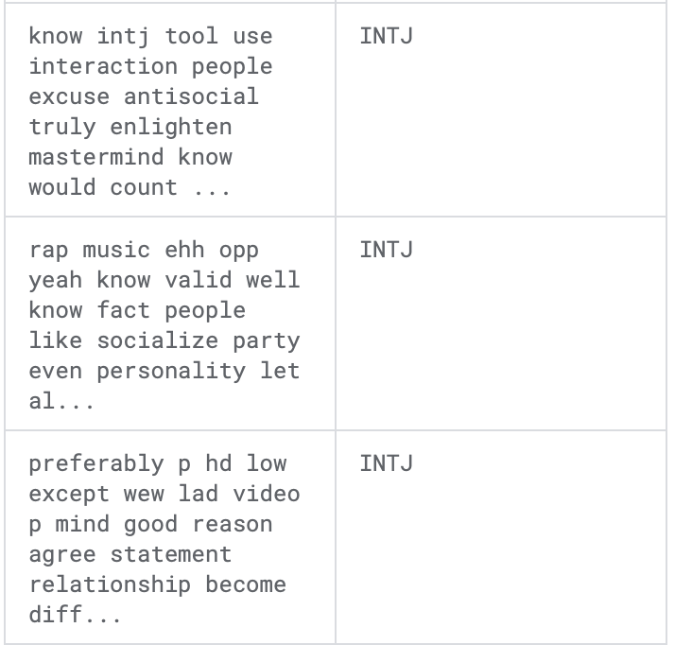
MBTI Classifier (LLM)
Dataset : MBTI500 (Kaggle Dataset)
100K instances with Posts & Writer’s MBTI type (Collected mostly from Reddit)
Labels(MBTIs) are highly imbalanced (INTP=24%, INTJ=21%, … )
Used the randomly sampled data for training
Sample Version 1 (Prop) : Proportional to actual MBTI proportions (ISFJ=9.08%, … )
Sample Version 2 (Bal) : Balanced sampling (6.25% for each MBTI)
Model Train Versions
Base Model : BERT / GPT-2
Dataset Version : All / Prop / Bal
Train Method : Generation / 16-label Classification / 4 * 2-label Classification

Slide 6
MBTI Classifier (LLM)
Train Results (After 10 Epochs, On Test Set)
BERT showed better performance than GPT-2
Classification was better than Instruction Finetuning & Generation
Model trained on ‘All’ or ‘Prop’ data tended to yield similar output all the time
“4 * (2 Classify)” is 4x heavier than “16 Classify” Model, but performance gap is marginal
Base | Data | Method | Perfect | 1 Wrong | 2 Wrong | Hit@5 | Hit@10 | I/E | N/S | T/F | J/P
GPT-2 | All | Generation | 23.89% | - | - | 39.39% | 71.87% | 75.76% | 91.58% | 65.46% | 58.37%
GPT-2 | Prop | Generation | 36.58% | - | - | 54.00% | 73.51% | 77.70% | 73.86% | 71.42% | 63.76%
GPT-2 | Prop | 16 Classify | 39.37% | - | - | 53.31% | 75.26% | 75.26% | 70.73% | 66.89% | 68.98%
BERT | All | 16 Classify | 77.20% | 2.80% | 6.23% | 90.32% | 96.46% | 89.23% | 95.00% | 92.60% | 87.57%
BERT | Prop | 16 Classify | 54.00% | 13.24% | 11.49% | 72.47% | 90.59% | 76.30% | 81.18% | 78.39% | 70.37%
BERT | Bal | 16 Classify | 54.48% | 5.17% | 13.44% | 79.31% | 94.13% | 78.62% | 83.79% | 85.51% | 73.44%
BERT | Bal | 4*(2 Classify) | 55.51% | 3.79% | 7.93% | - | - | 82.06% | 87.58% | 85.17% | 83.10%

Slide 7
MBTI Classifier (LLM)
Model Optimization (Base Model = BERT, Data = Bal, Method = LoRA / 4-bit Quantization)
Training with LoRA showed better performance (than vanilla training)
Model seemed to be overparameterized for this task
However, could not figure out the way to convert LoRA checkpoint into .ptl format
4-bit Quantization (of original vanilla model) showed marginal performance degradation
Further 10 Epoch of Quantization-Aware Training was done after quantization
Model Size : 417MB (Original) ➔ 173MB (Quantized) (41.48% of Original Model)
267MB when converted into .ptl format (Inevitable memory size increase when any .pt file is converted into .ptl)
Method | Perfect | 1 Wrong | 2 Wrong | Hit@5 | Hit@10 | I/E | N/S | T/F | J/P
None (Original) | 54.48% | 5.17% | 13.44% | 79.31% | 94.13% | 78.62% | 83.79% | 85.51% | 73.44%
LoRA | 56.44% | 10.10% | 13.58% | 77.00% | 92.68% | 79.44% | 79.79% | 82.22% | 75.95%
Quantization | 52.41% | 7.24% | 14.13% | 74.13% | 92.06% | 78.62% | 82.75% | 77.24% | 77.93%

Slide 8
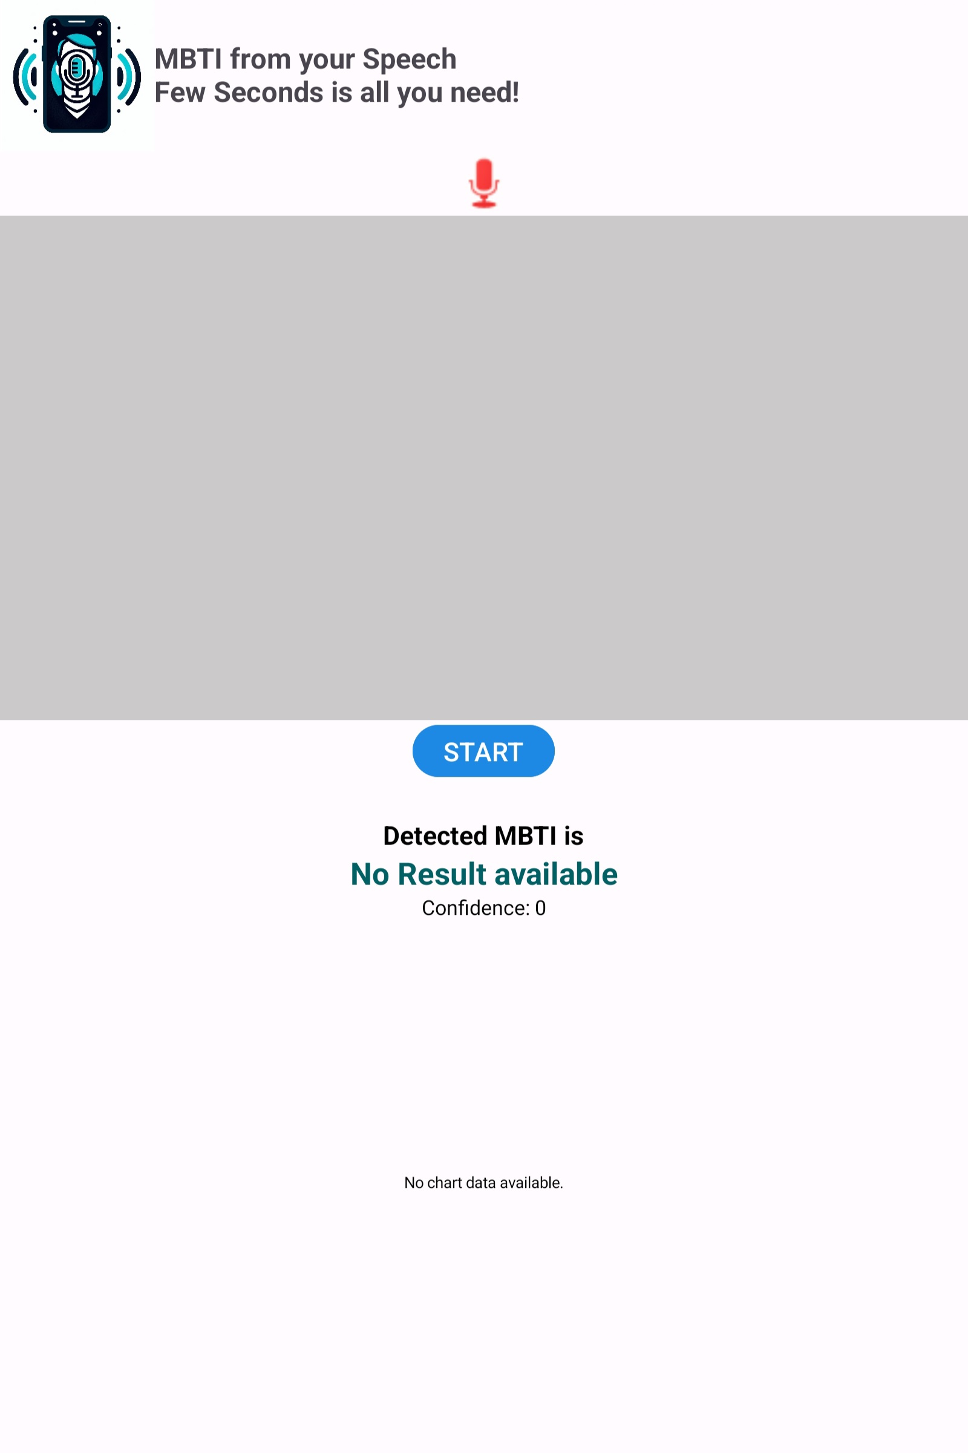
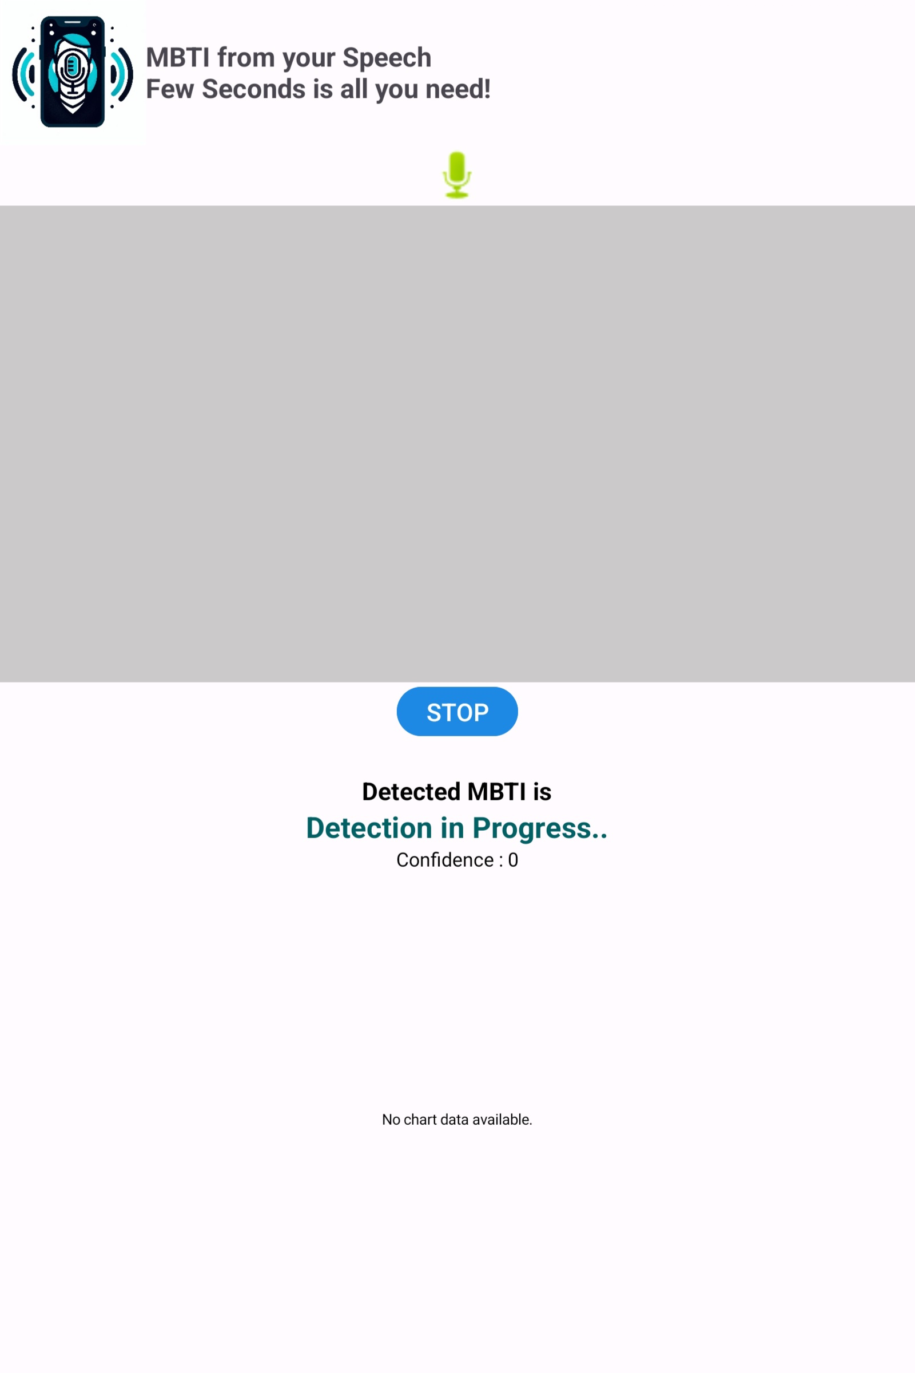
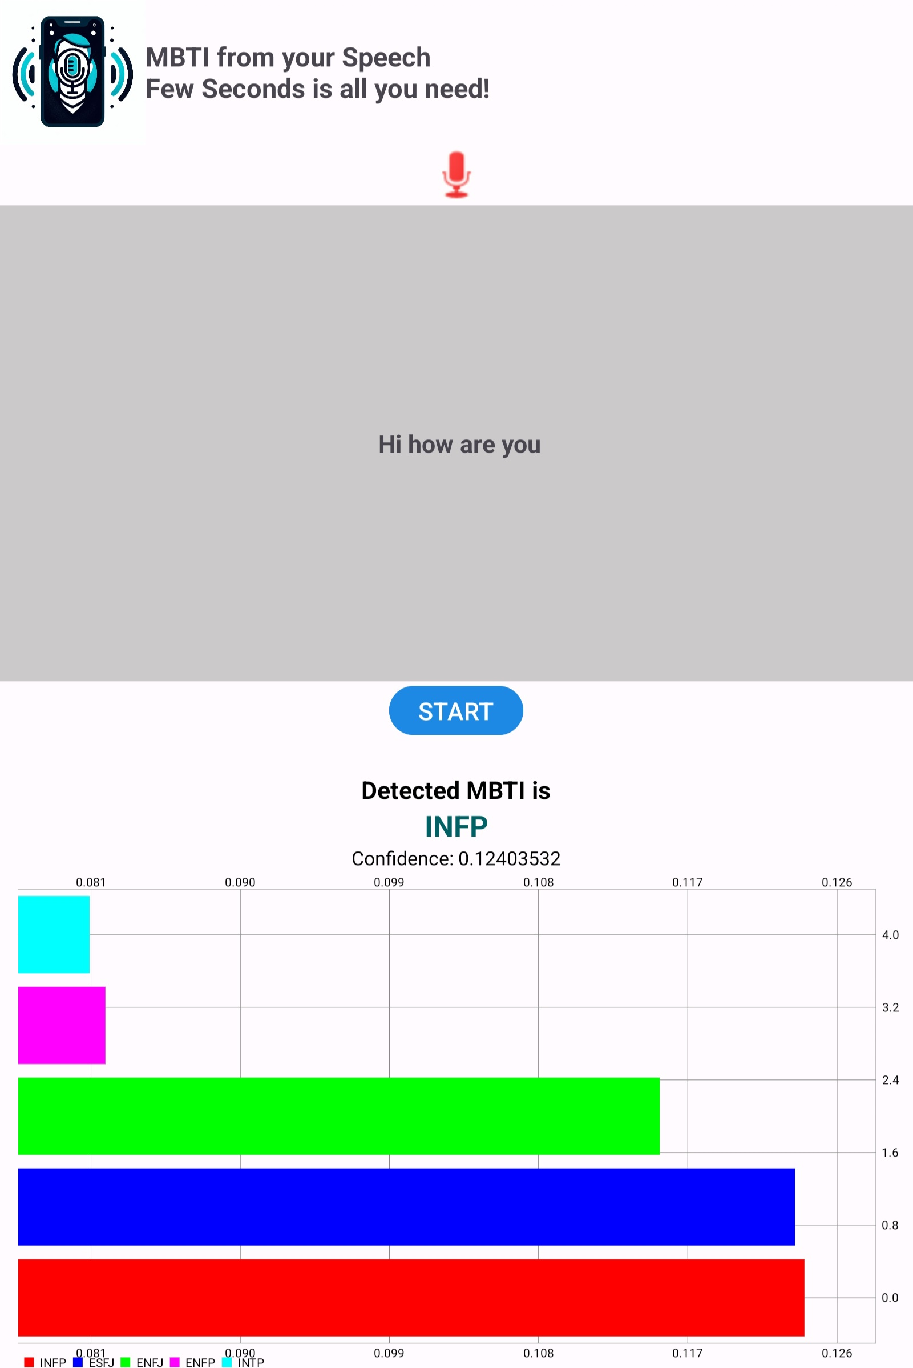
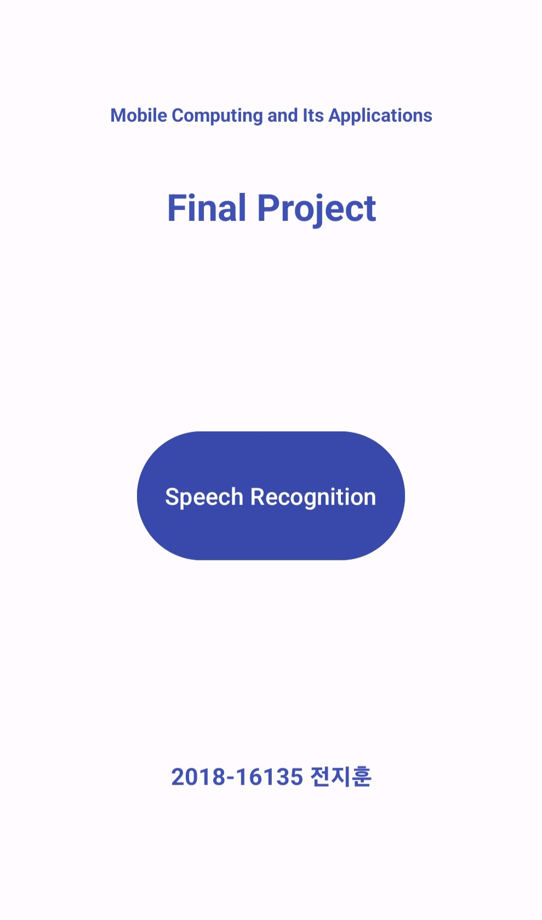
App Functionalities
Red: Detection OFF
Green: Detection ON
Recognized Text
Main Page
Detection Page
Top5 Predicted MBTI BarChart

Slide 9
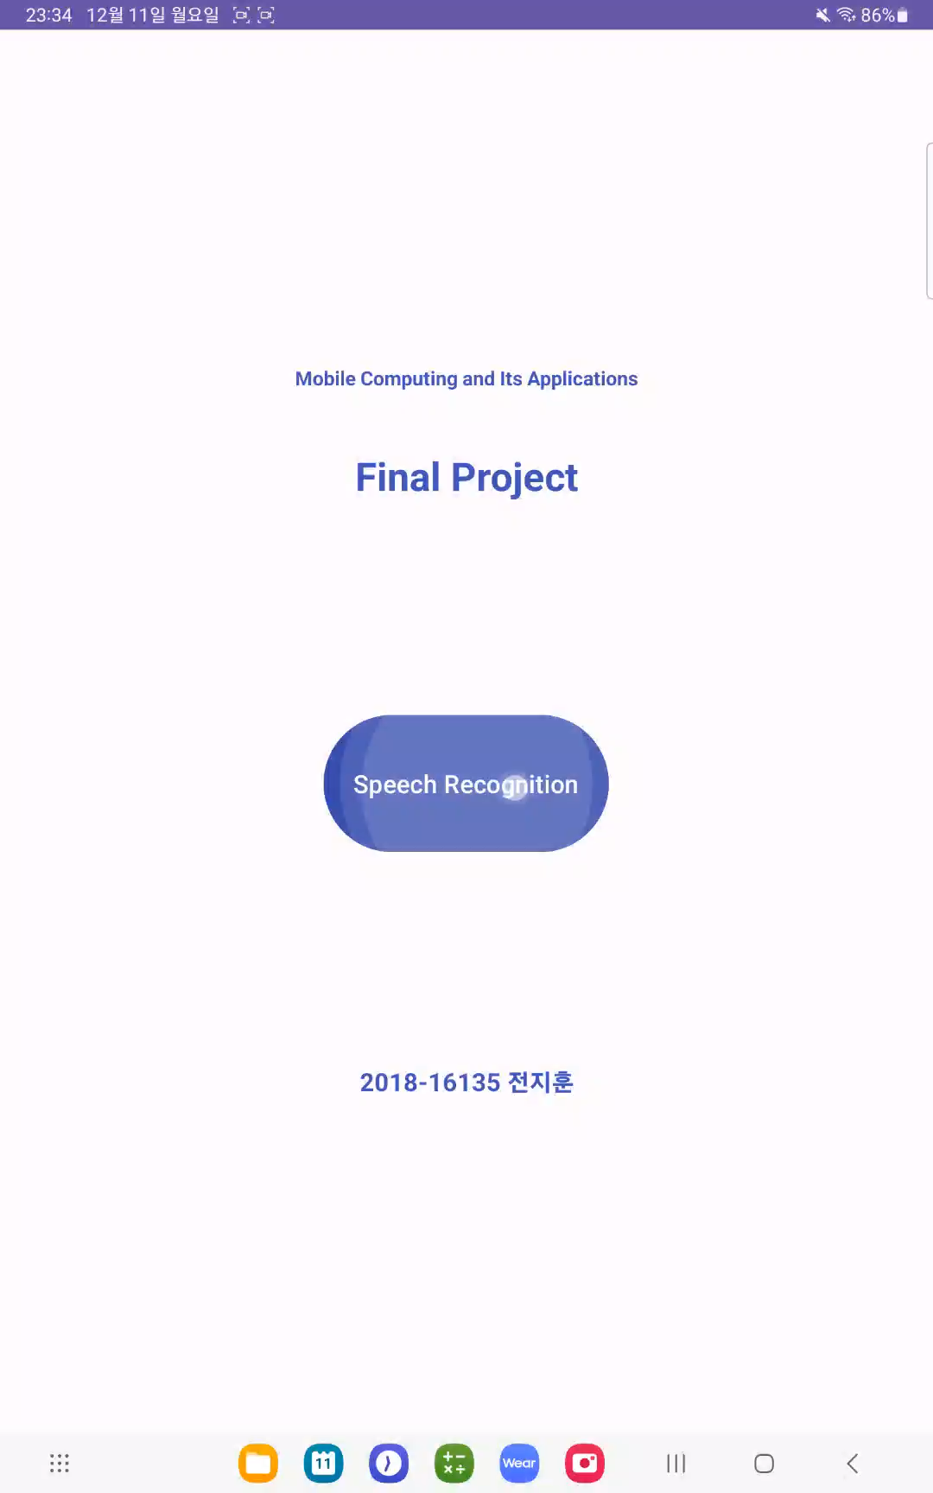
App Demo & Development Environment
Development OS: MacOS (Apple Silicon M2)
Development IDE (Language): Android Studio (Java)
Minimum SDK Version: API 26
Test Device OS Version: Android13 (“Tiramisu”)
Compile SDK Version: API 34
Target SDK Version: API 33

Slide 10
Project Timeline
11/2 ~ 11/16 : Speech Recognition Model Research
Performance was very poor ➔ Decided to use Android SpeechRecognizer
11/17 ~ 12/1 : LLM Research & Training & Performance Comparison
12/2 ~ 12/9 : Model Optimization & Android App Implmentation
Q & A

