Slide 1
E
New (e-)takeoff
for aviation industry
by Ann Brady
New technologies, from robotics to machine learning, are ushering in a period of rapid change and development.
While the aviation industry is working to reap the benefits of this industrial automation, standards, especially those of ISO/TC 184/SC 4, will play a key role in ensuring a smooth flight path – but only if they can keep up.
ver since Icarus boldly strapped on his wooden-framed wings made of feathers and wax and took to the skies,
As a result, the industry has had to seek new ways to design safer, faster, lighter, more fuel-efficient aircraft. And in the ever more environmentally aware 21st century, the industry also has to take action to reduce aircraft emissions and achieve a more sustainable carbon footprint – big challenges indeed in an era that has been described as "generation EasyJet”.
human beings have been defying gravity, designing and creating all kinds of contraptions and devices to get themselves airborne. Hubris, along with solar power, did it in for Icarus, but these days, the likes of Elon Musk, founder and chief designer of SpaceX and creator of Tesla, and Jeff Bezos, founder of Amazon.com and Blue Origin, are blazing new trails in the skies, driven by their vision and a sense of adven- ture, and propelled by the new technologies of the Fourth Industrial Revolution.
These modern-day Icaruses can afford to think big, and their successes, trailblazing endeavours and projections are splashed across the media. Of course, the aerospace and aviation industry has been pushing boundaries for years. From the first commercial air flight in 1914, demand for air travel has grown exponentially.
Fast and flexible
Finding solutions to these challenges calls for cost- effective, fast and flexible new production processes. Technologies such as advanced robotics, artificial intelligence, machine learning, cloud computing and the Internet of Things are playing a huge role in such processes and are quietly transforming our lives, particularly in the aviation industry. Every time we step on a plane and buckle up, we are handing ourselves over to some degree of automation.
ISOfocus_131 | 5

Slide 2
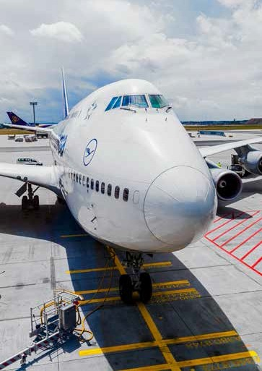

For instance (nervous flyers should look away now), we never think about the thousands of holes that are holding the different parts of the plane together and how those holes were drilled, a time-consuming task that also requires a lot of precision. Ben Morgan, Head of the Integrated Manufacturing Group at the Advanced Manufacturing Research Centre at Sheffield University, points out in an article on automated manufacturing in The Engineer, this is a task better suited to robots than people. "Automated systems can achieve greater precision, and do not get bored or tired; drills capable of handling aerospace materials and layers of different materials are bulky, heavy and difficult even for skilled staff to use, "he says. Good news for air travellers.
And when you consider that a Boeing 747, for example, consists of six million parts, which must all be assembled, it becomes clear that automated manufacturing has a key role to play in building new aircraft.
However, therein lies the challenge for the aviation industry – not only in staying abreast of the rapid development of new technologies but also ensuring standardization in the field of automation systems and their integration for design, sourcing, manufacturing, production and delivery, support, maintenance and disposal of products and their associated services.
One person with a unique perspective on both these challenges is Kenny Swope, Senior Manager, Business Capability Integration, at Boeing, and Chair of technical committee ISO/TC 184, Automation systems and integration, subcommittee SC 4, Industrial data. For a company like Boeing, which is a manufacturer of highly complex systems at scale, Swope says standards are critical to its overall success in the industry and are woven through the company’s "product, the supply chain and the service offerings in a myriad of ways ”.
Key role for standards
He cites three standards as playing a key role. According to Swope, one of the most successful standards in the adoption of a digital product design is ISO 10303, Industrial automation systems and integration – Product data representation and exchange, often referred to as STEP. ISO 10303 comes under ISO/TC 184/SC 4 on industrial data. STEP has evolved into the most commonly used standard for exchanging product design data between computer-aided design (CAD) systems, both inside companies and across the global supply chain.
He says: “As the heart of the product design and deliverable from engineering to manufacturing, the three-dimensional representation of the product design coupled with the engineering requirements and manufacturing information form the core of the digital twin. "This collection of data for a detailed virtual representation has clear benefits. At Boeing, Swope says, “the product design is distributed to both internal and external stakeholders at the component and assembly level and this standard is critical to that network”.
Disseminating complex data on product design for general instruction, training and documentation is another big challenge. Here, Swope highlights ISO 14306, Industrial automation systems and integration – JT file format specification for 3D visualization, which is also managed by ISO/TC 184/SC 4. He says the standard is invaluable in providing what he describes as a "lightweight version "of a complex data structure such as the visualization of the product for manufacturing, service and support, which "is useful in engineering documents, online service manuals and manufacturing stations”.
The third standard, ISO 32000, Document management – Portable document format, “is a strong partner to both ISO 10303 and ISO 14306”, says Swope. This standard, commonly known as the PDF standard, is, he adds, vital to the seamless operation of the digital future as it provides a universally accepted conveyance vehicle for the product design and its associated information.
Finally, ISO 8000, Data quality, and ISO 22745, Industrial automation systems and integration – Open technical dictionaries and their application to master data, are significant enablers to smart manufacturing. As ISO 9000 is to manufacturing quality, ISO 8000 is to data. Smart manufacturing requires data free of defect and openly shareable data definitions of commonly used parts. ISO 22745 provides a multi-industry solution to sharing definitions of these common parts for use across the supply chain.
The aerospace and aviation industry has been pushing boundaries for years.
6 | ISOfocus_131
ISOfocus_131 | 7

Slide 3
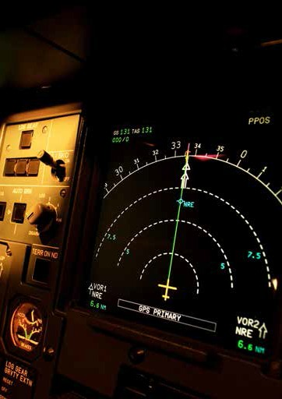
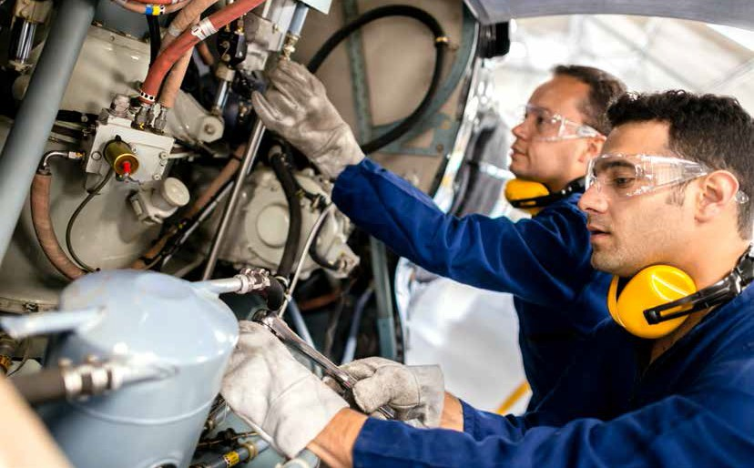
Automation and efficiency
Annalise Suzuki, Director of Technology and Engagement, at Elysium Inc., a software company that describes itself as a multi-CAD data exchange optimization platform, also extols the benefits of standards and the critical role they play as the trend for industrial automation grows. She says: "Organizations pursuing automation for efficiency gains must find a balance between adopting new technology and leveraging stability from standards where they can.”
Like Swope, Suzuki believes that leveraging standards allows organizations to quickly agree on the means and methodology to collaborate, without overcomplicating processes. She says : "It allows doers to take action without the need to solve 'how’ first." While standards allow collaboration among people today, she says they will be "a key enabler to drive automation potential for machine-to-machine communication, which will be the basis for achieving the Fourth Industrial Revolution”. Standards clearly go a long way to helping industry realize the full potential of automation, enabling people and technology to work hand in hand. But what about safety? Unlike our old friend Icarus, who turned a deaf ear to his father’s warning about flying too close to the sun, the aviation industry rightly puts safety concerns to the fore. But does smart manufacturing, and industrial automation in particular, carry the seeds of poten- tial lapses in safety, especially when it comes to data security?
While industry adoption is something that each company has within its control, Swope says that gaps are often found that need to be addressed and resolved. “These resolutions simply take too long in today’s rapid-paced business environment. In addition, new technologies and methods of manufacturing are emerging that are seeing significant industry excitement. Additive manufacturing, blockchain, and advanced robotics are recent examples. While value generation is occurring right now as an emerg- ing space, the real value will come when these and other technologies are standardized and replicated at a massive scale.”
Automated manufacturing has a key role to play in building new aircraft.
Bridging the safety gap
Christoph Preusse, an expert and designee from ISO/TC 199, Safety of machinery, and Chair of the Smart Manufacturing Coordinating Committee (SMCC), acknowledges the threat to safety from IT-system malfunctions. However, he points out that a lot of effort has been made by ISO/TC 184 (together with the International Electrotechnical Commission’s IEC/TC 65) as well as in ISO/TC 199 to improve security and the interaction between security and safety (for example, future technical report ISO/TR 22100-4). As a result, Preusse says, "industrial automation and its control systems are actually on the way to improving the safety of machinery ”.
As mentioned earlier, one of the striking characteristics of the Fourth Industrial Revolution is the speed at which new technologies are being developed. Many young people growing up now, for example, have never used a land line.
Open for opportunities
The biggest challenge, therefore, in many respects, is how ISO and other standards organizations can keep up and ensure their standards remain relevant. As Swope puts it: "There is speed to adoption and speed of development. "He says consensus can be time-consuming and the more stakeholders have to agree, the more difficult consensus becomes and the longer it takes to achieve.
However, along with the biggest challenge, Swope also sees a great opportunity – the rate of standards development. He says: "I see opportunity for ISO and other standards bodies to digitally transform themselves and move to that agile future state. There are encouraging pilots and early work occurring in this area." For Swope, ISO/TC 184/SC 4 is contributing to that future state "by adopting and promoting as many advancements as possible with these pilots, working with stakeholders in industry and across ISO”. Smart moves. ■
8 | ISOfocus_131
ISOfocus_131 | 9

Slide 4
From
high-tech
gadgets to
the smart enterprise
Technological change is taking place at a dizzying rate, transforming our lives in all manner of ways that are not always obvious. How can we ensure efficient management of these automated systems so disruption is positive and does not become a bewildering maelstrom beyond our control?
We have all read stories of robots taking over our jobs – from Flippy, the hamburger-flipping robot (aka an “AI-driven kitchen assistant”) at a restaurant in California, to Pepper, a humanoid robot from SoftBank Robotics, that can recognize human emotions and has been employed in stores around the world. But smart manufacturing is actually much more pervasive and already making a huge difference to all our lives, more quietly and, as in Flippy’s case, more efficiently.
As more and more of us gain access to the Internet, smart manufacturing will become an indispensable element in our daily routines. A survey from the Pew Research Center indicates that there has been a noticeable rise recently in the percentage of people in emerging and developing countries who use the Internet. It goes on to say that while people in advanced economies still use the Internet more and own more high-tech gadgets, the rest of the emerging world is catching up – fast.
10 | ISOfocus_131
ISOfocus_131 | 11

Slide 5

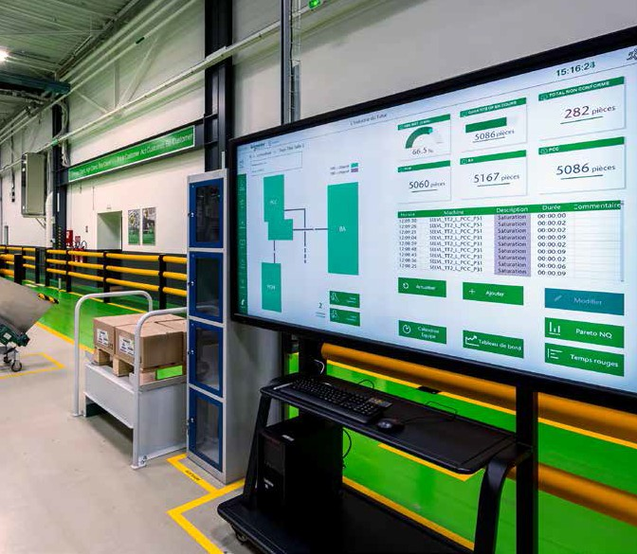
Patrick Lamboley is Chair of technical committee ISO/TC 184, Automation systems and integration, and Senior Director of Standardization at Schneider Electric. Schneider Electric is a European multinational corporation that specializes in energy management and automation solutions, spanning hardware, software and services. In the UK, for example, the company works with airports, providing them with state-of-the-art solutions to keep them competitive in a fast-moving business environment. Behind-the-scenes services include helping them implement the latest security measures using technology to keep baggage-handling systems working efficiently.
Here, Lamboley explains how standards can help address the biggest issues in smart manufacturing and why the relationship between human beings and machines has never been so important.
ISOfocus : What do you think are the greatest challenges for smart manufacturing?
Patrick Lamboley: I believe that managing digitization is the great challenge. As in the first industrial revolution, when national economies and the organization of the global economy changed, we are undergoing the same transformation or revolution. And this revolution is not a long-term vision; it’s a reality, taking place now. Today, the world’s biggest and most profitable companies no longer simply focus on what they produce; the focus is shifting to software companies, or the IT players dealing with data. This data is definitively an important point of attention of smart manufacturing and, of course, the big issue is how to ensure cyber security and data privacy for users and organizations alike with respect to their data, their knowledge.
Another big challenge is understanding and changing the relationship between these new technologies, such as artificial intelligence (through computers, apps, analytics, etc.), and the place of the human being in smart manufacturing, in order to achieve successful outcomes from this collaboration and define the role of humans in this new high-tech world.
How can ISO standards help overcome these challenges?
ISO committees have been strongly involved in automation and manufacturing for a very long time. An important element regarding ISO standards is that they don’t concentrate solely on technologies or one specific aspect,
Photo : Patrick Lamboley
Patrick Lamboley, Chair of ISO/TC 184 and Senior Director of Standardization at Schneider Electric.
Photo : Patrick Lamboley
ISO committees have been strongly involved
in automation and manufacturing for a very long time.
but at the level of the complete system, on the integration of subsystems and components. This is why our knowledge is so relevant to addressing the standardization of smart manufacturing.
One example of this desire to address the complete system is the creation of the Smart Manufacturing Coordinating Committee (SMCC), which comprises representatives of the relevant technical committees. As its name suggests, the SMCC is concerned with all the areas in ISO that fall within the scope of smart manufacturing, and establishes or reinforces relationships and concrete cooperation between them. And with the participation of joint technical committee ISO/IEC JTC 1 – the standards development environment where experts from ISO and the International Electrotechnical Commission (IEC) come together to develop worldwide information and communication technology (ICT) standards for business and consumer applications – the SMCC is also able to incorporate the IT world and associated topics.
12 | ISOfocus_131
ISOfocus_131 | 13

Slide 6
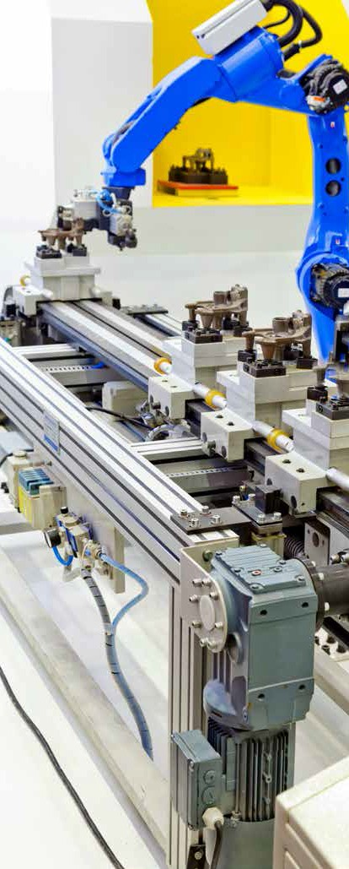
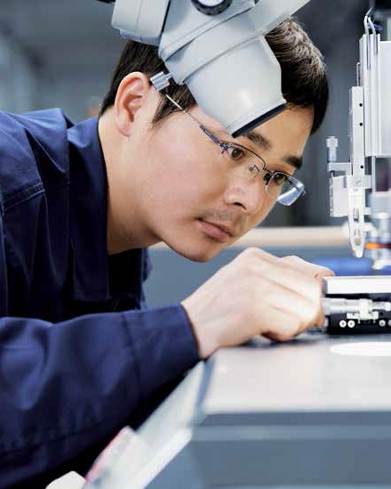
In what ways can ISO’s recent efforts in automatization bring added value?
As I mentioned already, the SMCC creates good emulation between stakeholders and new ideas and values in the respective committees. What’s more, smart manufacturing was a major topic at the annual meeting of ISO/TC 184, called the Super Meeting, in Beijing in May 2018. A full day was devoted to smart manufacturing as a means of initiating exchanges between the experts involved in this field, which was also a great opportunity to get fresh perspectives and generate initiatives. The event drew participants from industry and R&D institutions, such as AVIC, SAC, WIZ, JLS Innovations, Beihang University, Siemens, Boeing and many more.
We named this day the "cavalcade day” and it consisted of two parts. The first part was dedicated to the presentation of local views and the implementation of smart manufacturing, along with the activities of ISO/TC 184 and its associated subcommittees. The second part, which took place during a "world café” session, was an interactive debate between experts on how the technical committee and its subcommittees respond to smart manufacturing and how we can make progress on what has now become one of the world’s hottest topics.
We concluded the day with two demonstrations that were directly linked to the implementation of ISO/TC 184 standards for smart manufacturing and gave a review of the feedback, ideas and ways to improve our activities in the different working groups.
What standards are making the most impact on smart manufacturing and why?
There are many standards within the scope of smart manufacturing that help with the definition of all associated components, such as the life cycle of technical installations, reference model, digital twin, data quality, and so on. ISO/TC 184 and its associated subcommittees are leading or are strongly involved in some of them. ISO/IEC Joint Working Group 21 was set up with the aim of harmonizing existing reference models and overseeing the development of an underlying architecture with regard to smart manufacturing models, with a special focus on aspects such as life cycles and the technical and/or organizational hierarchies relating to assets.
The goal is to define the common rules needed to build reference models for a smart manufacturing system. This begins with the merging, comparison and analysis of existing models, and with the active participation of countries that have defined their own reference models (e.g. China, France, Germany, Japan, Sweden, the UK and the United States, among others), to deliver a standardized metamodel that includes existing standards and/or specificities coming from the countries involved.
The second key topic for me is the "digital twin”. It started in ISO/TC 184’s subcommittee SC 4 (industrial data) with ISO 15926. The purpose of ISO 15926 is to provide a common language for computer systems, thereby integrating the information produced by them. Originally designed for the process industries working on large projects that involve many stakeholders, and plant operations and maintenance that last decades, the technology can also be used by anyone wanting to set up a proper vocabulary of reference data to provide a shared understanding of a specific domain. Only in this way can true integrations emerge, bringing added value to industries that are, to a large extent, knowledge-based. ■
The goal is to define
the common rules needed to build reference models for a smart manufacturing system.
14 | ISOfocus_131
ISOfocus_131 | 15

