Slide 1
Reselling platform
Who will buy the second-hand luxury article in the consumer-to-consumer(C2C) platform?

Slide 2
Contents
Problem frame
1-1. Problem
1-2. Data set
1-3. Exploratory data analysis
Model
2-1. Baseline
2-1. Improved model
3. Interpretation 3-1 Interpretation of features
3-2 Action proposal

Slide 3
1. Problem frame

Slide 4

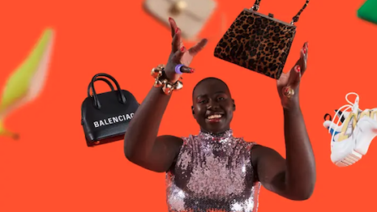
Which user purchase an article in this platform?
1-1. Problem
Vestiaire Collective is an online vintage mall.
For this C2C platform to succeed, transaction volume should grow.
This time, let’s see the characteristics of buyer in this platform.

Slide 5
Scraped user data from Vestiaire Collective
1-2. Data set
identifierHash
type
country
language
socialNbFollowers
socialNbFollows
socialProductsLiked
productsListed
productsSold
productsPassRate
productsWished
productsBought
gender
civilityGenderId
civilityTitle
hasAnyApp
hasAndroidApp
hasIosApp
hasProfilePicture
daysSinceLastLogin
seniority
seniorityAsMonths
seniorityAsYears
countryCode
identifierHash
type
country
language
socialNbFollowers
socialNbFollows
socialProductsLiked
productsListed
productsSold
productsPassRate
productsWished
productsBought
gender
civilityGenderId
civilityTitle
hasAnyApp
hasAndroidApp
hasIosApp
hasProfilePicture
daysSinceLastLogin
seniority
seniorityAsMonths
seniorityAsYears
countryCode
Data set has been collected from Kaggle¹⁾
User data of Vestiaier Collective
Before preprocessing
98,913 users, 24 features
No missing values
No duplicate data
Dropped 9 features
Redundant features: type, gender, civilityTitle, hasAnyApp, seniorityAsMonths, seniorityAsYears
Features of high cardinality: identifierHash, country, countryCode
After preprocessing
98,913 users, 15 features
98,913 users
24 features
98,913 users
15 features
1) E-commerce - Users of a French C2C fashion store (contributed by JEFFREY MVUTU MABILAMA)

Slide 6
Scraped user data from Vestiaire Collective
1-2. Data set
Variable | Description¹⁾
language | The user's preferred language
socialNbFollowers | Number of users who follow this user's activity. New accounts are automatically followed by the store's official
socialNbFollows | Number of user account this user follows. New accounts are automatically assigned to follow the official partners
socialProductsLiked | Number of products this user liked
productsListed | Number of currently unsold products that this user has uploaded.
productsSold | Number of products this user has sold
productsPassRate | % of products meeting the product description. (Sold products are reviewed by the store's team before being shipped to the buyer)
productsWished | Number of products this user added to his/her wish list.
productsBought | Number of products this user bought (Target of this analysis)
civilityGenderId | 1, 2, 3 (1 is Mr., 2 is Mrs, 3 is Miss)
hasAndroidApp | If user has ever used the official Android app
hasIosApp | If user has ever used the official iOS app
hasProfilePicture | If user has a custom profile picture
daysSinceLastLogin | Number of days since the last login
seniority | Number of days since the user registered
EDA: Online C2C fashion store - user behaviour (Kaggle, JEFFREY MVUTU MABILAMA)

Slide 7
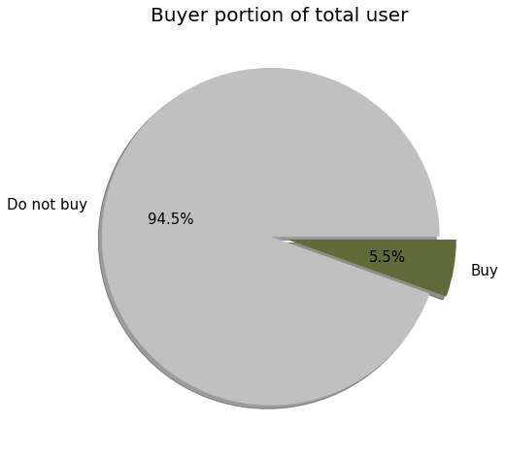
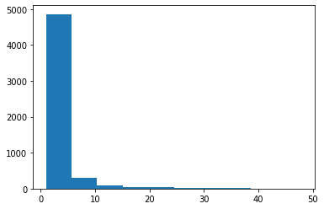
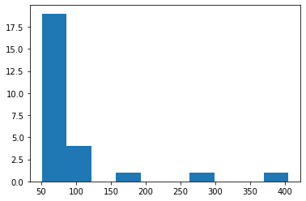
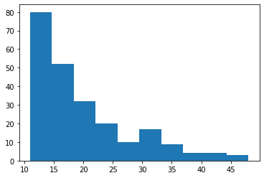
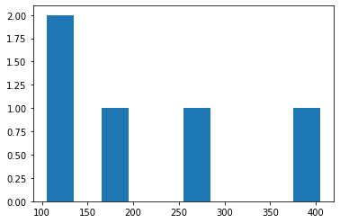
Target is imbalanced and right skewed
1-3. Exploratory data analysis
5.5% of total users ever bought an item
Distribution of buyers by the number of purchased item
Over 0 ~ Below 50
Over 50
Most buyers
bought less than 10 items
Over 10 ~ Below 50
Over 100
Total | 98,913
Do not buy | 93,494
Buy | 5,419

Slide 8
2. Model

Slide 9
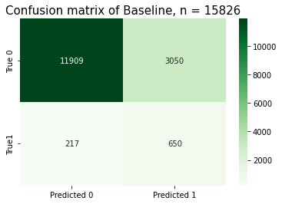
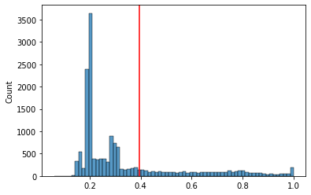
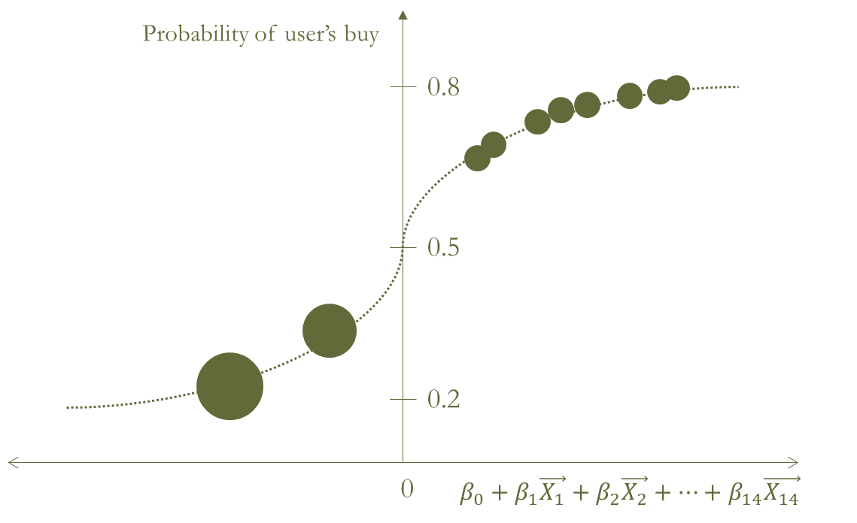
Logistic regression, recall is 0.75
2-1. Baseline
Logistic regression is a model that determines probabilities by putting a function called sigmoid on the linearity of a feature and a target. Binary classification based on the threshold Optimal threshold ¹⁾ is calculated as 0.39, and users with a purchase probability of 39% or more are classified as buyers.
(Recall is 0.75)
This model retrieved 75% of buyers.
(Fail in retrieving 25% of buyers.)
1) Use Area Under Curve (AUC) as the optimal threshold criterion

Slide 10
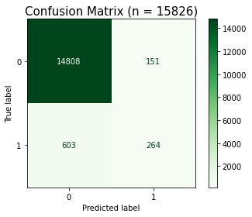
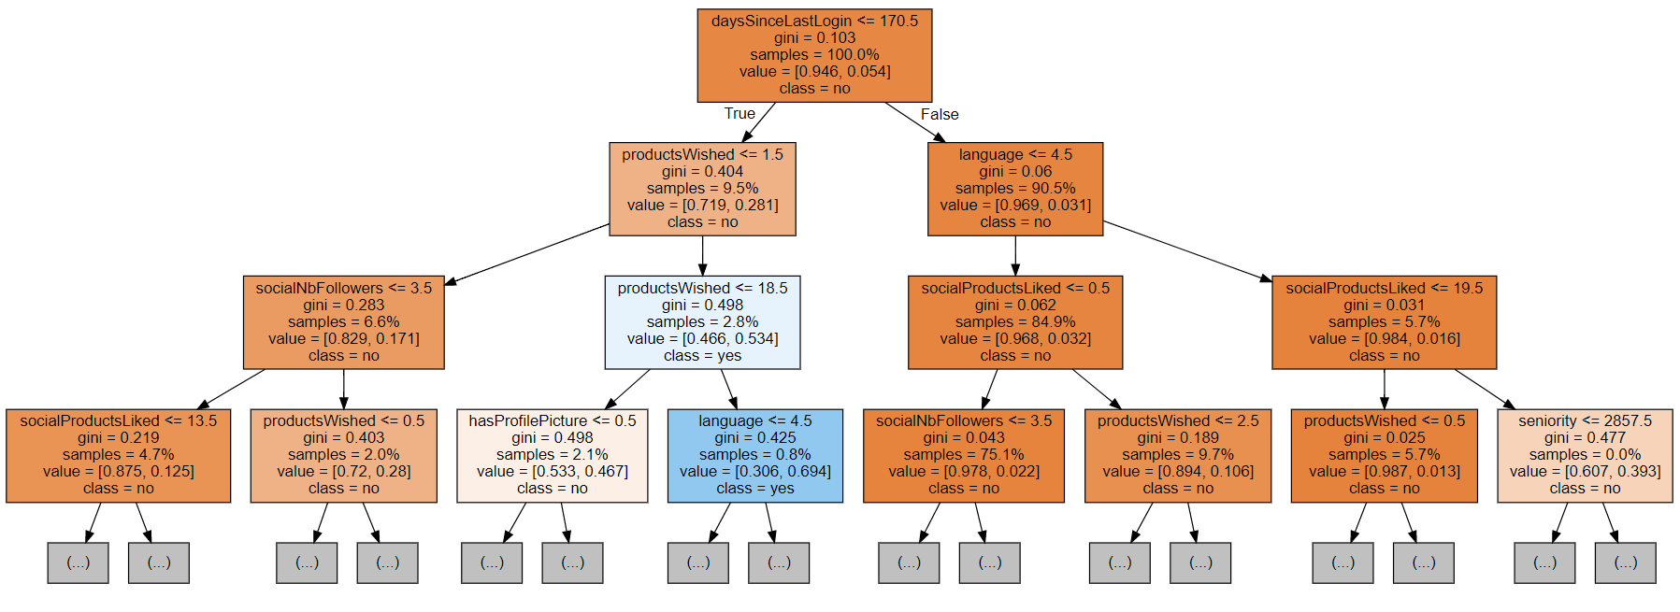
Random Forest, recall is 0.3
2-2. Improved model
One of many trees
Random Forest creates multiple trees and classifies users as purchasers/non-buyers by majority vote. Sampling with restoration was used, and the features are randomly extracted to create a tree, thereby alleviating the overfitting problem of trees that fit only a specific data set.
(Recall is 0.3)
This model retrieved 30% of buyers.
(Fail in retrieving 70% of buyers.)

Slide 11
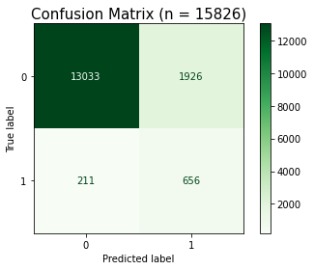
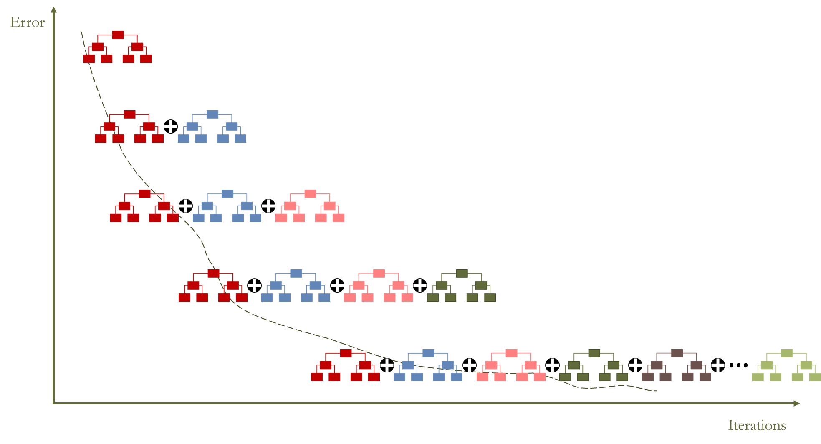
Gradient boosting decision tree, recall is 0.76
2-2. Improved model
Reduce residuals to solve underfitting problem
Gradient boosting decision tree is also an ensemble model that generates multiple trees to predict targets. Alleviate the overfitting problem by limiting the number of leaves in the tree
Also alleviate the underfitting problem by continuing to create a tree that reduces the residual of the tree created previously.
(Recall is 0.76)
This model retrieved 76% of buyers.
(Fail in retrieving 24% of buyers.)

Slide 12
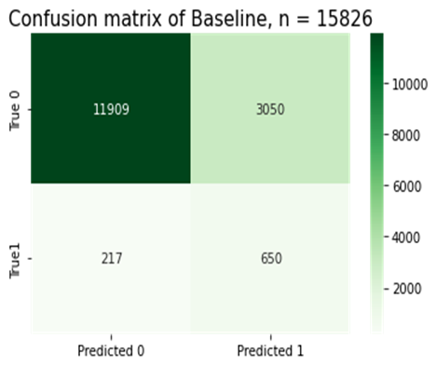
Performance of the gradient boosting decision tree model has slightly improved
2-2. Improved model
Final model
Logistic regression
(baseline) recall 0.75
Random forest
recall 0.3
Gradient boosting decision tree recall 0.76

Slide 13
3. Interpretation

Slide 14
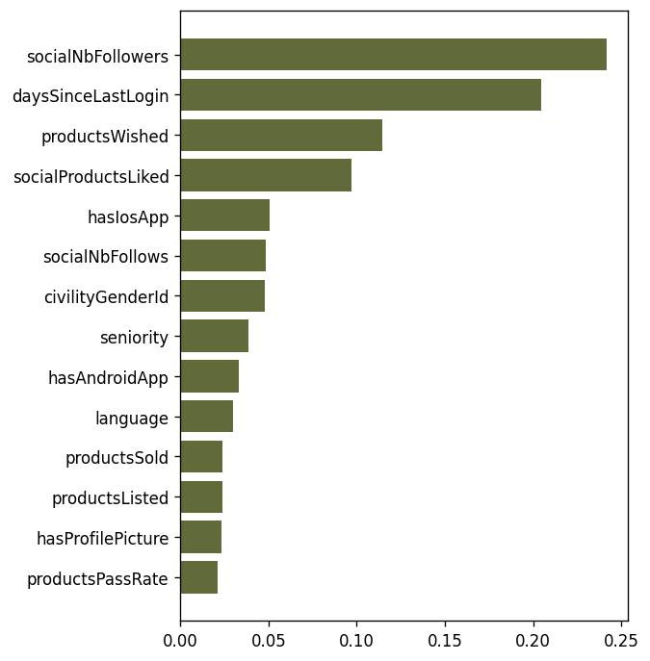
4 characteristics that are highly relevant to the probability of purchase
3-1. Feature interpretation
More relevant feature
Among feature importance ¹⁾, the difference between 'hasIosApp' and 'socialProductsLiked' is drastic as twicse.
Therefore, this time, the features that are highly related to the probability of purchase are determined as the following four points.
Number of users who follow this user's activity. Number of days since the last login. Number of products this user added to his/her wish list. Number of products this user liked.
Note: Positive or negative correlation is unknown, and causation is unknown
Less relevant feature
1) Feature importance is a criterion for checking how much the performance of the model changes when certain features are lost or differ from the original data, to determine how importantly the features are related.

Slide 15
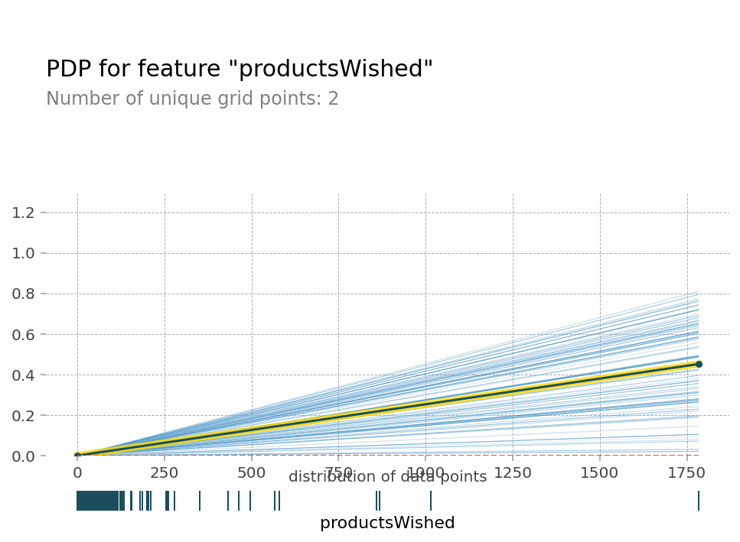
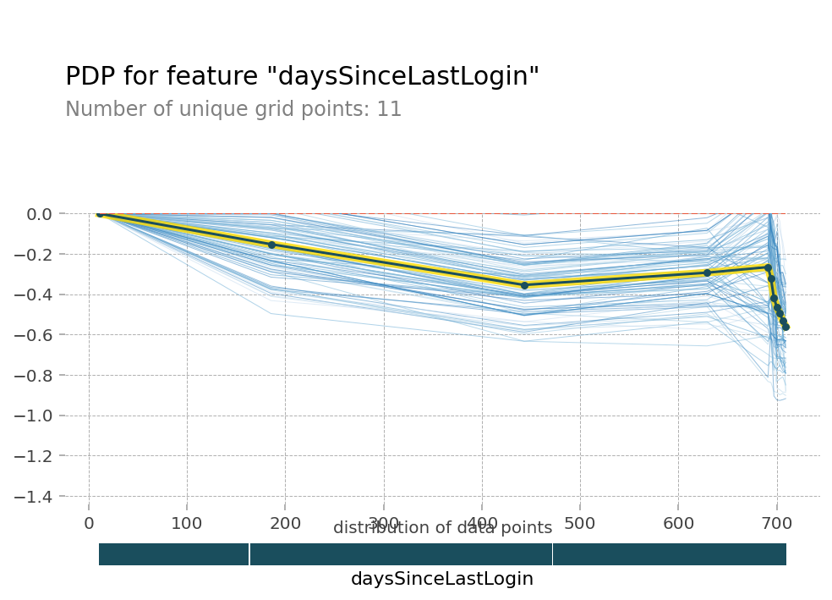
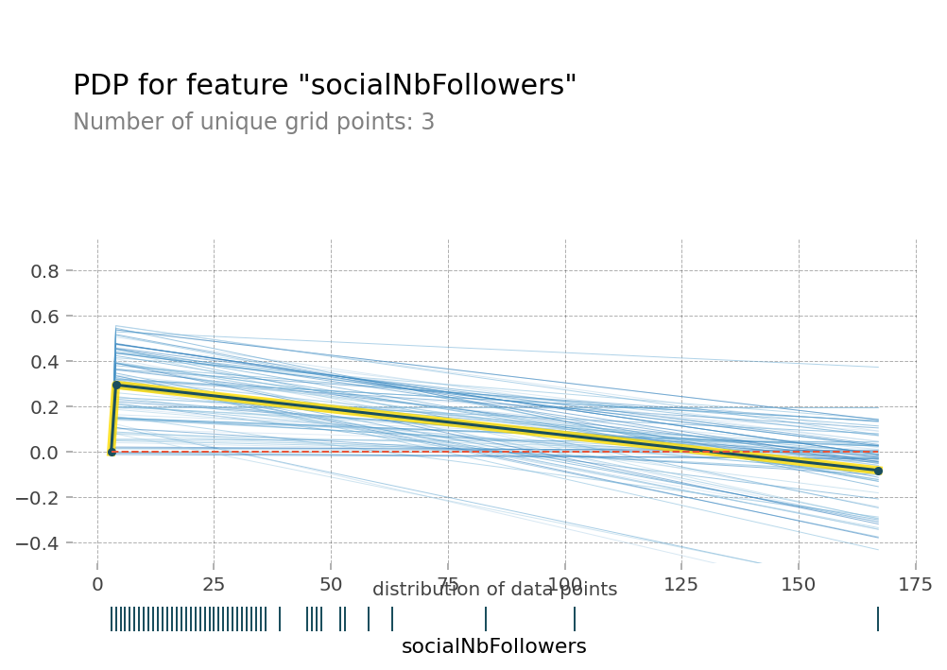
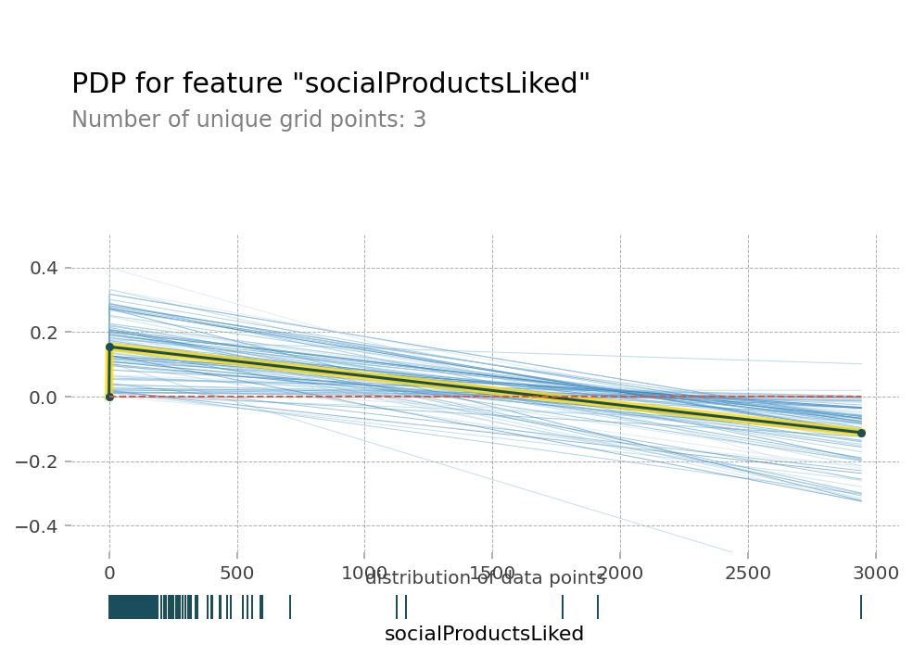
Partial dependence plot (PDP) and random 100 individual conditional expectation curves
3-1. Feature interpretation

Slide 16
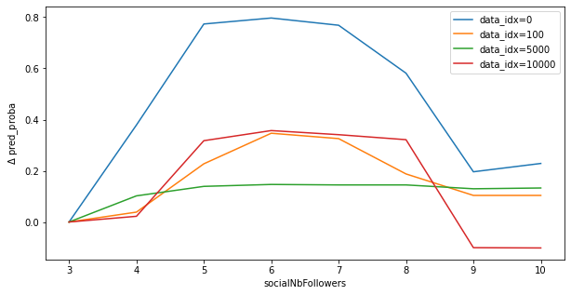
Relationship between counts of social follower and purchase probability
3-1. Feature interpretation
Only with 1~2 increase of social followers, the probability of being a buyer increases
However, with the more of social followers, the probability decreases
Causal relationship between social follower and the purchase needs to be further investigated. The current hypothesis is that sellers often follow buyers. Most buyers buy less than 5 pieces, so if the seller follows, the number makes sense.

Slide 17
Reasonable relationship between both days past since log-in and wished product and purchase probability
3-1. Feature interpretation
It is common sense that active users who have recently logged in are more likely to make purchases, and users with a lot of interested products are more likely to make purchases.

Slide 18
Relationship between the number of products that users 'liked' and the probability of purchase
3-1. Feature interpretation
It is contrary to common sense that the more ‘likes’ you click, the lower the probability of making a purchase. It is impossible to get too many likes, which seems to be the result of ICE making incorrect predictions. Further research is required to make an accurate judgment

Slide 19
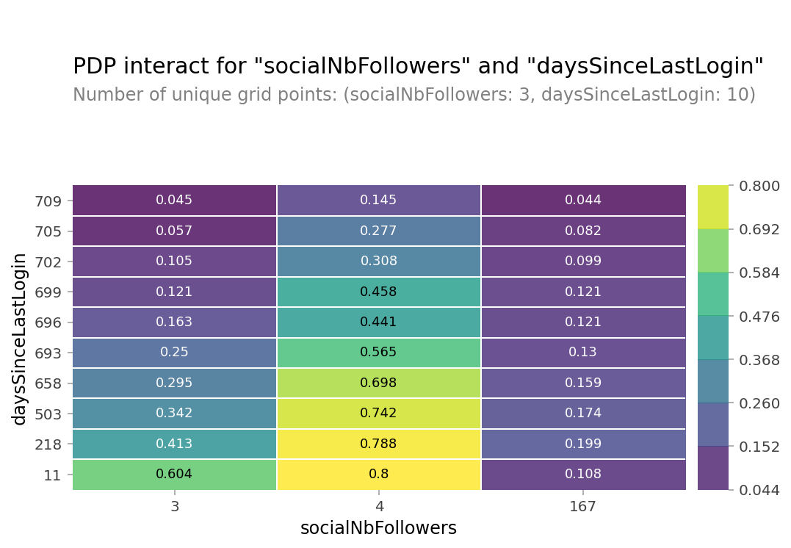
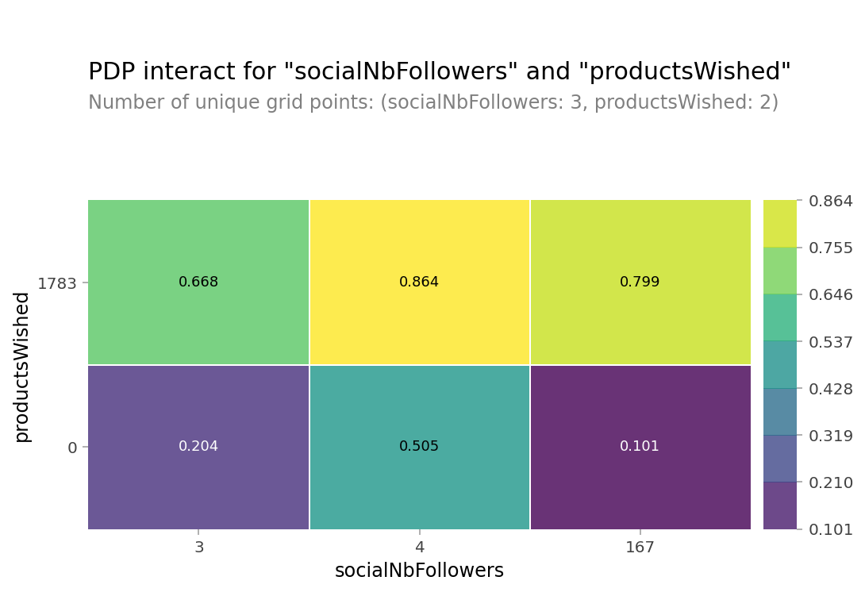
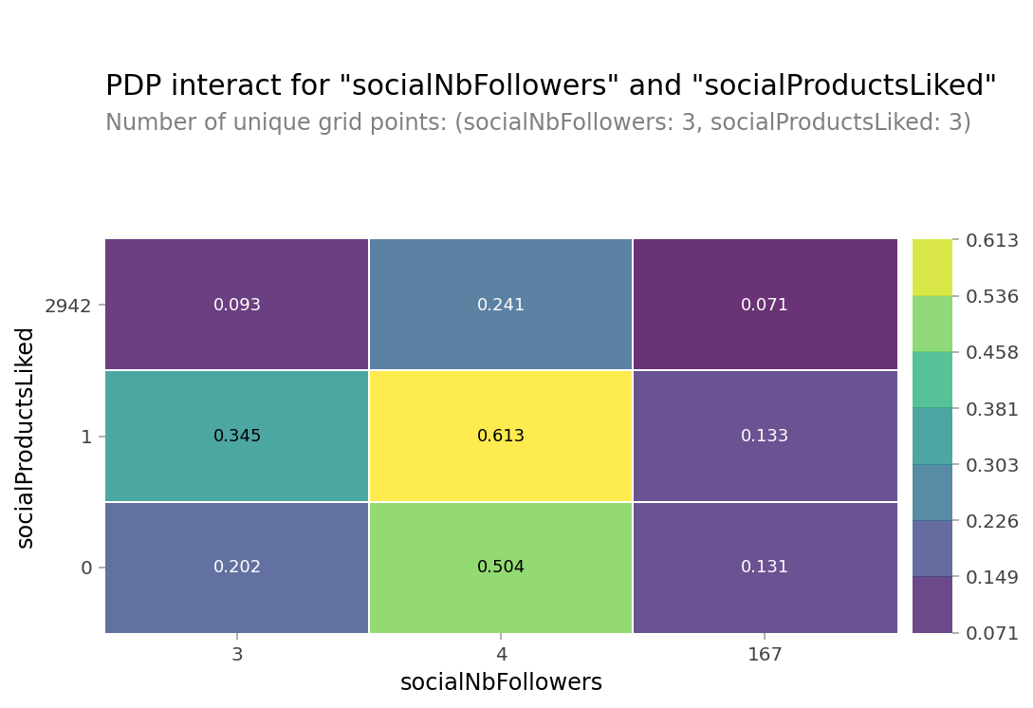
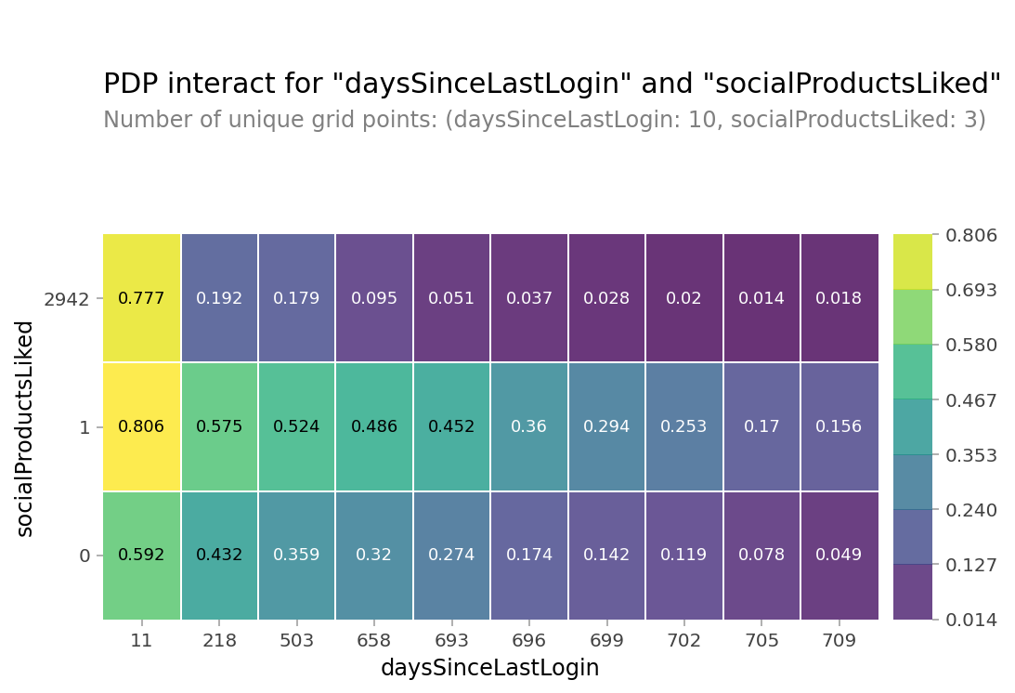
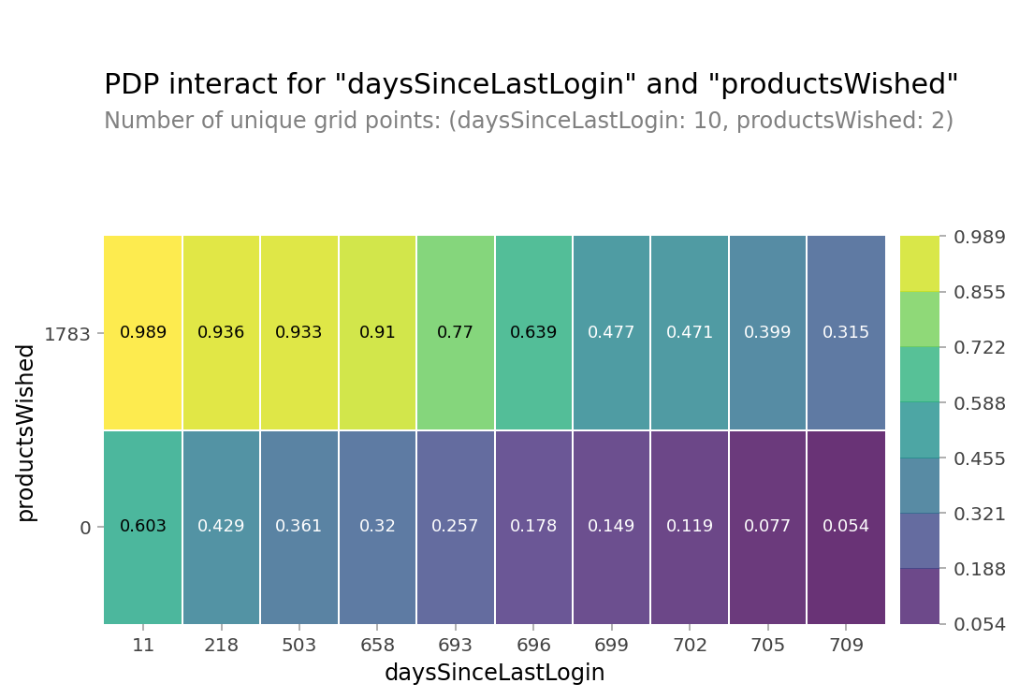
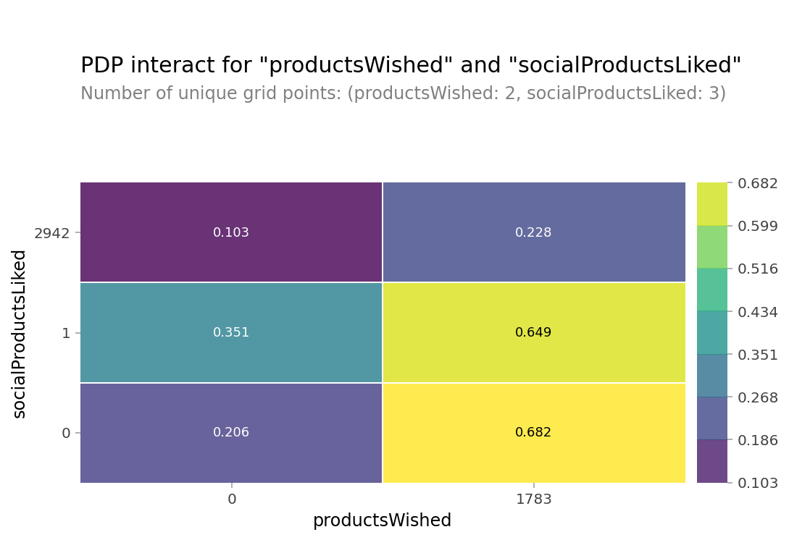
Cases when the probability of purchase is greater than 80% in PDPs of both characteristics
3-1. Feature interpretation

Slide 20
The more products customer wishes, the more likely customer is to buy, so you need to increase customer engagement
3-1. Feature interpretation

Slide 21
The more recently a customer logs in, the higher the probability of purchases is, so you need to increase the activity of your account.
3-1. Feature interpretation

Slide 22
3 suggestions
3-2. Action proposal
Focus on efforts to bring customers to the intent phase in Marketing funnel. Makes customers want to log in constantly in variable ways such as providing interesting content. Since the probability of purchase does not increase with more social product likes, we should redesign the like so that it can be an indicator of purchase intent.

