Slide 1
Analysis of multicategory online shopping mall and its users

Slide 2
Category
Project overview and organization
Procedures and methods of project implementation
Hypothesis about the problem
Hypothesis test and problem definition
Behavior analysis of customers
Consequence of the project
Self-assessment

Slide 3
Project overview and organization
Exploration of data
and set hypothesis
Hypothesis test and problem definition
Behavior analysis of customers
05-Jan ~ 06-Jan
07-Jan ~ 08-Jan
09-Jan ~ 12-Jan
Sampling
EDA
Feature Engineering
Pearson Correlation Analysis
Clustering
Pearson Correlation Analysis
Visualization
SQL (SSMS), Python, Visual Studio, Colab
Python, Colab
Python, Tableau, Colab
Does this mall fail to retain users?
Failure of retention
Failure to sell multi-category
Focus on high-involvement products
Suggestion of relevant marketing strategy

Slide 4
Failure to retention of customers is assumed
Hypothesis about the problem
Trend of number of events from Oct. to Nov.
Analysis on 9,780 users
 | 2019-Oct | # events |  | 2019-Nov | # events
Total | 100% | 42,448,764 |  | 100% | 67,501,979
view | 100% | 40,750,813 | 96% | 100% | 63,451,860 | 94%
cart | 100% | 848,975 | 2% | 100% | 2,700,079 | 4%
Other | 100% | 848,975 | 2% | 100% | 675,020 | 1%
Sample | 2.0% | 848,980 |  | 0.3% | 172810
view | 2.0% | 820,656 | 97% | 0.3% | 162,140 | 94%
cart | 1.8% | 15,093 | 2% | 0.3% | 8,210 | 5%
purchase | 1.6% | 13,231 | 2% | 0.4% | 2,460 | 1%
Non-Sample | 98.0% | 41,599,784 |  | 99.7% | 67,329,169
view | 98.0% | 39,930,157 | 96% | 99.7% | 63,289,720 | 94%
cart | 98.2% | 833,882 | 2% | 99.7% | 2,691,869 | 4%
Other | 98.4% | 835,744 | 2% | 99.6% | 672,560 | 1%
Increase
Plunge
Stagnation
Temporal spike
Stagnation
Declined in # of events of users in Oct
With high fluctuation, the number of events increased until 25th Oct
The number of events plunged since 25th Oct
Settled in about 5000 in Nov
Temporal spike from 15th to 17th in Nov
This spike seems to be due to promotion and fail to retain customers
Since it was impossible to load 5GB and 9GB data with the memory provided by Colab, a sample was extracted and analyzed. I wanted to extract 10,000 users, but when I set the user base in SSMS and extracted it with the TABLESAMPLE (ROWS = 10000) command, 9,780 users came out. November was also extracted according to the same number of people as in October.

Slide 5

In order to analyze the characteristics of customers who maintain use, they are processed into characteristics aggregated by user
Hypothesis test and problem definition
Segmentation in four types of time period
Feature | Description
n_purchase | The number of purchase of a user
n_cart | The number of cart of a user
n_view | The number of view of a user
n_user_session | The number of log-in of a user
n_category_id | The number of categories a user viewed or put in cart or purchased
n_product_id | The number of products a user viewed or put in cart or purchased
logged_seconds | Difference between the first logged-in time and the last logged-in time (seconds)
recency_seconds | Difference between the last time of the analysis and the last time the user logged in (seconds)
ratio_purchase | Ratio of the purchase event (n_purchase / n_user_session)
ratio_cart | Ratio of the cart event (n_cart/ n_user_session)
ratio_view | Ratio of view events (n_view / n_user_session)
visit_cycle | Visit cycle (logged_seconds / n_user_session)
n_sum_purchase | Total value of a user’s purchase
Gr-oup
Period in 2019
Trend in the size of event
G1
10/1 ~ 10/25
Increase
G2
10/25 ~ 10/30
Plunge
G3
11/15 ~ 11/17
Temporal Spike
G4
11/1 ~ 11/15
11/18~11/31
Stagnation

Slide 6
Users who used mall in stagnation (G4) are target persona to analyze
Hypothesis test and problem definition
Since the number of the events decreased in Oct, the correlation of "purchase ratio" and "sum of the purchase" increased. This means users who had intends to purchase increased more than those who just look around and don't purchase
In the mid of November, the high correlation of the sum of purchase and the number of user session is presumed to be due to promotion
The users of stagnation in November are plausible to continue to use this mall onward because of the high correlation between the 'ratio of purchase' and the 'sum of purchase value'

Slide 7
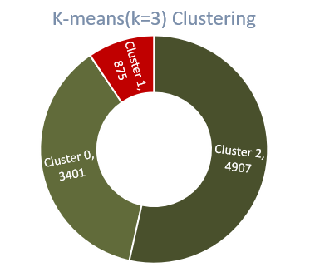
Little correlation between the diversity of categories and purchases, …it is necessary to find the main categories that customers purchase
Behavior analysis of customers
G4 users (Stagnation) 9,183
Clusters 0 and 2 have no purchase history, so the analysis target is reduced to Cluster 1
Maintaining multi-category inventory may be disadvantage because viewing multiple categories does not increase the purchased value

Slide 8
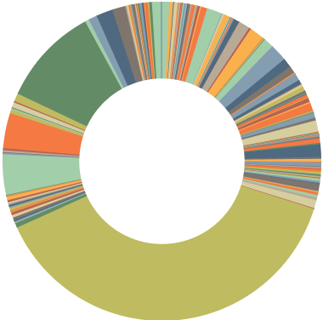
Consumers primarily buy high-involvement products
Behavior analysis of customers
Category Code : appliance.environment.vacuum(24)
Category Code : Null (149)
Category Code : appliances.kitchen.washer (22)
Category Code : electronics.video.tv (53)
Total # of purchase
1,486
Category Code : computers.notebook (19)
Category Code : electronics.audio.headphone (61)
Mode¹⁾ of purchased category Category Code : electronics.smartphone (570)
Mode of purchased category means most frequently purchased category

Slide 9
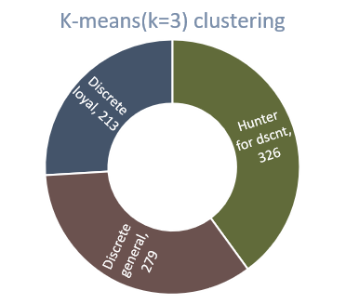
Users are segmented into three parts, of which discrete loyal group spends 1 hour and 10 minutes per session
Behavior analysis of customers
Discrete loyal customer
Hunter for discount
Discrete general customer
Recency
5 days
2 weeks
1 week
Cluster 1
users: 818¹⁾
Frequency
Purchased
3 times
Purchased 1 time
Purchased 1 time
Monetary²⁾
857.04
372.71
125.14
Involvement
1 hour 10 minutes
9 minutes
1 hour
x 213
x 326
x 279
Contribution to revenue²⁾³⁾
54% (182,550)
36% (121,503)
10% (34,914)
1) Of the 875 users in Cluster 0, 56 users who did not purchase at all were excluded 2) The units of Monetary and Contribution to revenue are not indicated because they are not precise. (However, the same units are used) 3) Sales refers to the percentage of customer groups in total sales, not per customer

Slide 10
It is necessary to understand the customers who purchase high-involvement products and to devise a marketing strategy
Consequence of the project
Although it is a shopping mall that sells multi-categories, the categories that customers actually purchase are high-involvement products such as electronic products and electronic furniture
Need to cluster with RFM + I (involvement), and develop marketing strategy according to customer tendency
For customers with a long navigation process → cautious customers: need to provide a lot of information
For customers with a short navigation process → customers with quick decisions: only key information needs to be prominently provided
Since users have already recognized that it is a good platform for purchasing electronic products, a strategy to further specialize the UI by providing convenient functions for purchasing electronic products is effective
When competitors who sell multicategories, such as Amazon, already have an edge in the market, focusing on a specific category is a way to attract new users
Since high-involvement products do not have a high frequency of purchase, it is important to not only increase the number of users, but also to continuously update the shopping mall so that it can be used for a long time to secure LTV

Slide 11
Regrets, learnings and achievements
Self-assessment
In the case of multi-category sales, it would be possible to determine at the EDA level whether a particular category was selling the most. If I had used Tablo from the beginning, the EDA process would have been faster. I don't use statistics much, so I concluded what anyone with a lot of domain knowledge would have already known. If we had targeted users with at least one purchase history from the beginning, the clustering steps would have been reduced The increase in data size from October (5GB) to November (9GB) can be expected to indicate an increase in users, but it would be a mistake to judge that the number of events decreased in November. It would have been nice to include not only the number of users, but also a certain percentage of the total data collected and compare them When visualizing in PowerPoint, using Excel and PowerPoint charts is easier and faster than Matthew and Seaborn. Succeeded in sampling Persona setting logic is appropriate I discovered the possibility of wasting inventory costs and suggested the strategic direction of the shopping mall.

