Slide 1
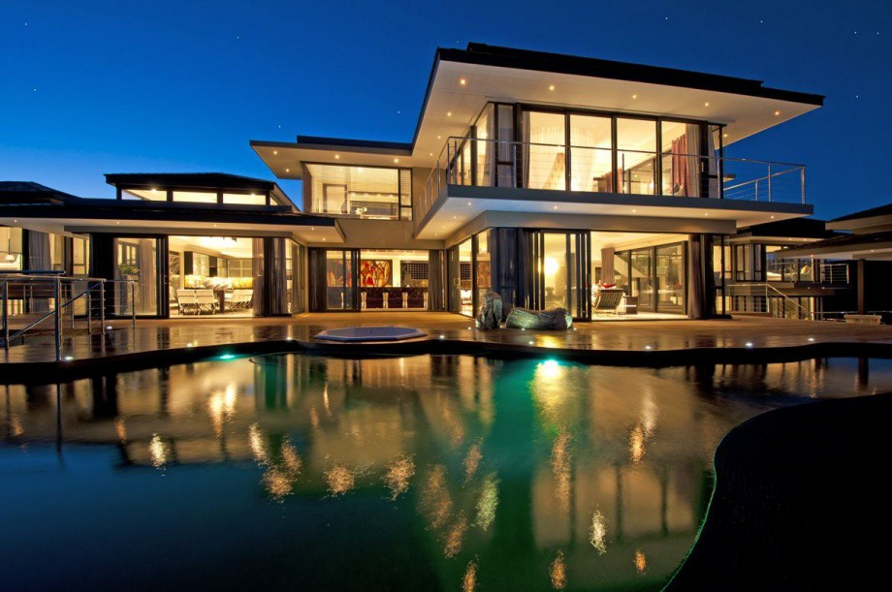
Housing Price Prediction

Slide 2
Outline
Abstract
Introduction
Goal
Purpose
Project Summary
Technology Used
Tools Used
Output Screen
How it works?
Future work

Slide 3
Abstract
❑ Real estate in least transparent industry in our ecosystem.
❑ House prices increase every year, so there is a need for a system to predict house prices in the future.
❑ Predicting House Prices with real factors.
❑ We aim to make evaluations based on every basic parameter that is considered while determining the price

Slide 4
Introduction
Problem Faced during buying a house
Buying a house is stressful thing.
Buyers are generally not aware of factors that influence the house prices.
Many problems are faced during buying a house.
Hence real estate agents are trusted with the communication between buyers and sellers as well as laying down a legal contact for the transfer. This just create a middle man and increases the cost of houses.

Slide 5

Goal
❑ The main goal of the Project is to predict the efficient house pricing for real estate customers with respect to their budgets and priorities.
❑ Our goal to deliver a perfect software which will be benefitting our user in an interactive way.
❑ The Focus is to create an “easy to use” website, which will allow to first time customer to complete their needs and ease.
❑ To make a customizable system including maximum option.
❑ To increase the ease of productivity.

Slide 6
Purpose
❑ We want to overcome the problems of existing prediction of house in the market.
❑ Removal of data storing through manual means.
❑ Provide a better services than the Previous one’s.

Slide 7
They believe that it depends upon:
The Square feet area
Neighbourhood
The number of bedrooms
But it depends upon many factors also...such as:
•
•
•
No. of Storeys
Area outside the house Rooms on one floor

Slide 8
Project Summary
❑ Our Project is an machine learning app, based on certain specifications of your future home it will try to guess the most accurate price.
❑ Information such as state, city, land_space etc.

Slide 9
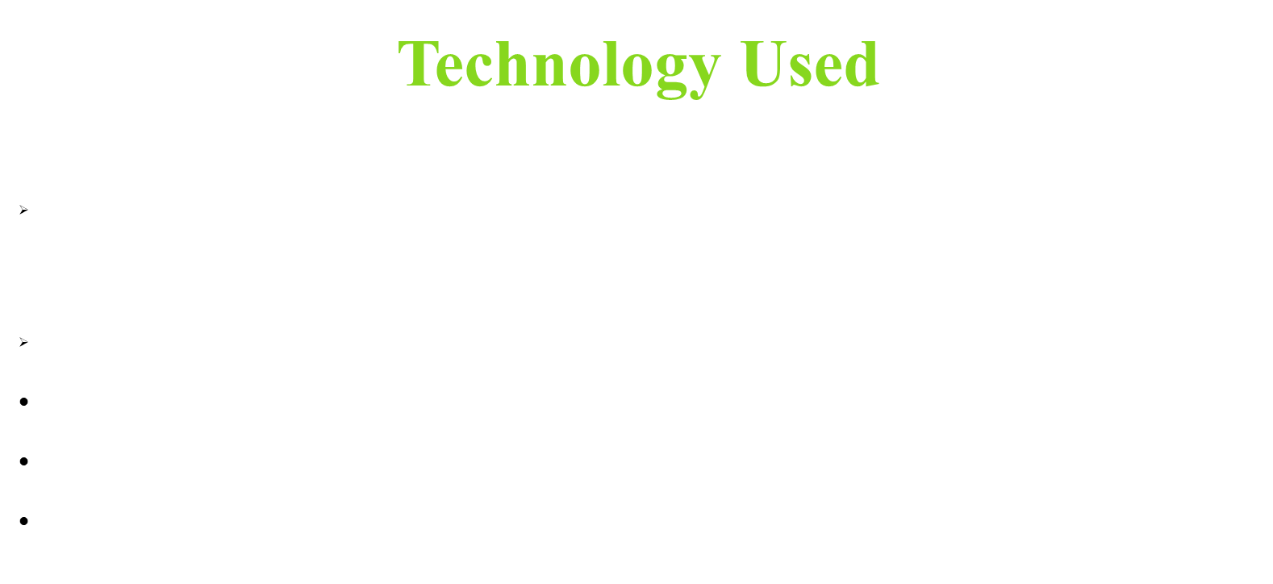

Slide 10
In general, any machine learning problem can be assigned to one of two broad classification: Supervised and Unsupervised learning.
●
●
Supervised Learning:-
In supervised learning , we are given a data set and already know what our correct output should look like, having the idea that there is a relationship between the input and the output. Supervised learning problems can be categorized into “regression” and “classification” problems.
In regression problems, we are trying to predict results within a continuous output, meaning that we are trying to map input variables to some continuous function.
In classification problem, we are trying to predict results in a discrete output. In other words, we are trying to map input variables into discrete categories.

Slide 11
Unsupervised Learning:-
Unsupervised learning allows us to approach problems with little or no idea what our results should look like. We can derive structure from data where we don’t necessarily know the effect of the variables. We can derive this structure by clustering the data based on relationships among the variables in this data. With Unsupervised learning there is no feedback based on the prediction results.

Slide 12
Linear Regression
Linear Regression is the basic form of regression analysis. It assumes that there is a linear relationship between the dependent variable and the predictor(s). In regression, we try to calculate the best fit line which describes the relationship between the predictors and predictive/dependent variable.

Slide 13
Example

Slide 14
Tools Used

Slide 15
Output Screen

Slide 16


Slide 17


Slide 18
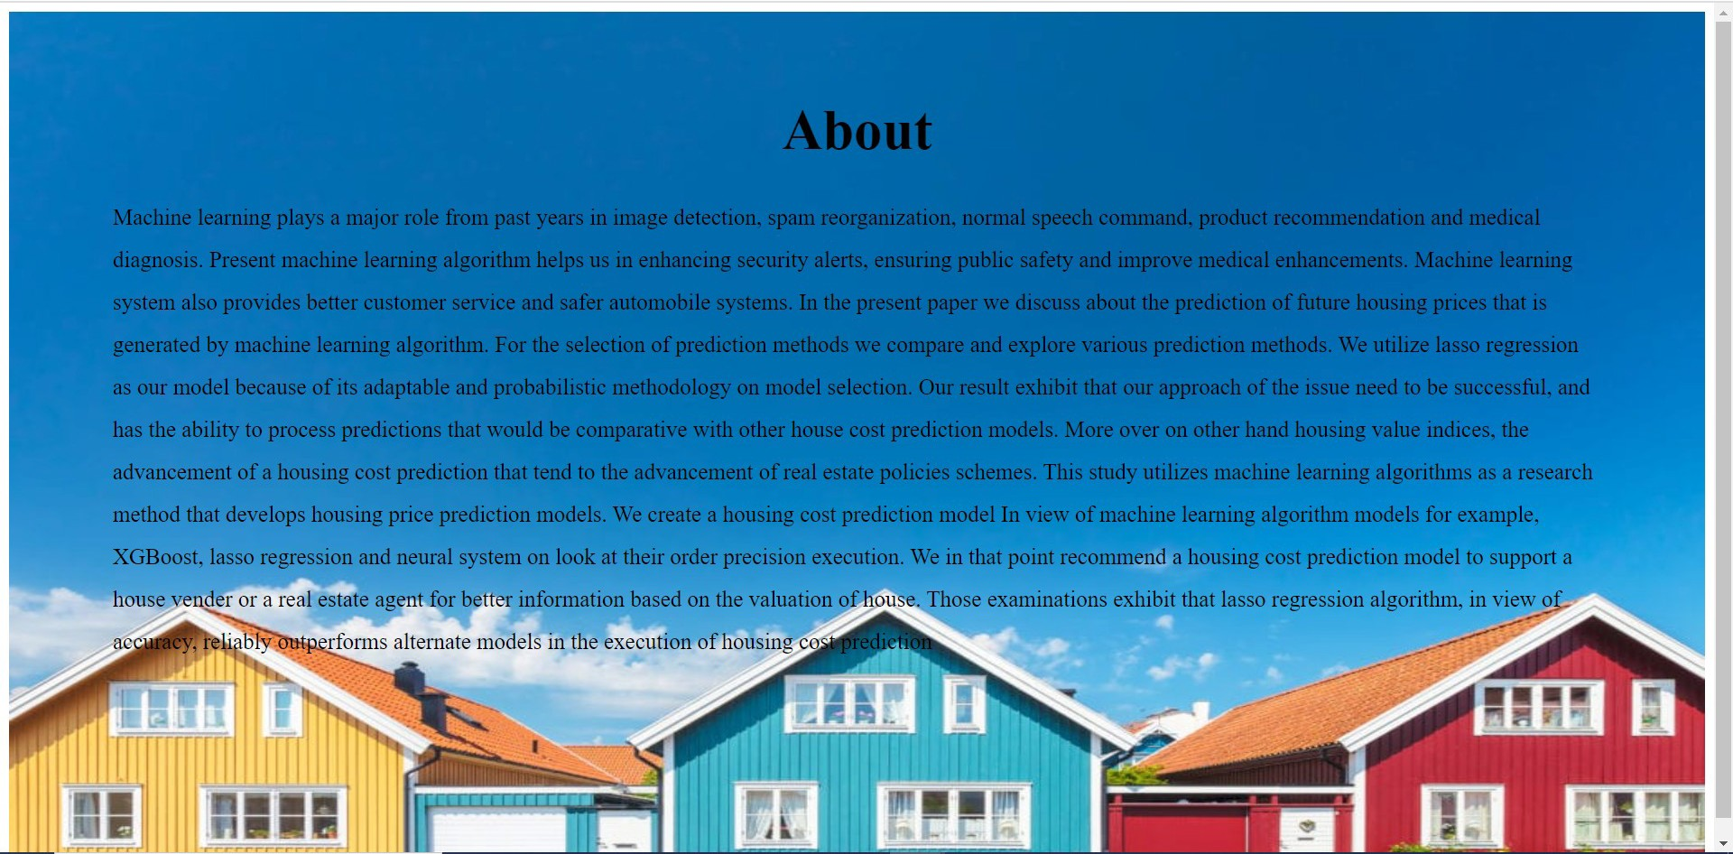

Slide 19


Slide 20
HOW IT WORKS?
Collecting Data: First step was to collect data, we collected data from kaggle website
source and merged them together to from our training dataset.
Then we trained the model using machine learning algorithm which in this case is linear regression.
Based on the generated graphs we predict the cost of house.

Slide 21
Future Work
More number of data sets can be used to increase the accuracy of the model. The main objective of using a different model should be to reduce the calculation time and carry out the whole process in ease.
In Future we can try to make “ALL IN ONE APPLICATION ” where users can easily find according to their needs.

Slide 22
THANK-YOU…

