Slide 1


Population
A group of all items of interest to a statistics practitioner
Frequently very large (infinite)
Descriptive measure: parameter

Slide 2


Population
Sample
Sampling
A group of all items of interest to a statistics practitioner
Frequently very large (infinite)
Descriptive measure: parameter
A set of data drawn from the studied population
A researcher determines the size
Descriptive measure: statistic

Slide 3
Population
Sample
Sampling
Statistical inference
A process of making an estimate, prediction, or decision about a population based on sample data
Confidence level and significance level provide the accuracy of the inference

Slide 4
Population
Sample
Sampling
Statistical inference
Inferential Statistics
Descriptive Statistics
“Inferential statistics is a body of methods used to draw conclusions or inferences about characteristics of populations based on sample data.”
“Descriptive statistics deals with methods of organizing, summarizing, and presenting sampled data in a convenient and informative way.”

Slide 5
Descriptive Statistics
Inferential Statistics
Measures of Central Tendency
Measures of Variability
Mean
Mode
Median
Range
Variance
Standard Deviation

Slide 6
Descriptive Statistics
Inferential Statistics
Measures of Central Tendency
Measures of Variability
Mean
Mode
Median
Range
Variance
Standard Deviation

Slide 7
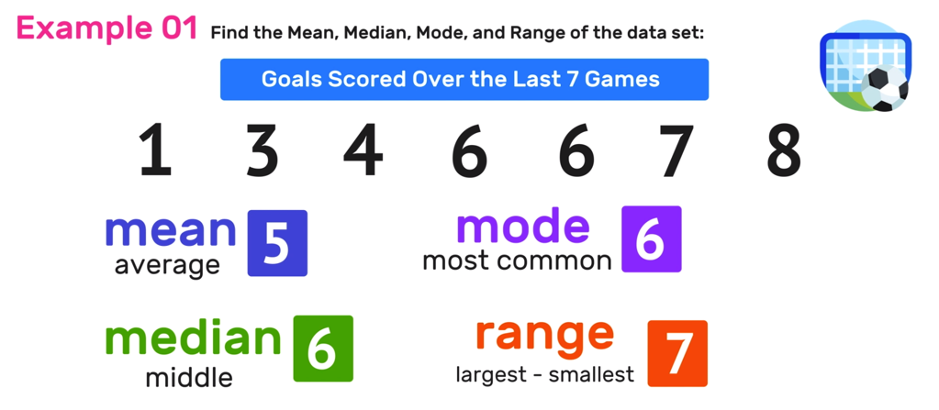

Slide 12
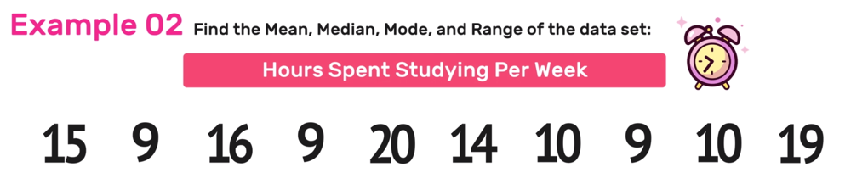
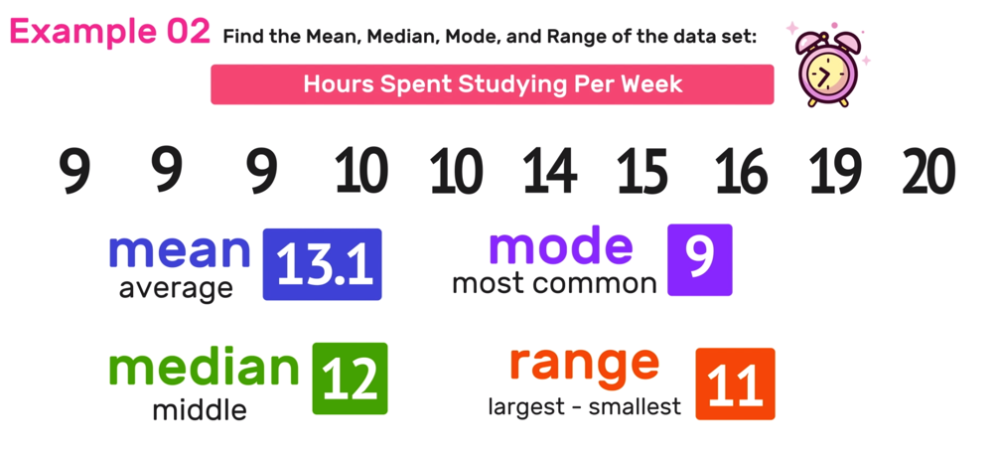

Slide 15
Descriptive Statistics
Inferential Statistics
Measures of Central Tendency
Measures of Variability
Mean
Mode
Median
Range
Variance
Standard Deviation

Slide 16
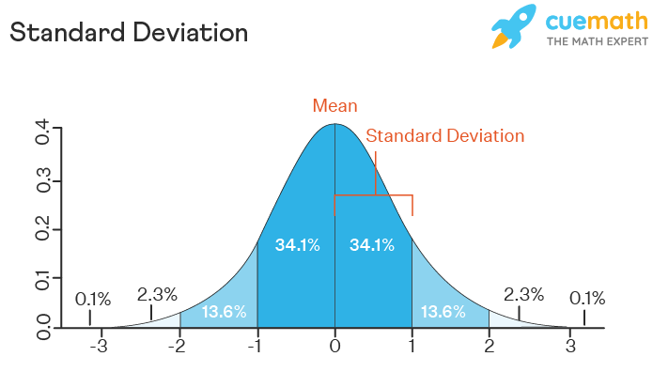
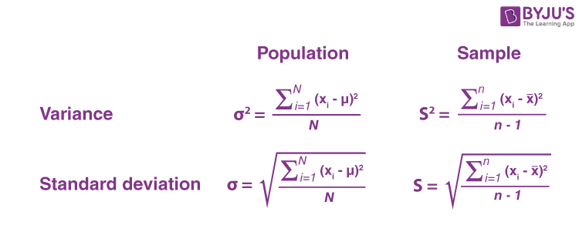

Slide 17
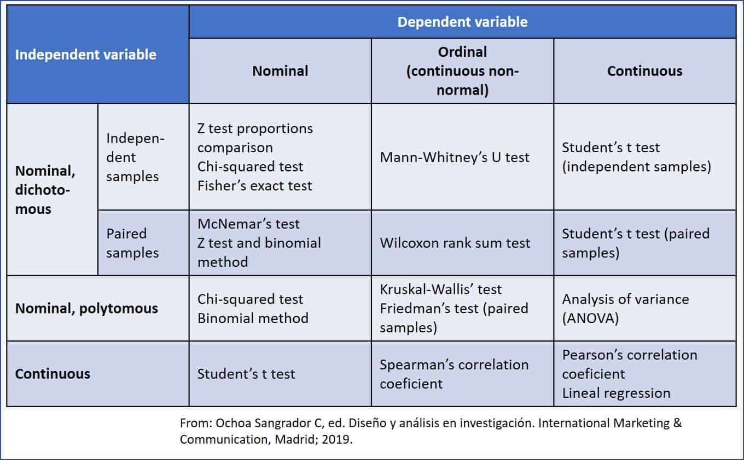

Slide 18
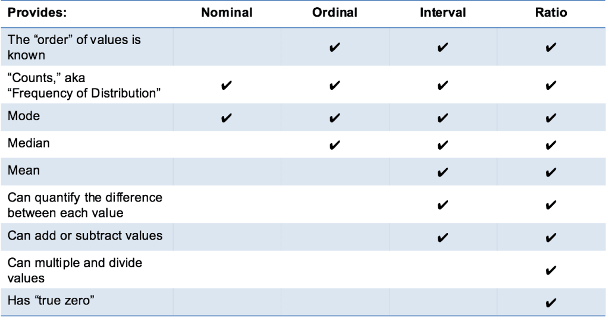

Slide 19
