Slide 1

IMDB API APP

Slide 2
TABLE OF CONTENTS
01.
02.
03.
04.
ABOUT US
PROBLEM
SOLUTION
CONCLUSION

Slide 3
01.
ABOUT US

Slide 4


ABOUT US
I am Jae-Heun LEE an EPF student and a free lance developer.
I dedicate myself to provide easy to use application and simplify user experience

Slide 5
02.
PROBLEM

Slide 6






PROBLEM
Nowadays people expect to have their questions answered in a short delay with the help of Internet
With streaming services becoming mainstream, people are inclined to watch more series and more movies
Usually people struggle to find the right show to watch. According to The Wrap Netlix users spend on average 18 minutes on a given day deciding what to watch
https://www.indiewire.com/2016/07/netflix-decide-watch-studies-1201708634/

Slide 7
03.
SOLUTION

Slide 8
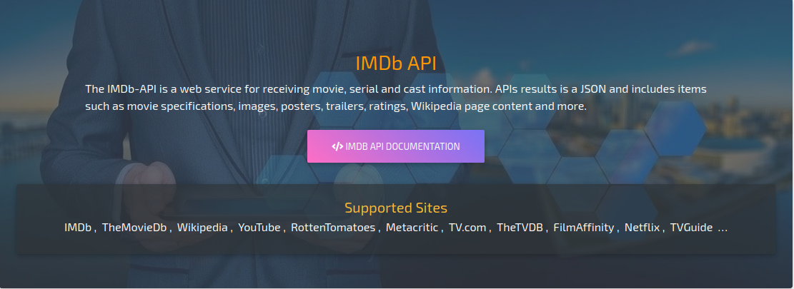

SOLUTION
To solve these problems we developed an application that calls the ImDb’s API to get the ratings of specific movies
Sends a list of movie title related the original input
Request the API for this movie title
Enters movie title
User
Application
ImDb’s API
Application
Request the API to get ratings for each of the movie
Displays the ratings
Sends the ratings
User
Application
ImDb’s API

Slide 9

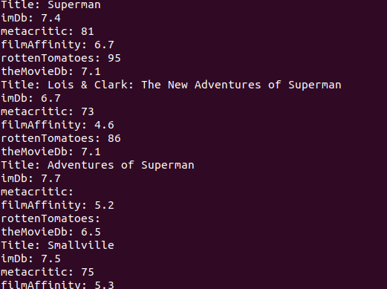
SOLUTION
Example of usage :
Let’s see the ratings for superman movies
Enjoy the result !

Slide 10
04.
CONCLUSION

Slide 11



CONCLUSION
FAST AND ACCURATE
EASY TO USE
EASY TO INSTALL
Guaranteed result under 40 seconds if there are no network issue
Come with detailed instructions in a README file
Two easy steps before starting the application. Detailed in the README file.

