Slide 1
Design a P2P download protocol
CS 305 Lab Project
季杰 林啸 罗天佐 炸鱼块
Dec. 24
Notes:
40985ebb-4066-40ce-a19d-096584c8f62b

Slide 2
PRINCIPLES
01
The basic architecture of P2P
Notes:
157b6f22-8ce9-4e71-90b6-51f47761b7c0

Slide 3
Principles
Architecture
(5) Update peer list of xxx
server
(1) Ask for xxx
tracker
client
(2) Peer list of xxx
(3) Ask for xxx 1/2
(3) Ask for xxx 2/2
(4) Send xxx 1/2
(4) Send xxx 2/2
server
server
client
client
Notes:
124e696a-b47e-41f0-99f2-c99de0a5bb42

Slide 4
IMPLEMENTATION
02
Approaches to realize the protocol
Notes:
c43a8f59-a7fd-40bf-b9d9-4d1c43c55a80

Slide 5
Tracker
Notes:
5d23991e-9f38-47ea-aabe-c7bbd2975d02

Slide 6
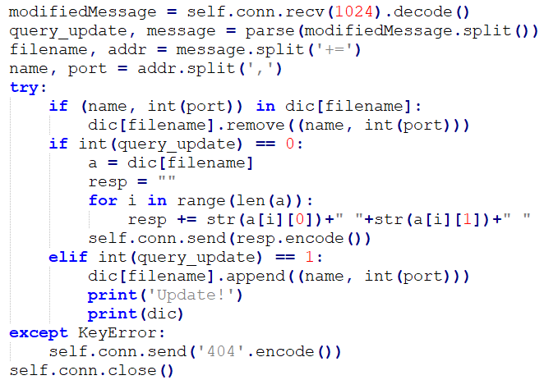
Tracker
Notes:
5d23991e-9f38-47ea-aabe-c7bbd2975d02

Slide 7
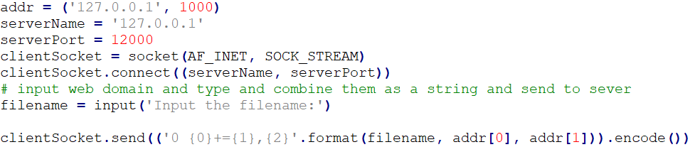

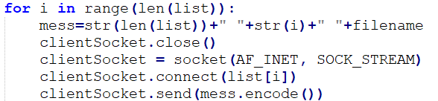
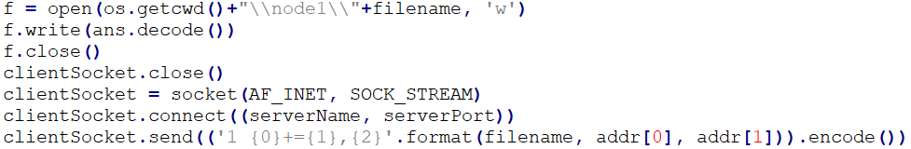
Client
Notes:
5d23991e-9f38-47ea-aabe-c7bbd2975d02

Slide 8
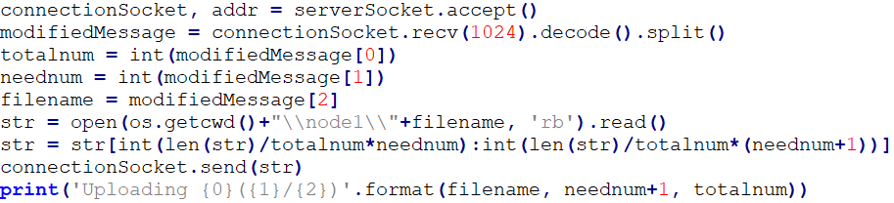
Server
Notes:
5d23991e-9f38-47ea-aabe-c7bbd2975d02

Slide 9
And Your Slogan Here.
Thanks.
Notes:
539d35a0-321f-44c6-bf7e-ef0429b8609e

