Slide 1

Discrete Choice Model(Limited Depend Model)
Python Working Group Presentation 2018 Fall
Jikhan Jeong
Presented in IAEE Conference 2015
Modified Version with ML approach

Slide 2
INTRO
1

Slide 3
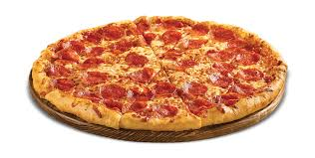
Do want to buy pizza?

Slide 4
Decision = Simple Choice {0,1}
(example) 0 = buy pizza 1 = stay library
0 = Die 1= alive
0 = infected 1= not infected
0 = success 1= failure
Multiple Choice or {0,1,2,3,4}
(example) 0 = domino pizza 1 = Pizza Hut 2….

Slide 5

What factors(=X) will effect on Your Decision (=Y)
X1 = Income
X2 = Age
X3 = Weight
.
.
.
.
Y$=F\left(X\right)$ = W*X
Buying Pizza
Mapping
X = {X1, X2, X3…}
Y={buy=1, otherwise=0}

Slide 6


INFERENCE : What factors causes your decision
Y$=F\left(X\right)$ = W*X
Discrete Choice Model = Logistic Regression (Simple)
$\hat{Y}=F\left(X\right)$ = $\hat{W}$*X

Slide 7








Prediction : Will make a decision or not
Y$=F\left(X\right)$ = W*X
Machine Learning
Functional Space
$$\hat{F(X)}$$
$$\hat{F(X)}$$
Average Prediction of $\hat{F(X)}$
$F\left(X\right)$
$$\hat{F(X)}$$
$$\hat{Y}$$
$$\hat{F(X)}$$

Slide 8


INFERENCE : Standard Logistic Regression
“Discrete Choice Methods With Simulation
PREDICTION : Logistic Regression
“The elements of statistical learning (ML approach in stat)
If time is allowable : Machine Learning
Random Forest + Bayesian Optimization
Ada Boosting + Bayesian Optimization

Slide 9
Research Example
“1. How to apply”
“2. Code for LR”
“3. ML approach”

Slide 10

Simple Example : Who buy Electric Vehicles and Why?
Decision : Buying EV =1
Not Buy EV = 0
For Coding, I made a Fake Data Set

Slide 11
Intro
Why we need electric vehicles?
National leaders have tried to find effective methods of reducing both carbon emissions and the dependency on fossil fuels.
Electric Vehicles (EVs) enable us to reduce :
① Greenhouse gas emissions in the transport sector,
② Car operation costs in times of high oil prices
③ Our dependency on fossil fuels.

Slide 12
Intro
EV Promotion in South Korea
GOAL
South Korean Government’s goal :
① Producing 1.2 million electric vehicles by 2015
② Registering 1 million electric vehicles by 2020.
HOW
Subsiding EV :
① The Ministry of Environment is subsidizing EV purchases
by approximately $13,900
② 10 major cities or provincial jurisdictions are providing
additional subsidies, ranging from $2,800 to $7,400

Slide 13
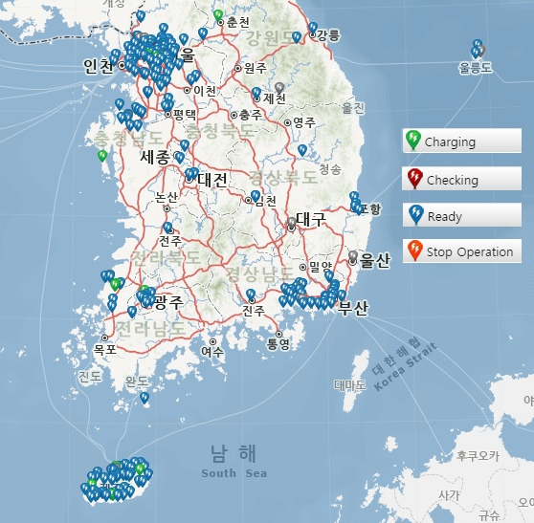
Intro
Current status deployment of Electric Vehicles (2015.5.8)
Very far from the goal ( = 1 million EVs by 2020)
① Registered EV charging station : 227
② Electric vehicles users : 3,341
Charging Station Monitor
Full of BLUE ( = Ready for charging )
→ Few EVs to use charging
* Source : https://evcis.or.kr/com/egovMain.do

Slide 14
Intro
Research Question
The aim of this paper is to analyze Korean customers’ willingness to
buy EVs, for customers who have experienced riding in an EV

Slide 15
Data
Model Specification
The data stems from a survey conducted by the Korea energy Management Corporation
over October 1-31, 2013
All respondents were EV users in either Seoul or the Jeju region, and the total number of
respondents was 180;
excluding cases with incomplete response
the total sample data : 155

Slide 16
Model Specification
Dependent Variable : Di you want to buy Electric Vehicle ?
Independent Variables : Age, Gender, Type of Job, Degree level, Service Group, Payment for Charging
Type | Name | Meanings
Dependent | buy_moti1 | Willingness to purchase electric vehicle among users | 1 = yes 0= no
Age Group | age20s | Age groups in 20s | Dummy = 50s
 | age30s | Age groups in 30s | Dummy = 50s
 | age40s | Age groups in 40s | Dummy =50s
Sex | gender | Types of gender | Male = 1 Female = 0
Types of Job | job_student | Student | Dummy = Researcher
 | job_office | Company employee | Dummy = Researcher
 | job_public | Public servant | Dummy = Researcher
 | job_speical | Specialist | Dummy = Researcher
Types of degree level | learn_ba | Graduated from undergraduate school | Dummy = High School
 | learn_ma | Graduated from graduate school | Dummy = High School
Service Group | club_sharing | A member of Korea car sharing service | Dummy = EV users in Jeju
 | club_kepco | A member of KEPCO EV car sharing service | Dummy = EV users in Jeju
16
Notes:
16

Slide 17
Descriptive Statistics
Model Specification
All variable are dummy variable.
Variables | Obs | Mean | Std. Dev. | Min | Max
buy_moti1 | 155 | .6258065 | .4854826 | 0 | 1
age20s | 155 | .1483871 | .3566356 | 0 | 1
age30s | 155 | .5096774 | .5015268 | 0 | 1
age40s | 155 | .2709677 | .4459002 | 0 | 1
gender | 155 | .7870968 | .4106867 | 0 | 1
job_student | 155 | .0322581 | .1772574 | 0 | 1
job_office | 155 | .4709677 | .5007744 | 0 | 1
job_public | 155 | .3225806 | .468979 | 0 | 1
job_speical | 155 | .0967742 | .2966084 | 0 | 1
learn_ba | 155 | .6967742 | .4611419 | 0 | 1
learn_ma | 155 | .2645161 | .442505 | 0 | 1
club_sharing | 155 | .1870968 | .3912533 | 0 | 1
club_kepco | 155 | .5096774 | .5015268 | 0 | 1
17
Notes:
17

Slide 18
Correlation
Model Specification
Weak correlation among independent variables in this study.
 | age20s | age30s | age40s | gender | Job student | job_ office | Job_ public | job_ speical | learn_ba | learn_ma | club_ _sharing | club_kepco
age20s | 1.0000
age30s | -0.4256 | 1.0000
age40s | -0.2545 | -0.6216 | 1.0000
gender | -0.0489 | 0.1835 | -0.1084 | 1.0000
job_student | 0.2319 | -0.0401 | -0.1113 | 0.0950 | 1.0000
job_office | 0.0425 | 0.2274 | -0.1681 | 0.3328 | -0.1723 | 1.0000
job_public | -0.1716 | -0.3170 | 0.3556 | -0.4840 | -0.1260 | -0.6511 | 1.0000
job_speical | -0.0752 | 0.0591 | -0.0523 | 0.0636 | -0.0598 | -0.3088 | -0.2259 | 1.0000
learn_ba | 0.0779 | -0.0855 | -0.0084 | -0.2402 | -0.1179 | -0.1087 | 0.3051 | -0.0214 | 1.0000
learn_ma | -0.0857 | 0.0615 | 0.0293 | 0.2404 | 0.1389 | 0.0495 | -0.2887 | 0.0511 | -0.9091 | 1.0000
club_sharing | 0.1720 | 0.0073 | -0.1064 | 0.0879 | 0.0997 | 0.1108 | -0.2957 | 0.0668 | -0.1874 | 0.1249 | 1.0000
club_kepco | -0.0262 | 0.3288 | -0.2441 | 0.4357 | 0.0330 | 0.4342 | -0.5379 | 0.0591 | -0.1978 | 0.2371 | -0.4891 | 1.0000
18
Notes:
18

Slide 19
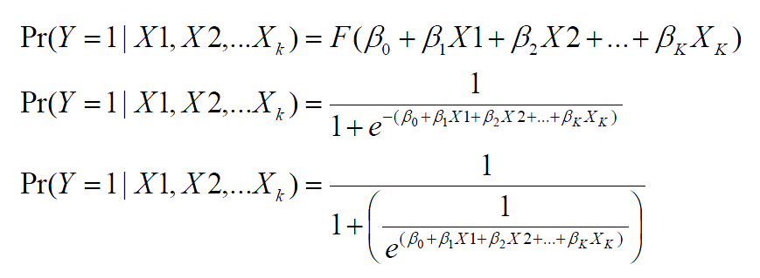
Logit Model
Discrete Choice Method and Other ML Techs(RF, Ada Boost)
Dependent variable in this study is binary which takes values 0 or 1
We use Logit regression which is a nonlinear regression model.
Logit models estimate the probability of dependent variable to be 1. It means the probability that some event happens.

Slide 20

Result

Slide 21

Inference
2

Slide 22
Empirical Result
Model Specification
Statistically, age group, types of job, service type have a influence on willingness to buy EVs
Variables | Coefficient | Standard Error | Z | P>|z|
age20s | -1.523536 | 1.080315 | -1.41 | 0.158
Age30s*** | -2.762704 | .9795369 | -2.82 | 0.005
Age40s | -1.170066 | .8991289 | -1.30 | 0.193
Gender | .2841433 | .5364555 | 0.53 | 0.596
job_student* | -2.633748 | 1.355707 | -1.94 | 0.052
job_office | .0201712 | .743817 | 0.03 | 0.978
job_public | -.21472 | 1.025917 | -0.21 | 0.834
job_speical* | 2.230069 | 1.340147 | 1.66 | 0.096
learn_ba | .6843675 | .9081867 | 0.75 | 0.451
learn_ma | .4114573 | .972233 | 0.42 | 0.672
club_sharing** | 1.989332 | .9412754 | 2.11 | 0.035
club_kepco** | 1.73136 | .8339964 | 2.08 | 0.038
_cons | .5239554 | 1.649572 | 0.32 | 0.751
Log Likelihood | Number of Ob | LR chi2(2) | Prob > Chi2 | PseudoR2
-84.584976 | 155 | 35.79 | 0.0004 | 0.1946
22
Notes:
22

Slide 23
Empirical Result
Model Specification
Age
30s are less willing to buy EVs than 60s (significant at 1% )
Job
Students show less willingness to buy EVs than researchers (significant at 10% )
Specialist have a higher willingness to buy EVs than researchers (significant at 10% )
Service
Group
The Korea car sharing service member have a higher willingness to buy EVs than
EV users in Jeju (significant at 5% )
The KEPCO’s EV car sharing service member have a higher willingness to buy
EVs than EV users in Jeju (significant at 1% )

Slide 24
Marginal Effects
Model Specification
Marginal Effects show the change in probability when the predictor or independent variable increase by one unit.
Variables | dy/dx | Standard Error | Z | P>|z|
age20s | -.3368977 | .2383876 | -1.41 | 0.158
Age30s*** | -.6109134 | .2135531 | -2.86 | 0.004
age40s | -.2587353 | .1981022 | -1.31 | 0.192
gender | .0628323 | .1185 | 0.53 | 0.596
job_student* | -.5823977 | .3026182 | -1.92 | 0.054
job_office | .0044604 | .1644718 | 0.03 | 0.978
job_public | -.0474808 | .2271083 | -0.21 | 0.834
job_speical* | .4931326 | .2860709 | 1.72 | 0.085
learn_ba | .1513334 | .2007506 | 0.75 | 0.451
learn_ma | .0909851 | .2148848 | 0.42 | 0.672
club_sharing** | .4398986 | .2052505 | 2.14 | 0.032
club_kepco** | .3828537 | .1824838 | 2.10 | 0.036
24
Notes:
24

Slide 25
Empirical Result
Model Specification
Age
The change in probability when age group goes from ‘50s’ to ‘30s’ decrease 61.09%
is significant at 1%
Job
The change in probability when types of job goes from ‘researcher’ to ‘job’ decrease
58.2% is significant at 10%
The change in probability when types of job goes from ‘researcher’ to ‘specialist’
increase 49.3% is significant at 10%
Service
Group
The change in probability when types of service group goes from ‘EV users in Jeju ’ to
‘Car sharing service group’ increase 43.98% is significant at 5%
Korea Car Sharing service members live in Seoul
The change in probability when types of service group goes from ‘EV user in Jeju group’ to
‘KEPCO EV car sharing service member’ increase 38.28% is significant at 5%
KEPCO EV car sharing service member live in Seoul

Slide 26

Results and Implication
3

Slide 27
Conclusion
Age group
The reason people in their 30s are less willing to buy an EV may be due to their social status.
In Korea, 30s need money for weddings, buying a house, and educating their children.
30s might have less room to pay for necessities.
☞ The government should provide greater subsidies that take customer’s
financial capacity to buy EVs into account.

Slide 28
Conclusion
Types of Job
Researchers and specialist showed different attitudes to buying EVs.
☞ The high income level of specialist may be the reason for their greater
willingness to buy compared to other groups.
Researchers and student showed different attitudes to buying EVs.
☞ The low income level of student may be the reason for their lower
willingness to buy compared to other groups.

Slide 29
Conclusion
Service Group
Korea car sharing group members in Seoul have a higher willingness to buy EVs than EV user in Jeju.
KEPCO car sharing group members in Seoul have a higher willingness to
buy EVs than EV user in Jeju.
☞ Perhaps, there are regional differences in willingness to buy EVs

Slide 30
Conclusion
Service group
The reason people in their 30s are less willing to buy an EV may be due to their social status.
In Korea, 30s need money for weddings, buying a house, and educating their children.
30s might have less room to pay for necessities.
☞ Korean government should provide greater subsidies that
take customer’s financial capacity to buy EVs into account.

Slide 31
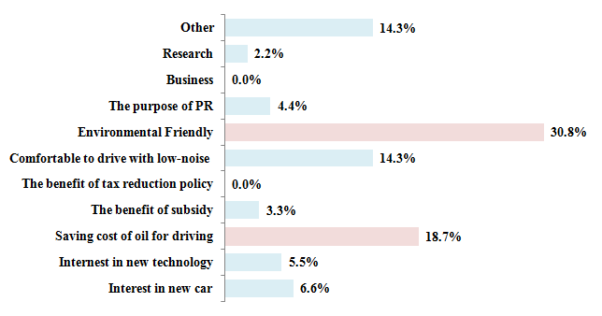
Conclusion
Specific motivation to buy EV among the respondent want to buy
91 out of 155 respondents answer that they want to buy EV.
Environmental Friendly (30.8%) > Saving cost oil for driving (18.7%)
☞ We should consider those point when we make a market strategic for EV

Slide 32
Conclusion
Policy Implication for Korea
The evidence from this study suggests that policy makers should clearly understand customer’s willingness to buy electric vehicle.
In this sense, policy makers should build up customized electricity-vehicle promotions based on their age group, types of job, service group, and region.
☞ In order to promote Evs, especially for EV users, Korea Government should consider market segmentation based on age, job, region.

Slide 33
Key Reference
Ona Egbue, Suzanna Long, Barriers to widespread adoption of electric vehicles: An
analysis of customer attitude and perceptions, Energy Policy, Volume 48, 2012, Pages
717–729
Alexander Kihm, Stefan Trommer, The new car market for electric vehicles and the
potential for fuel substitution, Energy Policy, Volume 73, 2014, 147–157
Korea Energy Management Corporation (KEMCO), EV demonstration project data
analysis and EV distribution, internal paper by KEMCO, October
2013 Electric Vehicle News, Electric car sales set to take off in South Korea, April 18,
2014

Slide 34
Why
Sample
Space
SSample
space
Sample
space
Sampling
Population
Space
Model Selection : Ensemble (Bagging, Boost)
Feature Selection : Regularization
Target Selection : Ordered Probit, Structured
prediction
4. Hyper parameter Selection : Bayesian Optimization
Estimation
95% Confidence interval :
real value may in this interval in 95%

Slide 35
Discrete Choice Method and Other ML Techs(RF, Ada Boost)
Inference with Logit Model (= Discrete Choice Model)
Prediction with Logic Model (= Discrete Choice Model)
Random Forest (=ML, Bagging)
Ada Boost (=ML, Tree Based, Boosting)

Slide 36
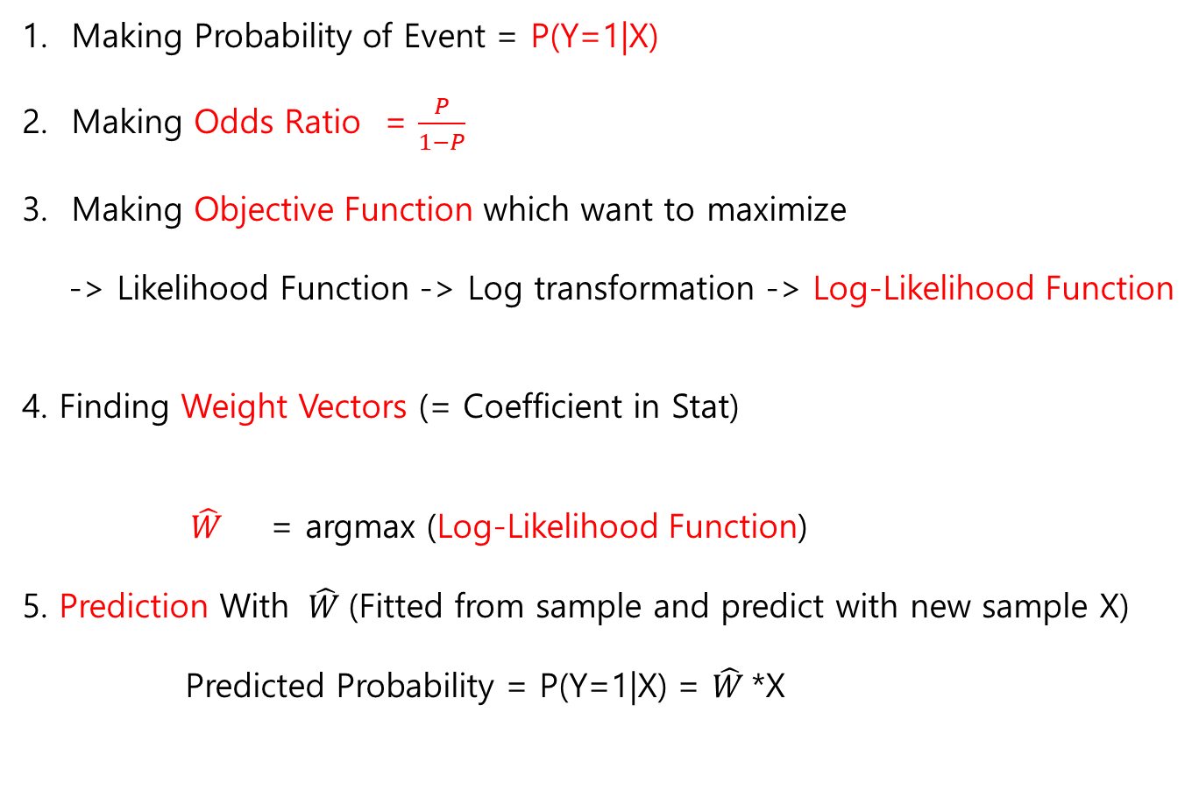
Y = F(x) =W*X
Making Probability of Event = P(Y=1|X)
Making Odds Ratio = $\frac{P}{1−P}$
Making Objective Function which want to maximize
-> Likelihood Function -> Log transformation -> Log-Likelihood Function
4. Finding Weight Vectors (= Coefficient in Stat)
$\hat{W}$ = argmax (Log-Likelihood Function)
5. Prediction With $\hat{W}$(Fitted from sample and predict with new sample X)
Predicted Probability = P(Y=1|X) = $\hat{W}$*X

Slide 37
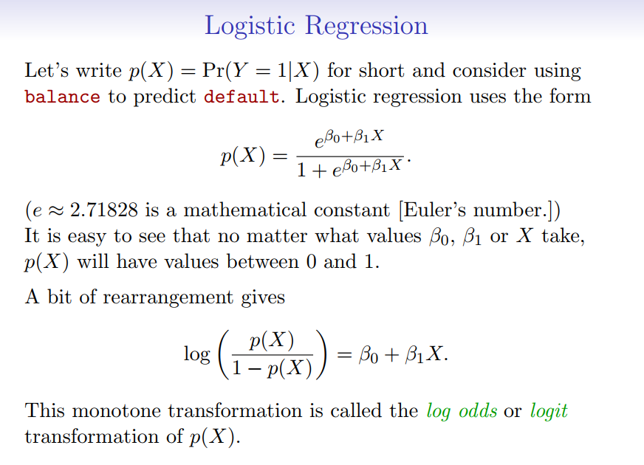

Reference : An Introduction to Statistical Learning, with Applications in R.

Slide 38
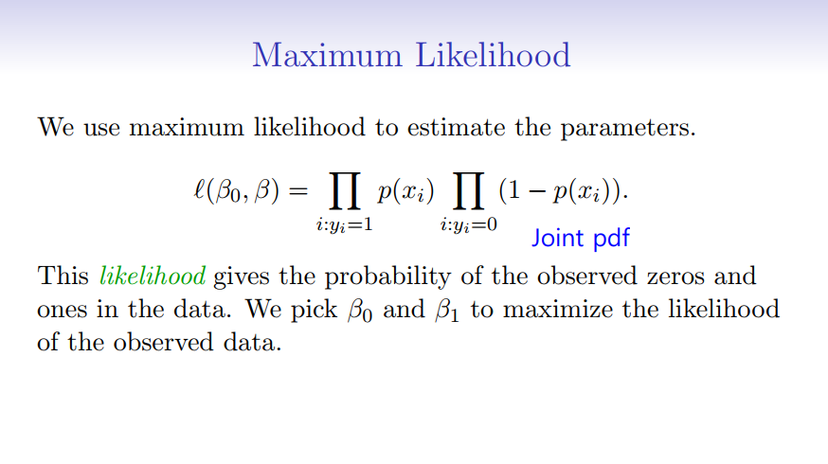
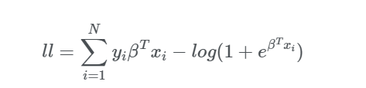
From : An Introduction to Statistical Learning, with Applications in R.
Monotonic Transformation : Loglikelihood

Slide 39
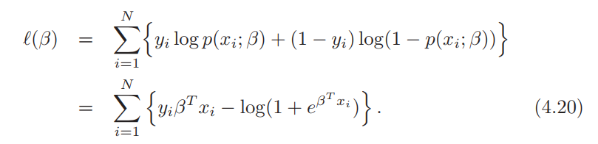
Reference : The elements of statistical learning

Slide 40
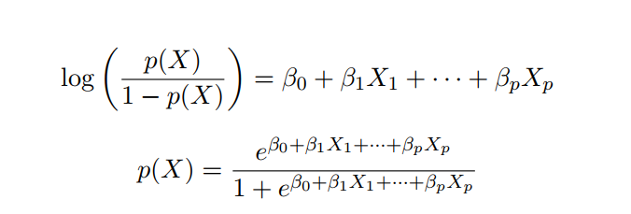

Reference : The elements of statistical learning
P = 0.5 >1
W*X(=Income, age) = Y = 0.6= 1 0.4 =0 0.3 =0

Slide 41
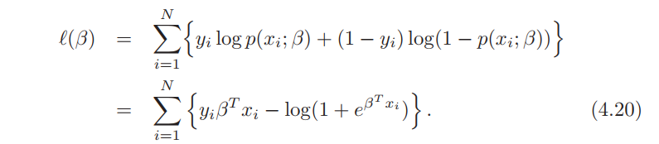
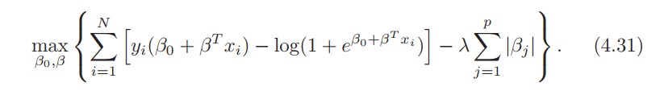
Reference : The elements of statistical learning
See the Code From Scracth
You can do it with Sklearn,
When you do prediction it is okay
When you do it for inference, you should check default setting
(Intercept, L2 regularization)
Sklearn Default = Regularized likelihood Function, No intercept

Slide 42
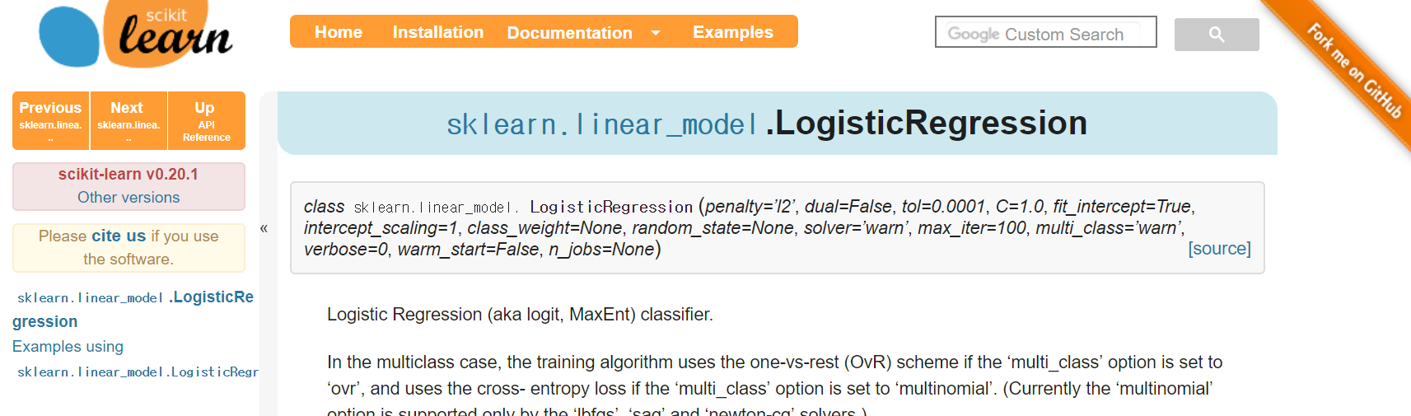
Coding from scratch and compare the results with Sklearn
https://scikit-learn.org/stable/modules/generated/sklearn.linear_model.LogisticRegression.html

Slide 43
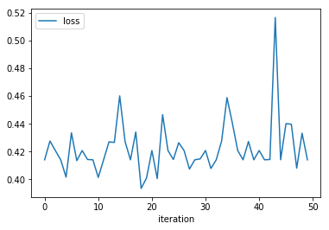
3. Prediction Compare it with ML (Decision Tree Model)
Boosting : Weak Estimator to Strong Estimator (No Noise, No Overfitting)
(Noise, Overfitting)
XGBOOSTing is the cutting edge, but not much applicable for regression world
Ada Boost is basic
Bagging : Random Forest <- Injecting randomness (Overfitting)
Parameter selection : Bayesian Optimazaiton ( Hype OPT, SMAC, SPEAR)
Start with P(D|X), your belief on distribution
See Observation, update belief, each
iteration
Choose the hyperparameter
minimize the loss function
Loss function = 1- accuracy
Whatever you want to minize: OLS (MSE)

Slide 44
HyperOpt : Bayesian Optimization (Other Smac, Spear)
1. Setting Objective Function to Minimize (Ex, Loss, MSE, -Prediction Accuracy)
2. Set the Hyperparameter(Depth of Tree, Number of iteration)
Space (Do main Space)
3. Optimize with iteration

Slide 45
Bayesian Optimization (Other Smac, Spear)
1. With Prior Belif P(D|X), Logic P= P(Y=1|X)
2. See the actual observation
3. Update P(D’|X)
4. Repeat until converge
-> Decrease the number of parameter to estimate
Python Bayesian Optimization Modul :
https://conference.scipy.org/proceedings/scipy2013/pdfs/bergstra_hyperopt.pdf

Slide 46
PREDICTION
2

Slide 47
Prediction Accuracy between Discrete Choice vs ML
5 Fold Cross Validation Accuracy (Small Data Set = 155 sample size case)
Without Bayesian Optimization
With Bayesian Optimization
Random Forest : 56%
Ada Boosting: 57%
(Decision Tree)
Binary Logistic: 60% (Win)
Random Forest : 59%
Ada Boosting: 63% (WIN)
(Decision Tree)
Binary Logistic: 60%
Machine lose
Machine Win

