Slide 1
PolliNet Architecture

Slide 2
PolliNet Software Requirements
Scout aboard code | Description | Pollinators code | Description | Control Computer(CC) | Description
Image recognition model and Task report | Recognizes flowers, computes their coordinates and sends a new task* to the CC. | Task Response | Listen to tasks from the CC, receives a Task and goes to the coordinates to perform | Task Queue | Maintain a queue of Task received from Scout drone.
Autonomous naviagtion** | TBD | Status Updates | CC must know if pollinators are busy or available | Status Queue | Which pollinator is busy/available.
Control Computer time out response | If CC does not respond to Tasks return to home coordinates. | CC time out response | If pollinator does not receive a task in 5 min return home. | Send Pollinators to a Task | Given a Task send clostes available pollinator
Displacement limit rules*** | Drone must not go more than x meter in any direction from home coordinates. | Pollination action (video) | Once at the Task coordinates, use on-board video to pollinate | Graphical 2D plot of target coordinates | Where are the flowers at****
* A Task is data that contains (LAT, LONG, HIGHT)
** Randomized Rule Base Navigation, Video data navigation
*** x will be determined by hardware limitations.
**** Not a critical requirement.

Slide 3
Randomized Rule Base Nav?

Slide 5
A
Response
Task
CC
Status
Status
B
Task
Task
C

Slide 6
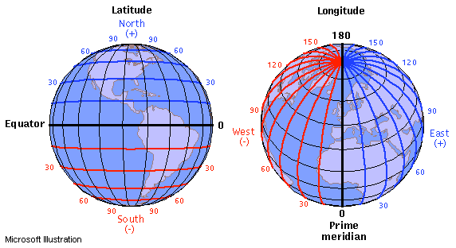
Challenge (Precision)
20 meters change in LAT is about 0.00018 degree change

Slide 7
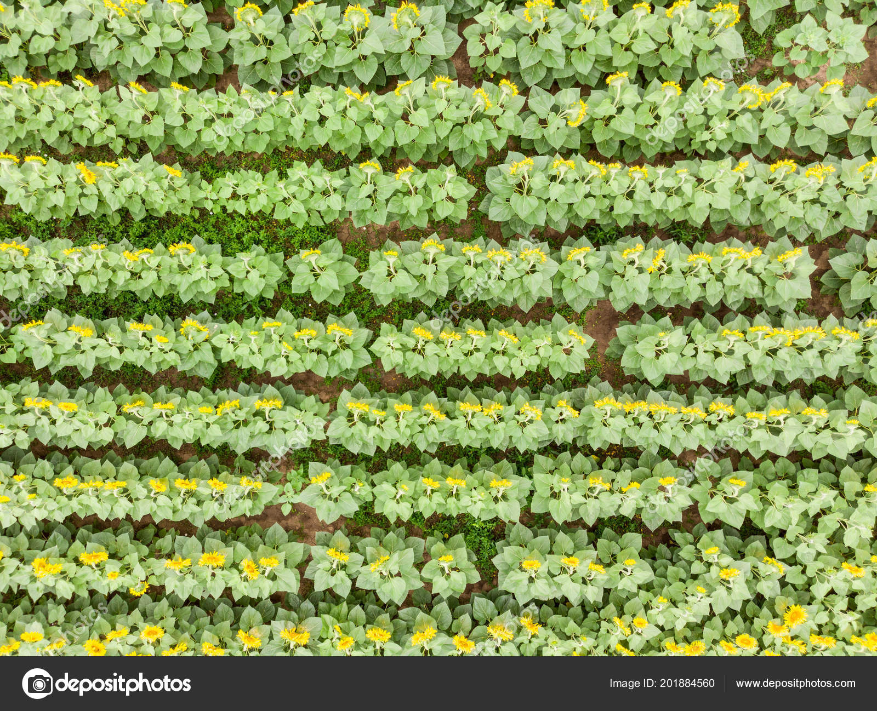
Challenge (Triangulation)
??
H
??
Move until flower drone is right on top of flower ?? Once a flower is identified (Video data takes over the nav)

Slide 8
Challenge (Pollination)
Video Control Nav

Slide 9
Condition of Success for Software
10% Review:
CV Model recognizes flowers from bird view.
Scout drone onboard PI can communicate with CC.
Successful Test of drone and CC communicating Task data (without drone).
30% Review: (Need a flying drone at this time).
Scout drone can explore autonomously.
2. Scout drone return home if CC communication fails.
3. Scout follows displacement limit rules.
50% Review:
Pollinators onboard PI can communicate with CC.
Pollinator seeds Status to CC.
Pollinator recognizes if CC timed out.
70% Review: (Pollinator drone flying at this time).
Pollinators go to the target position.
Pollinator can pollinate (Video guided nav).
Pollinator recognizes if CC timed out and returns home.
100% Review:
1. Integration Test (Go out and test if everything works.

