Slide 1
Welcome To The Presentation
Presented By –
Jiku Nandi
Id No # 12109003

Slide 2
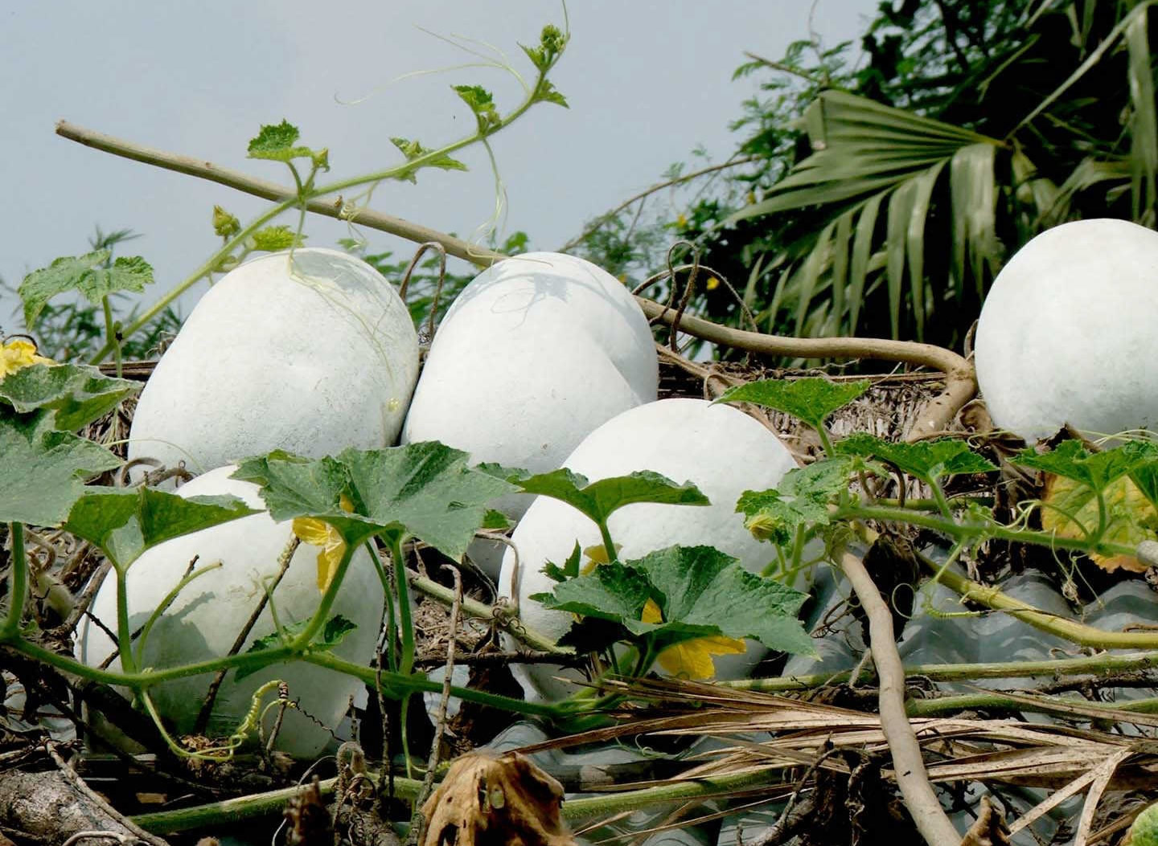
My Presentation Topic: Ash Gourd

Slide 3
Overview
Introduction
Origin & Distribution
Description
Scientific Classification
Climate & Soil
Varieties
Seed rate & Seed Treatment
Preparation of Field & Sowing
Intercultural Operation
Pest & Diseases
Harvesting
Cost of Production

Slide 4
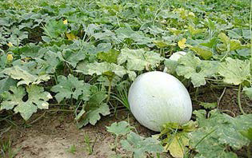
Introduction
Ash gourd is a popular vegetable cultivated throughout Bangladesh. The vegetables are cultivated mainly for culinary purpose. The vegetables are covered by white, chalky wax, which deters microorganisms and helps impart an extraordinary longevity to the gourd.

Slide 5
Origin and distribution
Crop originated in Asia specifically in Java and Japan. It is grown throughout old world tropics and is less common in new world tropics. In India, the crop is widely grown in UP and Delhi for preparation of ‘Agra petha’ and in southern states for use as vegetable. It is also cultivated commercially in Bangladesh.

Slide 6
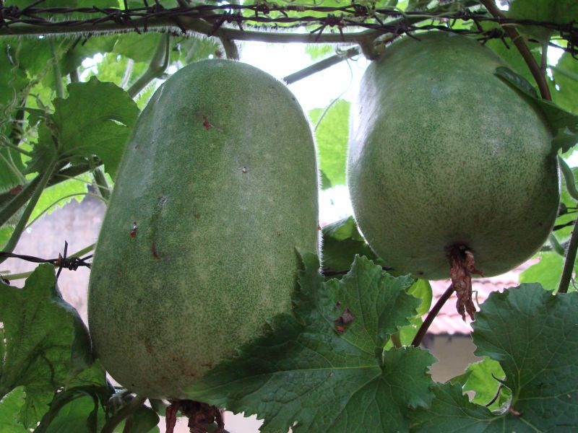
Description
The ash gourd is an annual creeping vine that can either climb structures or be allowed to spread out on the ground. This plant features large green leaves and thick stems covered with coarse hairs. The showy, golden yellow blooms appear early in the summer, and female flowers give way to round or spherical fruits. Young ash gourds are covered with a soft down that disappears with maturity. Fully matured gourds have a white, waxy coating covering the surface.

Slide 7
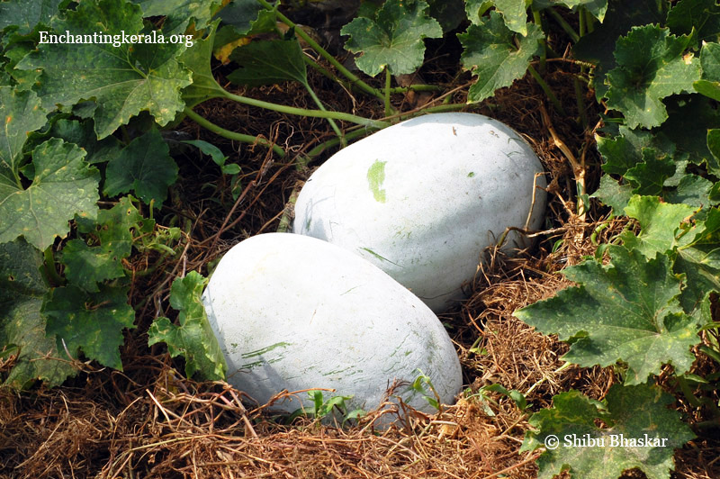
Scientific classification
Kingdom: Plantae
Order: Cucurbitales
Family: Cucurbitaceae
Subfamily: Cucurbitoideae
Genus: Benincasa
Species: B. hispida
Binomial name: Benincasa hispida

Slide 8
Climate & Soil
The optimal temperature for the growth of ash gourd is in the range of 24–27ºC. The plants are adapted to a wide range of rainfall conditions. It tolerates a wide range of soil but prefers a well drained sandy loam soil that is rich in organic matter. The optimum soil pH is 6.0–6.7, but plants tolerate alkaline soils up to pH 8.0.

Slide 9
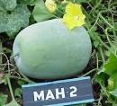
Varieties
Co 1: Large sized, round fruits with average fruit weight of 8.0 kg.
KAU local: Fruits are oblong, and medium sized.
Indu: Yield potential is 24.5 t/ha. Mean fruit weight is 4.82 kg.
In our country Co 1 & Co 2 is very popular.

Slide 10
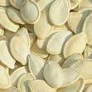

Seed rate & Seed treatment
The recommended seed rate for ash gourd is 0.75-1.0 kg/ha.
Soak the seeds in double the quantity of water for 30 minutes and incubate for 6 days.
The seeds are treated with Trichoderma viride 4 g or Carbendazim 2 g/kg of seeds before sowing.

Slide 11
Preparation of field & Sowing
January-March and September-December are the ideal seasons for growing ash gourd.
Prepare the soil to a fine tilth by ploughing and harrowing.
Plough the field 3 – 4 times.
Dig pits of 30 cm x 30 cm x 30 cm at a spacing 2 x 1.5 m and form basins.
Five to six seeds are sown in each pit.
After germination, the seedlings are thinned to two/ pit.

Slide 12
Intercultural Operations
Fertilization:
FYM - 15-20 t/ha
Urea - 90 kg/ha
Phosphorus - 55 kg/ha
Potassium - 50 kg/ha

Slide 13
Cont.
Irrigation & Drainage:
During the initial stages of growth, irrigate the crop at 3-4 days interval, and alternate days during flowering/fruiting.
Furrow irrigation is the ideal method of irrigating.
But in water limited environment, trickle or drip irrigation can be resorted to.
During rainy season, drainage is essential for plant survival and growth.

Slide 14
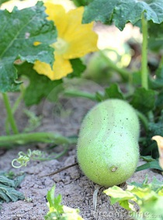
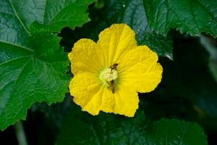
Cont.
Pollination:
Ash gourd is a cross pollinated crop.
Insects, especially bees, pollinate flowers.
Pollination can be a problem during the wet season since bees are less active dur­ing overcast conditions.

Slide 15
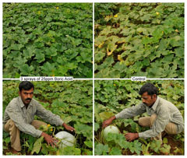
Cont.
Weed control:
Conduct weeding of the soil at the time of fertilizer application.
Earthing up is done during rainy season.
Hand or hoe weeding can be performed as needed.

Slide 16
Cont.
Mulching:
Mulching is commonly used for ash gourd crop grown on raised beds.
Use organic or plastic mulch depending on availability.
Mulch can be laid down before or after trans­planting and after sowing.

Slide 17
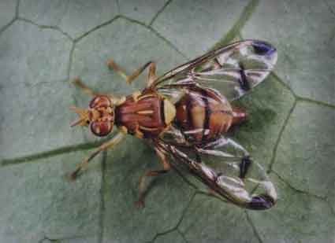
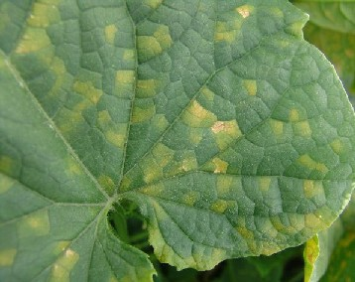
Pest & Diseases
Pest:
Fruit flies, Epilachna beetle, Pumpkin beetle, Aphids
Disease:
Powdery mildew, Downy mildew, Cucumber mosaic virus.

Slide 18
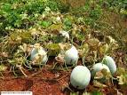
Harvesting
The fruits can be harvested at different stages depending on the purpose for which it will be used. Normally, green fruits are ready for harvest within 45-60 days; matured ones coated with powdery substance are harvested between 80 and 90 days after sowing. The fruit yield can vary depending on vari­ety and crop management. Average marketable yields are 20-25 t/ha. The harvested fruits can be stored 2-3 months in temperatures from 10 to 12°C and 50-75 % relative humidity.

Slide 19
Cost of Production/Hectare
Input Cost:
Material Cost - 9,100
Non-material cost - 52,000
Overhead Cost: 8,000
---------------------------------------------
Total Cost 69,100
Gross Income – 1,54,000
Net Income = (1,54,000 – 69,100) Tk
= 84,900 Tk

Slide 20

Thank You

Slide 21

ANY QUESTION?

