Slide 1

MAWLANA BHASHANI SCIENCE AND TECHNOLOGY UNIVERSITY
DEPARTMENT OF COMPUTER SCIENCE AND ENGINEERING
TOPIC :COMPOSITE & DECORATOR
COURSE CODE : CSE2205
Course Title: Object Oriented Analysis & Design
PRESENTED BY-
SUBMITTED TO-
Saiyedul Morsalina Sheba
ID : CE22008
Anik Bhattacharjee
ID : CE22053
Mohd. Sultan Ahammad
Assistant Professor
DEPT. OF CSE , MBSTU
Mohammad Ifteher Uddin
ID : CE22048
Sultana Akter Nabila
ID : CE22054
Md. Jilalish Saif Khan
ID : CE22051

Slide 2
Design Patterns Classification
Composite
&
Decorator

Slide 3
What are the Design Patterns in Object Oriented Design?
Proven solutions to common software design problems.
Reusable solutions to common problems in software design.
Provides templates for writing flexible, maintainable, code.
Categorized in 3 parts including Creational Patterns, Structural Patterns, Behavioral Patterns.

Slide 4
It is a structural design pattern.
It allows you to compose objects into tree-like structures.
Enables clients to treat individual objects and compositions of objects uniformly.
What is Composite Pattern?

Slide 5
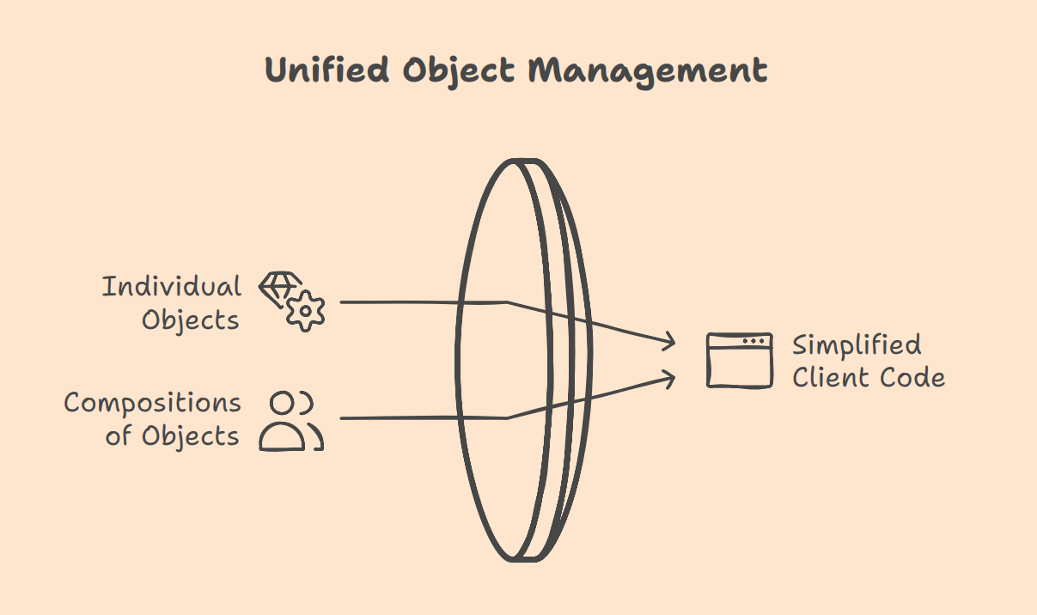

Slide 6
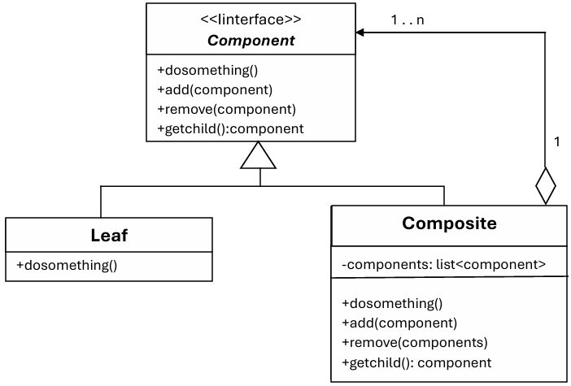
UML Diagram
Component: Defines the interface for all objects.
Leaf: Represents individual objects.
Composite: It consists of leaf elements and implements the operations in base component.

Slide 7
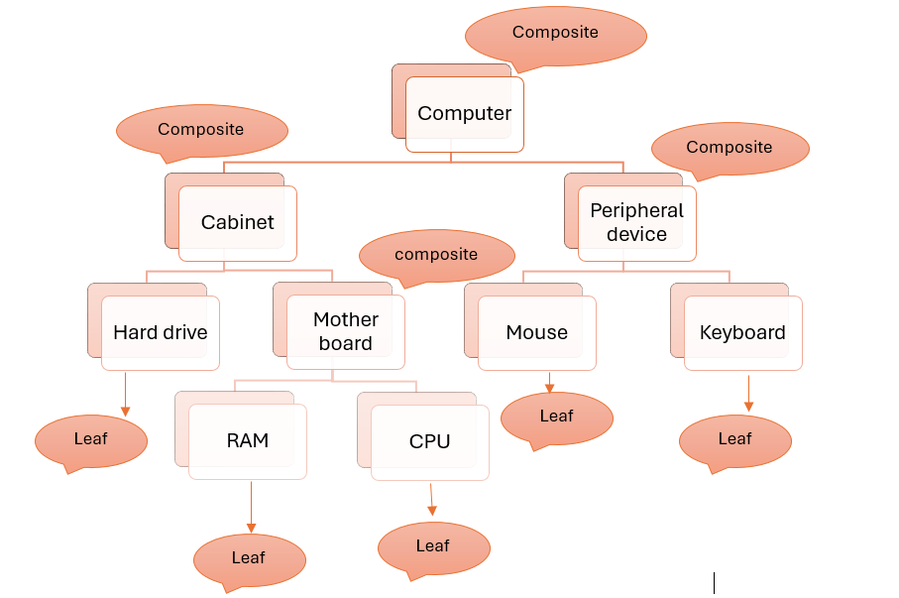
Real Life Example
Computer System

Slide 8
Course Simulation
Scenario: Building a class diagram for a university system:
Component: “Entity.”
Leaf: Individual courses.
Composite: Degree programs that group multiple courses.

Slide 9

Solving Real-Life Problems
Identify Hierarchy: Understand components and their relationships.
1
Define Common Interface: Ensure uniform operations for parts and systems.
2
Recursive Operations: Apply operations like turning on/off to all levels.
3
Flexibility in Expansion: Add new components easily.
4
Simplify Maintenance: Isolate and repair parts without affecting the system.
5

Slide 10
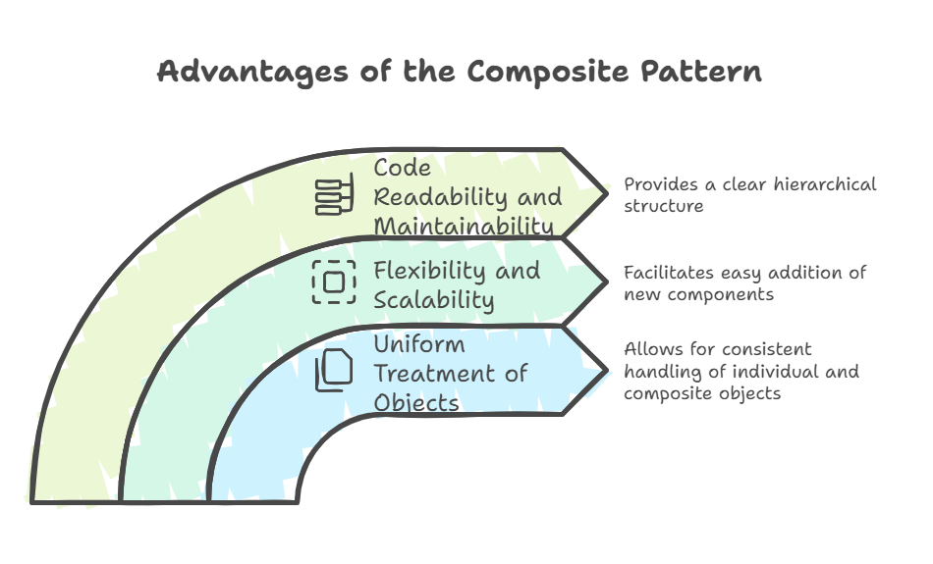

Slide 11
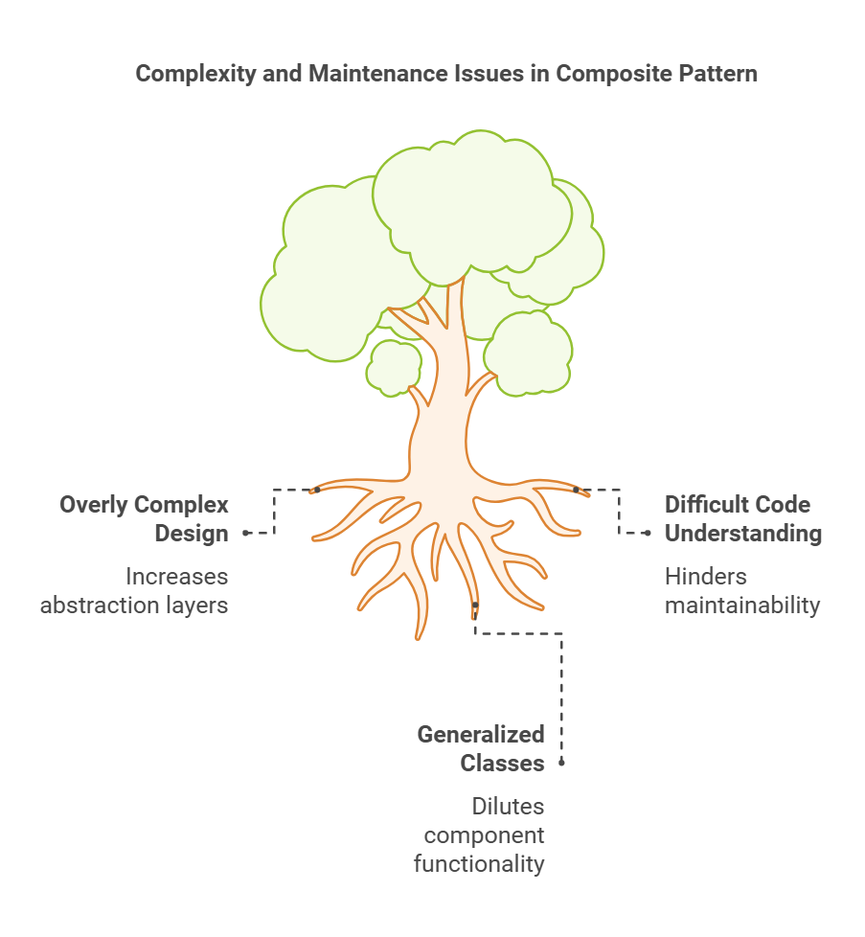

Slide 12
It is a structural design pattern.
It allows dynamic addition of functionality to objects without modifying their class
It is used to extend or modify an object's behavior at runtime.
What is Decorator Pattern?

Slide 13
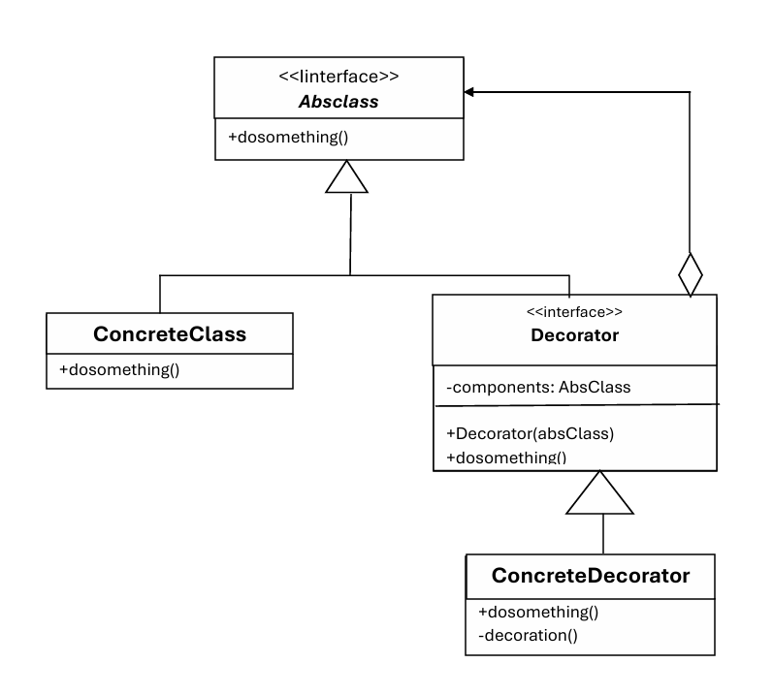
UML Diagram
Component: Defines the interface for objects.
Concrete Component: The base object whose behavior needs to be extended.
Decorator: Abstract class that wraps the component.
Concrete Decorator: Adds new behavior

Slide 14
Real Life Example
Coffee Shop
Base Component: Plain Coffee
Decorators:
Add milk
Add sugar
Add whipped cream
Flow:
Start with plain coffee → Wrap with "Milk" → Wrap with "Sugar" →
Result: Coffee with milk and sugar.
Diagram/Code Representation:
Show how each decorator adds behavior.
Highlight that each wrapper can be reused.

Slide 15
Course Simulation
Scenario: Online Course Platform
Base Component: A basic Course
Decorators: Quiz, Certificate, Live Session
Simulation Process: Get result

Slide 16
Solving Real-Life Problems
Identify Core Component: Define the base functionality to extend.
1
Add Decorators: Add extra features.
3
Wrap Dynamically: Wrap the core.
4
Combine and Test: Apply decorators as needed.
5
Create Interface: Ensure consistency.
2

Slide 17
Advantages
Reusable
No Changes
Flexible

Slide 18
Disadvantages
Complexity
Dependency on Composition
Overuse

Slide 19
Conclusion
Both Composite and Decorator Patterns are structural patterns that simplify complex designs.
Composite Pattern manages hierarchical structures, treating single objects and groups uniformly.
Decorator Pattern dynamically adds new behaviors to objects without modifying their structure.
Together, they promote flexibility, reusability, and clean design in software development.

Slide 20
REFERENCES
Book: “Design Patterns: Elements of Reusable Object-Oriented Software”
https://www.digitalocean.com/community/tutorials/composite-design-pattern

Slide 21
Thank You

