Slide 1
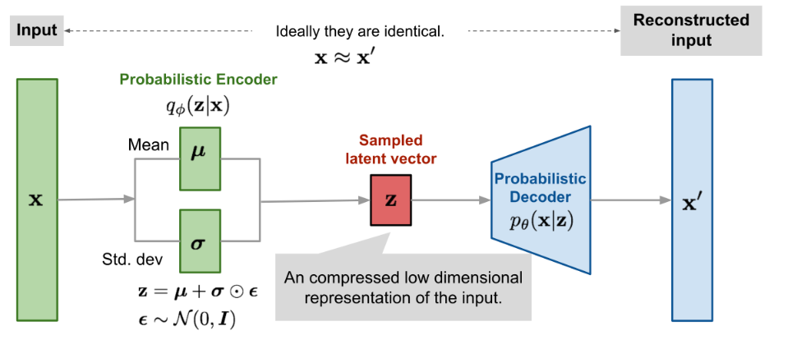
Probability with Deep Learning
VAEs meets Probability:
This combination adds new perspectives in
how DL models can be applied in (Regression)
Probabilistic models can be a good option
for improving NNs as we can parameterize
a probability distribution with the output

Slide 2
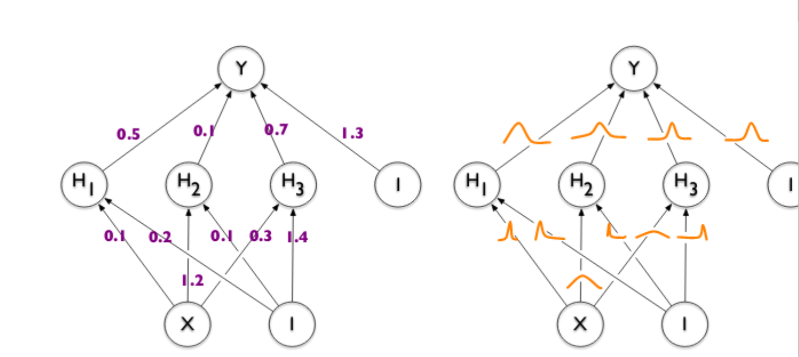
Probability with Deep Learning
Opting for Bayesian Networks with Parametrized Distributions

Slide 3
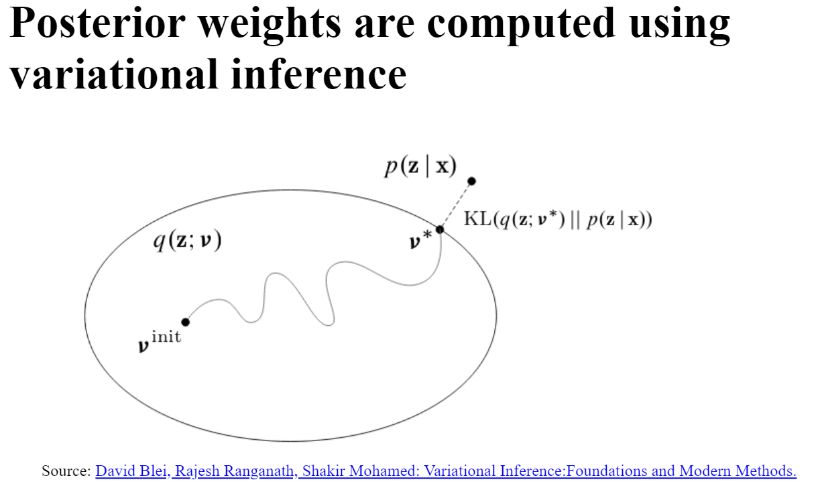
Probability with Deep Learning

Slide 4
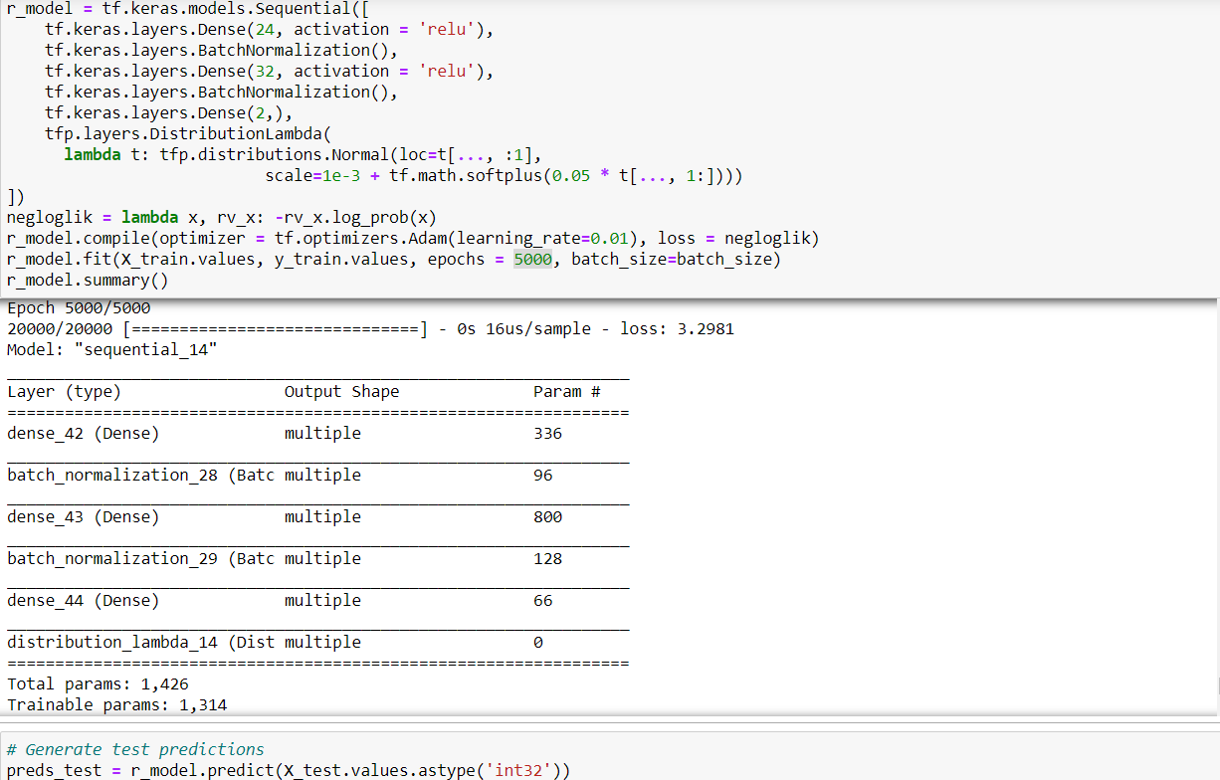
Probability with Deep Learning
Triaining a regressive probabilistic model which outperformed
a simple
feed forward nn

Slide 5
Overview:
This was part of my research in this new perspective that can bring improvements in training models
Modeling uncertatinity and learning more about how probability can add to the game

