Slide 1
Ankou: Guiding Grey-box Fuzzing towards Combinatorial Difference
Valentin Manès¹, Soomin Kim², Sang Kil Cha²
¹CSRC, KAIST ²KAIST

Slide 2
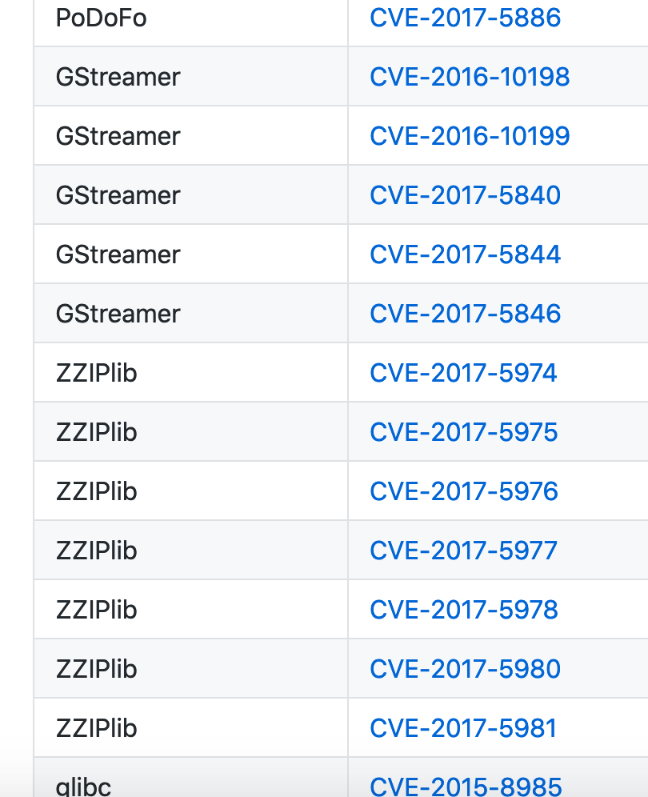
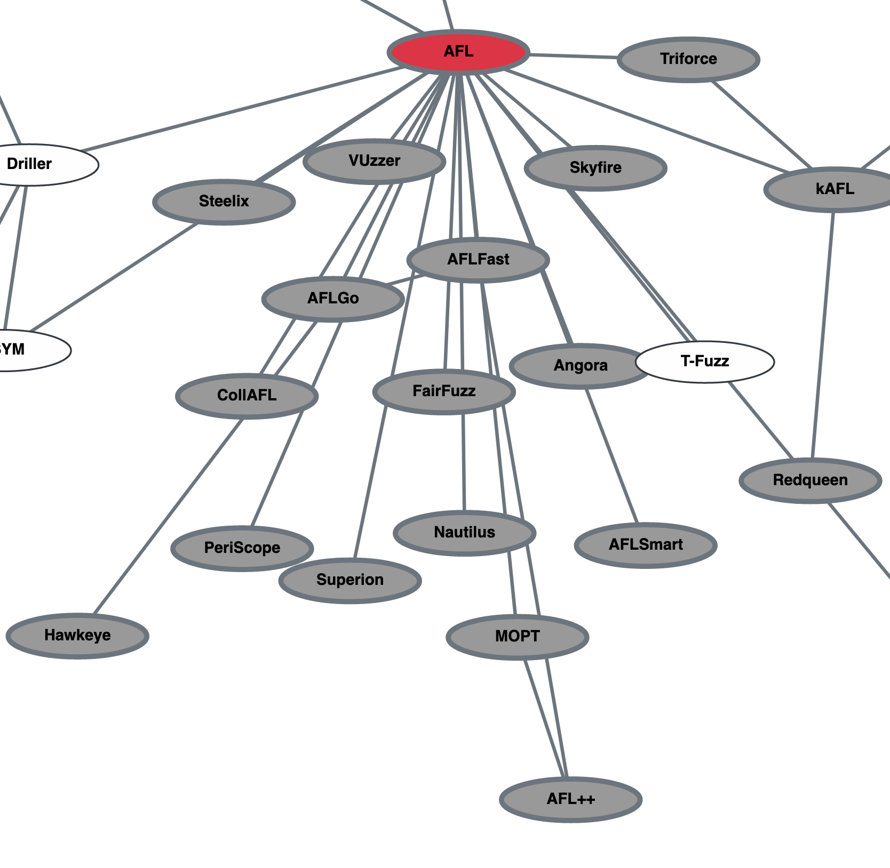
The Success of Grey-box Fuzzing
“OSS-Fuzz has found over 20,000 bugs in 300 open source projects.”
github.com/mrash/afl-cve
➔ Many CVEs
$$$$
Why one more ?

Slide 3
Grey-box, How?
Fitness Function: if(“interesting”): Add to seed pool
Test Case
Fuzzer
Seed Pool
Program
Test Case A
Test Case
Output
Test Case B
Test Case C

Slide 4
Which Feedback?
Coverage has proved a good tradeoff between cost and benefits.
Ankou: Opportunity to improve?
Branch Coverage
stdout/stderr
Branch Hit Count
Taint Analysis
No feedback
Cost
- zzuf
- BFF …
- AFL
- LibFuzzer …
- Vuzzer
- Angora …

Slide 5
Coverage-Based Fuzzing
Test Case | A | B | C | D
Value | “A” | “BB” | “AB” | “ABC”
Branch 1 | X |  | X | X
Branch 2 |  | X | X | X
Branch 3 |  |  |  | X
Test Case | A | B | C
Value | “A” | “BB” | “AB”
Branch 1 | X |  | X
Branch 2 |  | X | X
Branch 3
int combinedBranches(char *data) {
int bits = 0;
if (data[0] == 'A') bits |= 1;
if (data[1] == 'B') bits |= 2;
if (data[2] == 'C') bits |= 4;
if (bits == 7)
printf("BINGO\n");
return 0;
}
Test Case | A | B
Value | “A” | “BB”
Branch 1 | X
Branch 2 |  | X
Branch 3
Fuzzer
Program
Fitness Function: if(new branch): Add to seed pool
Test Case
Outputs
Seed Pool
A more informative Fitness Function is needed!
Test Case A
Test Case B
Test Case D
Notes:
-

Slide 6
Informative Fitness with Combination
Ankou goal: developing a fitness function taking into account combinations.
͏ Quantify the difference between program executions.
Make fitness computation fast.
Make the fitness adaptive to the program.

Slide 7
Point Representation

Slide 8
Distance between Executions
Euclidean Distance

Slide 9
Distance between Executions
Detects Combinatorial Difference!

Slide 10
Distance-based Fitness Function
Seed Pool
? Point-to-Pool ?

Slide 11
Distance-based Fitness Function
Seed Pool
Point-to-Pool = Minimum Point-to-Point

Slide 12
Cost Sensitivity
Seed Pool
The fitness function is computed for every test case.

Slide 13

Problem: Slow Computation
Euclidean Distance = $𝒪\text{(\#}\text{b}\text{ranch}\text{)}$

Slide 14

Cost Reduction
Euclidean Distance = $𝒪\text{(\#}\text{b}\text{ranch}\text{)}$
Dimensionality Reduction
See paper for details on the Dynamic PCA.
Euclidean Distance = $𝒪\text{(\#“}\text{reprentative} \text{branch}\text{”)}$

Slide 15
Ankou Adaptive Fitness Function
Ankou fitness function:
if(new branch): if(Point-to-Pool distance ??):
Add test to seed pool
Coverage-based fitness function:
if(new branch): Add test to seed pool

Slide 16
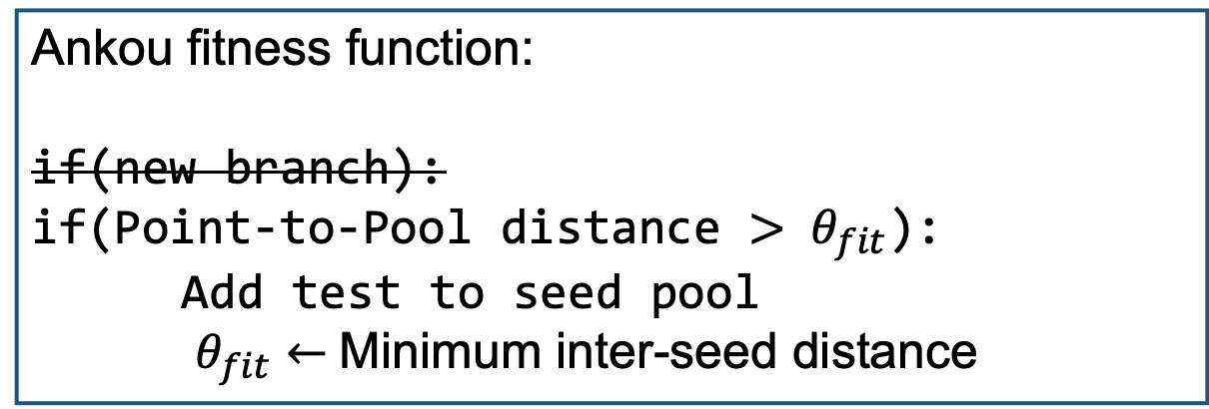
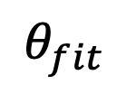
Ankou Adaptive Fitness Function
Ankou fitness function:
if(new branch): if(Point-to-Pool distance $> θ_{fit}$):
Add test to seed pool
$θ_{fit}←$Minimum inter-seed distance
$$θ_{fit}$$

Slide 17
Benchmark
Use 24 packages used by CollAFL¹.
All experiments are 6x24 hours runs.
In total: our experiments constitute 2,682 CPU days.
Notes:
2682/7=7.35 years

Slide 18
Q: Is the New Fitness Function Effective?

Slide 19
Ankou with and without Distance-based
Distance-based finds 44% more crashes.
Notes:
Overall, distance-based fitness function found 44% more unique crashes, and produced more crashes in 60% of the subjects, excluding the 5 subjects where no crashes were found.
Ankou using distance-based fitness function had a test case generation throughput 51% lower because of the time spent on computing its fitness function.

Slide 20
Q: How does Ankou compare to other grey-box fuzzers?

Slide 21
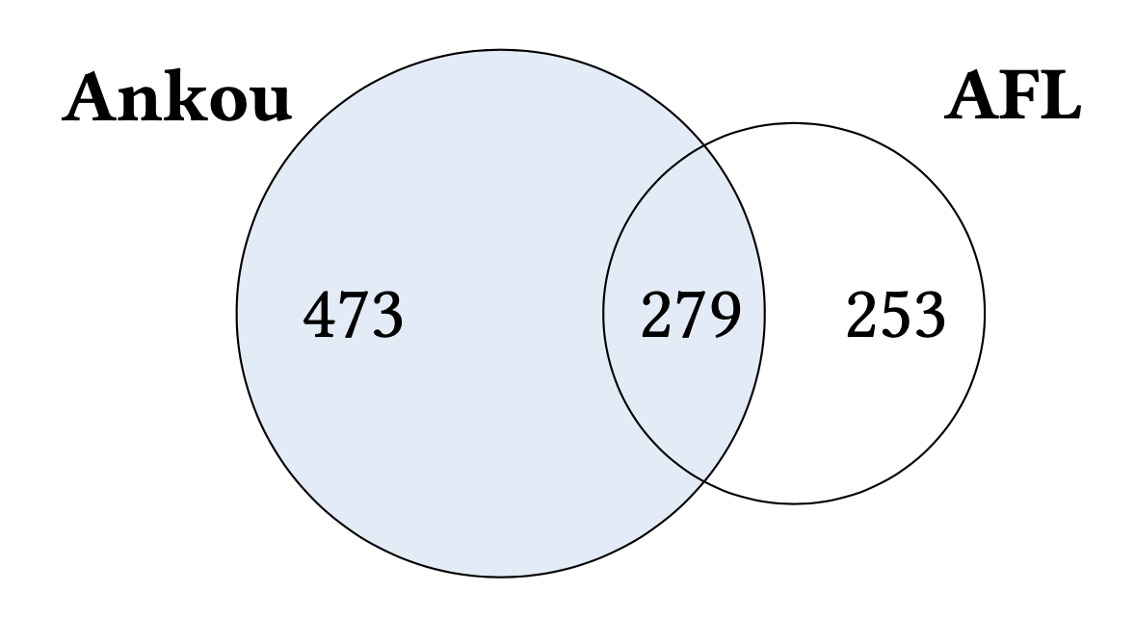
Ankou vs. AFL
Ankou finds 41% more unique crashes.
Notes:
Coverage: negligeable: 1.27% more for Ankou
So all our experimental results confirm our intuition: "There are important test cases that do not necessarily increase coverage while can detect bugs in software!" <--- This is the main intuition of the entire talk.

Slide 22
Ankou vs. AFL: Speed
Ankou is 35% slower than AFL.

Slide 23
Conclusion
Coverage-based fuzzers ignore combinations of branches.
Ankou distance-based fitness function quantify combinatorial difference while being fast and adaptive to programs.
While being 35% slower than AFL, Ankou finds 41% more crashes.

Slide 24
Question?

Slide 25
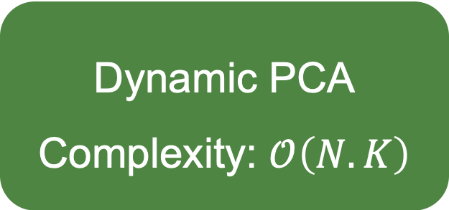
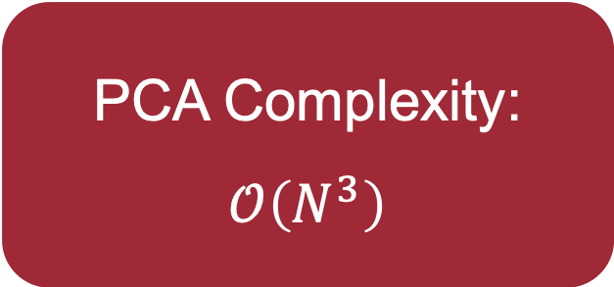
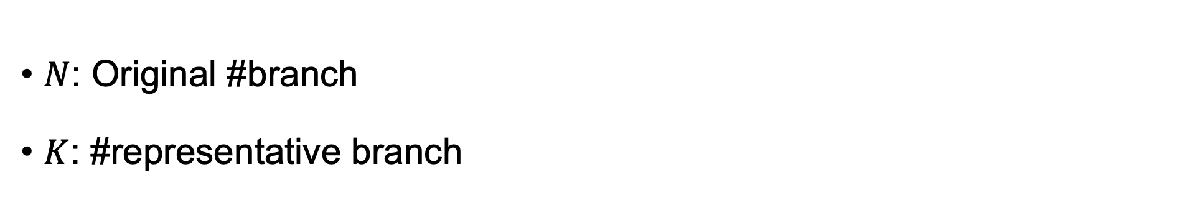
Why develop the Dynamic PCA
PCA Complexity: $$𝒪\left(N^{3}\right)$$
Dynamic PCA Complexity: $𝒪\left(N.K\right)$
Con: loss of guaranteed effectiveness
$N$: Original #branch
$K$: #representative branch

Slide 26
Limitations
Why the Euclidean Distance? Why not another one?
Why using the minimum for the Point-to-Pool distance?
Better threshold setting policy?
Dynamic PCA → Better dimensionality reduction technique?

Slide 27
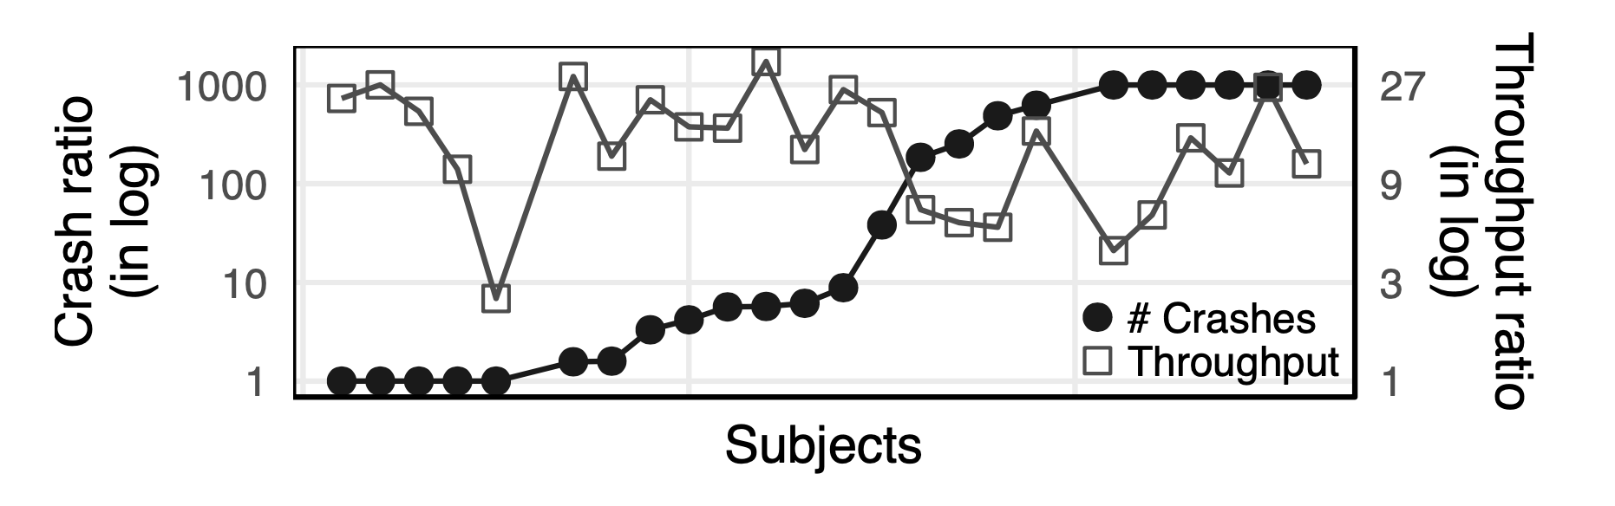
Q: Is the Dynamic PCA necessary?

Slide 28
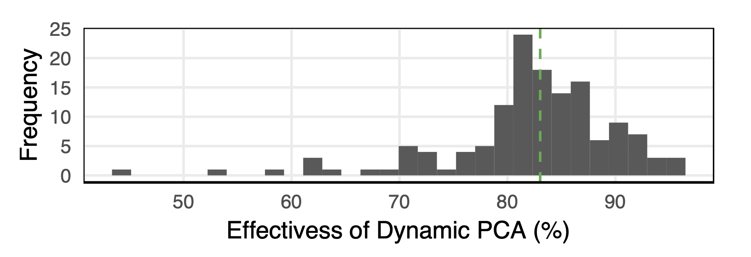
Q: Dimensionality Reduction Effectiveness

