Slide 1
The Art, Science, and Engineering of Fuzzing: A Survey
Valentin J.M. Manès, HyungSeok Han, Choongwoo Han, Sang Kil Cha, Manuel Egele, Edward J. Schwartz, and Maverick Woo

Slide 2
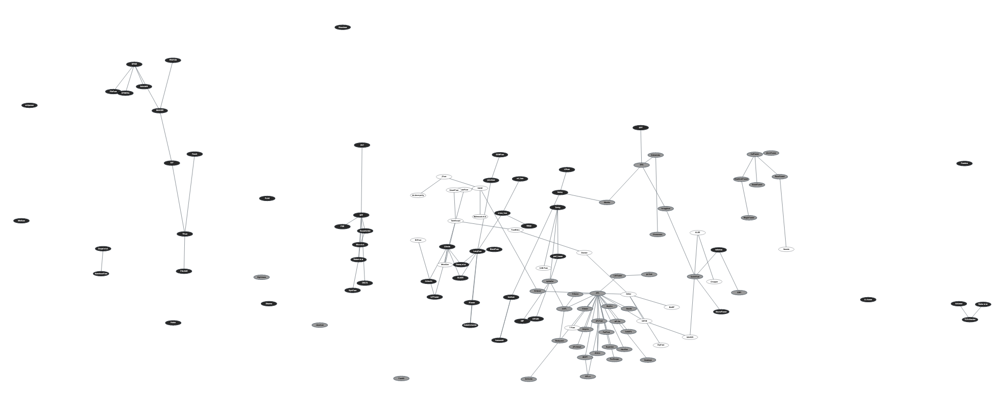
A Complex Field
2

Slide 3
Fuzzing: Potential Definitions
Some say: “Fuzzers are tools to make crashes.” ➔ What kind of crash? ➔ PerfFuzz¹ just looks for “algorithmic complexity vulnerabilities”.
Some say: “Fuzzers create inputs, either by mutating seeds (e.g. zzuf), or based on models, like grammars (e.g. Peach).” ➔ Random Testing may not use any seed. ➔ Concolic execution use neither.

Slide 4
Common Pitfalls
A definition should:
Not be goal oriented. ➔ Fuzzers are tools: there goal is defined by the user.
Not be method oriented. ➔ The field has shown too much diversity.

Slide 5
Fuzzing: What it is?
Fuzzing refers to a process of repeatedly running a program with generated inputs to test if a program violates a correctness policy.*

Slide 6
Fuzzers: How to Model Them?
Fuzzer
①
InputGen
test cases
InputEval
②
PreProcess
③
execinfos
Schedule
ConfUpdate

Slide 7
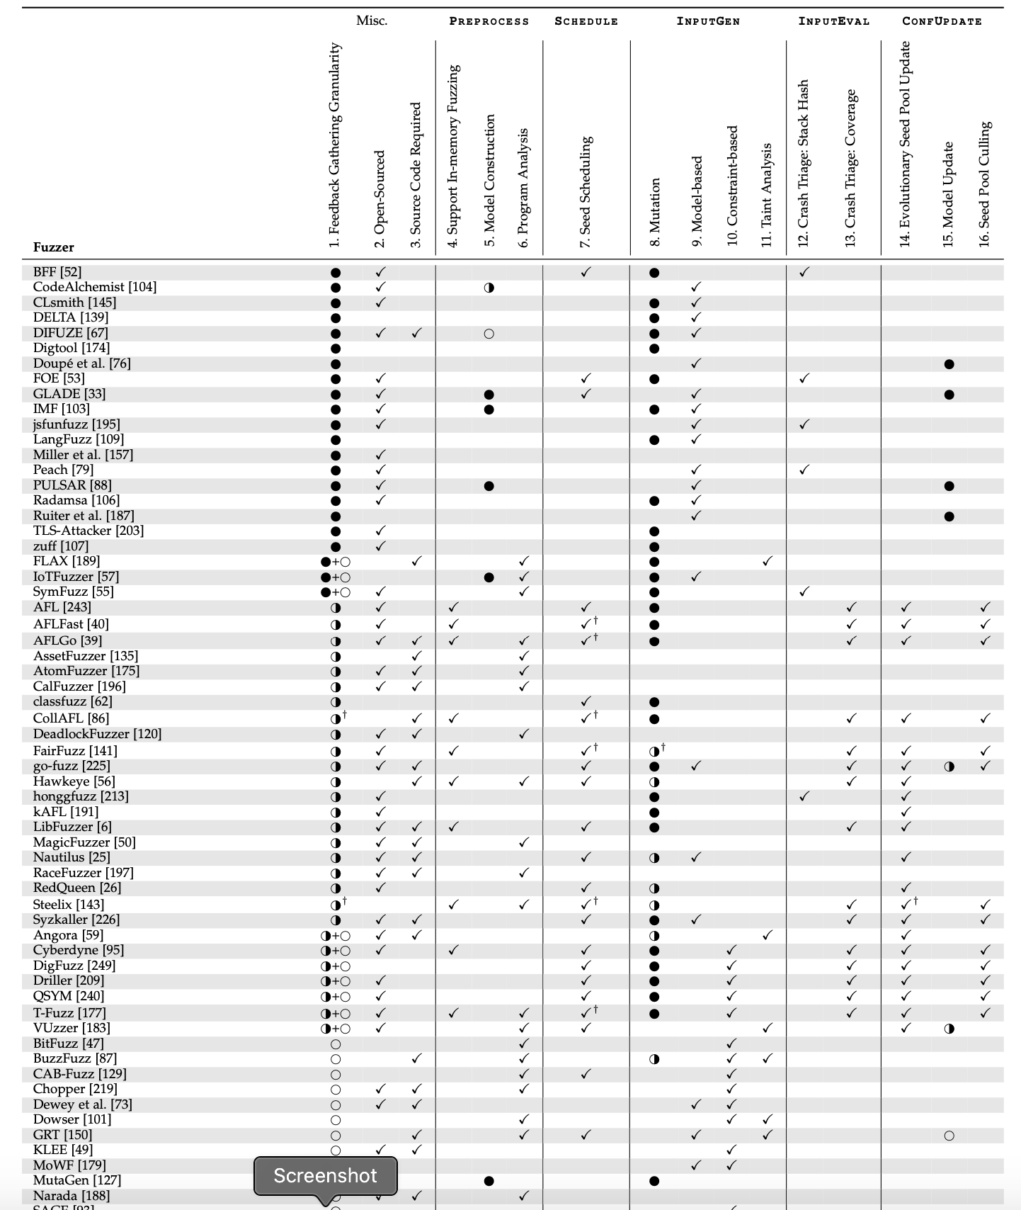
Survey Methodology
We surveyed the field for 10+ years:
Major Github repositories
Major conferences (Security & Software Engineering)
Let’s look at two examples: zzuf , AFL

Slide 8
Example
Simple Execution
Fuzzer zzuf
Seed bit flip
InputGen
test cases
InputEval
PreProcess
execinfos
Schedule
ConfUpdate

Slide 9
Example
Instrumented Execution
Fuzzer AFL
Mutation operations
InputGen
test cases
InputEval
Instrumentation
PreProcess
execinfos
Coverage-based Fitness Function
Round Robin++
Schedule
ConfUpdate

Slide 10
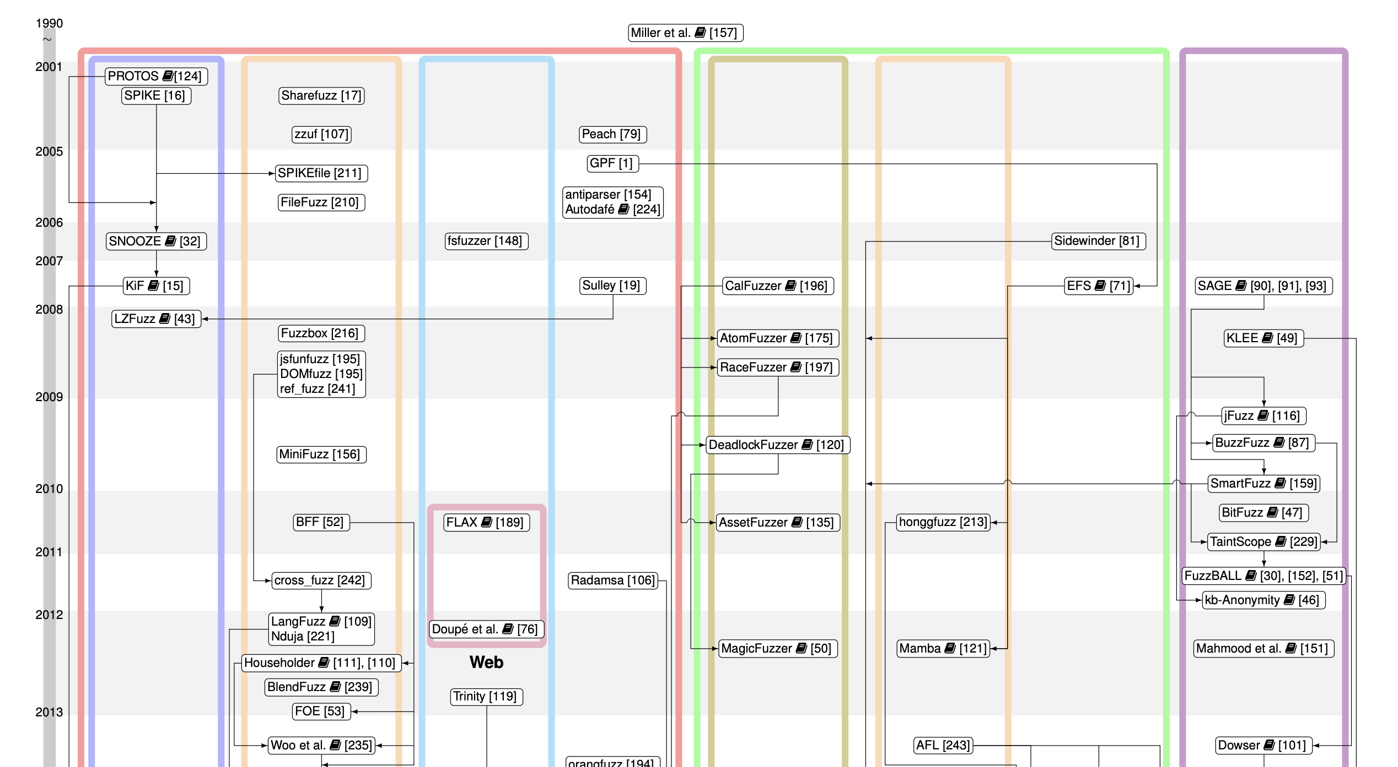
Genealogy

Slide 11
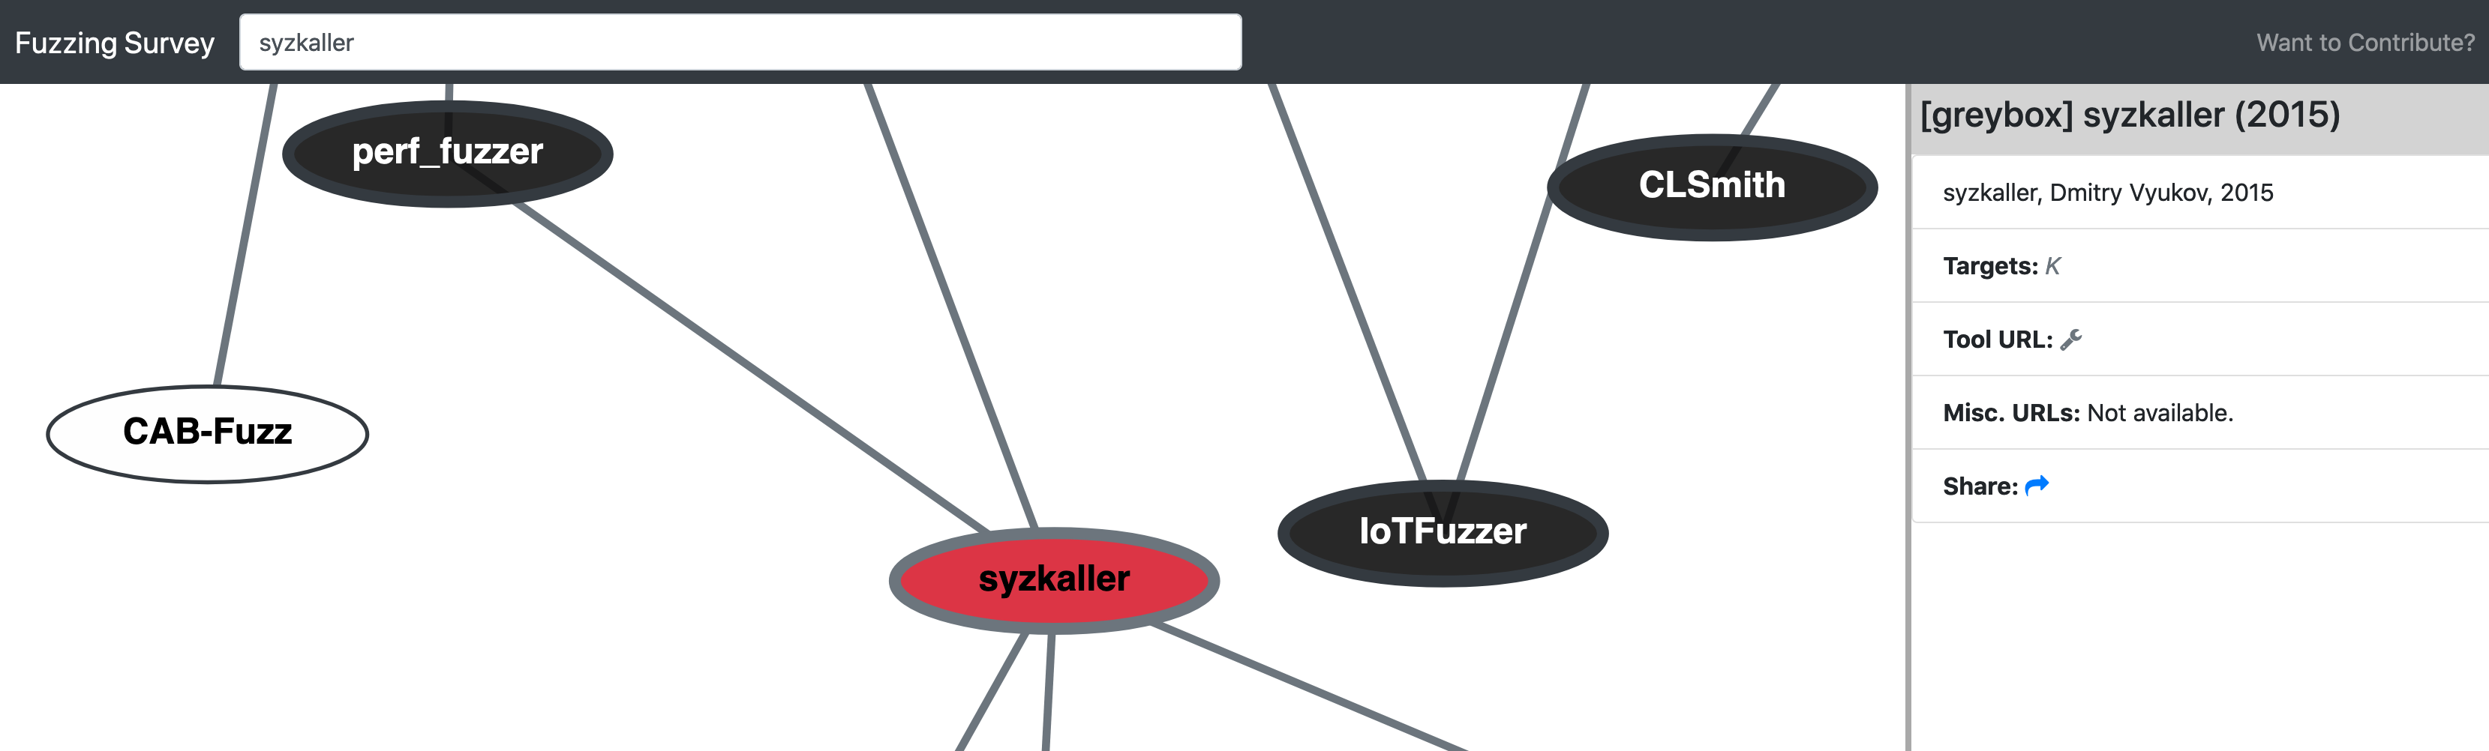
Companion Website: fuzzing-survey.org

Slide 12
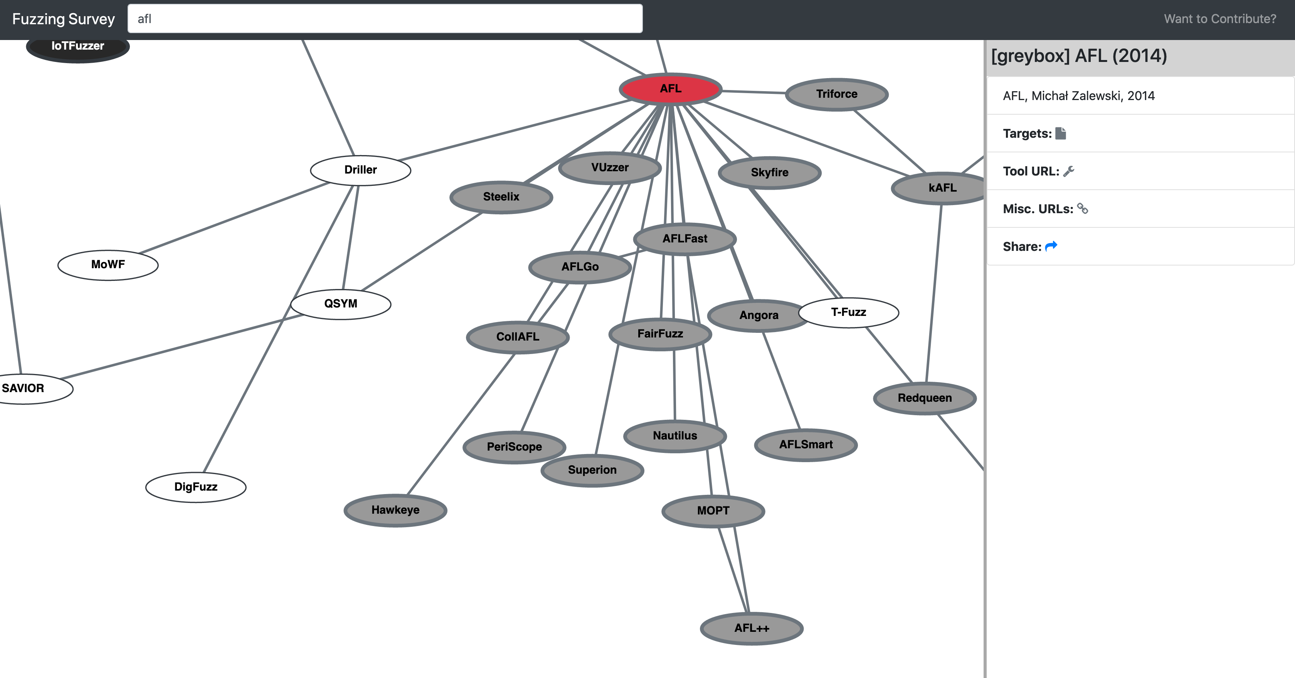
AFL: A Grey-box Hub

Slide 13
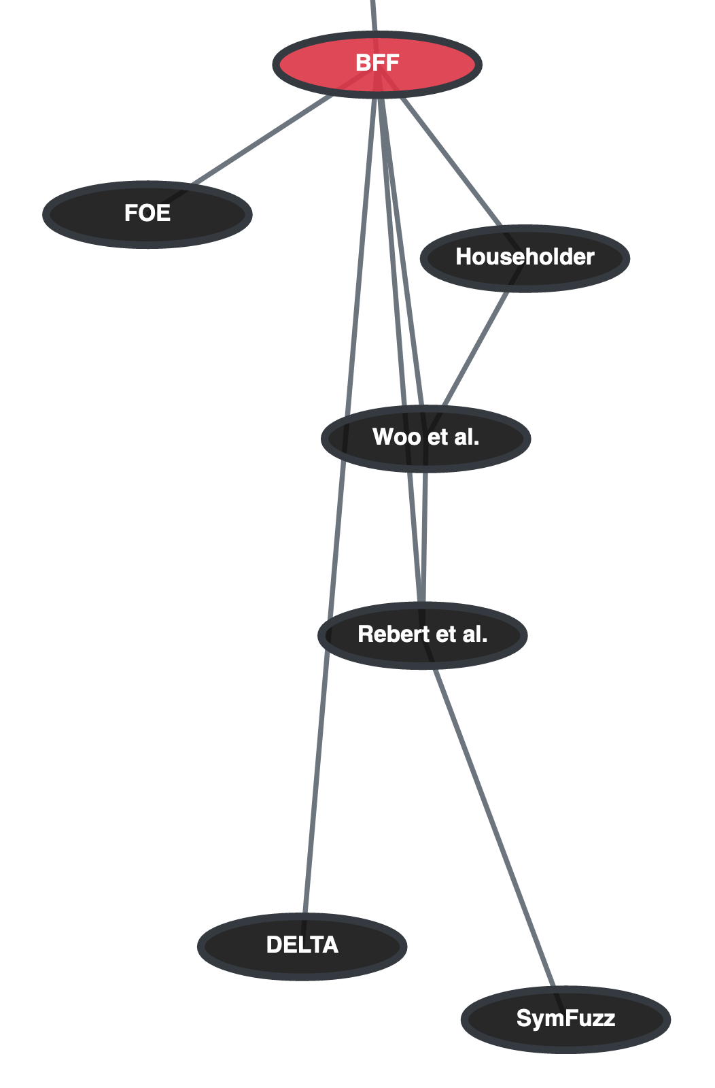
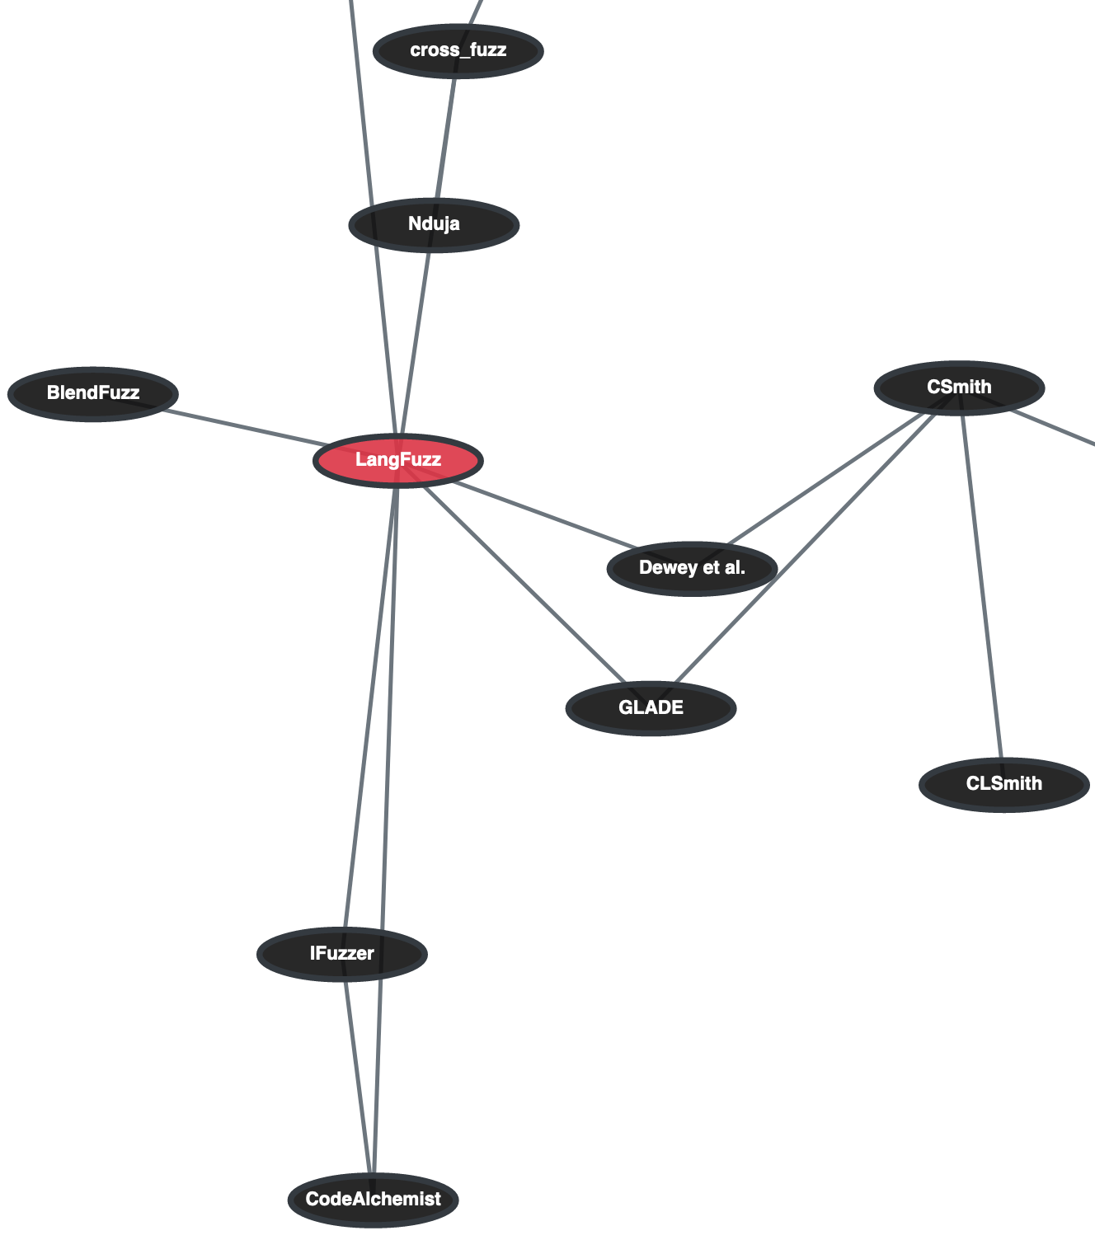
Black-box Hubs
BFF
LangFuzz

Slide 14
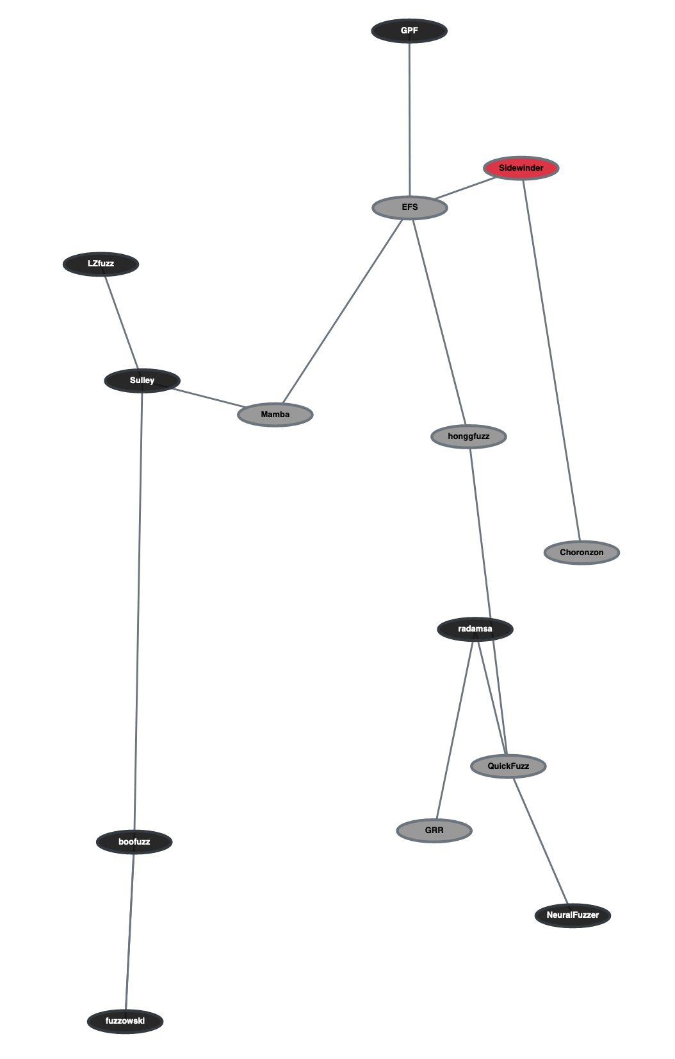
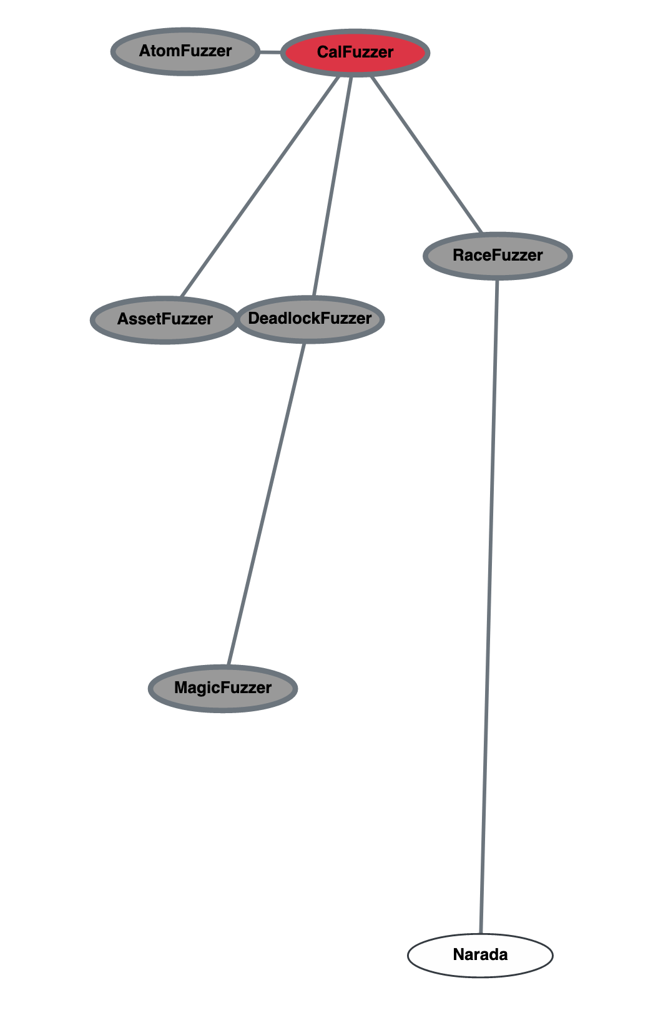
Grey-box Outliers
CalFuzzer
Sidewinder

Slide 15
Companion Website: fuzzing-survey.org
Make a PR to add fuzzers ☺
github.com/SoftSec-KAIST/Fuzzing-Survey

Slide 16
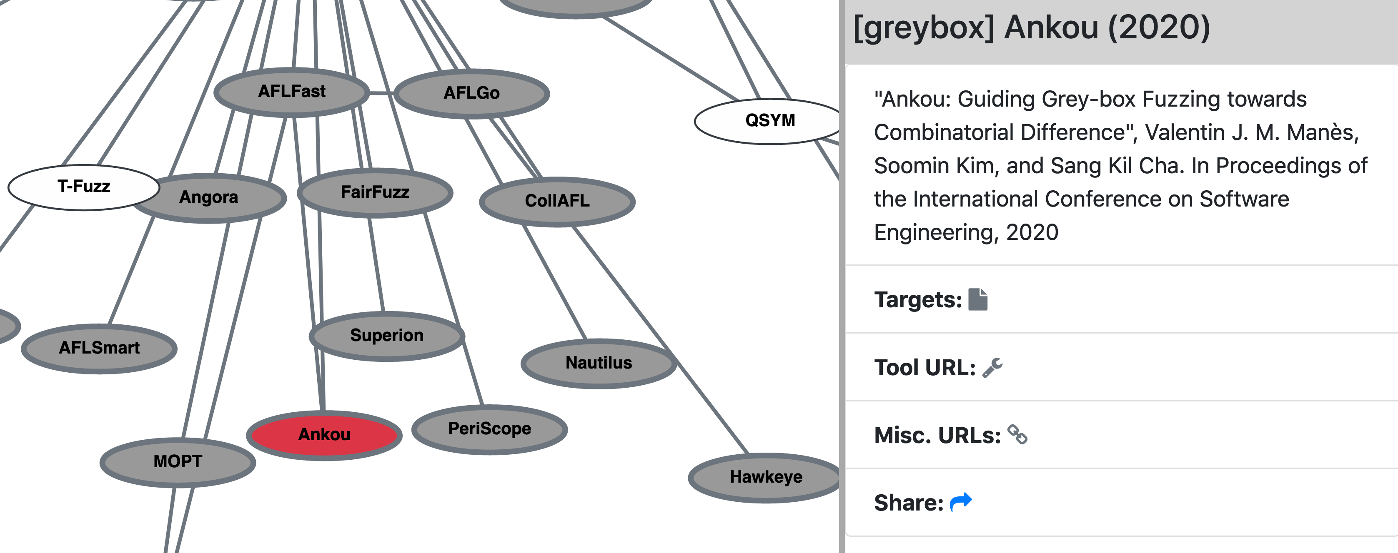
Share your fuzzer!
Sharable links: fuzzing-survey.org/?k=Ankou

Slide 17
Question?

