Slide 1

G2M Case Study
Virtual Internship
20-07-2022

Slide 2
Background
XYZ is a private firm in US. Due to remarkable growth in the Cab Industry in last few years and multiple key players in the market, it is planning for an investment in Cab industry and as per their Go-to-Market(G2M) strategy they want to understand the market before taking final decision.
Objective: Help XYZ firm identify the right company to invest

Slide 3
Data summary
359392 rows of transaction data available after the four datasets are merged
Dates of travel range from 2016-1-4 to 2019-1-2 (set base to 1900-01-01)
Columns after the initial merging: Transaction ID, Date of Travel, Company, City, KM Travelled, Price Charged, Cost of Trip, Customer ID, Payment_Mode, Gender, Age, Income, Population, Users

Slide 4
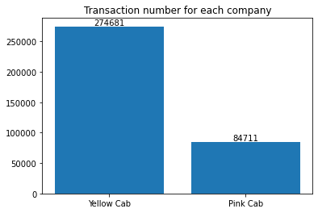
Transaction number for each company
From the plot we can see that Yellow Cab company has much larger transaction number during this period.

Slide 5
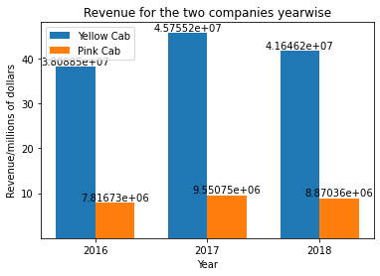
Revenue of each company
From the plot we can see that Yellow Cab company performs better in terms of total revenue, which is calculated by adding all price charged.

Slide 6
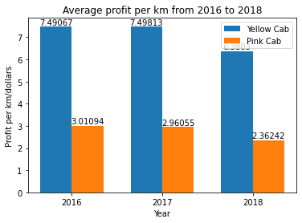
Average profit per km
Yellow Cab performs better in terms of average profit per km. This means that Yellow Cab has better cost management mechanism and thus greater capability to generate profit.

Slide 7
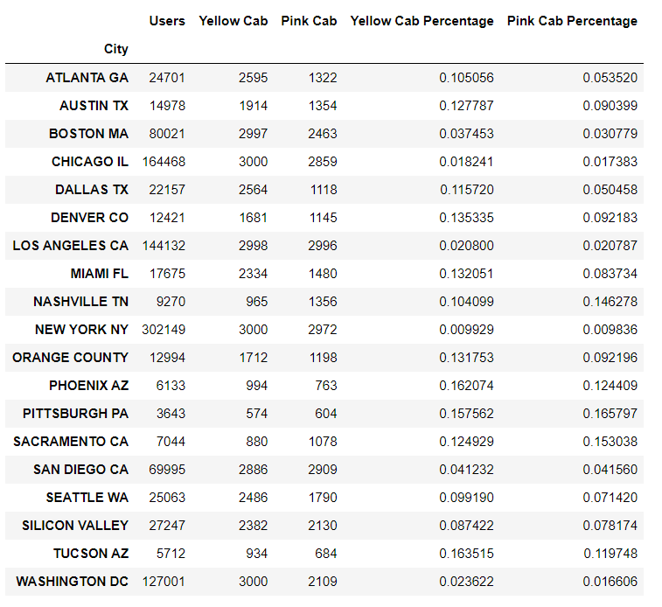
User-City Table
“Users” column is interpreted as the total number of cab users in the corresponding city. From the table we can see that both companies only account for a small portion of users in the cities.
We should also note that neither of the companies had operation in San Francisco.

Slide 8
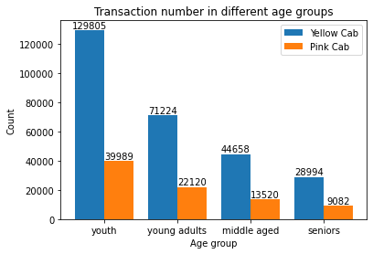
Transaction number in different age groups
We can see that Yellow Cab is more popular among all age groups. Here “youth” means 18-25 years old; “young adults” means 26-40 adults; “middle aged” means 40-55 years old; “seniors” means 55-65 years old.

Slide 9
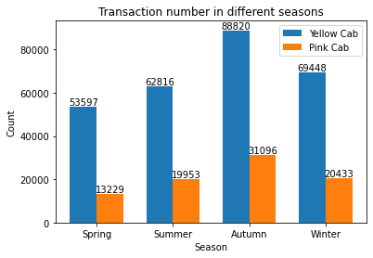
Seasonality
We can see that transaction number varies in different seasons. In Autumn there is greater demand for cabs while in spring there is less demand. This trend is reflected in both companies’ data.

Slide 10
Recommendations
From the analysis in previous slides we can see that Yellow Cab performs better in every way. It had more transaction number, generated more profit per km, and was more popular among all age groups.
Therefore, we recommend Yellow Cab for investment.

