Slide 1

Pizza Sales Analysis
Interactive Sales Analysis using SQL & Power BI
Jill Prajapati

Slide 2

Project Overview
This project transforms one year of pizza sales data into an interactive, insight-driven dashboard.
Interactive Dashboard
Built a Power BI dashboard for real-time business decision-making.
Analyzed Revenue
Examine total sales and revenue trends across the full year.
Pizza Performance
Evaluated which pizzas drive the most revenue and orders.
Customer Behavior
Understand ordering patterns by day, time, and pizza type.

Slide 3
Dataset & Preparation
The analysis brings together 4 structured CSV files, cleaned in Excel and integrated in SQL Server to create a unified model for analysis.
Orders
Order Details
Pizzas
Pizza Types
Order ID, Date, Time
Pizza ID, Quantity, Order ID
Pizza Type ID, Size, Price
Name, Category, Ingredients
Loaded, cleaned and transformed raw Excel data.
Joined tables & Created a View in SQL.
Imported the SQL View into Power BI.

Slide 4
Dashboard Features
KPI Cards
Interactive Slicers
Synced Filters
Dynamic Tooltips
Multi-Page Navigation
DAX Measures

Slide 5
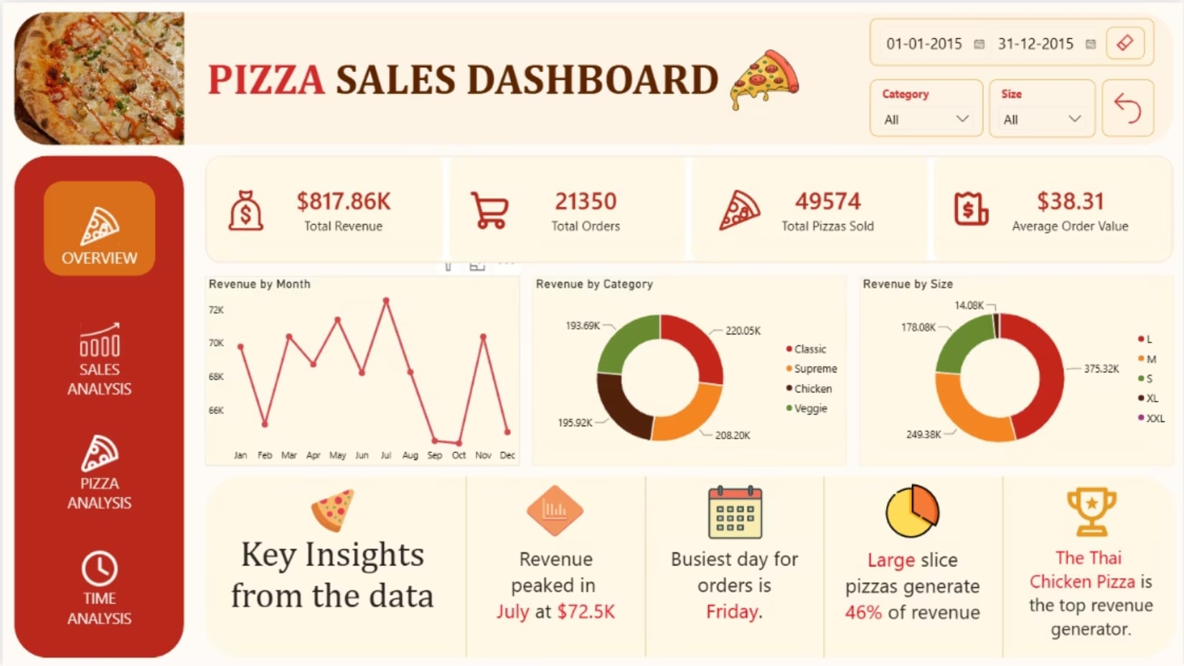
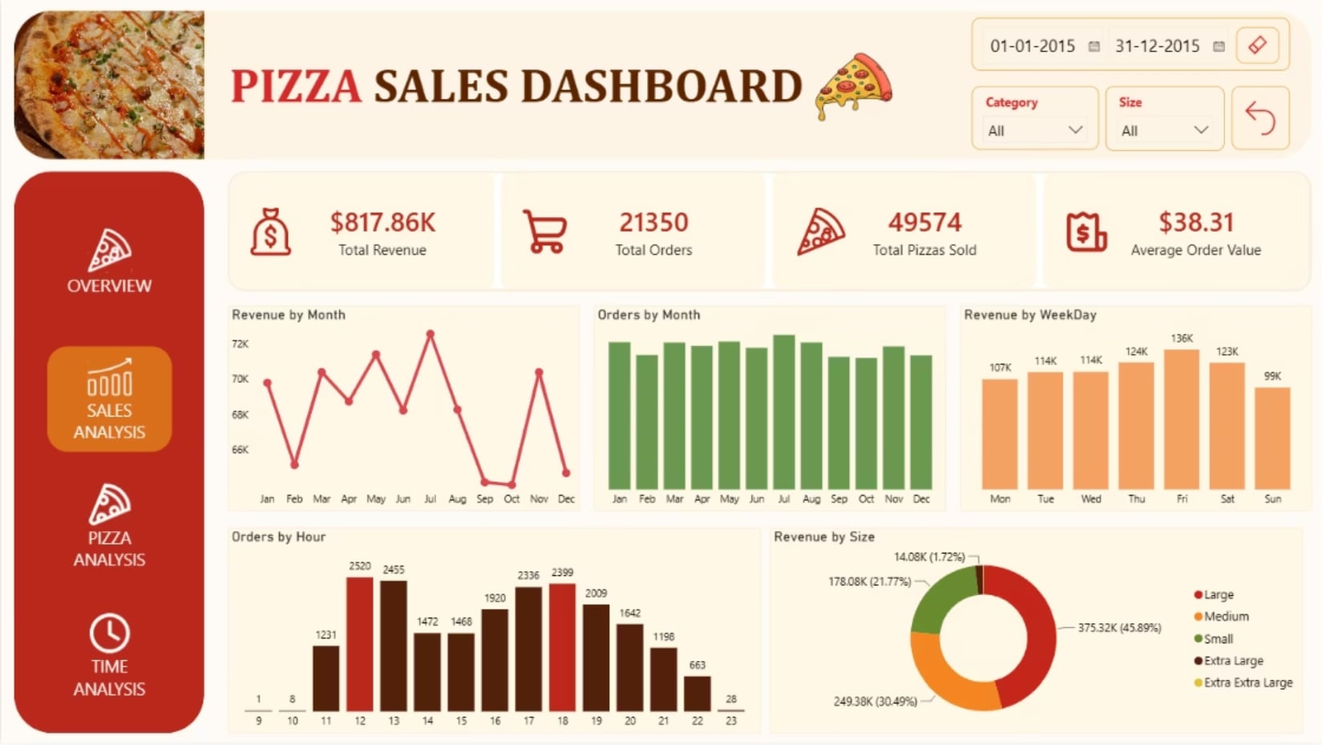
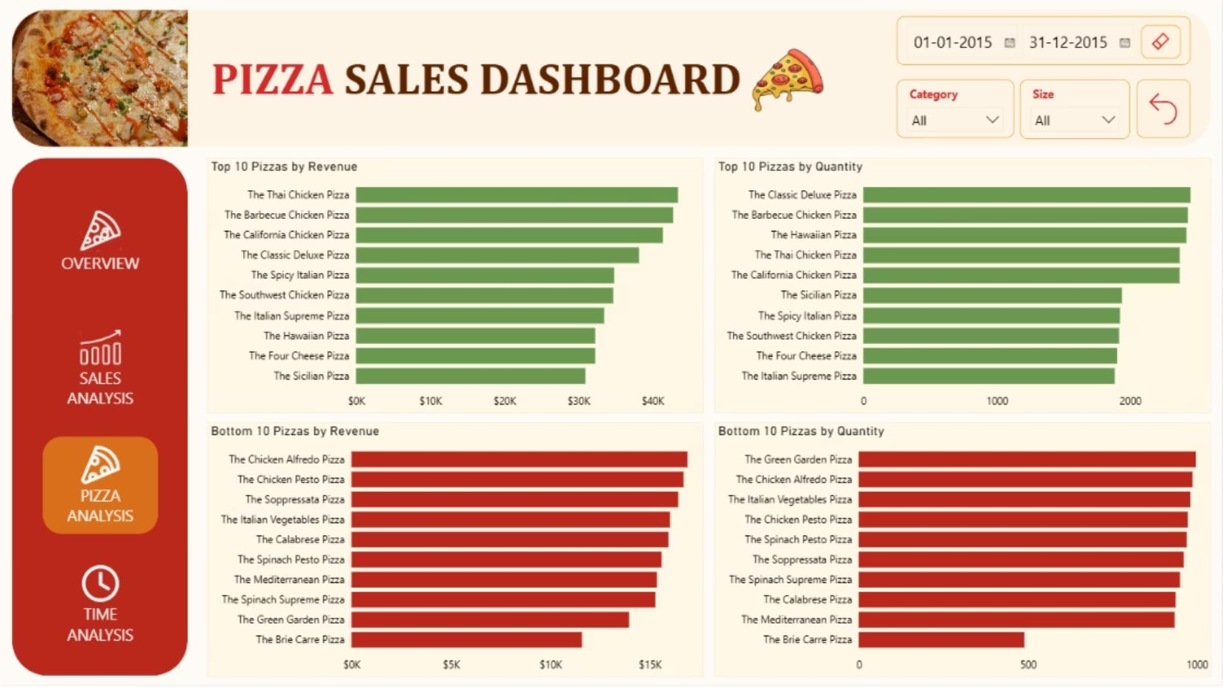
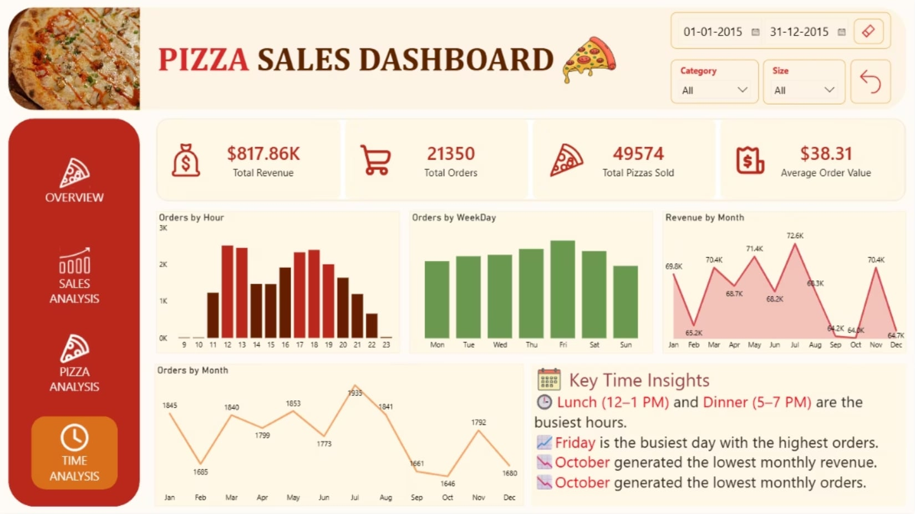
Dashboard Pages
Overview
Sales Analysis
Overall business performance and key KPIs.
Revenue and order trends across categories and time.
Pizza Analysis
Time Analysis
Best and worst performing pizzas by revenue and quantity.
Sales patterns by hour, weekday, and month.

Slide 6
Data Questions
Analysis of one year of sales data revealed clear patterns in revenue, customer behavior, and product performance and these questions:
Which month recorded the highest revenue?
Which day was the busiest day in terms of customer orders?
What timings of the day recorded the highest orders?
Which Pizza Size contributed the most in Revenue?
Which Pizza bought the most Revenue?
Which Pizza performs the worst out of all the pizzas?

Slide 7
Business Recommendations
Optimize low-performing pizzas by reviewing ingredients, pricing or discontinuing
consistently poor performers.
Increase sales during low-revenue months through campaigns or seasonal promotions
to boost Revenue during those months..
Boost weekday demands by introducing special offers for days that receive fewer orders
than Friday.
Schedule more staff and prepare inventory for peak hours while optimizing staffing
during off-peak hours.
Capitalize on best-sellers by promoting Large pizzas and the Thai Chicken Pizza in
combo deals.

Slide 8
Challenges & Solutions
Each technical hurdle was addressed with a targeted solution, improving both data quality and dashboard usability.
Challenge
Solution
Multiple CSV files to integrate
Created an SQL View (PizzaSales) joining all tables
Weekday names sorting incorrectly
Added a Custom Day Number column for proper sort order
Filters not syncing across pages
Enabled Sync Slicers in Power BI for cross-page consistency
Static tooltips limiting context
Designed dedicated Tooltip Pages for dynamic detail
No easy way to reset filters
Added a Reset Button linked to a Bookmark

Slide 9
Skills Demonstrated
Job Responsibilities
Skills Required
Skills I Have
Retrieve, clean, and organize datasets for analysis, ensuring data integrity and accuracy. - NIQ
Excel, Data Cleaning, Data Transformation
Cleaned and transformed raw pizza sales data in Excel before importing into SQL Server.
Develop and execute SQL queries for data retrieval, manipulation, and analysis. – Tech Mahindra
SQL, JOINs, Aggregate Functions, Views
Developed SQL queries using joins, aggregate functions, and filtering to retrieve, analyze, and prepare pizza sales data for reporting.
Develop and Maintain SQL scripts and procedures.
- GVM technologies LLP
SQL Procedures, UDF, Views.
Developed SQL Views, Stored Procedures and User Defined Functions for reusable data retrieval.
Analyze complex data sets to identify trends, patterns, and correlations. – E4 Softwares
SQL, Data Analysis, Analytical Thinking
Analyzed pizza sales data to identify revenue trends, customer ordering patterns, peak sales periods, and top- and bottom-performing products.
Develop and maintain interactive dashboards and reports using Microsoft Power BI
– NITI Technologies
Power BI, Dashboard Development
Designed an interactive four-page Power BI dashboard with KPIs and navigation.

Slide 10
Conclusion
Project Outcome
Built an end-to-end data analysis solution.
Created an interactive Power BI dashboard.
Identified key sales and customer trends.
Generated actionable business insights.

