Slide 1
A platform for creating and managing online crosswords
Group 20

Slide 2
Group Members
Name | Student ID | Contribution
RUDRA P GOHEL (Group Leader) | 202001178 | Backend, Crossword Creation and Crossword Solving Frontend, Testing functions in Unit Testing
BHAVSAR JAINAM MAYANKBHAI | 202001233 | Home Page Frontend, Non - Functional Testing, Test Cases for Crossword Creating in Unit Testing, Diagrams, Tutorial Pages
PATEL DHYAN DINESHBHAI | 202001225 | Home Page Frontend, Non - Functional Testing, Black Box Testing, Video, PPT
DARJI RUCHIR SHAILESHKUMAR | 202001194 | Home Page Frontend, Black Box Testing, Test Cases for Crossword Creating, user registration or login in Unit Testing, Diagrams
CHAUDHARY JILL KIRITKUMAR | 202001181 | Backend, Login, Sign-up Page, Crossword Solving Frontend, URL Testing

Slide 3
Name | Student ID | Contribution
DARSHAN KISHORBHAI GOHEL | 202001207 | Documentation - User Stories
MAHERIYA JATIN BHARATBHAI | 202001227 | Admin Pages Frontend and Meeting Logs
TANK NANDANI JAGDISHBHAI | 202001201 | SRS and Tutorial Pages frontend for creation and solving
AASHKA ARVINDBHAI THUMAR | 202001205 | SRS, Unit Testing, Crossword Creation Frontend and Signup Frontend
HARSORA VIVEKKUMAR MANISHBHAI | 202001234 | Profile Page, GUI Testing

Slide 4
Objective
The objective of the project is to develop a platform that allows users to create and manage online crossword puzzles. The platform should also include features such as automatic creation , manual creation of crosswords puzzles and feature to solve the created puzzles.
Design a user-friendly interface for users to register or login to a web app for manually or automatically creating crossword puzzles and completing crossword puzzles online.
Build a database to keep track of user activities, including crossword puzzles by default, and to assist users in searching through their previous created or completed crossword puzzles.
Provide a rating system to crossword and also feedback system for web application so that we as a designer can test and improve our work

Slide 5
Milestones
Mid Evaluation
Gathered Requirements
Implemented Login and crossword creation
Implemented crossword solving
Testing
Finalized tools and technologies
Created Web pages
Implemented crossword Browsing
Deployment

Slide 6
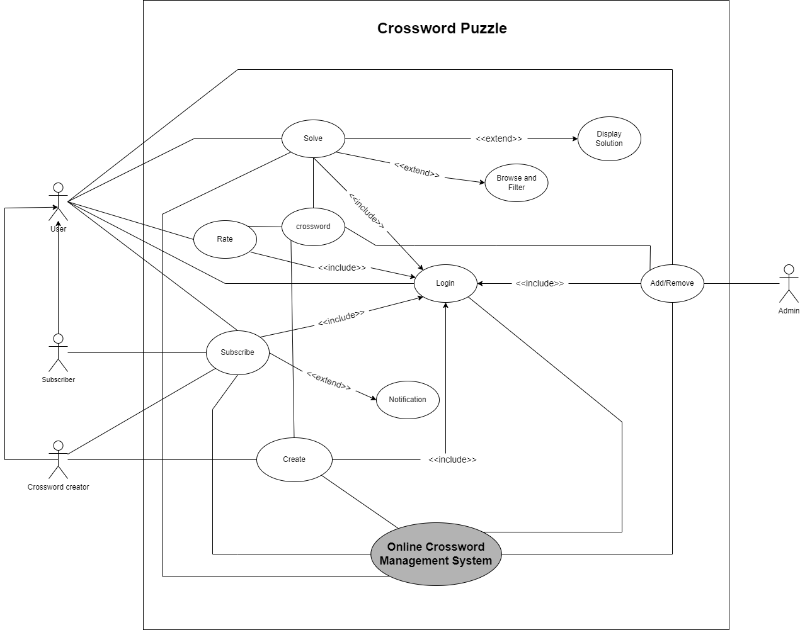
Use Case Diagram

Slide 7
Lessons
From this project we learned complete life cycle of a software, how to gather requirements, how to estimate the required time and cost, how to develop the software, how to test it and deploy it.
We learned various innovative tools and frameworks like, github copilot for code auto complete and django unicorn framework for interactive frontend.
We learned importance of various types of testing, how to perform them in python. We learned how to deploy our project.
We learned importance of teamwork.

Slide 8
Achievements
Successfully implemented login functionality, automatic crossword creation, manual crossword creation, crossword solving, crossword browsing and user profile page.
Developed, tested and deployed webapp.
Achieved experience of software development process.

Slide 9
Mistakes
Instead of making frontend pages manually we could have used online available templates for uniformity across all webpages.
We were not able to make web pages responsive to screen size.
We were not able to implement all features written in the SRS document.

Slide 10
Features Not implemented
Crossword creators cannot modify their crosswords once its created.
Puzzle of the day feature is not implemented.
Crossword solvers cannot access hints.
Subscribers don’t get email notifications on new crosswords from their subscribed creators.
Sorting of crosswords based on difficulty or topics.

Slide 11
Rating of software artifacts
Name | Rating(0-5)
Code Artifacts | 4
Documentation | 4
Testing | 4
Deployment | 3
Project Management | 3.5

Slide 12
Project Rating
7.5 / 10

