Slide 1

C O M P E T I T I V E A D V A N T A G E. R E A L I Z E D.
Halliburton Validation Results:
Team Member Family - TMCB

Slide 2
Participant Sampling/Data Collection
Sampling procedures to target a representative set of participants
Participants completed the TMCB between October and December 2007
Standard data quality filters applied
Final matched sample = 102

Slide 3
Validation Sample Characteristics: Demographics (N = 102)
Race
  Caucasian 45.1%; African American 12.7%; Hispanic 25.5%; American Indian or Alaskan Native 2.9%; Other 3.9%; Not Reported 9.8%
Gender
  Male 90.2%; Female 0.0%; Not Reported 9.8%
Age
  Younger than 40 65.7%; 40 or Older 16.7%; Not Reported 17.6%
  Mean = 31.9 years; SD = 8.4 years

Slide 4
TMCB – Short-Form Content Configuration
Making Effective Judgments and Decisions
  Included: Safety Awareness, Quality Orientation, Collaboration
  Excluded: Situational Judgment
Managing Self and Getting Along with Others
  Included: Self Efficacy, Adaptability, Job Fit Team Member
  Excluded: Locus of Control, Decision Making Style, Work Quality
Demonstrating Personal Competence
  Included: Adaptability, Work Standards
  Excluded: None

Slide 5
TMCB – Short-Form Content Configuration
Initial Test Length
  107 items
Final Test Length
  68 items
Estimated Time
  About 20 minutes

Slide 6
TMCB – Scoring Configuration
Composite scoring:
    Making Effective Judgments and Decisions = 1
    Managing Self & Getting Along with Others = 2
    Demonstrating Personal Competence = 1
DDI recommends administering 2 scales within the Managing Self & Getting Along with Others composite of the TMCB, initially scored:
    Adaptability & Job Fit Team Member

Slide 7
TMCB – Performance Composite Correlations (N = 95 - 102)
 | Overall Performance | Ability-related Performance | Motivation-related Performance | Interpersonal Performance | Bottom-line Performance
TMCB Overall Score | .48 (.38)** | .48 (.38)** | .46 (.37)** | .45 (.36)** | .47 (.38)**
Note: Values in parentheses represent validity coefficients uncorrected for criterion unreliability.
* Denotes significance at the .05 level; **Denotes significance at the .01 level.

Slide 8
TMCB – Competency Correlations (N = 95 - 102)
 | Adaptability | Applied Learning | Communication
TMCB Overall Score | .36 (.28)** | .40 (.32)** | .45 (.36)**
 | Contributing to Team Success | Decision Making | Quality Orientation
TMCB Overall Score | .43 (.34)** | .50 (.40)** | .42 (.34)**
 | Safety Awareness | Stress Tolerance | Work Standards
TMCB Overall Score | .45 (.35)** | .42 (.33)** | .51 (.40)**
Note: Values in parentheses represent validity coefficients uncorrected for criterion unreliability.
* Denotes significance at the .05 level; **Denotes significance at the .01 level.

Slide 9
TMCB – Bottom-Line Correlations (N = 101-102)
 | Avoid Disciplinary Actions & Other Policy Violations | Compliance with Safety Guidelines | Avoid Misuse of Time
TMCB Overall Score | .37 (.29)** | .36 (.29)** | .51 (.41)**
 | Maintain Low Error Rates | Meet Productivity Goals | Speed to Productivity
TMCB Overall Score | .40 (.31)** | .46 (.37)** | .41 (.33)**

Slide 10
TMCB – Attitudinal Criteria Correlations (N = 92)
 | Engagement | Retention Likelihood
TMCB Overall Score | .28 (.27)** | .33 (.31)**
Note: Values in parentheses represent validity coefficients uncorrected for criterion unreliability.
* Denotes significance at the .05 level; **Denotes significance at the .01 level.

Slide 11
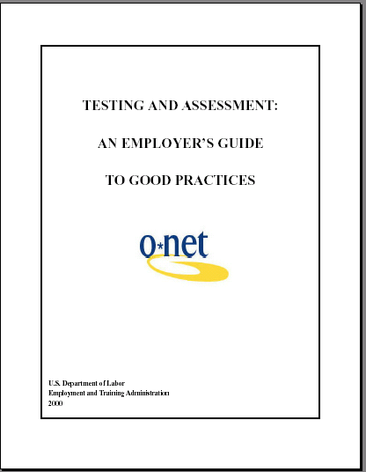
US Department of Labor Guidelines for Interpreting Validity Coefficients
Validity Coefficient Value | Interpretation
Above .35 | Very beneficial
.21 - .35 | Likely to be useful
.11 - .20 | Depends on circumstances
Below .11 | Unlikely to be useful
.48 w/
Overall Perf
  TESTING AND ASSESSMENT: AN EMPLOYER’S GUIDE TO GOOD PRACTICES
  U.S. Department of Labor Employment and Training Administration, 2000

Slide 12
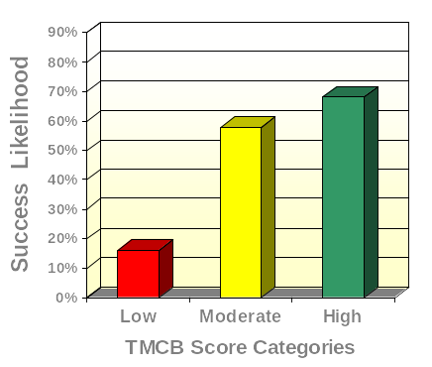
TMCB and Overall Performance
(N = 102)
High Scorers
11.2 times more likely to succeed
than Low Scorers

Slide 13
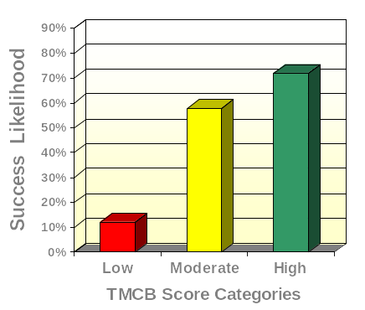
TMCB and Can-do Performance
(N = 102)
High Scorers
18.9 times more likely to succeed
than Low Scorers

Slide 14

TMCB and Will-do Performance
(N = 102)
High Scorers
11.2 times more likely to succeed
than Low Scorers

Slide 15
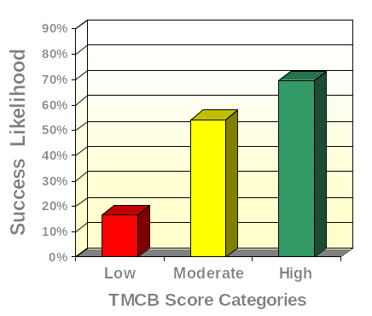
TMCB and Interpersonal Performance (N = 95)
High Scorers
11.4 times more likely to succeed
than Low Scorers

Slide 16
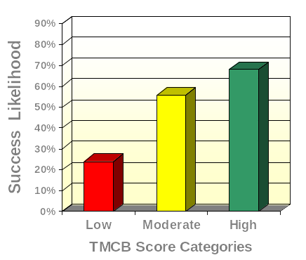
TMCB and Bottom-line Performance (N = 102)
High Scorers
6.7 times more likely to succeed
than Low Scorers

Slide 17
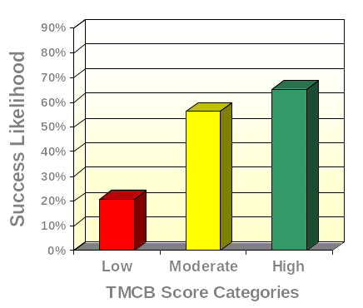
TMCB and Adaptability
(N = 95)
High Scorers
7.1 times more likely to succeed
than Low Scorers

Slide 18
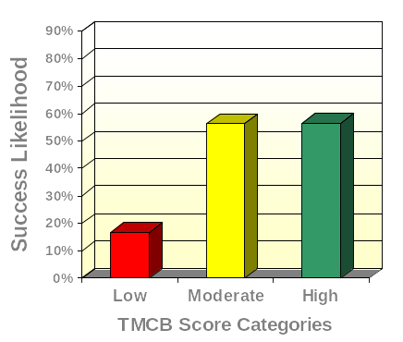
TMCB and Applied Learning
(N = 95)
High Scorers
6.5 times more likely to succeed
than Low Scorers

Slide 19
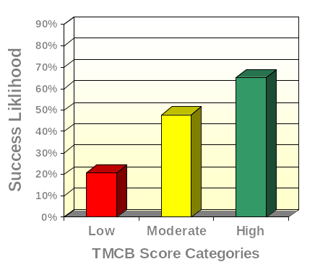
TMCB and Communication
(N = 95)
High Scorers
7.1 times more likely to succeed
than Low Scorers

Slide 20
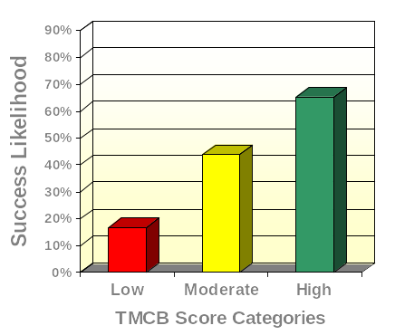
TMCB and Contributing to Team Success (N = 95)
High Scorers
9.4 times more likely to succeed than Low Scorers

Slide 21
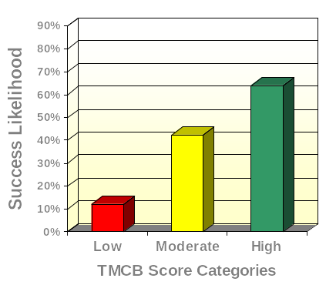
TMCB and Decision Making
(N = 102)
High Scorers
13.0 times more likely to succeed than Low Scorers

Slide 22
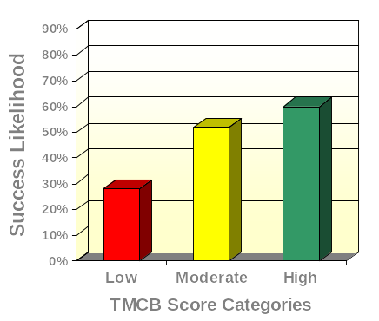
TMCB and Quality Orientation
(N = 102)
High Scorers
3.9 times more likely to succeed than Low Scorers

Slide 23
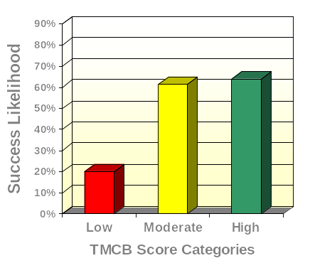
TMCB and Safety Awareness
(N = 102)
High Scorers
7.1 times more likely to succeed than Low Scorers

Slide 24
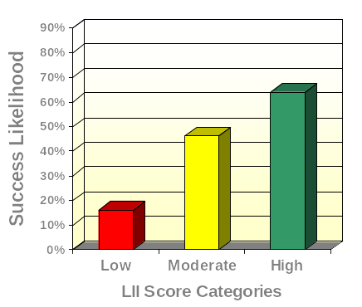
TMCB and Stress Tolerance
(N = 102)
High Scorers
9.3 times more likely to succeed than Low Scorers

Slide 25
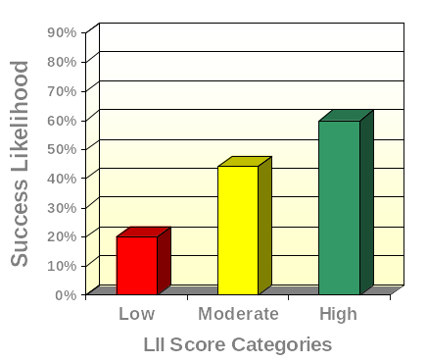
TMCB and Work Standards
(N = 102)
High Scorers
6.0 times more likely to succeed than Low Scorers

Slide 26
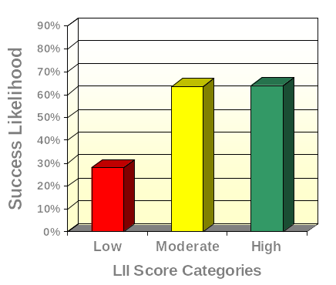
TMCB and Avoiding Disciplinary Actions & Other Violations of Company Policy (N = 102)
High Scorers
4.6 times more likely to succeed than Low Scorers

Slide 27
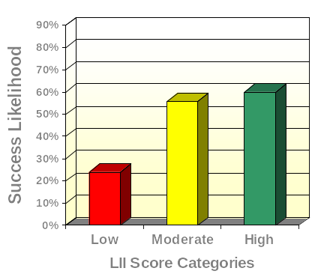
TMCB and Compliance with Safety Guidelines (N = 102)
High Scorers
4.8 times more likely to succeed than Low Scorers

Slide 28
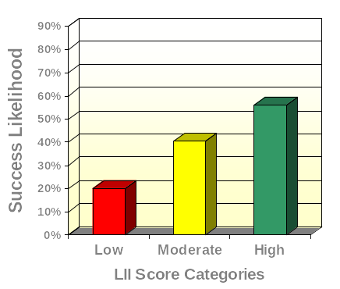
TMCB and Avoiding Misuse of Time (N = 102)
High Scorers
5.1 times more likely to succeed than Low Scorers

Slide 29
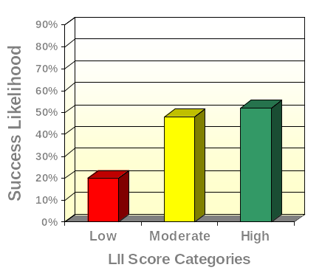
TMCB and Maintaining Low Error Rates (N = 102)
High Scorers
4.3 times more likely to succeed than Low Scorers

Slide 30
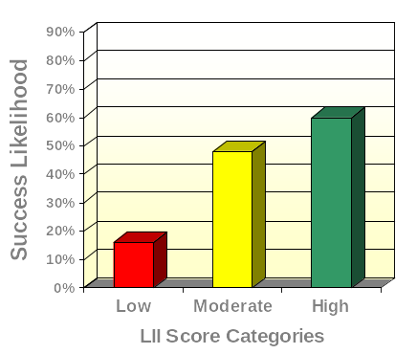
TMCB and Meeting Productivity Goals (N = 102)
High Scorers
7.9 times more likely to succeed than Low Scorers

Slide 31
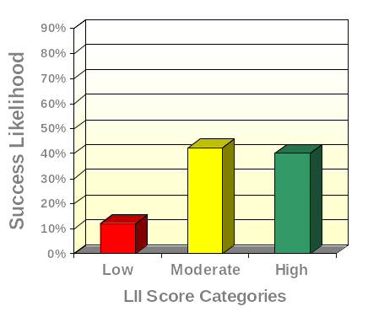
TMCB and Speed to Productivity
(N = 102)
High Scorers
4.9 times more likely to succeed than Low Scorers

Slide 32
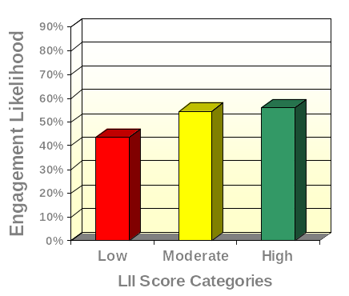
TMCB and Engagement (N = 92)
High Scorers
1.7 times more likely to be engaged than Low Scorers

Slide 33
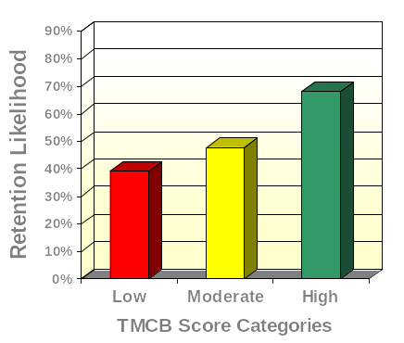
TMCB and Retention Likelihood
(N = 92)
High Scorers
3.3 times more likely to report a high Intent to Stay than Low Scorers

